Slide 1
Acute Resuscitation in Children
06-12-22, Kalcheliba Subcounty Hospital
Jenny Koertge, MD, PhD

Slide 2
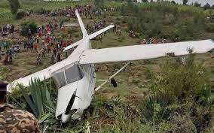
Acute resuscitation
A – Airway
B – Breathing
C – Circulation
D – Disability
E – Exposure

Slide 3
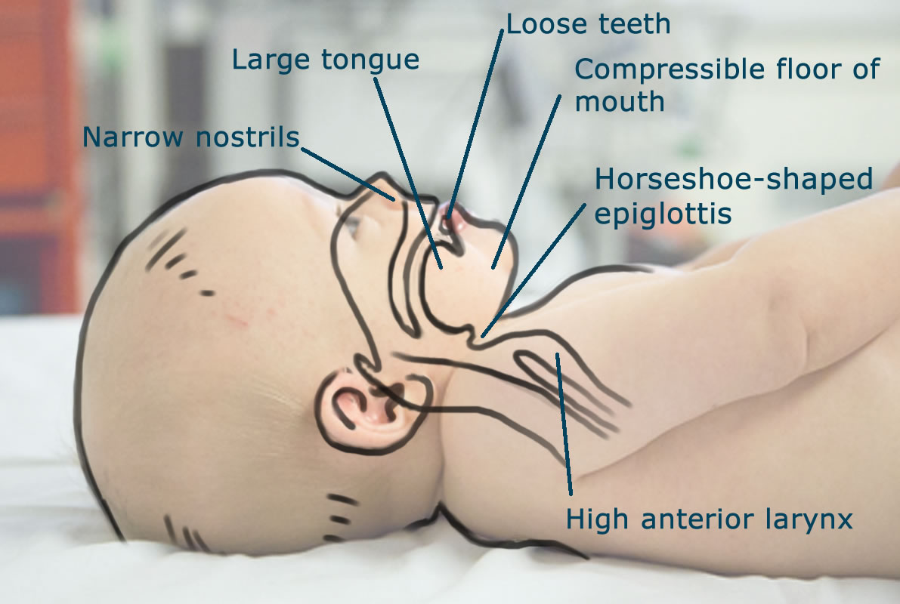
A - Airway
Obligate nasal breathers up to 6 weeks – keep nostrils clear
Small, narrow airways
Short neck
Large tounge
= more suceptible to airway obstruction and respiratory distress

Slide 4
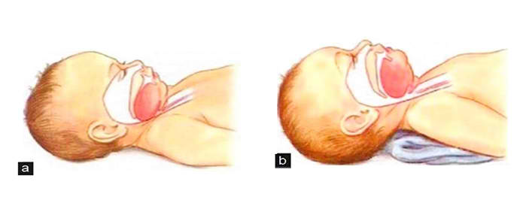
< 1 years: Neutral position

Slide 5
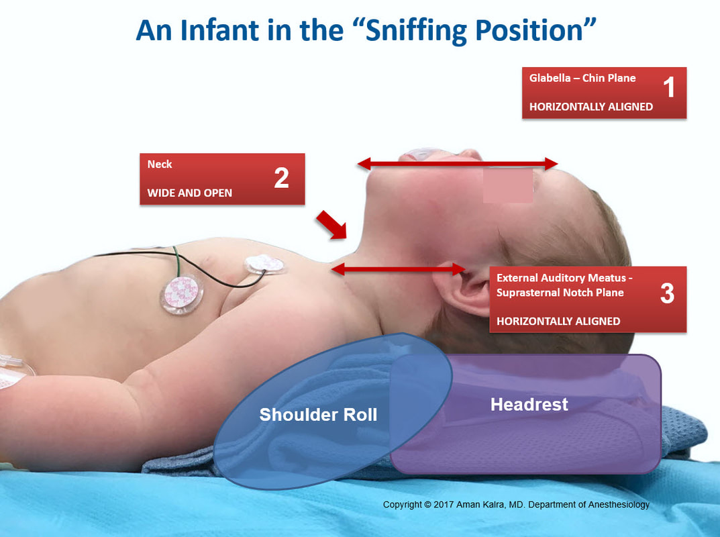
> 1 year: Sniffing position

Slide 6
Evaluate/stabilize airway
Look – foreign body? mucus? blood?
Listen - stridor? grugling?
Feel – breath?

Slide 7
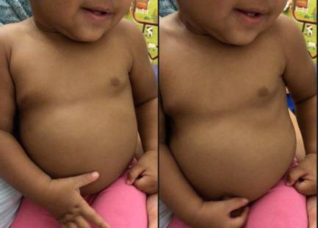
B - Breathing
Immature respiratory/neurological system
responds less effective to hypoxia
Evaluate effort vs effect!
How well does the breathing work at the moment?
Does the baby need immediate help?
Can we expect the child is able to continue breathing like this?

Slide 8
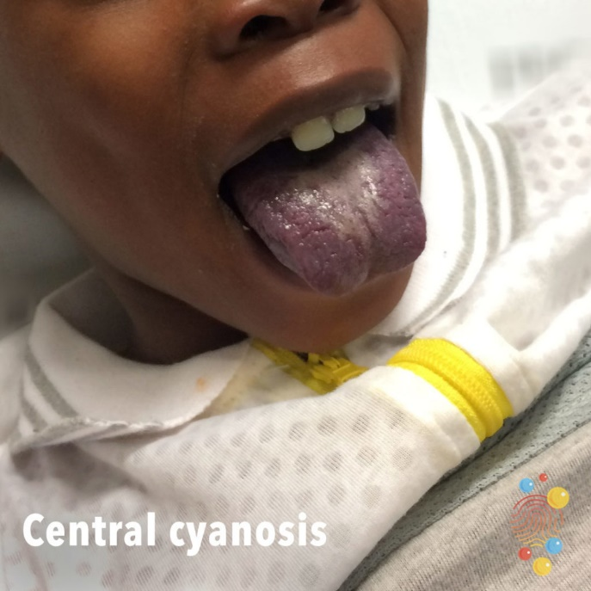
Evaluate the breathing
Effort
Respiratory rate
Breathing pattern
Retractions
Wheezing
Grunting
Nasal flare
Näsvingespel
Andningsljud – ett ”tyst” bröst är en
varningssignal
Effect
Level of consciousness
Cyanosis
Saturation
Cyanosis

Slide 9
Stabilize breathing

Slide 10
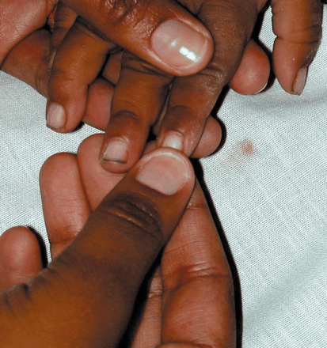
C - Circulation
Puls
Capillary refill test, normal <2sec
Low blood pressure – late sign!
Bolus 20ml/kg Ringers Lactate

Slide 11
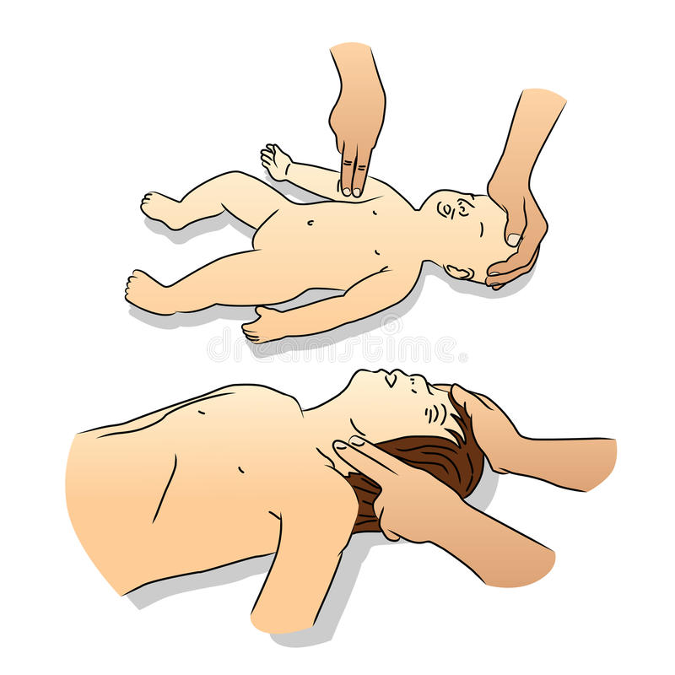
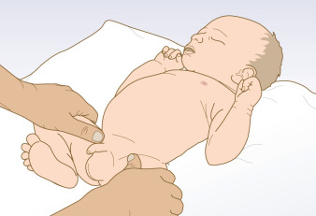
Circulation
<1 år
Brachial
Femoral
>1 year
Carotid

Slide 12
D - Disability
Level of conciousness
Neurological status
Seizures: Diazepam 0,2 mg/kg
Glucose! 2 ml/kg 10% dextrose

Slide 13
Level of conciousness

Slide 14
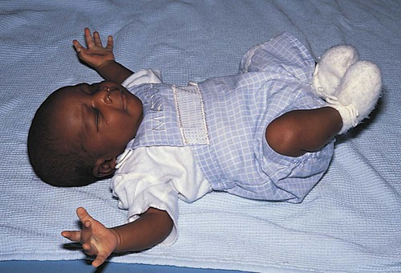
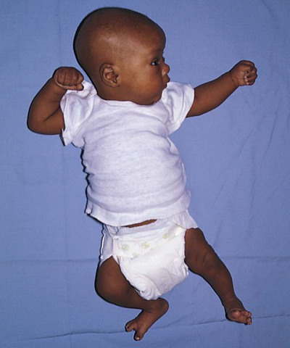
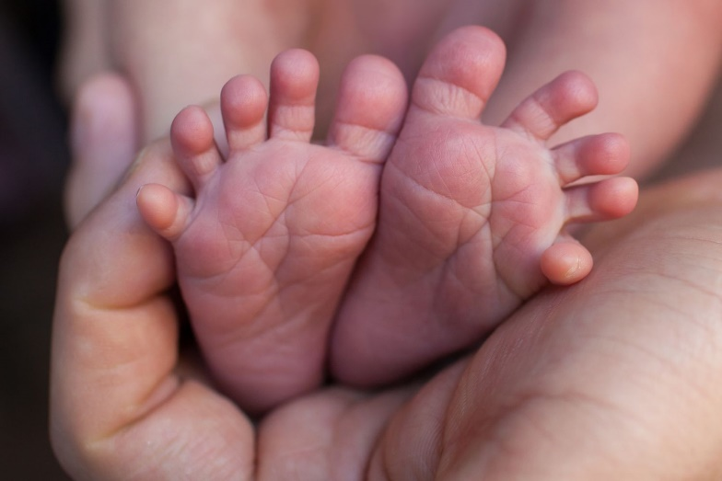
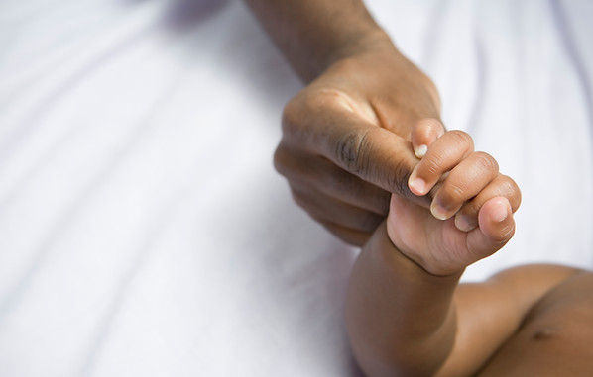
Neurologic examination
muscletonus
smile > (1-)2 months
follow with the gaze >1 month
moro reflex <3 (-6) months
grip reflex <3-4 months
tonic neckreflex <4-5 months
babinski positive <12(-24) months

Slide 15
Causes of coma in children
Meningitis/Encephalitis/cerebral abscess
Cerebral Malaria, Tyfoid or Shigella encephalopathy
Septicemia
Hypoxia
Intoxication
Epilepsy – post ictal state
Hypoglycemia
Diabetic ketoacidosis
Cerebral hemorrage/infarcion
Burn encephalopathy
Metabolic disorders

Slide 16
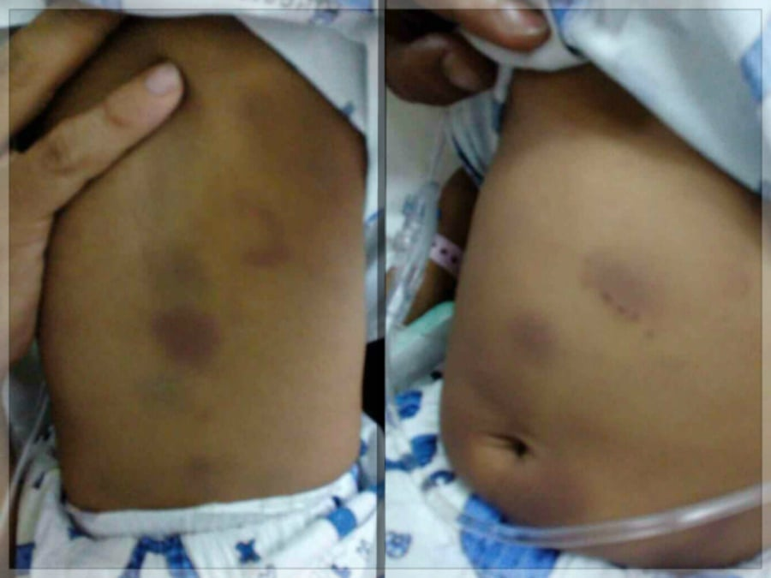
E - Exposure
fever
rash/petechiae
bruises or fractures
signs of abuse
malformalities
protect from hypothermia!

Slide 17
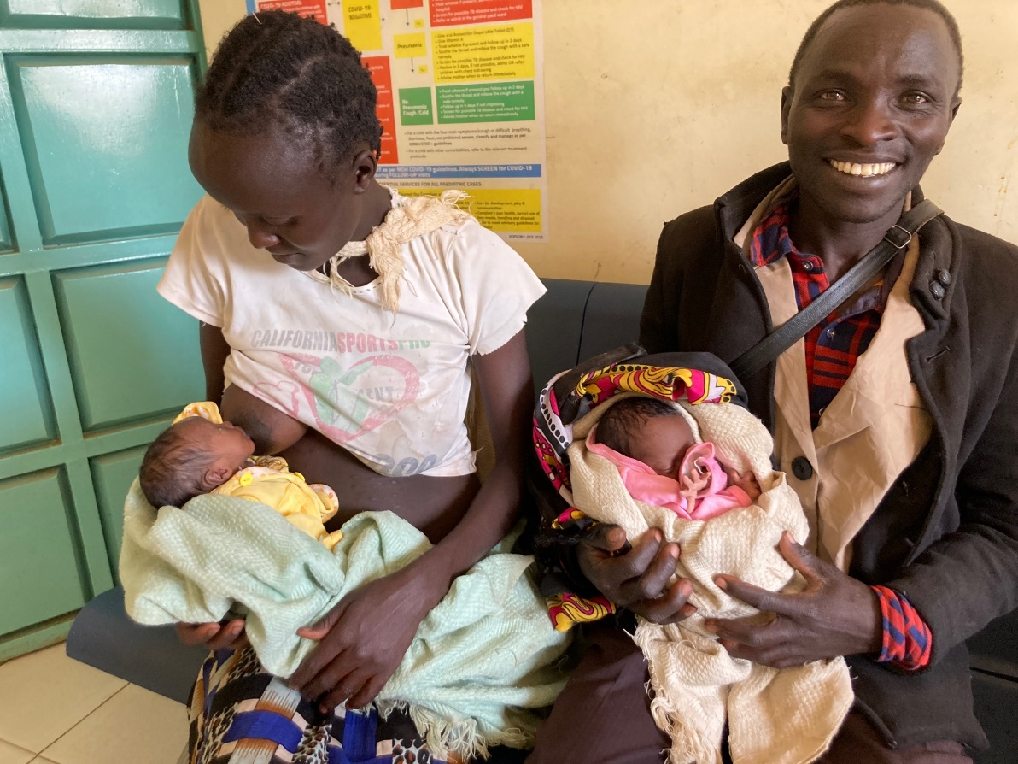
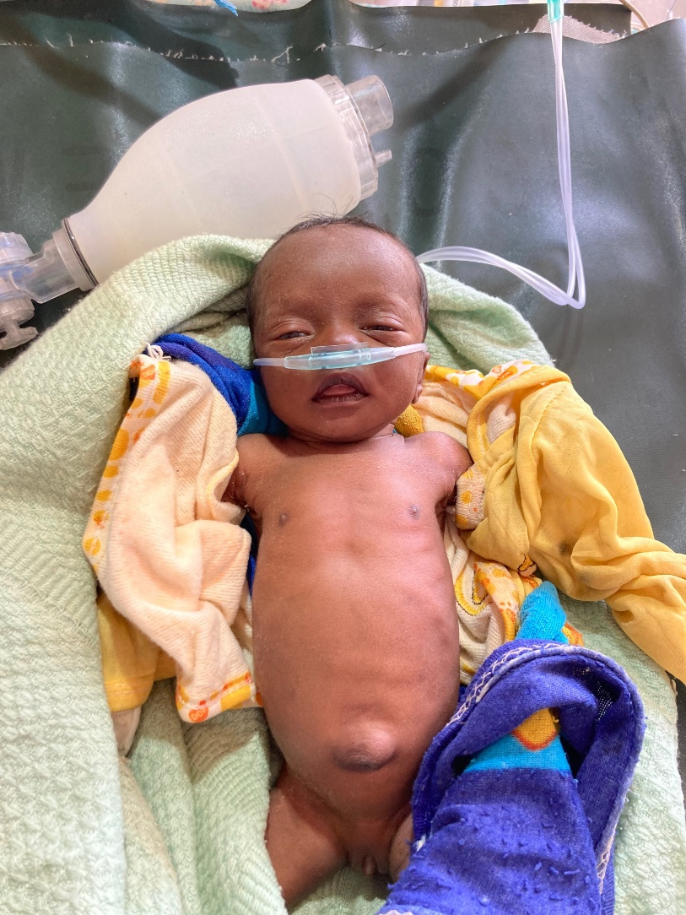
CPR in infants

Slide 18
CPR in infants
Children have healthy cardiovascular system – arrythmias rare
Most cardiac arrests due to hypoxia – oxygen and monitoring of saturation is important!
If child is unresponsive – ask for help!
Check breathing: look, listen, feel
If no breathing: start CPR and oxygenate 100% ASAP
3. Adrenaline 0,01 mg/kg iv/io

Slide 19
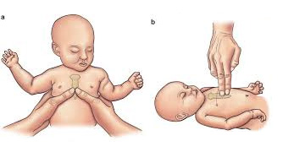
< 1 year
neutral position
Start with 5 breaths cover both nose and mouth
15 compressions
1/3 of the chestwall
100-120 bpm
2 breaths, 15:2

Slide 20
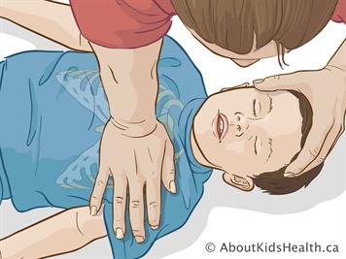
> 1 year – 18 years
Extend the neck ”sniffing position”
Start with 5 breaths – pinch the nose
15 compressions
1/3 of chestwall
100-120 bpm
2 breaths, 15:2

