Slide 1
ABCDE
A Structured approach to the sick patient

Slide 2
WHY ABCDE?
In case of a sick patient, the most important problem should be identified and treated first. A is more important than B is more important than C…
A- Airways
B- Breathing
C-Circulation
D-Disability
E-Exposure

Slide 3
A= Airways
Can the patient talk? If yes, A (and B and C) are normally more or less ok
If not:
LOOK: inspect mouth/neck
Mucus/blood?
Swelling of neck?
LISTEN: signs of stridor/foreign body? Remove if possible
ACTION:
Suction/remove blockage
Open airway- see next slide

Slide 4
A-AIRWAY- ACTION
OPEN AIRWAY- se next slides
SUCTION
HEIMLICH MANEUVER in case of foreign body.
STABILIZE NECK: In case of trauma to the neck and risk of spinal cord injury

Slide 5
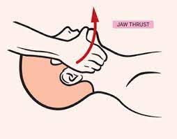
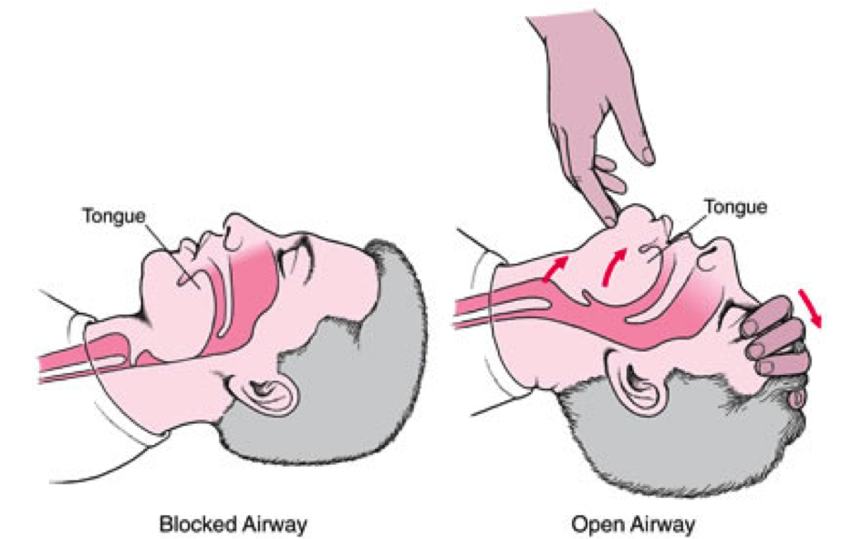
A= AIRWAY- ACTION
If airway is not free= Open airway. Headtilt or jawthrust

Slide 6
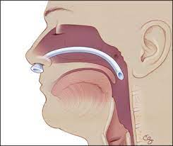
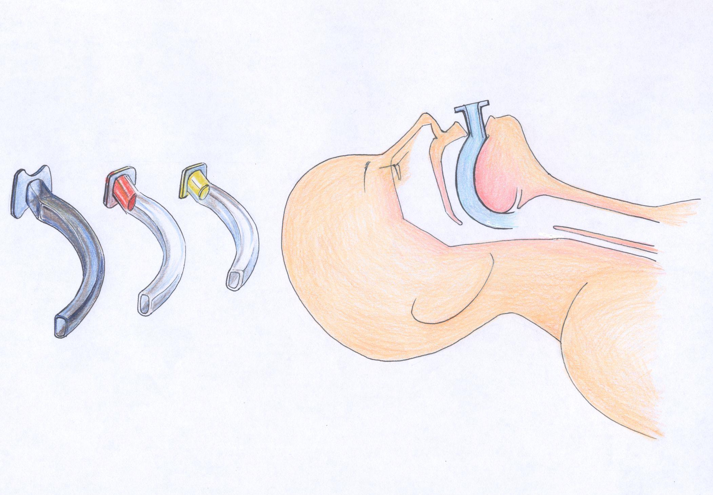
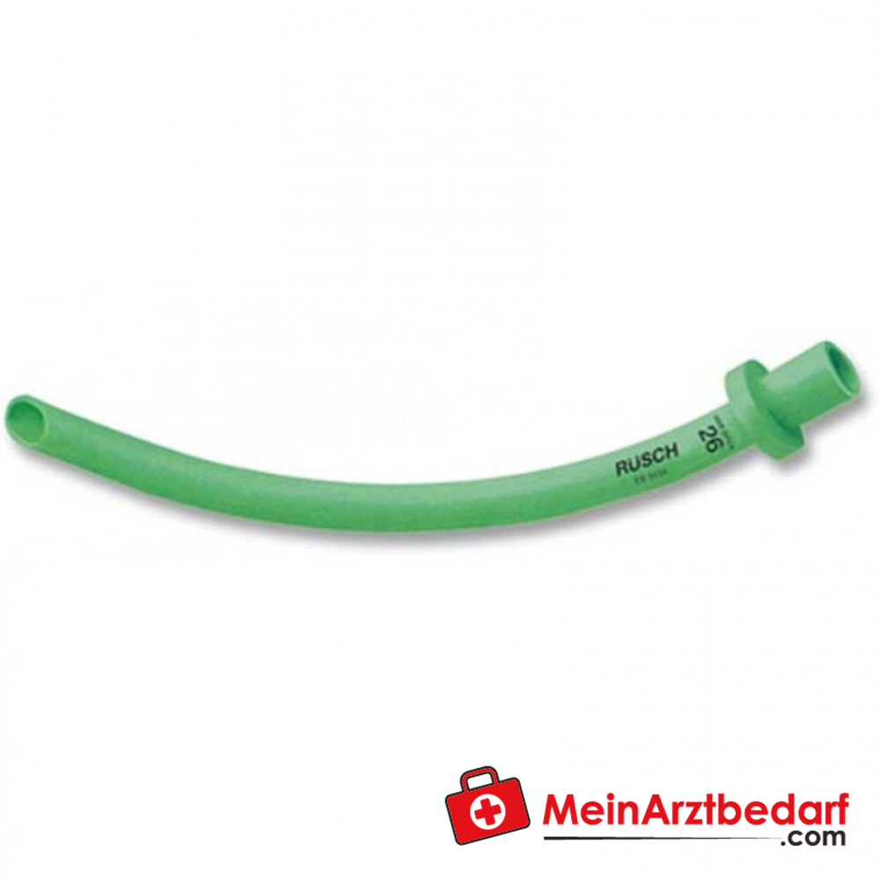
A- AIRWAY- ACtion
To keep airway open in an unconscious patient:

Slide 7
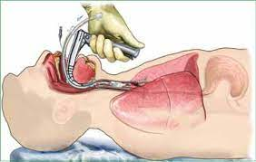
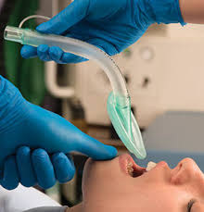
A= Airway- ACTION
OTHER: Laryngeal mask, intubation

Slide 8
B- Breathing
Is the patient breathing? If not, start Rescucitation immediately!
LOOK: Heavy breathing? Symmetric breathing?
LISTEN: Lungs clear on both sides?
FEEL: trachea in midline? Pneumothorax?

Slide 9
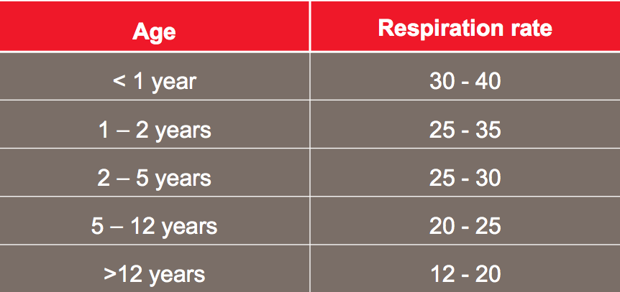
B-BREATHING- What to measure
Count respiratory rate
Saturation

Slide 10
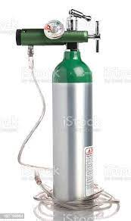
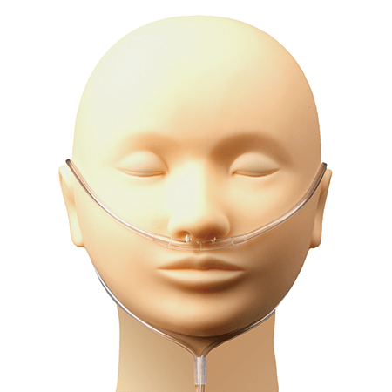
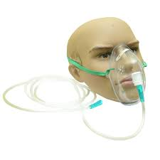
B- Breathing- ACTION
GIVE OXYGEN:
goal saturation is above 92 % in general.
If no oxymeter but cyanotic or very pale with heavy breathing- give oxygen.
On nasal cannula- give 2 l, on mask it’s possible 2-10 liter

Slide 11
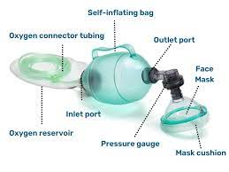
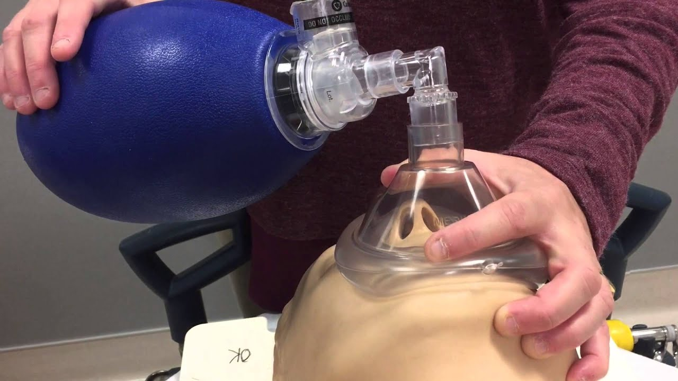
B- BREATHING- ACTION
VENTILATION with bag-mask if not breathing

Slide 12
C- CIRCULATION
LOOK: cyanotic?
LISTEN: to the heart
FEEL: the pulse- present? Regular? Strong?
Radial artery: Bloodpressure is normally above 90 mmHg systolic
Carotid artery: Bloodpressure is normally above 80 mmHg systolic
Femoral artery: Bloodpressure is normally above 70 mmHg systolic
Capillary refilltime: Normally less than 3s
Warm or cold peripherally?
Hemorrhagic shock- often cold
Septic shock- often warm

Slide 13
CIRCULATION- WHAT TO MEASURE
Take pulse-rate? Normal is between 60-100 beats/min
Take bloodpressure (or feel arteries for pulse.)

Slide 14
CIRCULATION- ACTION
STOP BLEEDING
Example postpartum bleeding
IV LINE- if very sick always 2 IV lines with wide gauge
GIVE FLUIDS! If signs of hypovolemia (dehydration, bleeding, massive infection) give fluids STAT
Bolusdose 20 mg/kg for children
200-500 ml in adults.
Repeat

Slide 15
D-DISABILITY
LOOK
Is the patient conscious?
Pupils: responding to light, symmetric?
FEEL
TONUS
SYMMETRIC strength in arms and legs?
ACTION- Medication for seizure?
ACTION

Slide 16
E-EXPOSURE
LOOK: Undress patient and examine the whole patient.
Rashes
Wounds
Deformaties
DO: Measure temperature

Slide 17
E- EXPOSURE - ACTION
TESTS: Malaria, Glucose, Hemoglobin etc
Consider need for further diagnostic tools- ultrasound/X-ray etc.

Slide 18
ALWAYS RE-EVALUATE!!
When ABCDE is completed always re-evaluate!
Back up in the ABCDE algorithm if there is problem
If you have done an intervention always re-evalute- is it better/has the patient improved? If not, start over.

Slide 19
IN SUMMARY
A: Airway. Open airway, suction, think of possible spinal cord injury
B: breathing. Measure breathingrate, saturation. Symmetric? Oxygen? Ventilate?
C: Circulation. Take pulse/bloodpressure. IV lines. Fluids?
D: Disability. Pupils? Moving all extremities?
E: Exposure. Take temp. Undress and examine the whole patient. Need for further testing?
Always re-evaluate!! Back up if neccessary. A is more important than B is important than C….etc.

