Slide 1
Another neglected disease-Podoconiosis
C.M.E Kacheliba
Dr. Bugra Merdol
August 2024

Slide 2
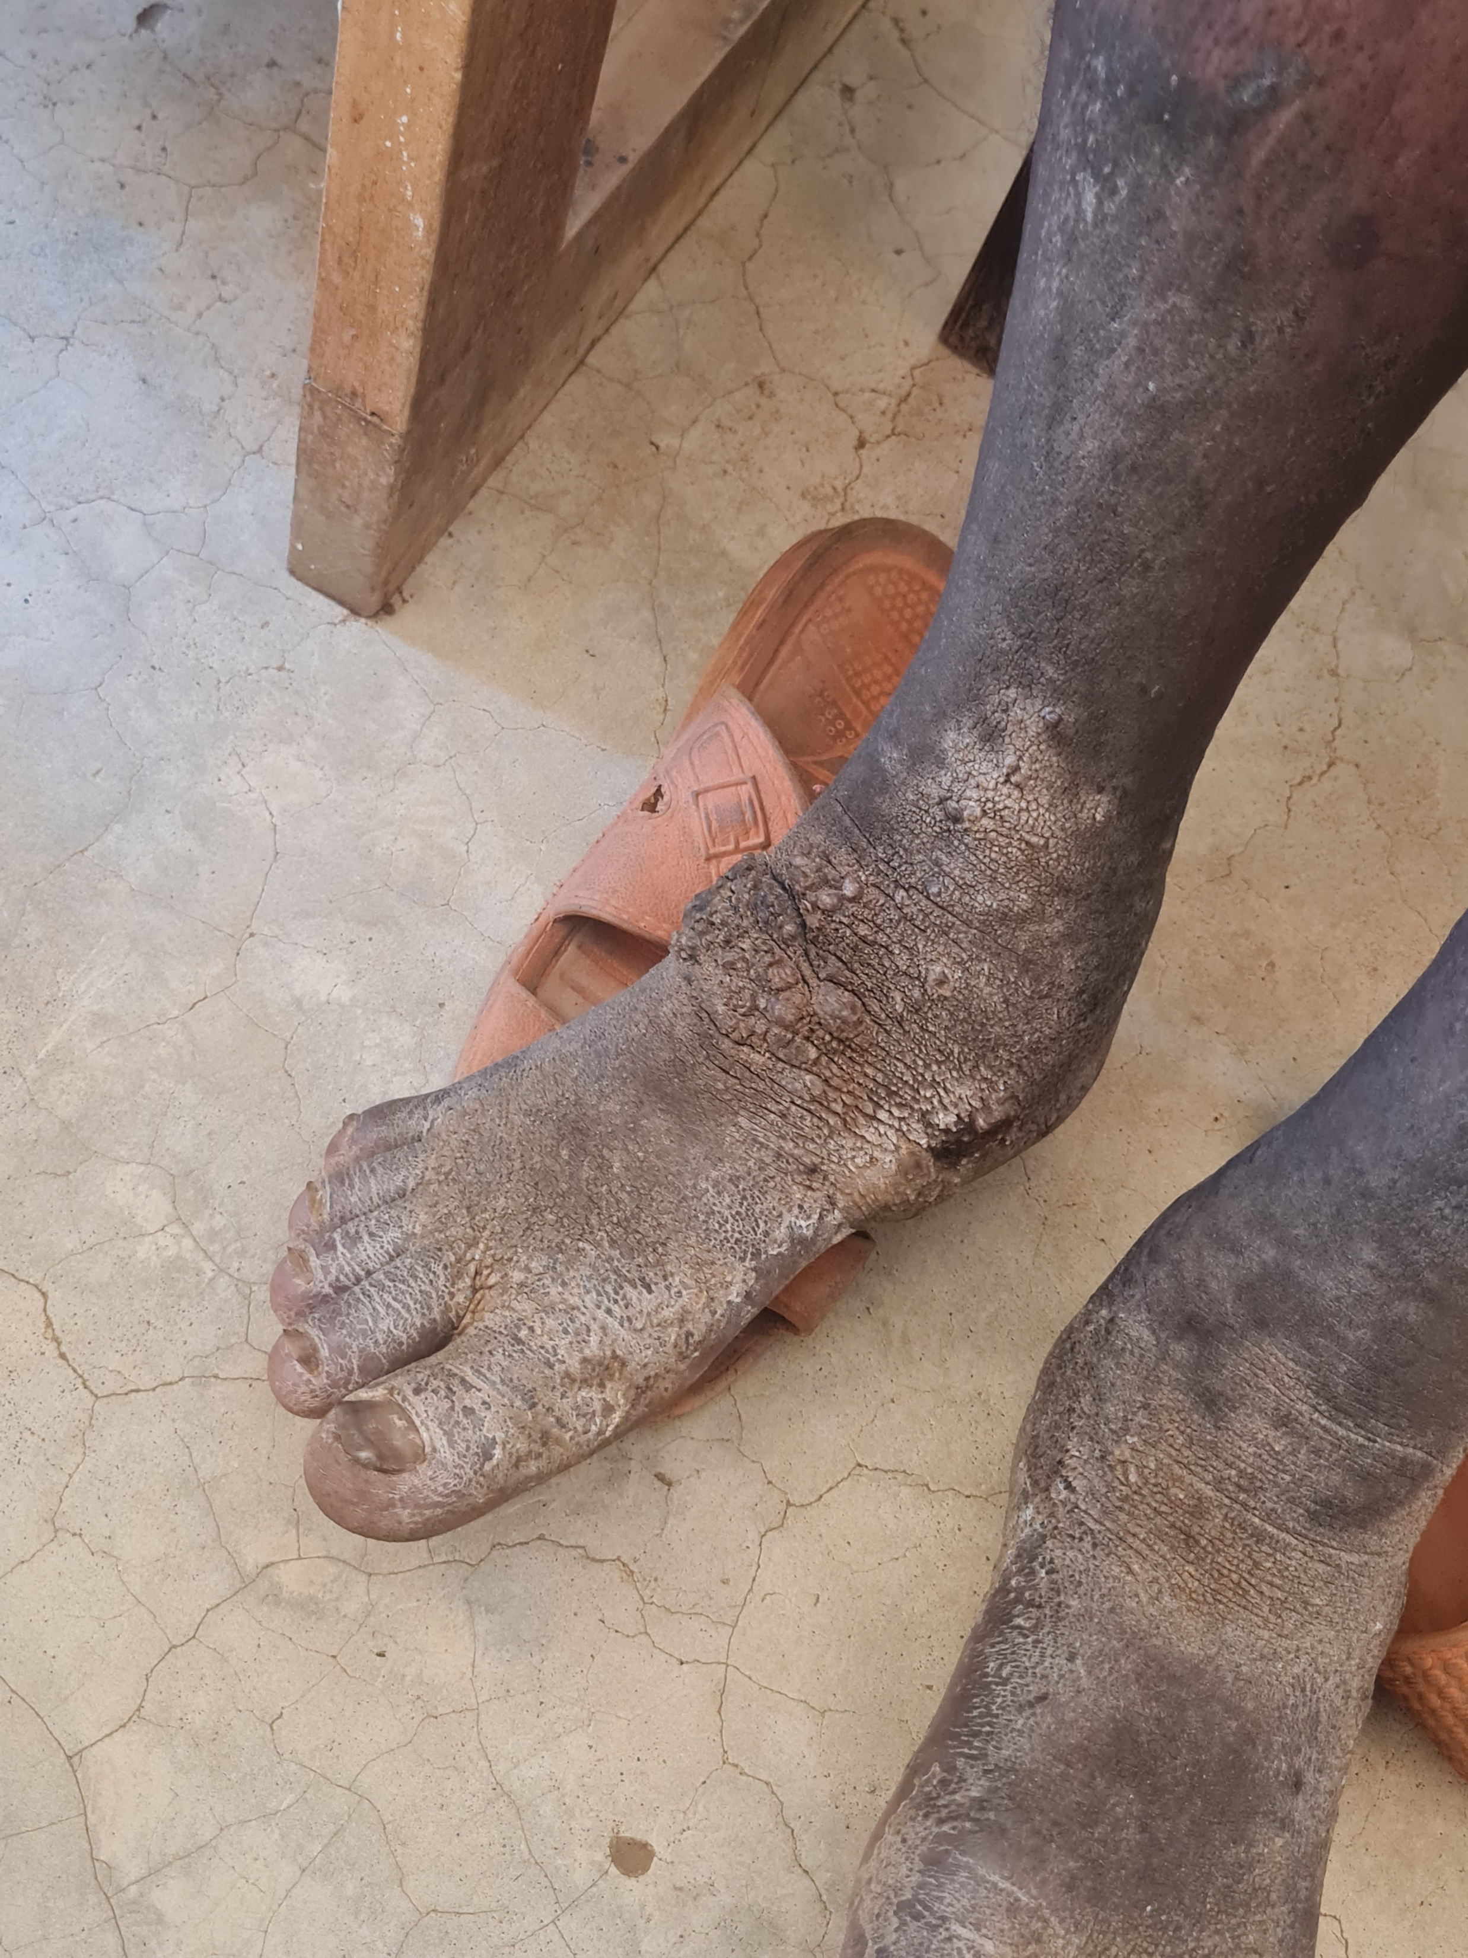
Podoconiosis
Podoconiosis is a non-infectious geochemical leg swelling (lymphoedema) caused by long-term exposure of bare feet to irritant soils.

Slide 3
Podoconiosis

Slide 4
Podoconiosis

Slide 5
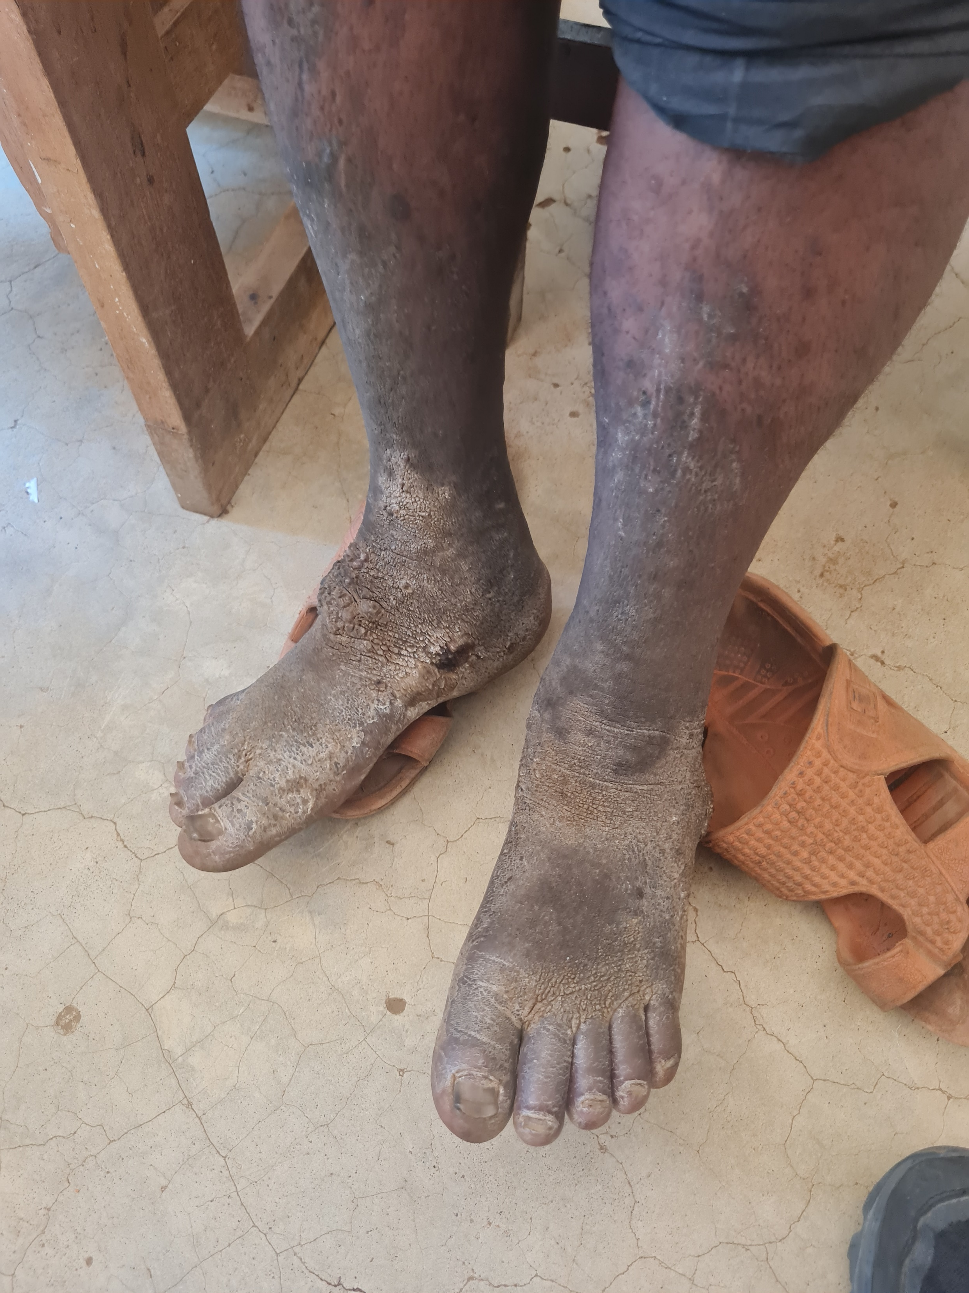
Podoconiosis

Slide 6
Podoconiosis
Podoconiosis (or podo as it is known) is a neglected tropical disease that causes avoidable disability in around 4 million people across Africa, Asia and Latin America.
It is non-infectious, tropical lymphoedema caused by many years of barefoot contact with red clay soil of volcanic origin in highland tropical regions.

Slide 7
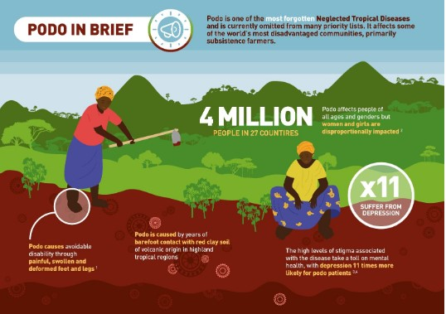
Podoconiosis
Lymphoedema is a chronic condition that causes swelling in the body’s tissues when the lymphatic system isn’t working properly. The disease is commonly misunderstood, causing terrible stigma and distress.
Those most affected are some of the world’s most disadvantaged communities, especially subsistence farmers, who are already living below the poverty line. The impact of podo can be devastating on their lives.

Slide 8
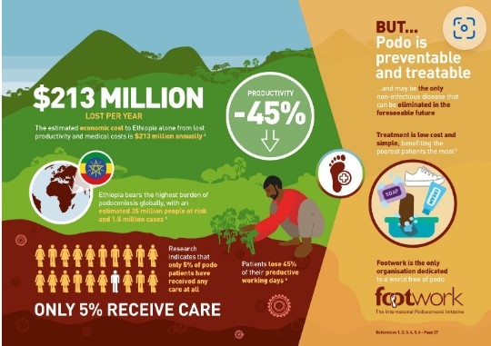
Podoconiosis
Lymphoedema is a chronic condition that causes swelling in the body’s tissues when the lymphatic system isn’t working properly. The disease is commonly misunderstood, causing terrible stigma and distress.
Those most affected are some of the world’s most disadvantaged communities, especially subsistence farmers, who are already living below the poverty line. The impact of podo can be devastating on their lives.

Slide 9
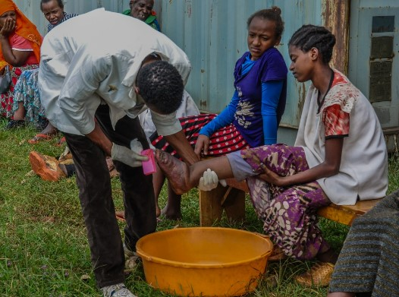
Podoconiosis
Podoconiosis Treatment
Foot hygiene : daily washing with soap and water (diluted bleach is also useful in the early stages of treatment)
Skin care: use of simple ointment/ moisturizer.
Daily use of socks and shoes.
Use of elastic bandage.
Elevation and movement.
Minor Surgery to remove nodules.

