Slide 1
Antimicrobial resistence (AMR)
Åsa Lundgren, Rotary Doctors,
June 2024

Slide 2
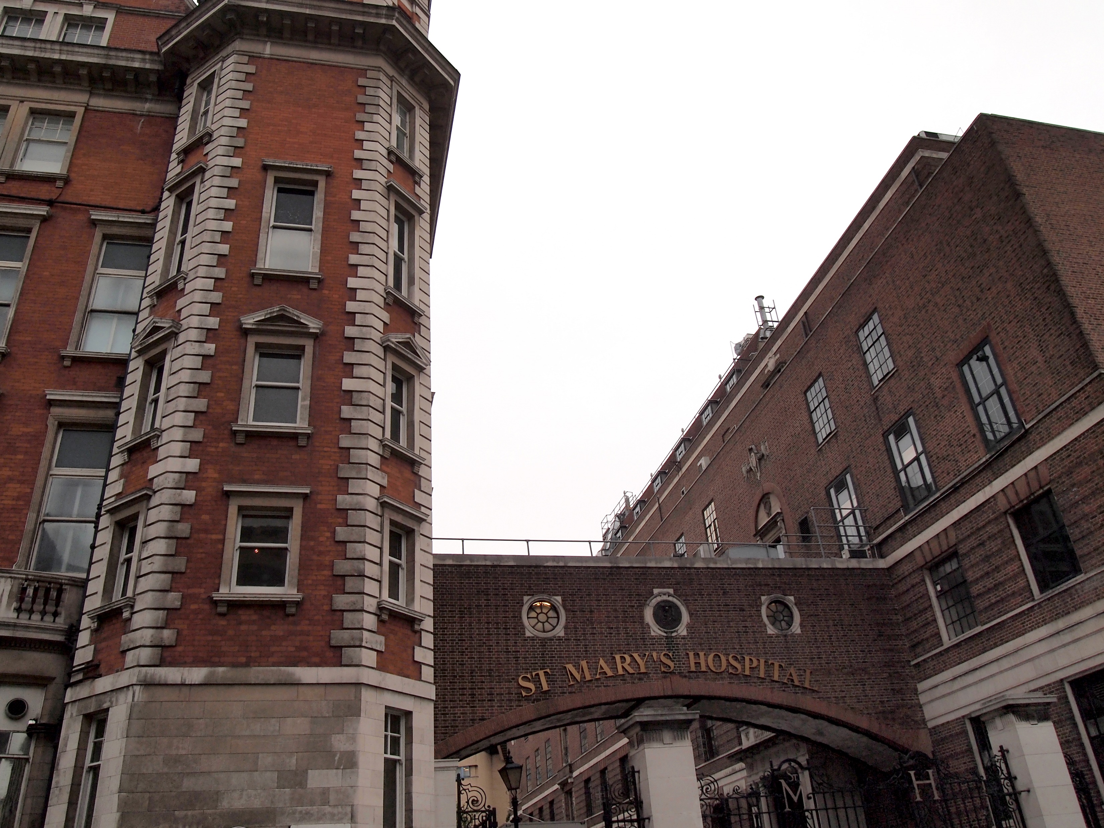
Antibiotics: How it started
Anti bios = Against life (bacteria)
1928 Penicillin
Sir Alexander Flemming

Slide 3
The antibiotic timeline

Slide 4
The revolution of antibiotics but…….. Emerging of antimicrobial resistance

Slide 6
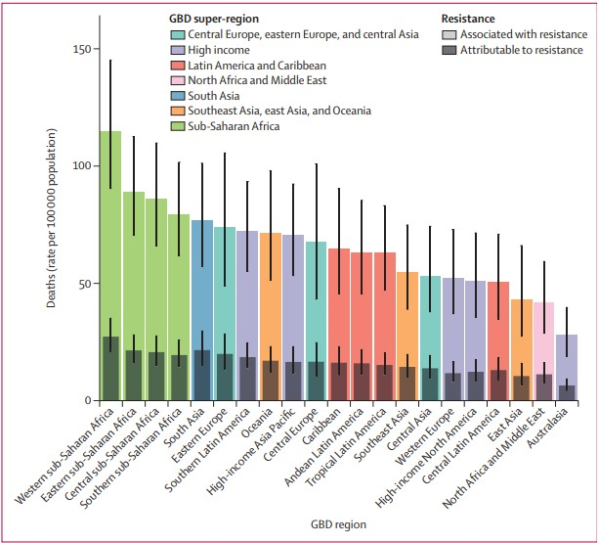

Slide 8
Natural resistance
Antibiotics have different target bacteria.
Examples: - Ciprofloxacin and gramnegative bacteria (UTI) - Flukloxacillin and grampositive bacteria (stafylococci)
Narrow spectrum antibiotics: Nitrofurantoin, Flukloxacillin
Broad spectrum antibiotics: Ceftriaxon, Cotrimoxazole

Slide 9
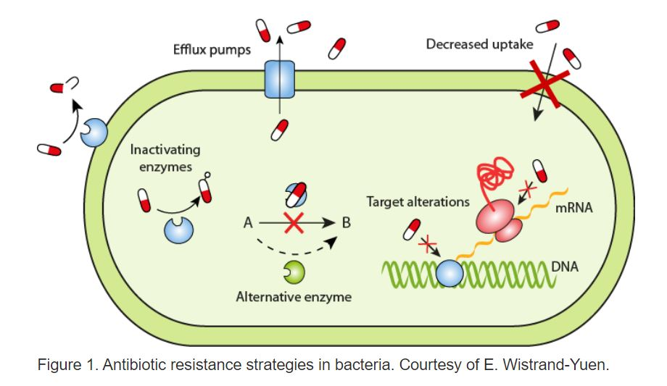
Acquired antibiotic resistance
Mutations

Slide 10
Natural selection of resistant bacteria

Slide 11
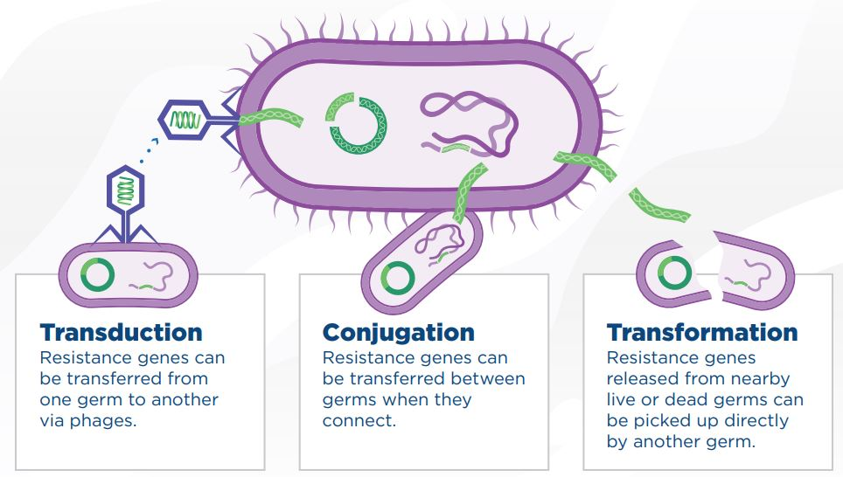
Spreading of antimicrobial resistance
Between different bacteria species

Slide 12
How do we spread AMR between us?
Direct contact
Indirect contact: Coughing/sneezing Touch of surfaces
From animals
From food and water

Slide 13
Risk factors for spreading AMR?
Poor hygiene
Poor sanitation
Poor infection control
International travelling and trade (animals and food)
Overuse of antibiotics in animals and agriculture
Overuse in humans (too much and too broad)
Over the counter sale

Slide 14
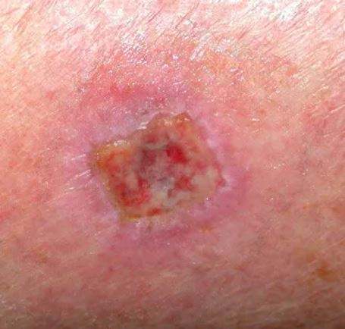
Skin and wound infections
Mostly stafylococcus aureus
Flukloxacillin (Floxapen)
MRSA
Methicillin resistant stafylococcus aureus.
Floxapen and cefalosporins (ceftriaxon, cefuroxim etc) don´t work.

Slide 15
MRSA But different countries do different amount of cultures

Slide 16
Gastroenteritis
Kenyan Basic Paediatric Protocols: ”Antimicrobials are NOT indicated inless there is dysentery or proven amoebiasis or giardiasis”
Shigella dysentery: Bloody diarrhea. Ciprofloxacin.
Amoebiasis: More sick. Abdominal discomfort. Can be bloody. Metronidazol. Giardiasis: Watery diarrhea, abdominal discomfort, cramping. Metronidazol.

Slide 17
Pneumonia - bacterial
Pneumococci or other bacteria
Normal resp rate
Elevated respiratory rate
Respiratory distress
Unwell, sick looking
High fever
Cough
Chest wall in drawing
Crepitations often heard when examining
Age | Resp rate/min
< 1 year | 30 – 40
1 – 5 years | 25 - 30
> 5 years | 20 - 25
Adults | 12 - 16

Slide 18
Common cold/URTI - virus
Fever
Cough
Running nose
Not so sick
3-5 days but can last longer
A normal child has 6-7 seven common colds/year.
Nasal saline drops, cough syrup (honey water), paracetamol.
No antibiotics needed!

Slide 19
What harm does antibiotics do to the patient?
AMR
Disturbing the normal flora of bacteria
Antibiotic associated diarrhea/clostridium-enteritis
Allergic reactions
Other side effects (nausea common)
Oral and vaginal candidosis
Cost money

Slide 20
How can we fight antimicrobial resistance?
Is it really a bacterial infection?
Teach patients
Small spectrum antibiotics
Good hygien
Vaccination

Slide 22
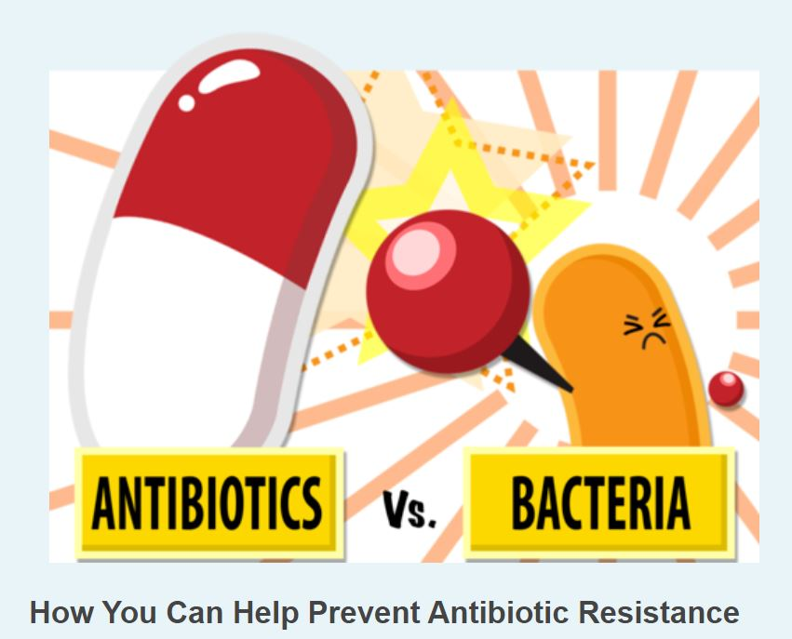
More reading
ReAct: A global network dedicated to the problem of antibiotic resistance. www.reactgroup.org

