Slide 1
Antimicrobial resistence (AMR)
Åsa Lundgren, Rotary Doctors,
October 2022

Slide 2
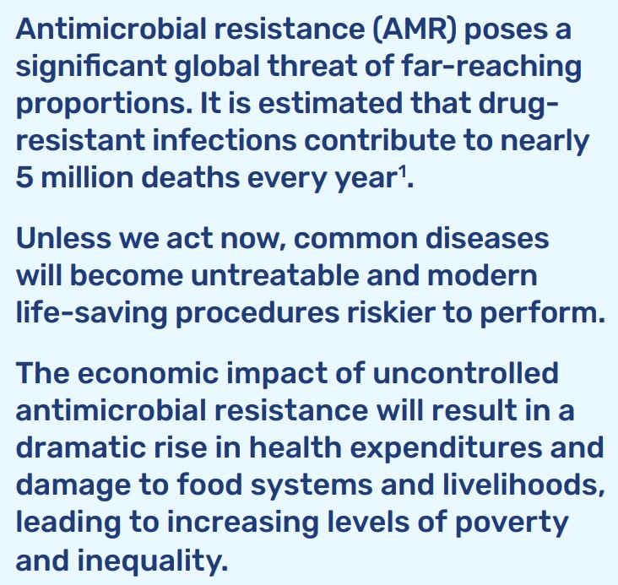

Slide 3
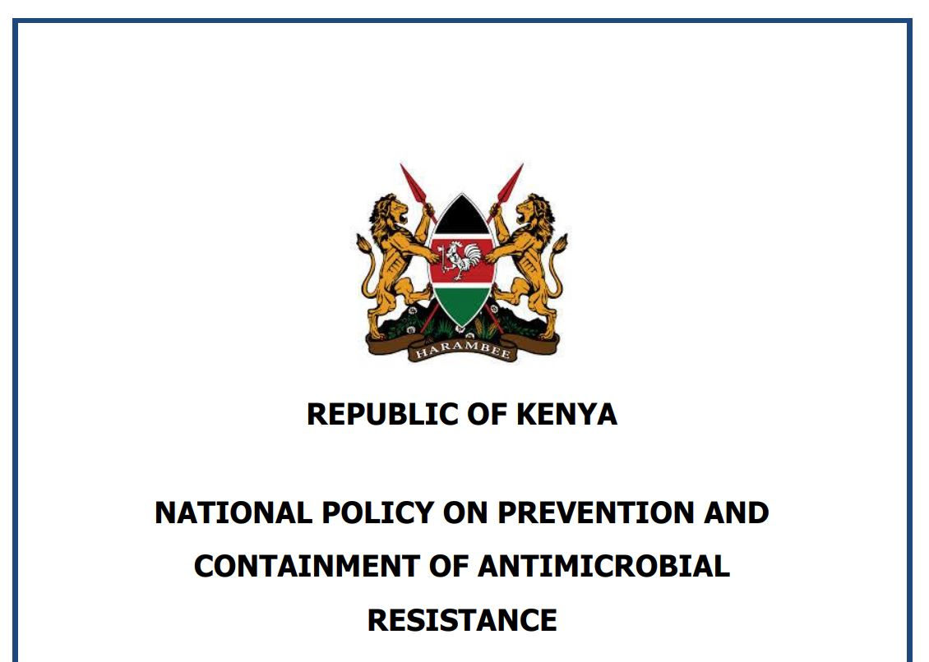

Slide 4
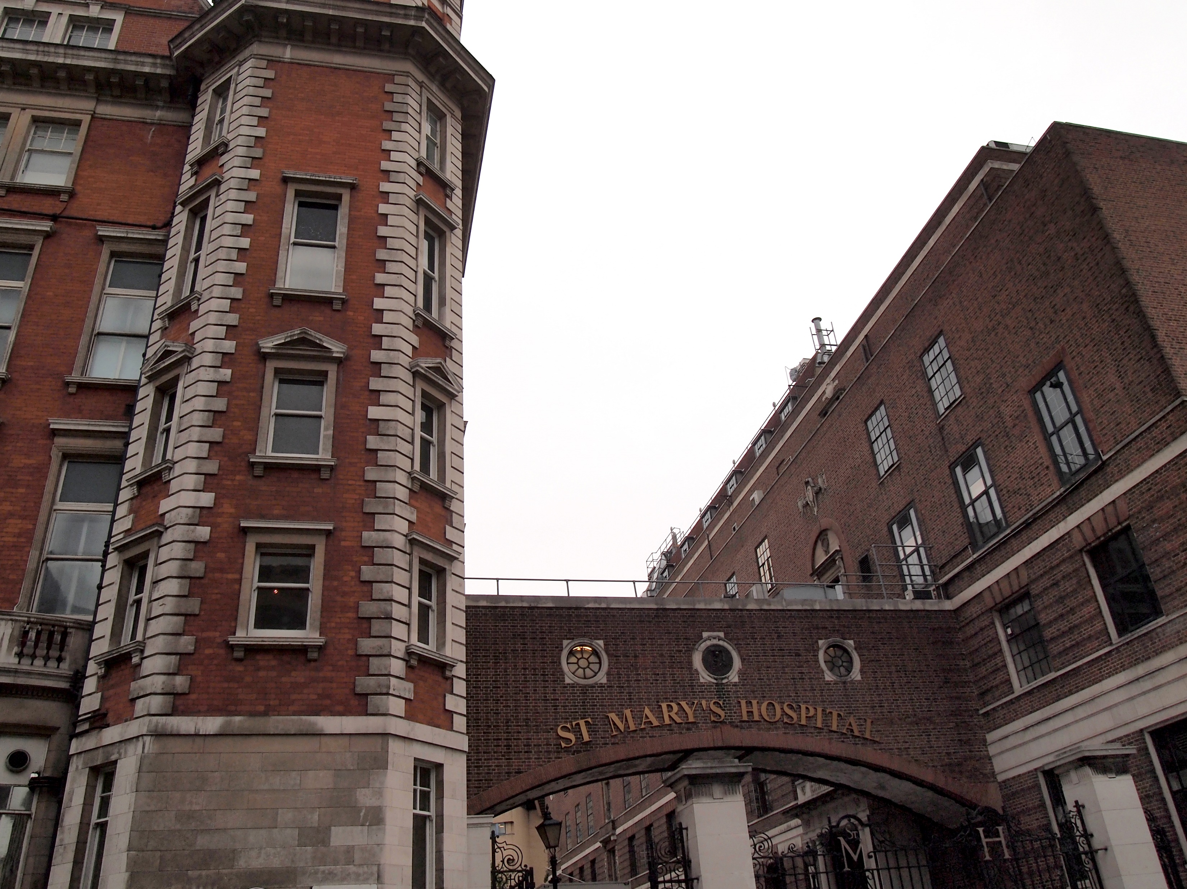
How it started
Anti bios = Against life
1910 Salvarsan for syphilis
1928 Penicillin
Sir Alexander Flemming

Slide 5
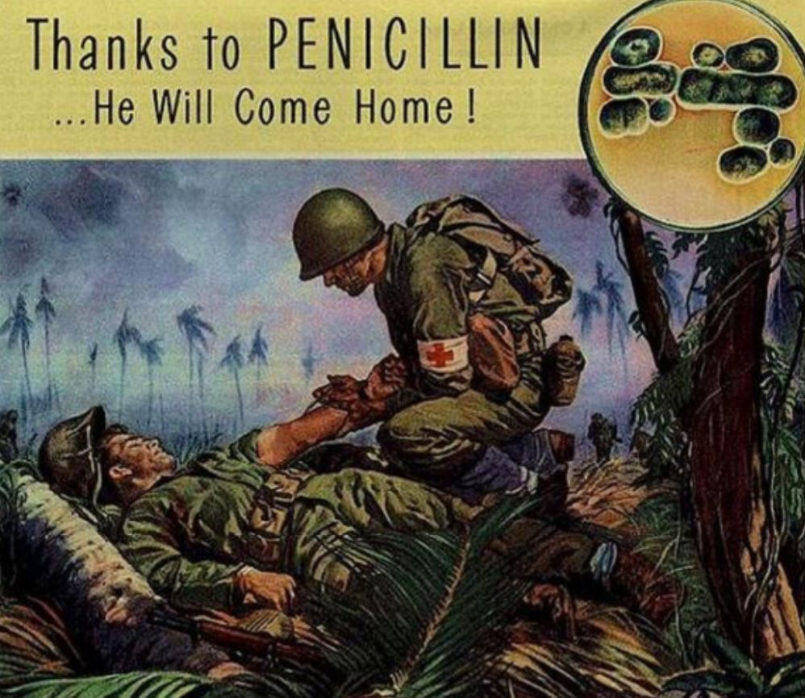
”The war against infectious diseases has been won!”
U.S. Surgeon General, 1969
The Revolution of Modern Medicine!

Slide 6
The antibiotic timeline

Slide 7
The revolution of antibiotics but…….. Emerging of antimicrobial resistance

Slide 8
Natural resistance
Antibiotics have different target bacteria.
Examples: - Ciprofloxacin and gramnegative bacteria (UTI) - Flukloxacillin and grampositive bacteria (stafylococci)
Narrow spectrum antibiotics: Nitrofurantoin, Flukloxacillin
Broad spectrum antibiotics: Ceftriaxon, Cotrimoxazole

Slide 9
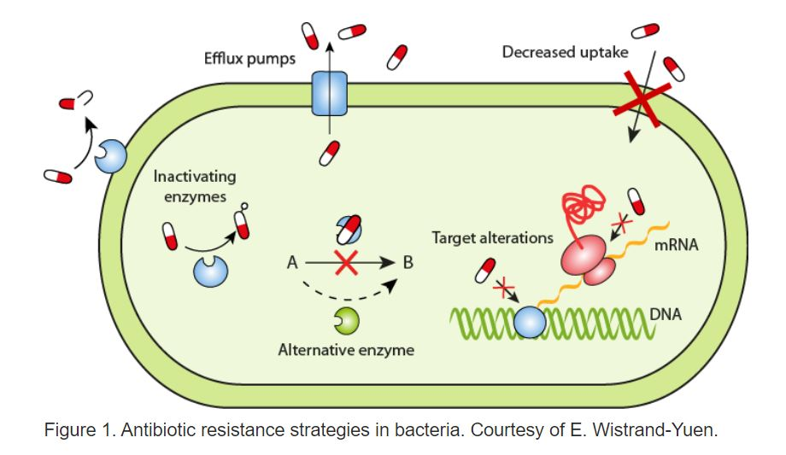
Acquired antibiotic resistance
Mutations

Slide 10
Natural selection of resistant bacteria

Slide 11
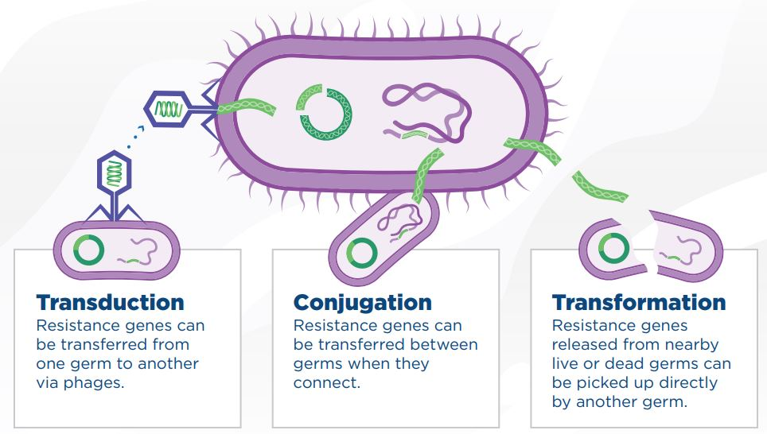
Spreading of antimicrobial resistance
Between different bacteria species

Slide 12
How do we spread AMR between us?
Direct contact
Indirect contact: Coughing/sneezing Touch of surfaces
From animals
From food and water

Slide 13
Risk factors for spreading AMR?
Poor hygiene
Poor sanitation
Poor infection control
International travelling and trade (animals and food)
Overuse of antibiotics in animals and agriculture
Overuse in humans (too much and too broad)
Over the counter sale

Slide 14
Health care facilities
Health care facilities are hot spots for resistant bacteria since many sick people are in close vicinity of each other and antibiotic usage is high resulting in selection and spread of resistant strains.
Poor hygiene practices may facilitate the spread of resistant bacteria via the hands or clothes of doctors, nurses and other health care staff, patients or visitors.
Instruments that are not cleaned properly, improper cleaning of the facilities and insufficient sanitation.
Crowded wards and few isolation rooms further facilitate spread[

Slide 16
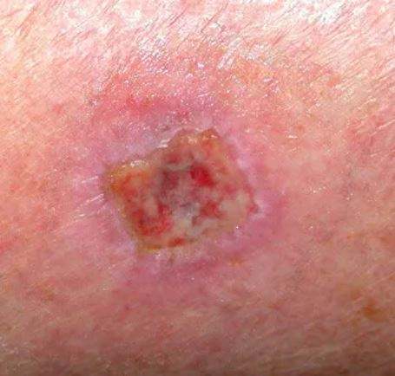
Skin and wound infections
Mostly stafylococcus aureus
Flukloxacillin
MRSA
Methicillin resistant stafylococcus aureus.
Flukloxacillin and cefalosporins (ceftriaxon, cefuroxim etc) don´t work.

Slide 17
MRSA But different countries do different amount of cultures

Slide 18
Urinary tract infections Gramnegative bacteria, most often e coli
Cystitis
No fever.
Nitrofurantoin 100 bd or 50 TDS 5/7
Pyelonefritis
Fever.
Pain
Ciprofloxaxin
Cotrimoxazole

Slide 19
Pneumonia - bacterial
Pneumococci
Normal resp rate
Elevated respiratory rate
Difficulty breathing
Unwell, sick looking
High fever
Cough
Chest wall in drawing
Age | Resp rate/min
< 1 year | 30 – 40
1 – 5 years | 25 - 30
> 5 years | 20 - 25
Adults | 12 - 16

Slide 20
Common cold/URTI - virus
Fever
Cough
Running nose
Not so sick
A normal child has 6-7 seven common colds/year.
Nasal saline drops, cough syrup (honey water), paracetamol.
Not antibiotics!

Slide 21
Reasons to restrict antibiotic use
AMR
Disturbing the normal flora of bacteria
Antibiotic associated diarrhea/clostridium-enteritis
Allergic reactions
Other side effects (nausea common)
Oral and vaginal candidosis
Cost money

Slide 22
How can we fight antimicrobial resistance?
Is it really a bacterial infection?
Teach patients
Small spectrum antibiotics
Good hygien
Vaccination

Slide 24
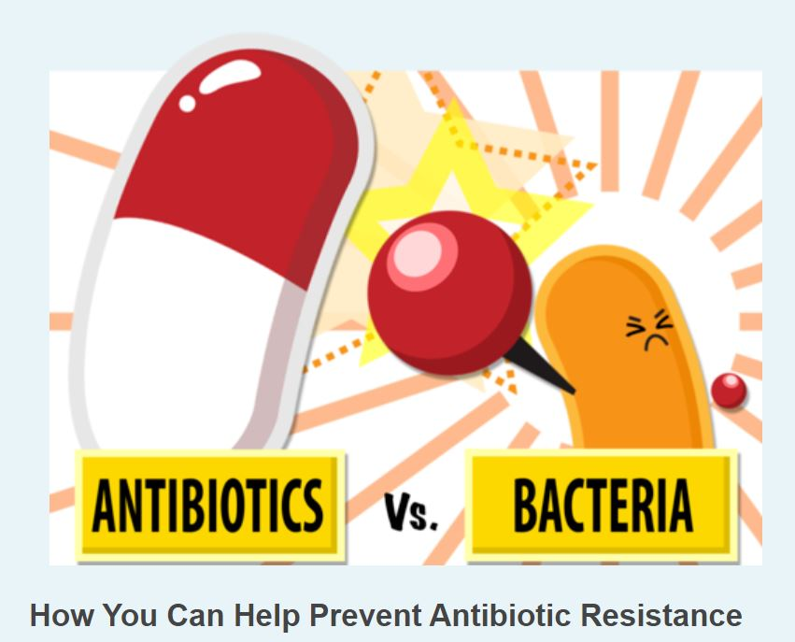
More reading
ReAct: A global network dedicated to the problem of antibiotic resistance. www.reactgroup.org

