Slide 1
Hand hygiene for HealthCare Workers
Dr Sara lann, MD
cme at kwanza and Endebess 2024
Source of information: the World health organisation

Slide 5
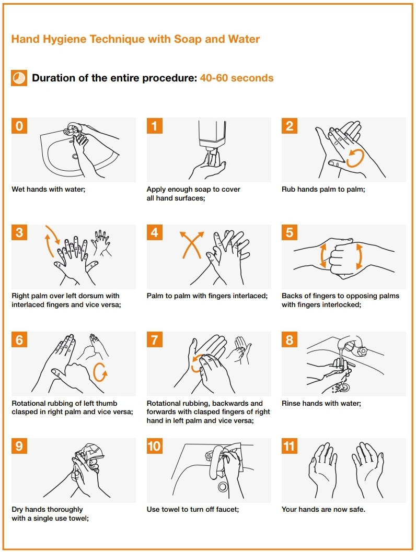

Slide 7
Hand sanitizers
The antimicrobial activity of alcohols results from their ability to denature proteins. Alcohol solutions containing 60–80% alcohol are most effective, with higher concentrations being less potent. This paradox results from the fact that proteins are not denatured easily in the absence of water.
Iodophors cause less skin irritation and fewer allergic reactions than iodine, but more irritant contact dermatitis than other antiseptics commonly used for hand hygiene.
Numerous reports confirm that alcohol-based formulations are well tolerated and often associated with better acceptability and tolerance than other hand hygiene products. In general, irritant contact dermatitis is more commonly reported with iodophors

Slide 8
Notes:
Cryptosporidium, coccidia

Slide 9
Non-enveloped
vs
Enveloped (lipophilic)

Slide 14
Gloves should be used during all patient-care activities that may involve exposure to body fluid (including contact with mucous membrane).
Health-care workers should be informed that gloves do not provide complete protection against hand contamination. Pathogens may gain access to the caregivers’ hands via small defects in gloves or by contamination of the hands during glove removal.
Hand hygiene by rubbing or washing remains the basic to guarantee hand decontamination after glove removal.
Key learning point: gloves do not provide complete protection against hand contamination.

Slide 18
Key learning point: it is important that health-care workers are able to differentiate between specific clinical situations when gloves should be worn and changed and those where their use is not required

Slide 20
Other aspects
Several studies have shown that skin underneath rings is more heavily colonized than comparable areas of skin on fingers without rings. The consensus recommendation is to strongly discourage the wearing of rings or other jewellery during health care. If religious or cultural influences strongly condition the HCW’s attitude, the wearing of a simple wedding ring (band) during routine care may be acceptable, but in high-risk settings, such as the operating theatre, all rings or other jewellery should be removed
Long sleeves
Long nails

Slide 21
Take home message
Handwash, hand sanitizers and gloves all play their separate parts in keeping both the HCW and patiens safe.
Use the right method at the right time.
Availability is a must.
Help remind eachother.

Slide 23
Thoughts?
Is this doable?
Is it important?
What do we need to make it work?

