Slide 1
CME on the malnourished child
Dr Siri Maartensson
Mr Ribson K Rop, Clinical Nutrition Officer
Kacheliba Sub-County Hospital
03/10/2023

Slide 2
Definition
W/H – weight for height, relative to standard weight of healthy child.
Z-score -2 SD → MAM (moderate acute malnutrition)
Z-score -3 SD → SAM (severe acute malnutrition)
MUAC (mid upper arm circumference), degree of muscle wasting
Ages 1-5 yrs
<11,5 – SAM
11,5-12,5 – MAM
12,5-13,5 – at risk
Lower-limb oedema, periorbital oedema

Slide 4
Malnourishment in children (combination common)
Kwashiorkor
Protein deficiency
Low-normal MUAC, W/H
Oedema – bilateral pitting oedema, periorbital oedema
Skin changes
Hair changes – dry, thin hair
Hepatomegaly
Miserable, lethargic, apathetic
Marasmus
Protein and energy deficiency
Wasting – low MUAC, W/H
Thin, flaccid skin, prominent spine/ribs/pelvis
Alert, irritable
Distended abdomen (weakened muscles + gas from small bowel bacterial overgrowth)

Slide 5
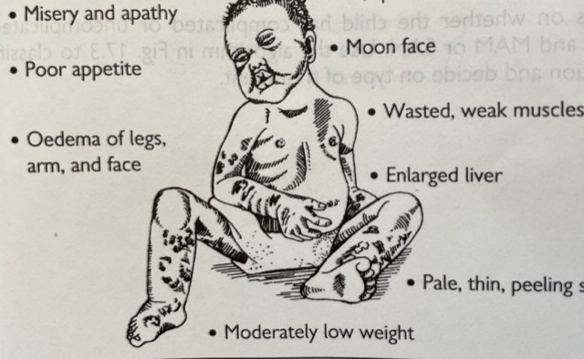
Kwashiorkor Marasmus

Slide 6
Patophysiological consequences
Anaemia (↑free iron → inflammation, infection, cell membrane dysf.)
Compromised immune system – very susceptible to infection
Decreased barrier of skin, gut, respiratory tract
Decreased systemic immunity
Electrolyte imbalance – ↓Ca2+, K+, Zn2+, Mg2+, Cu2+
Metabolic disturbances, susceptible to hypoglycemia, hypothermia
Reduced gut mobility, bacterial overgrowth, villous atrophy, gut enzyme deficiencies → impaired digestion and absorption
Muscle wasting

Slide 7
Micronutrient deficiencies
↓ Vitamin A – xerophtalmia (night blindness, corneal ulcers etc)
↓ Vitamin C – scurvy (impaired collagen, bleeding gum etc)
↓ Iron/Folate/B12 – anaemia
↓ Vitamin D/Calcium – rickets (bone deformity)
↓ Vitamin K – blood clotting abnormalities
↓ Iodine – goitre (thyroid growth)

Slide 8
Clinical assessment - history
Concurrent illness/symtoms
Vomiting/diarrhoea? – frequency, duration, nature (postprandial?)
Recent malaria, respiratory tract infection etc
Behaviour changes, irritability, apathy?
Feeding history
Appetite? Thirst? Food and fluid intake last days?
Breastfeeding – mixed/exclusive? How often and long?
Growth history
Premature? Twin? Growth chart available?
Other medical/family history
HIV/AIDS of mother or child?
Development milestones reached?
Immunization status? Vitamin A supplements?
TB contact?

Slide 9
Clinical assessment – further examination
Physical examination
General appearence, behaviour, mood, level of consciousness
Pallor? Jaundice? Fever?
Hydration assessment difficult (SAM causes similar clinic) – important to take history! Urine output? D/V?
Abdomen – distended? Hepatosplenomegaly?
Skin changes/infection? Rashes?
Oedema – lower-limb, facial
Lab
FHG, at least Hb
PITC
RBS
Possibly U/A - rule out severe proteinuria (nephrotic syndrome), check for UTI
BS for MP´s
Appetite test

Slide 10
In- or outpatient care?

Slide 11
Phases of treatment
1. Stabilization phase
Low protein/fat/energy feeds (F-75) → re-start metabolic and physiological processes, clear oedema (will loose weight initially). Usually 8 feeds/d.
Treat medical complications
No iron supplements! (pro-inflammatory → can promote infection)
2. Transition phase
Once appetite return, oedema clears, medical complications are treated (usually 3-7 days)
Possible to increase dietary intake, switch to F-100/RUTF. Gradually increase amount.
3. Rehabilitation phase
Once tolerating feeds, not loosing weight
To promote rapid growth. Usually 5 feeds/d.

Slide 12
Therapeutic nutrition
Initial cautious feeding – re-start metabolic processes, improve absorption. Risk of overloading fragile system!
Therapeutic feeds – protein, energy, fats, micronutrients, vitamins. No iron in F-75/F-100.
F-75 – 75kcal, 0.9g proteins/100 ml. Stabilization phase.
F-100 – 100kcal, 2.9g protein/100 ml. Transition/rehab phase.
RUTF – approx. 500 kcal/92g sachet. Transition/rehab phase. Long shelf life, suitable for outpatient treatment.

Slide 13
Treatment of medical complications
Blood transfusion if needed, caution to avoid fluid overload
Initial antibiotics
Severe infection might not be as symtomatic as in healthy child. Might present with hypothermia, hypoglycemia, lethargic appearence.
Immune response decreased – high risk of infection
Nystatin if signs of oral candidiasis
Albendazole after stabilization
Avoid iron supplements until stable, increases risk of infection

Slide 14
Dehydration/diarrhoea
Diarrhoea common – due to e.g infection, osmotic load of the food, lactose intolerance.
Oral resuscitation preferred. F-75/F-100 contains Zn.
ReSoMal instead of regular ORS – contains ↓Na+, ↑K+
Resuscitate, approx. 70-100ml/kg in the first 12 hours (5ml/kg every 30 min)
Then give after every loose stool
Therapeutic foods will facilitate recovery of mucosa and restore digestive enzymes, gastric acid and bile.

Slide 15
EDIT
Following slides prepared by hospital nutritionist Mr Ribson K Rop.

Slide 16
Calculation of feeds:
F-75
For severe oedema, start with 100 mls/kg bwt/day
Wasting/marasmus only- 130ms/kg bwt/day
Case 1
Edematous Child has weight of 8.9kg, what is the feed?
=100ms×8.9÷8 feeds , incase of three hourly feed
=100mls×8.9÷12 feeds, incase of two hourly feed

Slide 17
Case 2
Child 1: 6.8kg, no oedema , 3 hourly feed?.............
Child 2: 8.5 kg, mild (+) oedema, 2 hourly feed? …………
Child 3: 5.2 kg, severe (+++) oedema, 2 hourly feed? ……..
NOTE:
For F100, child have fully gained appetite and oedema resolved, so the amount of feed 130 mls/kg/day

Slide 18
Feeding
It is best to feed the child with a cup
Encourage the child to finish the feed.
It may be necessary to feed a very weak child with a dropper or syringe.
Do not use a feeding bottle.
Never leave the child alone to feed.
Catch dribbles by holding a saucer under the cup

Slide 19
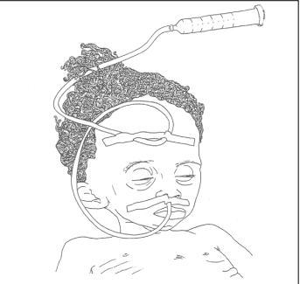
FEEDING UTENSILS

Slide 20
AFTER FEED
Record the amount of feed offered.
After offering the feed orally, measure and record the amount left in cup.
Subtract the amount left from the amount offered to determine the amount taken orally by the child.
If necessary, give the rest of the feed by NG tube and record this amount.
Estimate and record any amount vomited (and not replaced by more feed).
Ask whether the child had watery diarrhea (any loose stool) since last feed. If so, record “yes”.

Slide 21
Difference (F-75 F100)

