Slide 1
EDIT
This presentation about perioperative management was adapted for the resources available at Kacheliba Sub-County Hospital and prepared for staff from all professions.

Slide 2
CME on perioperative managemant Focus post-op care and C/S
Dr Siri Maartensson
Kacheliba Sub-County Hospital
26/09/23

Slide 3
C-section indications
Planned/elective, e.g:
Breech
Placenta previae
Several previous C/S (vaginal delivery possible after only one previous C/S!)
Emergency, e.g:
Obstructed labour
Uterine rupture
Placental abruption
Chord prolapse
Fetal distress
I.e –> Mother at risk or child at risk

Slide 4
Pre-operative preparations
At least 1 i.v cannulae
Risk of bleeding – blood group and crossmatch. FHG.
6 hours fasting – decrease risk of aspiration
Hygien precautions - shower, new clothes/bedsheet is possible
Urinary catheter – empty bladder for easier surgical access and to avoid bladder damage
Describe procedure to patient! M.O arranges consent form
Pre-op ceftriaxone + flagyl iv – to be given 30 min before surgery
Pre-operative fluid bolus to avoid hypotension with spinal anaesthesia

Slide 5
Perioperative risks with C-section
Large abdominal surgery.
Risk of damage to bladder/bowel
Complications with anaesthesia, both spinal and general
Hemorrhage

Slide 6
During C/S
Constant monitoring of vital signs
Often spinal anaesthesia – much safer, mother awake
Emergency C/S – sometimes need for general anaesthesia. High risk of aspiration because of pregnancy and labour. Difficult airway.
Up to 1000 ml bleeding normal

Slide 7
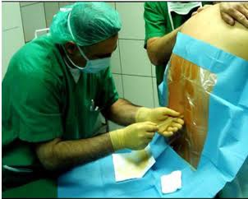
Spinal anaesthesia
Bolus injection local anesthetic and opioid in intrathecal space
Analgesia and paralysis for 1-4 hours
Low blood pressure common side effect – fluid bolus, vasopressors

Slide 8
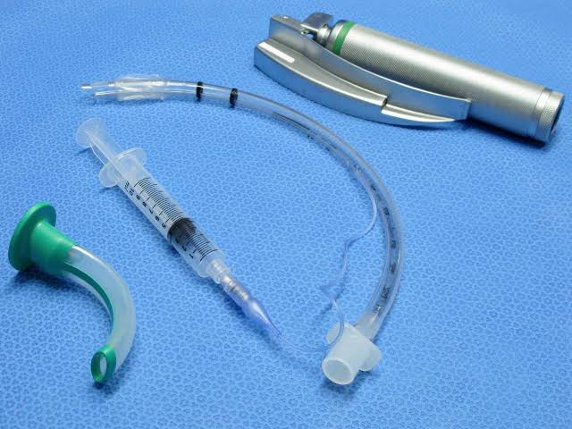
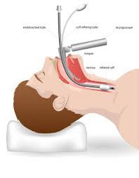
General anaesthesia
Need for airway protection and ventilator assist
In C/S always endotracheal intubation to protect from aspiration
Intravenous induction, inhaled gas for maintenance
Possible respiratory complications, e.g postop pneumonia

Slide 9
Post-operative risks after C/S
Hemorrhage
Thrombosis – increased risk with pregnancy, surgery, immobilized
Wound infection, wound rupture
Pneumonia – especially if general anaesthesia
If spinal - risk of post-puncture headache. Absent while lying down, increases in upright position (leakage of spinal fluid). Treat with analgesia, fluids.
Child – higher risk of respiratory failure and breast feeding difficulties.
Increased risk of uterine rupture with multiple C/S

Slide 10
Early post-operative phase
Monitor vital signs (BP, pulse, SaO2) – every 15 min first hour, then every 30 min until patient can move legs (if spinal)
Continously palpate uterus, monitor for P/V bleeding
Antibiotics to be given?
Continue i.v fluids as prescribed (depending on hemorrhage), monitor urine output.
Encourage oral intake after 2 hours if stable. Important to avoid dehydration.

Slide 11
Analgesia (pain relief)
Adequate pain relief is very important!
Analgesia facilitates mobilization – reduced risk of thrombosis, pneumonia
Easier to take deep breaths and cough – reduced risk pneumonia
Patient care!
Paracetamol, dicofenac (if not major hemorrhage), opioids (tramadol or morphine – monitor baby!). Regularly for the first days.

Slide 12
Post-operative care ctd.
Encourage patient to be ambulatory – reduced risk thrombosis and pneumonia!
Sit up after spinal effect is gone, stand up same day. Repeat several times per day.
Prevent constipation - especially if opioid treatment – treat with e.g lactulose, encourage water intake.
Urinary catheter removed as soon as possible, usually after 8 hours, depending on patient and surgery.
Encourage and explain benefits of KMC (skin-to-skin) with baby!
Stimulates baby´s growth, prevents hypothermia and infection
Stimulates breastmilk production

Slide 13
Post-op ctd.
No heavy lifts first weeks – will need assistance at home with daily work!
Full recovery at least 4-6 weeks
Patient will come for post-op check up after approx. 1 week
Encourage patient to come back if signs of infection (fever, wound infection/rupture, P/V discharge) or bleeding
Encourage family planning

