Slide 1
Danger sings during pregnancy
Elinor odeback
Midwife
Rotary doctors sweden 2025

Slide 2
Before getting pregnant
Good to inform the mother to take supplement as Folic Acit to prevent abnormalities like spina bifida
Also important for the mother to eat healty, food with lots of iron
Also take supplement to boost the iron storage

Slide 3
hyperemesis
In early pregnancy morningsickness is very common, due to the hormonal change. This seldom is a big problem for the health. The mother then needs to eat small portion, something before she goes up from bed and small portions during the day. Important to drink fluid.
Hyperemesis is a problem where the mother doesn´t get enough food or drink. She will vomit it all up. She then needs to get energy from infusions to be able to cope and nurture her baby.

Slide 4
Early pregnancy
Bleeding
It is common to have a small bleeding during first trimester when the mother usually would have her menstrual period.
It is also common to have a small bleeding when the egg attach to the uteruswall in pregnancy week 2-3
Both above is not any cause to worry

Slide 5
Bleeding later in pregnancy
Bleeding can be a cause of many differet things. Important to go for an ultrasound to see the cause.
- Bleeding after trauma, ex sex or heavy lifting (most often not any danger)
Placenta praevia – the placenta is then placed over the inlet to the pelvis. The baby can not be delivered vaginally.
Placenta abruptio, this is a life threatening situation. The mother then immediatly has to go to the hospital for C-section. Baby probably wont survive. If mother is coming in late she also may die.
Rupture of the uterus (This is more common after many C-sections)

Slide 6
Continue Bleeding…
Vasa praevia, that means that its bleeding from the cord. In Sweden we have a test that can be done when the mother comes in with bleeding. Vasa praevia test. This will show if the bleeding comes from the mother or the baby. If this Vasa praevia shows baby blod, the mother needs to do a C-section to save the baby.

Slide 7
Itching during pregnancy
This can be due to Intrahepatic cholestasis (ICP)
Bile Acids that normally flow from liver to gut to help digest food do not flow properly, it build up in the body instead.
This is rare but important to find
Symptoms is itching all over the body but most common on hand and feet.
Worse at night
Dark urine and pale poo.
Sometimes yellowing in the skin and eyes (this less common)

Slide 8
ICP
If you think this is ICP, the patient should go for liver bloodtest and bile acid measurment tests
ICP increase the risk of stillbirth, premature labor, meconium staining, preeclampsia and gestational diabetes.

Slide 9
High bloodpressure?
If the mother has an high bloodpressure we need to monitor her pregnancy better.
Is this cronic hypertension – How high has the BP been before pregnancy?
Is this BP hight due to the pregnancy or did she have a high BP before?
Is the mother on any medication? Need to be put on medication?
Headace? Epigastrial pain? Blurie eyes? Swollen? Gained weight rapedly?
This can be signs of preeclampsia. This needs to be checked at the hostpital for more investigation.

Slide 10
preeclapsia
If the mother has Preeclampsia she needs to be closly monitered.
Bloodtests that usually will rule out preecalampisa is complete bloodcount with platlet count and assessement of creatinine, liver enzyme levels and sometimes uric acid.
Also urin test is done to rule out if the mother is leaking protein.
Preeclamsia the diagnos can be made after two hight BP and one other sign as last page.
Preeclampsia can lead to less bloodflow to the placenta, low birthweight and preemature birth
If mother is sick, she should be induced. This will cure the disease….

Slide 11
eclampsia
The mother is having fits due to swelling in the brain. This needs to be treated immediatly…
Fist can also be caust by other things like epilepsy and braintumur.

Slide 12
Breathlessness
This can be caused by a heart disease.
Congenital heart disease is the most common in the United States.
Other causes: Asthma, peripartum cardiomyopathy and pulmonary embolism.

Slide 13
Low hemoglobin
This should be taken seriously
This can cause preemature birth and low birthweight in the baby.
This can also cause problems with bleeding after birth and higher risk of infections after birth

Slide 14
Water leaking
If the mother says she is leaking amniotic fluid this needs to be checked.
Sometimes this is just a normal discharge
Check if you see any amniotic fluid, smell and color.
If you see water and the mother is premature, send to the hospital for checkup.
Take the temperature.

Slide 15
Fetal movement
The babies should be felt moving every day.
The mother usually start feeling movements around week 20 for primi and multi week 18.
In the end of the pregnancy the baby movement will change due to less room. BUT the mother should feel the baby move many times every day
If the mother dont feel any movements she need to be checked. This can be a sign of featal distress.

Slide 16
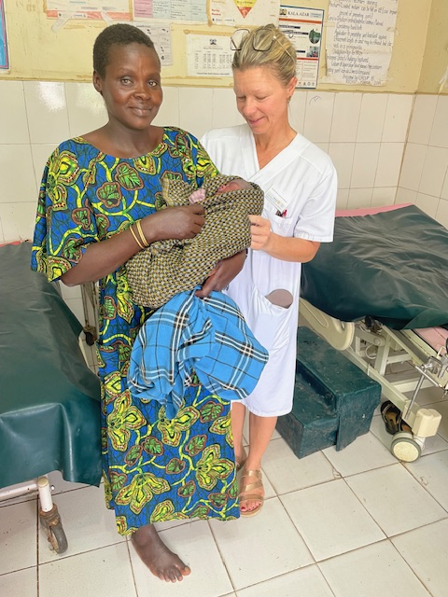
Thank you for listening

