Slide 1
Defining Quality & Quality Improvement

Slide 2
Session objective
By the end of this session, participants will be able to:
Define quality and quality of care
Describe the dimensions of quality
Describe quality improvement

Slide 3
Quality is associated with:
Excellent
Superior
High Caliber
Best
What else?

Slide 4
Defining Quality
Totality of features and characteristics of the Kenyan Healthcare system that relates to its ability to satisfy a stated or implied health need (KQMH-Ministry of Health 2011)
2. Quality is "the totality of features and characteristics of a product or service that bears its ability to satisfy stated or implied needs” (ISO 8402-1986)
3. A subjective term for which each person has his or her own definition. In technical usage, quality can have two meanings:
The characteristics of a product or service that bear on its ability to satisfy stated or implied needs.
A product or service free of deficiencies.
(American Society of Quality)

Slide 5
Quality in health care
Accessible and effective care delivered in compliance with evidence-based standards and meets clients’ needs and expectations
E.g. CD4 testing coverage done at appropriate schedule leading to appropriate ART initiation.
E.g. high immunization coverage delivered at appropriate schedule and age leading to control of immunizable diseases

Slide 6
Quality in health care
Quality means doing the right things the right way, otherwise there is no quality
Doing “right things” means applying correct interventions to meet customer needs.
Doing “right way” means applying correct processes, efficiently and on time (using set standards).

Slide 7
Quality grid
+ What you do (things) –
RIGHT WRONG
RIGHT THINGS RIGHT WAY | WRONG THINGS RIGHT WAY
RIGHT THINGS WRONG WAY | WRONG THINGS WRONGS WAY
WRONG RIGHT
– How you do it (way) +

Slide 8
Quality grid as applied in lab testing
Right things, right way Filled out correct lab form and provided accurate information Conducted lab test as requested on schedule and conducted correctly | Wrong things, right way Filled out incorrect form, but provided accurate information Conducted wrong lab test, but conducted it on schedule
Right things, wrong way Filled out correct form and but provided inaccurate information Completed correct lab test but patient left before results were available due to long wait | Wrong things, wrong way Filled out incorrect form with inaccurate information. Conducted wrong lab test and delayed in getting results back to patient

Slide 9
Quality is built on
Standards
Guidelines
Client needs and expectations

Slide 10
Standards
Refers to a statement of “desired”/ “achievable” performance of health care intervention which serves as a reference point for evaluation
Examples:
All HIV positive pregnant women should be on started ARVs.
Wearing of gloves when drawing blood
Standards are usually set by professional societies, health care organizations, panels of experts or governments

Slide 11
Guidelines
Refers to a set of standards according to which certain services should be provided in order to obtain the expected results
Examples:
Comprehensive Emergency Obstetric and Newborn Care guidelines
National Guidelines for the Clinical Management of HIV and AIDS
KQMH Implementation Guidelines 2011
KHQIF Operational guidelines

Slide 12
Client Needs and Expectations
“Quality does not occur by accident”
What does the client actually want?
Identify, understand and agree - client requirements
How are you going to meet those requirements?
Plan to address them

Slide 13
Example of difficulty translating guidelines and standards into practice
Clinics should ensure reasonable waiting time
BUT many clients spend longer time than they would like to at the clinic waiting for services
~4.5 hours
Clinic visit stages | Time (min)
Arrives at registration | 0
Wait | 30
Vitals taken by nurse | 5
Wait | 90
Seen by doctor | 10
Wait | 30
Counseling session | 20
Wait | 45
Lab blood draw | 5
Wait | 30
Pharmacy drug pick up | 1
Leaves for home | ---
Total time | 266

Slide 14
Example of difficulty translating guidelines & standards into practice
HAART reduces mortality among patients with HIV
BUT many eligible HIV-positive people don’t start HAART

Slide 15
Dimensions of Quality
A health care system should address all dimensions of quality
KHQIF is aligned with the six quality of care domains prescribed by the World Health Organization

Slide 16
Dimensions of Quality
Quality Dimensions (Adapted from WHO)
Safety | The avoidance or reduction to acceptable limits of actual or potential harm from health care management or the environment in which health care is delivered
Accessibility | Obtaining health care that is timely, geographically reasonable, and provided in a setting where skills and resources are appropriate to medical need
Effectiveness | Care, intervention or action achieves desired outcome
Efficiency | Achieving desired results with the most cost-effective use of resources
Acceptability/patient-centeredness | Service provides respect and is client orientated; respect for dignity, confidentiality, participation in choices, promptness, quality of amenities, access to social support networks and choice of provider
Equity | Delivering health care which does not vary in quality because of personal characteristics such as gender, race, ethnicity, geographical location, or socioeconomic status

Slide 17
Exercise 3: Dimensions of Quality
When you or a family member last received healthcare, how did you judge its quality?
Think of the last time you or a family member received health services. Describe your visit briefly (where did you seek care, reason for seeking care, and experience at the facility)
Dimension of Quality | Dimension Met? | Comments on why met or why not met?
Safety
Accessibility
Effectiveness
Efficiency
Acceptability/Patient centeredness
Equity
Evaluate your experience by the quality dimensions – indicate if the dimension was met or not and explain your reasons.
Notes:
reasons

Slide 18
Quality: Concepts View Point
Quality Management
Quality Improvement
Quality Assurance
Quality Control

Slide 19
Definitions: QC, QA, QI, and QM
QC: Identify problems based on established benchmarks
a product-based reactive, or corrective approach of checking and ensuring that items conform to specific standards
QA: Prevent problems based on established benchmarks
a process oriented to guaranteeing that the quality of a product or a service meets some predetermined standard
QI: Raising the quality of a product or service beyond current standard
a process of incrementally improving quality of a product or service beyond current standard
QM: Coordinating activities and infrastructure within an organization
-- a management model designed to support the activities that address quality and institutionalize change
Notes:
What about QM?

Slide 20
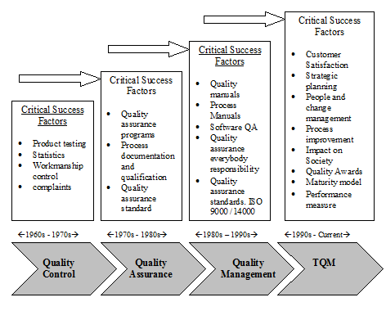
Quality
improvement
QI
improvement

Slide 21
What is quality improvement ?
What IS
The G A P
What should BE
Quality improvement is...
AND
designing, testing and monitoring interventions that bridge the gap
QI is a systematic process of assessing performance of a health system and its services, identify gaps and causes, and introducing measures to improve quality and monitoring the impact
Notes:
After the slide:
PI is about moving from a current, undesired or imperfect state, to a desired, ideal one, or as close as possible. So in general, you need to know where you are, or learn how to assess where you are, and what you want, then find ways to get there. In simple terms: you have a problem, you need to understand it, and find ways to deal with it. That is what (QI and) this training is all about.

Slide 22
Defining Quality concepts
Quality Control | Quality Assurance | Quality Improvement
What went wrong? | What went wrong and how do we prevent? | What can we do to improve?
Reactive | Reactive | Proactive
Seeks to check and ensure conformation to standards | Seeks to fulfill quality requirements per standards | Avoids blame on individuals but seeks to determine root causes
Focuses on corrective responses. | Focuses on the specific incident | Focuses on the entire system and fosters system change
Notes:
QC: Identify problems based on established benchmarks
a product-based reactive, or corrective approach of checking and ensuring that items conform to specific standards
QA: Prevent problems based on established benchmarks
a process oriented to guaranteeing that the quality of a product or a service meets some predetermined standard
QI: Raising the quality of a product or service beyond current standard
a process of incrementally improving quality of a product or service beyond current standard

Slide 23
What does QI entail?
Leadership
Client Focus
Team Work
Data-driven
Systems/process focus
Dissemination and shared learning
Notes:
This training will focus on all focus areas in QI

Slide 24
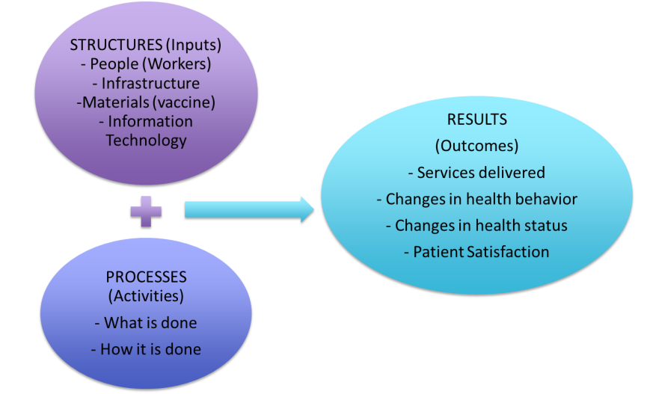
KQMH Approaches to QI based on Donabedian Model
Notes:
Activities or processes within a health care organization contain two major components which constitute a system; 1) what is done (what care is provided); and 2) how it is done (when, where, and by whom care is delivered). Quality Improvement is achieved by addressing either component; however, the greatest impact is achieved when both are addressed.
Working within this systems based approach, KHQIF emphasizes the creation of an enabling environment for successful implementation of quality improvement initiatives, and strengthening the capacity of healthcare service providers to improve and sustain improvements. An enabling environment is achieved using the 5S approach and provider capacity is built using the PDSA approach. Both approaches depend on the iterative use of routine service and program data to measure improvements in service delivery and processes, and the extent to which consumer (patient) and program needs are met (outcomes).

Slide 25
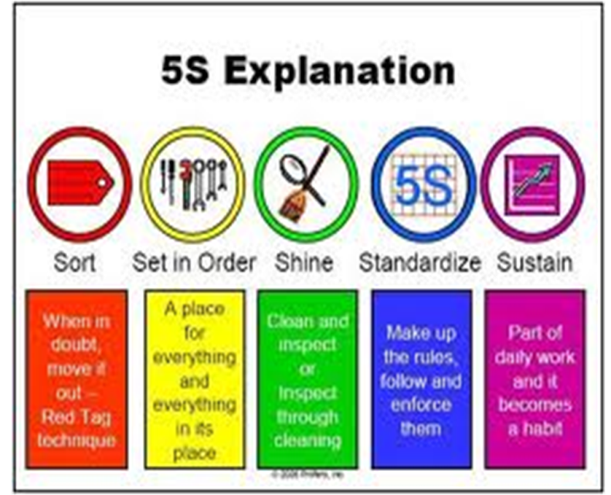
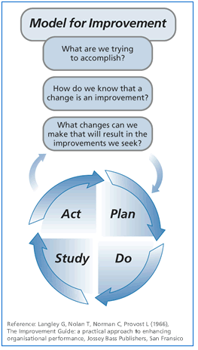
Donabedian through 5-S and PDSA…
An enabling environment for successful implementation of QI is achieved using the 5S approach
Provider capacity to improve and sustain quality services is built using the PDSA approach.
Both approaches rely on routine service and program data to measure improvements in service delivery and processes, and the extent to which client and program needs are met (outcomes).

Slide 26
Key Points
So far we have focused on:
Defining quality and quality of care
Differences in terminologies
Understanding standards, guidelines and the client needs and expectations
Understanding dimensions of quality
Understanding what is quality improvement

Slide 27
Q&A

Slide 28
THANK YOU
info@ampathkenya.org | www.ampathkenya.org | @ampathkenya

