Slide 1
Leadership, roles and responsibilities of QI teams at different levels
QUALITY IMPROVEMENT TRAINING
TRANS NZOIA
JULY 2022

Slide 2
Session objectives
By the end of this session, participants will be able to:
Define the concept of leadership
Mention attributes of a leader
Describe the roles of a leader in QI in health care setting
Identify the roles and responsibilities of QI teams at the different levels of the health system in Kenya

Slide 3
Definition of leadership
Leadership
is the art or process of influencing people so that they will strive willingly and enthusiastically toward the achievement of group goals
Therefore:
A Leader
places him/herself before the group as they facilitate progress and inspire the group to accomplish for this case QI goals

Slide 4
What are the roles of a leader?
Classroom exercise

Slide 5
Attributes of a leader
Some of the attributes of a leader include:
The ability to influence others
Inspire others to achieve set objectives
Have a shared vision
Ability to direct

Slide 6
Quality of a leader
Some qualities of a leader that are essential in most leadership styles
Truthful
Approachable
Patient
Accountable
Persuasive
Adaptive
Credible
Confident
Focussed
Communicator
Integrity
Any others?

Slide 7
Skills of a QI Leader
Communication
Clearly communicate the team's objectives and goals and actively listening
Creativity
Give room for innovation, encouraging non-traditional methods
Feedback
constructive feedback, removing micro-managing
Motivation
Encourage, praise where necessary, recognizing efforts
Delegation
Assign roles based on areas of strength
Responsibility
Self reflection, self awareness, open to criticism
Commitment
Keeping promises, following through
Positivity
Developing a healthy work environment
Trustworthiness
Demonstrating integrity; building trust
Flexibility
Accepting change; horizon scanning, problem solving

Slide 8
Roles of a leader in a QIT
To guide a team of people to improve the quality of Health services
To inspire and assure cooperation among the group
To promote individual contribution towards achieving set objectives

Slide 9
Roles of a leader in QI in the health care setting
There are four specific roles:
A Support a systematic approach to QI
B Communicate priorities
C Support team members
D Facilitate innovation and learning

Slide 10
Roles of a leader in QI (1)
A. Support a systematic approach to QI
Guidance
Participate in QI team meetings
Use data for decision-making
Support QI changes
Allocate resources to support implementation of changes

Slide 11
Roles of a leader in QI (2)
B. Communicate priorities
Develop and reinforce a sense of common purpose
Clarify the goals and priorities
Prioritization of areas for improvement
Facilitate ongoing dialogue between leader and team members on QI activities

Slide 12
Roles of a leader in QI (3)
C. Supporting team members
Guidance
Re-assurance (instill hope on team members)
Recognizing their quality efforts

Slide 13
Roles of a leader in QI (4)
D. Facilitate innovation and learning
QI → introducing and testing changes
Support staff as they learn new skills
Create a safe environment for learning and for experimentation

Slide 14
What Leadership styles do you know?
Classroom exercise
Notes:
Laisez faire
Authoritarian/Dictator….
Democratic

Slide 15
Inclusive Leadership
What is inclusive leadership?
Effective collaboration: They empower others, pay attention to diversity of thinking and psychological safety, and focus on team cohesion.
Cultural intelligence: They are attentive to others’ cultures and adapt as required.
Awareness of bias: They show awareness of personal blind spots, as well as flaws in the system, and work hard to ensure a meritocracy.
Listen to understand
Value contributions

Slide 16
TEAM ROLES AND
RESPONSIBILITIES AT DIFFERENT LEVELS OF THE HEALTH CARE SYSTEM

Slide 17
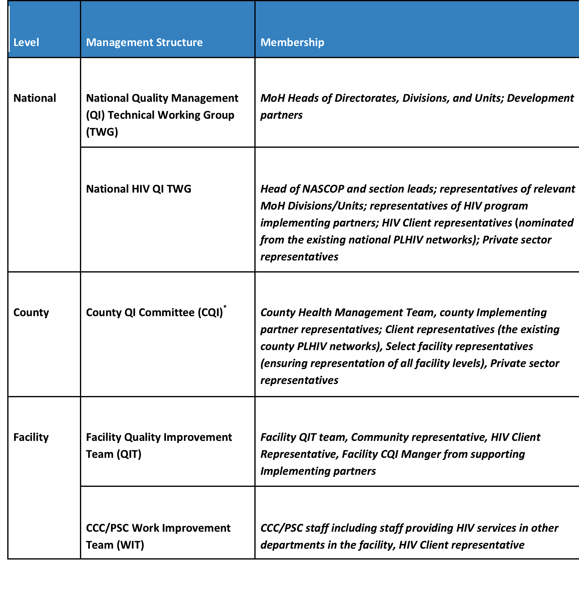
Examples of Quality Management Teams
Department of Quality standards and regulations.
KQMH/eKQMH
Committee of experts at NASCOP.
QI leadership in HIV programming.
KHQIF framework
COUNTY teams leadership
Existence?
Active?
Your Role?
Implemetors of policies from TOP
Existence?
Active?
Your Role?
WITs (MCH, OPD etc..)
Notes:
Refer participants to a clearer picture in OM and KQIF- KQMH

Slide 18
Tasks across all levels
Teams are responsible for:
Goal setting,
Activity planning,
Implementation
Roll out, and
Program evaluation at their respective levels.
Onward reporting of findings and data to the next level.
Annual goals will be based on national goals and strategies, and informed by prior year performances.
Each team will have a team leader.

Slide 19
National QM TWG
Policy development guiding implementation of QM
Periodic review of the health indicators, training material and curricula
Resource mobilization
Coordination of implementing partners on QI activities
Provision of technical assistance to County QM teams
Training and mentorship of staff
Monitoring and evaluation of National QM program
National level environmental scanning and identification of emerging trends for influencing policy
Representation of Health interests on the national QM TWG
Scale up of best practices in Health care QM and CQI

Slide 20
County QM Committee
Adaptation of national policies guiding implementation of QI
Establishment and support of reporting systems
Capacity building of sub-county and facility staff
Training, Supportive supervision and mentorship of county and facility staff
Resource mobilization at county level
Coordination of Health care implementing partners on QI activities.
Monitoring and evaluation of the County QM program
Oversight for expansion and support of Health care QI across counties
County level environmental scanning and identification of emerging trends for influencing policy
Scale up of best practices in Health care QM and CQI

Slide 21
Facility Quality Improvement Team
Development of monthly, quarterly and annual QI plans for all services offered at respective facilities
Identification of data sources for QM assessment, monitoring and evaluation
Facility level implementation of national and county QI plans
Training of facility staff on QI, CQI and QM
Conducting periodic situation analysis and local environmental scanning
Facility level M and E of QI plans including monthly review meetings
Documentation of QI activities and onward reporting to county and national QM structures
Oversight of QI activities and mentorship to facility departmental WITs, including WIT
Resource mobilization and support for QI activities
Representation of facility in external QI learning and sharing platforms

Slide 22
Work Improvement Teams
Routine collection of QI performance data
Direct monitoring of incremental changes brought about by 5-S and PDSA activities
Client engagement and the obtaining of relevant feedback from patients and clients served
Collation and submission of QI performance data to Facility QITs
Provision of feedback to relevant stakeholders (including clients and the community)

Slide 23
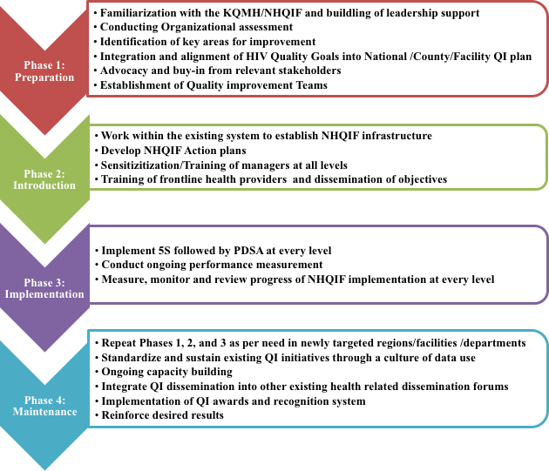
What is needed to operationalize QI?
Notes:
Refer participants to the specific page in the NHQIF/ Operational Manual

Slide 24
Key points
The session focused on:
Defining the concept of leadership
The attributes of a leader
Describing the roles of a leader
Roles of leaders in QI
Roles of QI teams at the different levels of the health system
How leadership can support operationalization of QI

Slide 25
THANK YOU
info@ampathkenya.org | www.ampathkenya.org | @ampathkenya

