Slide 1

Establishing QI Structures
QUALITY IMPROVEMENT TRAINING
TRANS NZOIA
JULY 2022

Slide 2
Learning Objectives
By the end of this session, participants will be able to:
  Describe establishing a QI structure
  Define roles and responsibilities of members of a QI Team
  Identify good candidates for QI Team members and leaders
  Describing stages of team formation
  Attitude and QI success
  Describing roles and responsibilities of QITs & WITs

Slide 3
ESTABLISHING A QI STRUCTURES
Quality Improvement Team (QITs)
The Quality Improvement Teams should aim at improving the speed of decision-making and enhance commitment for quality improvement in the hospital/health facility
How is QIT Formed:
Nominated by the top leadership and should include members of the Health Facility Management Team and Middle Management

Slide 4
ESTABLISHING QI STRUCTURES
Quality Management Infrastructure
  - QMT –Sub-county/County…….
Core facility-based structures in KQMH:
  Quality Improvement Team (QIT)
  Work Improvement Team (WIT)

Slide 5
Roles (ToR) of the Quality Improvement Team:
Main roles:
  Coordinate planning and implementation of quality improvement activities
  Sets overall vision for QI in facility
  Mentorship and coaching to WIT
    Promotes WITs activities
    Selects and appoints WITs facilitators
    Evaluates and rewards WITs activities
    Allocates resources for WITs operation
  Facilitates “Total Quality Management”

Slide 6
Work Improvement Teams (WITs)
Essentially employee-based (workers/implementors)teams.
How is WIT Formed?
  Nominated by QIT and departmental management
  Should be 3-15 members of same work unit who meet regularly to identify, analyze and solve problems and improve outputs of their work unit.

Slide 7
Primary Roles of WITs:
  Implement CQI activities at section level (5-S, PDSA) and ongoing performance measurement
  Share and disseminate findings
  Work with QIT to institutionalize changes

Slide 8
What are WITS Objectives?
WITS aim to improve:
Performance
- Quality of service, output
- Productiveness
Motivation
- Making work more meaningful
- Providing little challenges here and there
- Having open and effective communication
- Developing more positive attitudes
The Quality of work life
- Job satisfaction
- Work environment
- Teamwork and human relations

Slide 9
Composition of Q(W)ITs
Patron: someone with clout
Team Leader-
Sponsor/Initiator - Someone who suggests new ideas. One or more people can have this role at a time.
Rapporteur/Secretary– Documentation of minutes…..
Devil's Advocate/Skeptic - This is someone whose responsibility is to look for potential flaws in an idea.
Optimist - Timekeeper - Someone who tracks time spent on each portion of the meeting.
Subject matter experts..
Members………..

Slide 10
QI TEAM RESPONSIBILITIES: SPONSOR/INITIATOR
Charters the improvement teams
  Provides the initial improvement goal and monitors the team progress.
  Develops the initial QI charter, before teams refine it further.
  Supports the QI teams through the implementation process
This role can be a group of people or a person e.g. the ScHMT can be the sponsor of a QI initiative.

Slide 11
QI team responsibilities: leader
Organizes and directs the work of the QI Team
  Develops meeting agendas and timelines, recruits members and monitors progress
  Identifies need for other technical and QI support
Acts as the link between service delivery and facility management
  Provides management updates
  Bears responsibility for implementing change

Slide 12
QI Team Responsibilities: QI Expert
Establishes a contract with the QI Team Leader to define how to intervene, whether through the Leader or directly with the QI Team
Guides QI Leadership Team through the QI process
  Improvement steps
  QI Tools
  Analyses
  Monitors QI Team effectiveness and suggests ways to enhance performance
Notes:
In our experience, one of the major challenges for a QIP team is working as a team. Usually the QI expert is the most well qualified to help the leader address issues of group dynamics, interpersonal communication, conflict management, change management and so on. However, there may be other better qualified people available to the team. Do not hesitate to ask them to help with these matters.

Slide 13

QI Team Responsibilities: Members
Present reality in analysis of the current situation
Represent the concerns of the provider/supplier/customer/beneficiary group, as appropriate
Carry out assignments between meetings

Slide 14
QI Team Responsibilities: Rapporteur
Records and maintains QI Team documents
  Meeting notes (agendas, minutes, attendees)
  Results of analyses
  Team storyboard
Provides communication among QI Team members, QI Team Leadership and external people
Ensures ideas are captured and displayed during discussion – newsprint
Prepares publications and information releases

Slide 15
QUALITY IMPROVEMENT TEAMS (QITs) & WORK IMPROVEMENT TEAMS (WITs) FOR PRODUCTIVITY AND QUALITY IMPROVEMENT

Slide 16
Definitions
A Team is a group of people working together to achieve a common goal for which they share responsibility
Team work is solving problems together whereby all members have the ability to influence decisions and apply their strengths effectively

Slide 17
Team work is not…
A group of people and one ‘STAR’ who does all of the work.
Neither is it ………
A group of people and a leader dictating to them what to do.

Slide 18
TEAM DYNAMICS
Stages of team development;
  Forming; inclusion and acceptance
  Storming; Assert control fight for own voice
  Norming; Teams have clarity on the goal and objectives, want to accomplish goal.
  Performing; Highly effective problem solving stage
  Closing;
All teams go through this process but not necessarily in the order above

Slide 19
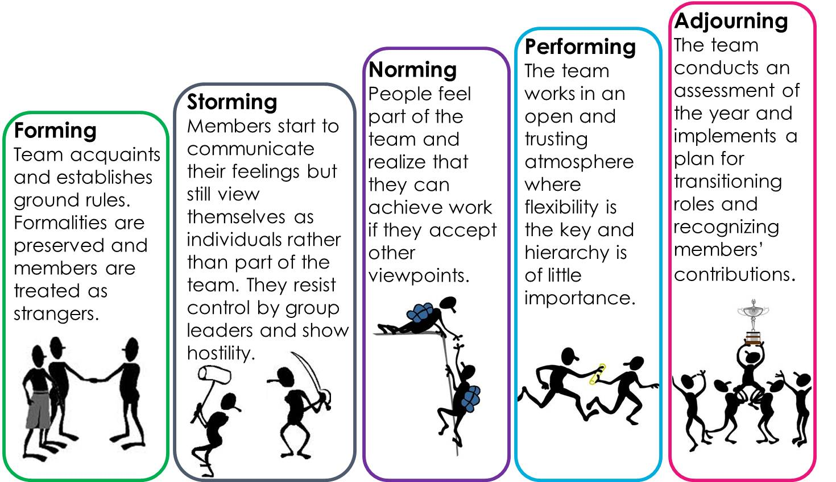
Stages of team development
Forming
Storming
Norming
Performing
Closing

Slide 20
Stage 1 - Forming
When a team is forming:
  Members cautiously explore acceptable group behavior
  People’s roles change from “individual” to “member”
Members may challenge the authority of the leader/coach BUT also tend to depend on them for orientation and direction
This stage is complete when members begin to think of themselves as part of the team.

Slide 21
Stage 2 - Storming
Storming is critical to effective group development
  Tasks ahead may seem harder than expected
  Some team members may become impatient, argumentative and resist collaborating with each other
  This stage provides the opportunity for individuals to establish their own expertise within the group
  They will forge ways of working together and respect each other’s point of view
This stage is complete when there is a relatively clear hierarchy of leadership within the group

Slide 22
Stage 3 - Norming
During this stage members realize their:
  Common goals
  Begin to accept the team
  Roles and the individuality of fellow members
As a result conflicts are minimal and there is more cooperation
This stage is complete when the group structure becomes established and the team develops a shared understanding of how a team member should behave.

Slide 23
Stage 4 - Performing
During this stage:
    The team starts identifying, solving problems, choosing and implementing changes
    Members accept each other’s strengths, weaknesses, and know their own roles
It is during this stage that the team performs at its best.

Slide 24
Stage 5 - Closing
The work of a problem-solving or quality improvement team is intended to end when process improvements are in place
  The team must deal with either the success or failure of their efforts and the dissolution of the team
  The team should identify lessons learned and plan how they will be communicated
The leader and team celebrate their successes and provide support if the project has not been successful

Slide 25
Success of KQMH-5S-CQI (KAIZEN) implementation depends on:
    Leadership
    Commitment
    Positive mindset & Everyone’s participation

Slide 26
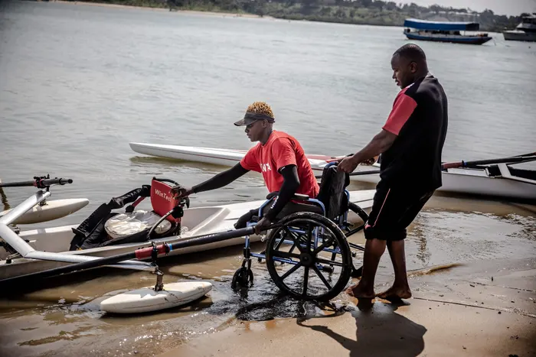

“Attitude is a little thing that makes a big difference.” ~Winston Churchill

Slide 27
“The greatest discovery of my generation is that human beings can alter their lives by altering their attitudes of mind”.
William James of Harvard University

Slide 28
Attitude…………
“Everyone likes to do what he or she likes and not what should be done”
Why?

Slide 29
Answer is….
“Knowledge and Skills aren’t enough. It’s your positive attitude which makes the difference”.

Slide 30
So, let’s ask ourselves these important questions……
  Can an executive be a good executive without a good attitude?
  Can a student be a good student without a good attitude?
  Can parents, teachers, employers or employees be good in their roles without a good attitude?
  Yatafakari Hayo!!

Slide 31
What is attitude?
  On the surface, attitude is the way you communicate your mood to others. When you are optimistic and anticipate successful encounters, you transmit a positive attitude and people usually respond favorably. When you are pessimistic and expect the worst, your attitude is often negative and people tend to avoid you.
  Inside your head, where it all starts, attitude is a mind-set. It is the way you look at things mentally.
  Negative thinking can become a destructive habit. Watch your thoughts more closely, and aim to turn your negative self-attitude around.

Slide 32
WHAT MAKES YOUR LIFE 100% ?
Let each letter of the alphabet has a value equals to it in the sequence of the alphabetical order:
A | B | C | D | E | F | G | H | I | J | K | L | M | N | O | P | Q | R | S | T | U | V | W | X | Y | Z
1 | 2 | 3 | 4 | 5 | 6 | 7 | 8 | 9 | 10 | 11 | 12 | 13 | 14 | 15 | 16 | 17 | 18 | 19 | 20 | 21 | 22 | 23 | 24 | 25 | 26
S | K | I | L | L | S
19 | 11 | 9 | 12 | 12 | 19
=
82
K | N | O | W | L | E | D | G | E
11 | 14 | 15 | 23 | 12 | 5 | 4 | 7 | 5
=
96
H | A | R | D |  | W | O | R | K
8 | 1 | 12 | 4 |  | 23 | 15 | 18 | 11
=
98
A | T | T | I | T | U | D | E
1 | 20 | 20 | 9 | 20 | 21 | 4 | 5
=
100

Slide 33
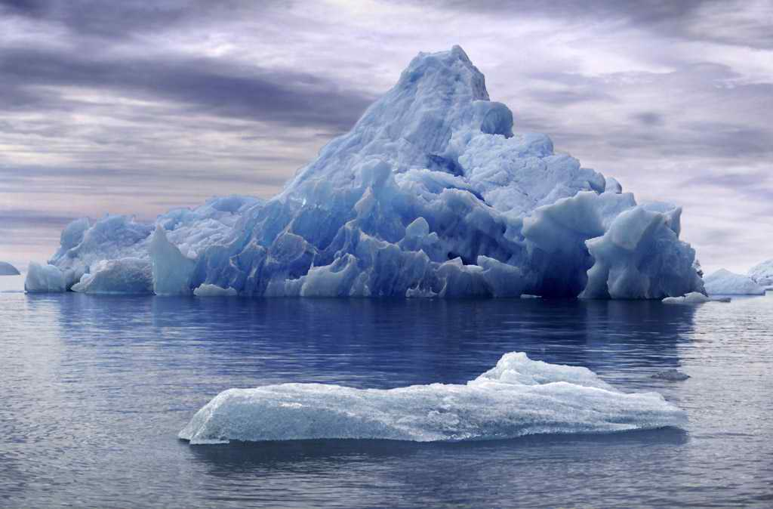

THE ICEBERG
THE ICEBERG EFFECT
HOW MUCH DO YOU SEE OF AN ICEBERG?
Notes:
10% known – 90% unknown to others – Behaviour 10% - Attitude unseen – 90% values, ethics, motivation, beliefs, judgments, standards

Slide 34

Key points
This session focused on:
Defining team and team work
Describing stages of team formation
Attitude and QI success
Describing roles and responsibilities of QITs & WITs

Slide 35
THANK YOU
info@ampathkenya.org | www.ampathkenya.org | @ampathkenya

