Slide 1
Root Cause Analysis
QUALITY IMPROVEMENT TRAINING
TRANS NZOIA
JULY 2022

Slide 2
Learning Objectives
By the end of this session, participants will be able to:
Define the term “root cause” as applied to quality challenges;
Describe the utility of common Root Cause Analysis QI tools (5 Whys, Fishbone Diagram, Process Maps);
Apply Fishbone Diagrams to identify root causes of poor quality within the healthcare system.

Slide 3
Outline
Root Cause Analysis
Define “Root Cause”
QI Tool: Fishbone Diagram
Group Work

Slide 4
Traditional Problem Solving
Many health care leaders face the same challenge: Individuals believe their own perceptions of the problem are correct
The tendency is to jump in and make improvements – but often, team members will disagree on where to focus
This increases the risk of a mismatch between the intervention and the true cause of the quality problem

Slide 5
Avoiding “Type 3” Error:
The perfect solution to the wrong problem
Without the application of QI, traditional problem solving often leads us here
Costly and Ineffective

Slide 6
What is Root Cause Analysis?

Slide 7
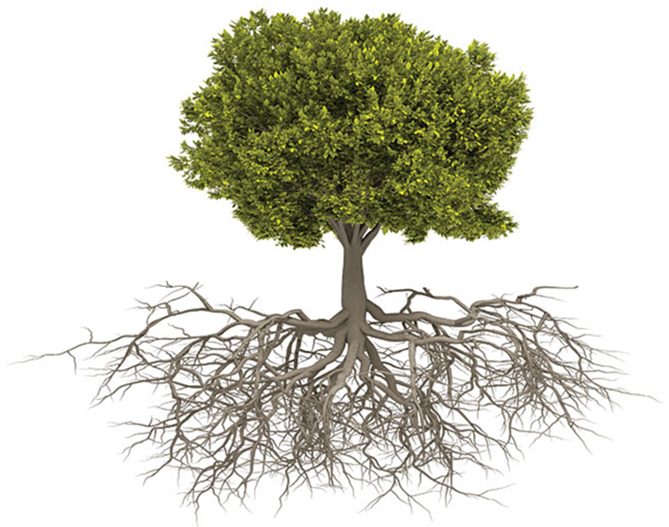
Direct, Contributing & Root Causes
Direct Cause
Directly results in the problem
The Problem
Poor patient outcomes
Contributing Cause
Part of the problem, but not enough to cause the problem on its own
Root Cause
If fixed, would prevent the problem from happening
Notes:
What is a root cause?
Root Cause- origin of the problem. It’s the initiating cause of a causal chain that leads to an outcome
Should point to a process that is not working, a behavior that is adjustable, gaps in knowledge, lack of standards, guidelines,
Our Goal is to uncover and address the root causes.
A few of our QI tools that we will be talking about today, are essentially problem solving tools/ methods to work within a complex adaptive system.
What often ends up happening is that we fix… direct or contributing causes and then fail to create iniatives that solve the problem. We keep repeating the same problem over and over again.

Slide 8
Root Cause Definition
“The most basic cause (or causes) that can reasonably be identified that management has control to fix and, when fixed, will prevent (or significantly reduce the likelihood of) the problem’s recurrence.”
- Paradies (2005)
Notes:
One of the issues we see in QI is that many people have different understanding and interpretation of the concept
B/C health care is part of a complex adaptive system, there will be more then one root cause.
These root causes identify the change solutions that are most appropriate… from simple revisions to entire systems redesign based on the increase level of understanding about the root causes.

Slide 9
Examples of Root Causes
A process that is not working
A behavior that is adjustable
A gaps in knowledge
Lack of established standards
Lack of guidelines
Others?

Slide 10
Root Cause Analysis
Make issues more clear for everyone to agree
Gives teams a chance to learn everyone’s perspectives
Helps the health care team to understand all the different activities going on that they may not be involved directly with
Provides baseline data
Notes:
Improve team communication and systems thinking competencies
QI Principals

Slide 11
QI Tool: The 5 whys and Fishbone Diagram

Slide 12
The “Five Whys” Technique
Repeated question-asking technique used to find the root cause!
Why?
Why?
Why?
Why?
Why?
May require more than five questions!
Who can give me an example of a root cause of a health care challenge?
Notes:
Key Messages:
Asking “Why?” may be a favorite technique of your three year old child but for the purposes of today we are using it to find root causes.
2. Typically , the fifth why suggests a broken process or an alterable behavior, which is indicative of reaching the root-cause level. A key phrase to keep in mind in any 5 Why exercise is "people do not fail, processes do".
3. The questioning for this example could be taken further to a sixth, seventh, or higher level, but five iterations of asking why is generally sufficient to get to a root cause.
4. often observe teams may refer classical answers such as not enough time, not enough investments, or not enough manpower. These answers may be true, but they are out of our control. Therefore, instead of asking the question why?, ask why did the process fail?

Slide 13
Nurses don’t have the supplies they need
WHY?
Supplies are hard to find
WHY?
Supplies are stored in different places
WHY?
Different people are stocking the supplies in different ways
WHY?
There is no standard protocol for supply storage

Slide 14
There is a delay in patients moving from the ED to the ward
WHY?
There are no beds in the ward
WHY?
There are still patients waiting to be discharged
WHY?
Patients are still waiting for medication & discharge papers
WHY?
Because the charge nurse did not know the patients were being discharged today
Notes:
Are we done asking why?

Slide 15
The Five Whys
Often uncover systems problems not incompetent or untrained people
“If you pit a good performer against a bad system, the system will win almost every time” – Deming
You don’t always need five!
Remember – these are still hypotheses that need to be tested, not proven causes
The analysis is a part of the QI process, not an endpoint

Slide 16
The Fishbone Diagram
Also known as the Cause-and-Effect diagram/ Ishikawa
Structured Brainstorming tool to arrive at Root causes
It is a picture of categories of “causes” leading to a poor quality “effect”
Helps identify many/several causes of quality problems
Complex problem analysis
Notes:
Juliana

Slide 17
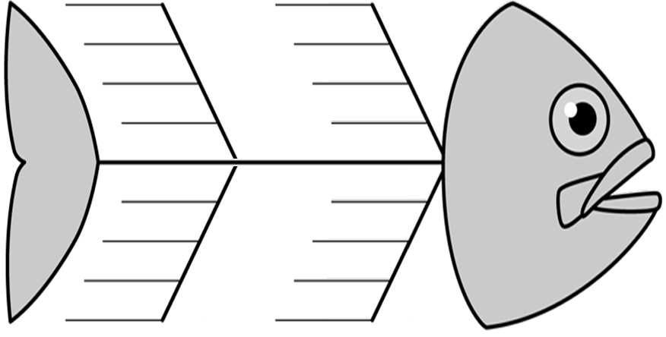
Building a Fishbone Diagram
Major Cause Category
Major Cause Category
Cause
Cause
Cause
Cause
Cause
Cause
Effect
Problem
Event
Cause
Cause
Cause
Cause
Cause
Cause
Cause
Cause
Major Cause Category
Major Cause Category
Notes:
1. When To Use?
When needing to identify multiple causes for an issue that seems overwhelming.
Team building technique that can sort all the ideas into useful categories.
This methodology can be used on any type of problem, and can be tailored by the user to fit the circumstances. Use of this tool has several benefits to process improvement teams:
Straightforward and easy to learn visual tool.
Organizes discussion to stay focused on the current issues.
Promotes "System Thinking" through visual linkages.

Slide 18
Building a Fishbone Diagram
The problem (Effect) is placed at the head of the “fish” while the causes are placed on the fins along the major cause categories.
Brainstorm the major categories of the problem:
People. What staff and patient issues lead to the problem?
Process/Policy. What procedures lead to the problem?
Equipment/Supplies. Is there equipment that leads to the problem?
Environment. Does the immediate environment contribute?

Slide 19
Building a Fishbone Diagram
For each cause identified, ask the 5 whys?
Other Major categories could include:
Cost
Culture
Measurements
Methods
Education and training
Patient factors/characteristics
Team factors
Individual factors
Organizational factors
Task factors
Notes:
How do you determine your common cause categories? Practice, and can be adjusted during the brain storming phase.
The First pass at a FB diagram may not be enough to understand the issues.
It may be necessary to break down cause categories further to achieve finer gradations- increasing the level of detail.

Slide 20
Fishbone Example
People
Processes
IPC nurse was not
aware of the issue
Distracted doctors
with many patients
No policy to address
supply shortages
Triage nurse did not identify cough patients for separation & isolation
Facility staff shortage
of two doctors
Children
malnourished
Malnourished children not identified for supplementation
Large increase in respiratory tract infections in children <5 in IPD
New triage nurse
Varying hand hygiene practices among staff
Nutrient supplements not readily available
Frequent PPE
stock-outs
Variable supply of gloves & masks
High-volume
IPD
X-ray machine not working to perform CXR for diagnosis
Rainy season leads to clients coming to facility late in illness
Equipment
Environment
Notes:
RCA process
Facility Level Example.
Note the cause categories
Who can point out a few of the root causes? Lets highlight them.

Slide 21
Fishbone Diagram: Analysis
After your fishbone is generated, highlight the priority problem areas
After the fishbone diagram is completed, QI teams then find what they consider root causes that they have the power to fix.
Then then brain storm on change ideas to fix the problems
Looking For Solutions

Slide 22
Analysis of Fishbone Example
People
Processes
Why?
IPC nurse was not
aware of the issue
Distracted doctors
with many patients
No policy to address
supply shortages
Triage nurse did not identify cough patients for separation & isolation
Facility staff shortage
of two doctors
Children
malnourished
Malnourished children not identified for supplementation
Why?
Large increase in respiratory tract infections in children <5 in IPD
Root Cause
New triage nurse
Varying hand hygiene practices among staff
Nutrient supplements not readily available
Frequent PPE
stock-outs
Root Cause
Variable supply of gloves & masks
High-volume
IPD
X-ray machine not working to perform CXR for diagnosis
Root Cause
Rainy season leads to clients coming to facility late in illness
Equipment
Environment
Notes:
RCA process
Facility Level Example.
Note the cause categories
Who can point out a few of the root causes? Lets highlight them.

Slide 23
Fishbone Diagram Example
People
Low motivation of staff due to low pay
Frequent transfers of trained staff
Some staff are not trained
Staff feel supervision is punitive, not helpful
Not enough regional staff to fill supervision and scheduled visits
No malaria focal person on regional team
Staff feel overwhelmed with other pressures
Policy/Process
Unclear process of regional staff for follow-up of issues noted during supervision
Treatment Guidelines not up-to-date
No routine orientation of new employees
Distribution of lab equipment not clear
Training records of staff not maintained
No in-service training to update staff
Low diagnosis of malaria in one region
in Ghana
Some facilities lack proper diagnostic equipment
Some rural dispensaries don’t have lab services
Equipment has been stolen
Shortages of rapid test kits and slides
Treatment drugs are occasionally stocked out
Region with unknown high incidence rate
Rainy season affects road conditions and decreases OPD visits
Region with known non-compliance with ITN
Rainy season increases staff absenteeism and tardiness
Community is transient
Education campaigns ineffective
Community has multiple popular traditional healers
Equipment/Supplies
Environment
Notes:
Diagram Regional / National Example
Adapted from: “CQI for Malaria Control in Ghana” 2013
IHI and MOH Ghana
Case Study from book “Implementing CQI in Health Care: A global case book.”
1. Problem statement: “Despite many highly-publicized programs to fight malaria, involving billions of dollars in unilateral and multilateral aid and NGO donor programs. Malaria remains one of the most serious health problems in sub-saharan Africa. While national rates ebb and flow with economic development and government stability overall progress is slow and uneven.
Nov 2009: National Health Minister reported that cost of treating malaria was crippling Ghana’s health budget: 772 mil (which was the same as the entire health budget.)
Malaria endemic in Accra. Number one cause of mortality and morbidity. Data provided.
Who can point out some of the root Causes?
What are some of the examples of things we have no control over?
What are some of the benefits that people see with using this?...

Slide 24
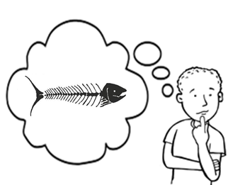
Things that Can Go Wrong!
Disagreements and arguments
Identifying causes that are too broad
Identifying causes the team has no control over
No analysis of the diagram
Using the tool as the end result rather than using it to identify root causes

Slide 25
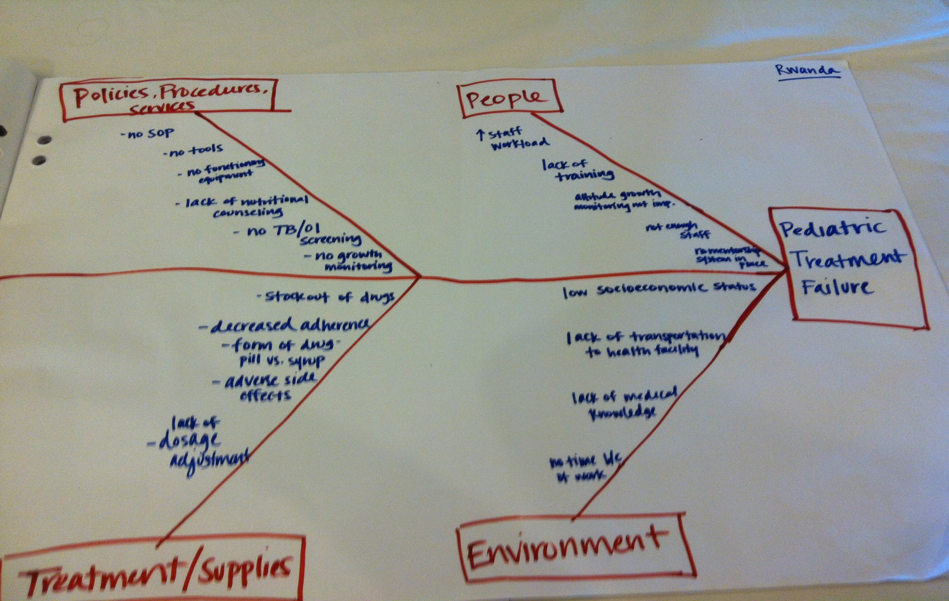
Rwanda Team: Pediatric Treatment Failure
Notes:
This is what your fishbone diagram will look like, Christabel and Irene can take up the teams in Machakos and Mombasa

Slide 26
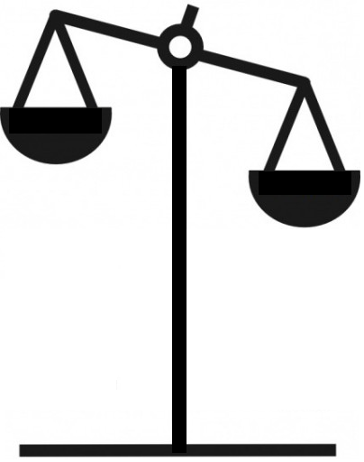
Fishbone Diagram Summary
Strengths
Weaknesses
Because “bones” represent multiple factors, many team members will have knowledge to fee engaged and participate
Cannot be used to define the importance or frequency of a particular issue
As a result, teams will
need to use complementary methods and tools to prioritize problems
Doesn’t always capture all of the issues related to a process or problem
Great brainstorming technique to elicit multiple opinions
Quickly categorizes problems

Slide 27
Group Work
Teams will construct a fishbone diagram of their quality challenge
(60 minutes)

Slide 28
THANK YOU
info@ampathkenya.org | www.ampathkenya.org | @ampathkenya

