Slide 1
PROCESS MAPS
QUALITY IMPROVEMENT TRAINING
TRANS NZOIA
JULY 2022

Slide 2
Learning Objectives
By the end of this session, participants will be able to:
Apply Process Mapping exercise to identify a root causes of poor quality within the healthcare system.

Slide 3
Outline
QI Tool: Process Map
5 Whys Energizer
Group Work

Slide 4
Root Cause Definition
“The most basic cause (or causes) that can reasonably be identified that management has control to fix and, when fixed, will prevent (or significantly reduce the likelihood of) the problem’s recurrence.”
- Paradies (2005)
Notes:
One of the issues we see in QI is that many people have different understanding and interpretation of the concept
B/C health care is part of a complex adaptive system, there will be more then one root cause.
These root causes identify the change solutions that are most appropriate… from simple revisions to entire systems redesign based on the increase level of understanding about the root causes.

Slide 5
Do you agree with this statement?
Process Maps
“If you can’t describe what you are doing as a process, you don’t know what you are doing.”
- W.E. Deming

Slide 6
QI Tool: Process Map
A picture of how a process works-A picture that shows how things get done!
Also called a flow chart
Provides teams with opportunities to learn the different steps in a process where many people are involved
Often, team members do not actually agree on the steps
Identifies root causes: Bottlenecks, duplicative steps, wasteful steps, disagreement about steps, rework due to errors, sources of delays, role confusion…

Slide 7
Process Map Symbols
Ovals
Start & end of process
Rectangular S
Documentation points
Rectangles
Action steps
Clouds
Unclear steps
Arrows
Flow lines
Diamonds
Decision points
Smooth edged rectangles
Delays in a process
Notes:
Important to note: Requires a planned approach May take several meetings to reach agreement about a current process. Teams can initiate the process by determining how detailed they want to go. Teams need to first consider the purpose of why they need the map and therefore can agree on the level of detail. OR- Can start with High Level then move to detail level if needed
Teams may revisit the process map several times during PDSA cycle phases to review current processes again.

Slide 8
TYPES OF PROCESS MAPS
There are several types of process Maps:
Detailed process map
Top-down proces map
High – level proces map
Deplyoment process map (Cross functional)
Notes:
Detailed goes into the minor details, includes decision points
Problems with inefficienceis
High level proces map minor steps excluded, no decission points, team focusses on major steps.
Deployment, includes roles and responsibilities of different staff, useful in processes with handoffs between people and departmnets, reveals unclear responsibilities.,missing info, unshared expectations
Top-down major steps arranged sequentially across the top and detailed steps listed under each major step, no decission point or other steps with inefficineceis, systematic manner to better understand activities involved and their interconnectedness.

Slide 9
TYPES OF PROCESS MAPS
I. (High level process Map)
Immunization process at the health facility

Slide 10
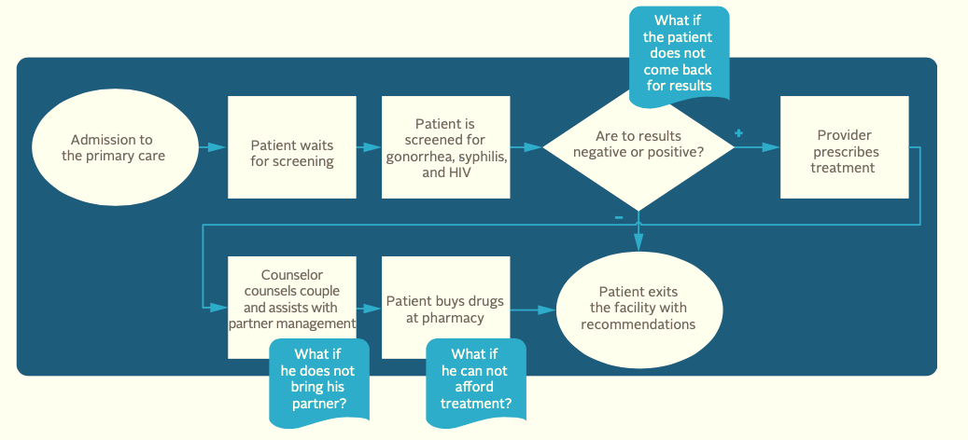
TYPES OF PROCESS MAPS
II. (Detailed process map)
Detailed process of the care provided to a male STI patient source; FHI360 QI handbook

Slide 11
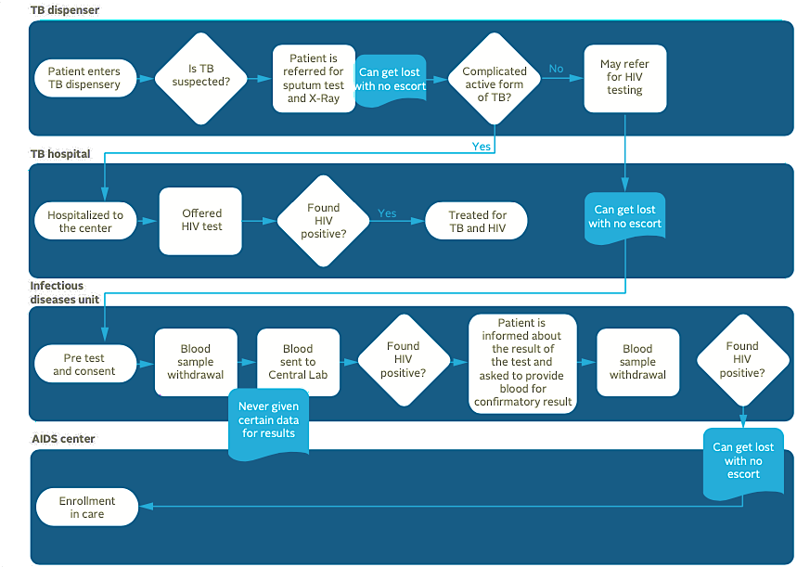
III. (Deployement process Map)
Immunization process at the health facility
Notes:
Patient flow for HIV ocunselling and testing for suspected and confirmed TB patients in gITHUNGURI sUB COUNTY HOSPITAL

Slide 12
(Top-down process Map)
STEP 1
STEP 2
STEP 3
2a
3a
1a
2b
3b
1b
2c
3c
1c
2d
3d
2e

Slide 13
Process Maps: Steps
Identify start and end points
Agree on mapping method and symbols:
Start with steps in the process that’s actually happening
Start with steps in the ideal process, and compare to what’s actually happening
Ask questions to facilitate Process Map development:
What happens next?
Who is responsible?
How long does it take?
Consider each step from a different perspective, like that of the client or consumer

Slide 14
Example: Client Registration Process
Patient arrives at front desk
Start/End
Nurse asks for patient name & searches for his/her file
Decision
Is the patient in the system?
Ask the patient to complete registration
No
Action
Yes
Ask the patient to wait in the waiting area
Notes:
Simple example from HIV Clinic registration process- just to illustrate picture and set up of steps.
Great way to Visually demonstrate COMPLEXITY- Link back to systems thinking
Has a great Patient centered focus by Capturing the reality of the patient experience through all stages
Ultimately, it is ideal to have a ‘simple’ process map, so even for complex issues, teams will strive to simply the processes.
Only map the process you are focused on, not everything in the organization
You want to be able to see the whole end to end process that a patient experiences. Resist trying to just map one departments role in the process.

Slide 15
Example: Delivery Care (Before Improvement)
PPH?
Mother-to-be arrives
Routine care
No
Immediate postpartum care
Yes
Reception & orientation
Discharge procedure
Stabilization?
Delivery care
Evaluation & examination
Discharge
Examination in labor room
Yes
Monitoring of labor
Referral
- Application of Collaborative Improvement in Developing Countries: Practical Orientation Guide
Notes:
Source: Application of Collaborative Improvement in Developing Countries: Practical Orientation Guide
This in an Example: Flowchart of delivery care at a health facility before improvement

Slide 16
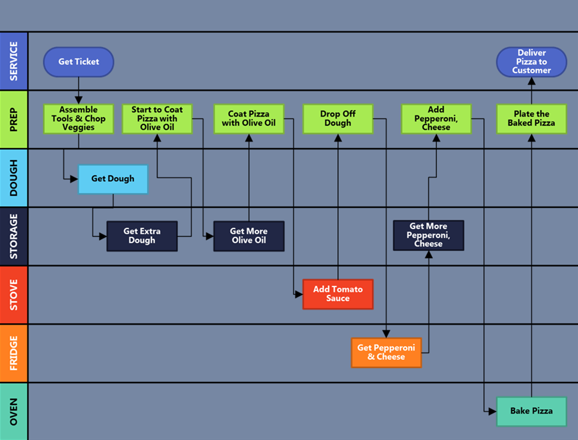
Example: The Pizza Place (Current State)
- North Carolina Center for Public Health Quality
Notes:
Example of a “Cross functional- Swim Lane Map”

Slide 17
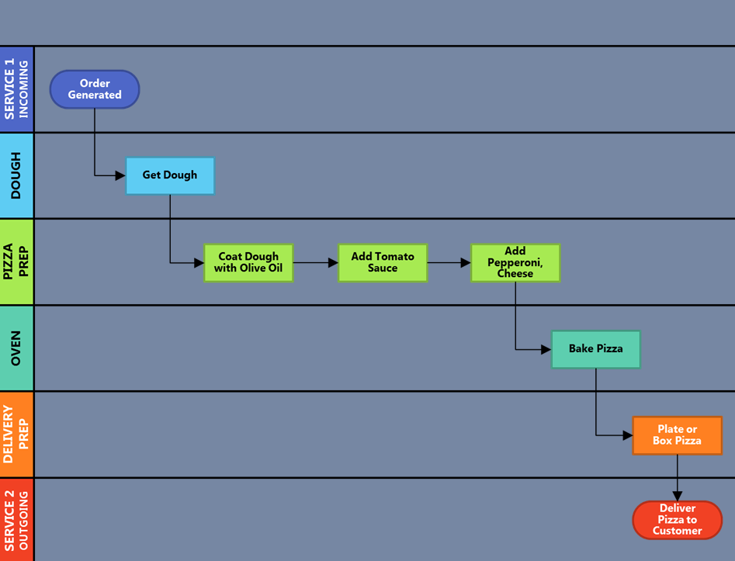
Example: The Pizza Place (Ideal State)
- North Carolina Center for Public Health Quality
Notes:
- Not how they SIMPLIFIED A complex process with too many steps.

Slide 18
Process Map: Analysis
Utilize the Whys Technique
(Why is it done? Why its done this way? By this person? At this place and time?)
Are there any disagreements?
Are there any duplications?
What is the time between steps?
Are the steps in the right order?
Is the right person doing the job?

Slide 19
Example: Infant ART initiation How Would you help the team Analyze this Process?
Follow up again
Nurse receive HIV + result
Initiate on ART
Nurse obtains client file from the storage area
Document on EID Register
Contact info available?
Document on EID Register
Ask caregiver to bring infant immediately to clinic
No
Yes
Yes
Does the care giver bring the infant back to the facility ?
Nurse texts caregiver to notify that client needs to come to clinic immediately
No
Document on EID register
Follow up Call? When?

Slide 20
Process Map Summary
Strengths
Weaknesses
Allows multidisciplinary teams to gain a deep understanding of how
a process actually works
If the right people aren’t engaged from the start, some process steps may be unclear or missed
Facilitates ownership among staff
Great tool to visualize a process
Creates a shared mental model from which to develop change ideas
During meetings, some team members may get stuck on mapping the ideal process rather than the actual process
The process may need to be repeated multiple times

Slide 21
Group Work
Teams will construct a process map from the case study on QI reference guide..
(60 minutes)

Slide 22
THANK YOU
info@ampathkenya.org | www.ampathkenya.org | @ampathkenya

