Slide 1
Developing Solutions

Slide 2
Learning Objectives
By the end of this session, participants will be able to:
Discuss methods to develop and classify change ideas
Discuss the utility of driver diagrams as QI tools to systematically identify change ideas to address quality challenges
Define the primary and secondary drivers as they relate to quality challenges
Apply the driver diagram to quality challenges
Explain the “HOW” of change interventions
Draft a list of change interventions based on the root cause analysis exercises yesterday
Notes:
-Who has worked with driver diagrams?
Discuss the utility of driver diagrams as a QI tool to systematically identify interventions (“change ideas”) to address quality challenges;
Define primary and secondary drivers as they relate to quality challenges;
Apply the driver diagram to quality challenges in order to analyze systems, generate change ideas, and develop measurement plans.

Slide 3
Outline
Description and Purpose of Driver Diagrams
Driver Diagrams and the Model for Improvement
Developing a Driver Diagram
Primary and Secondary Drivers
Generating Change Ideas
The “HOW” of change ideas
Group Work
Notes:
Questions after change ideas

Slide 4
“Not all changes lead to improvement, but all improvement requires change”
So, what kinds of changes will lead to improvement?
- Langley et al. (2009) The Improvement Guide: A Practical Approach to Enhancing Organizational Performance
Notes:
-

Slide 5
Driver Diagrams
Help to answer the question,
What change can we make that will lead to improvement?
Outlines your “Theory of Change” Conceptualize a quality issue and generate change ideas linked to root causes
Explore systems and process mechanisms through primary and secondary drivers
Generate theories and hypotheses about change initiatives that can lead to improvement aim
Notes:
Driver Diagrams are a tool designed to answer that question.
The driver diagram is a useful tool for Gaining knowledge about improvement. Aids in establishing consensus in change initiatives.
Serves an excellent communication tool for the team approach, leadership commitment. Helps teams focus and communicate thoughts
Another example of a QI tool that can be applied in almost any environment for any level of the health system
Action Oriented tool!

Slide 6
Driver Diagrams: Purpose
Strategic planning and analysis tool that is updated systematically throughout an entire project
Breaks down an aim into the drivers that contribute and the detailed actions that could be done to achieve the aim
Helps to focus on the cause and effect relationships that exist in complicated systems
Provides a pathway for change which identifies the types of interventions that can bring about the desired outcome
Notes:
Some more points about the purpose

Slide 7
Driver Diagrams
Logically links change ideas to drivers
Often used with Fishbone Diagrams and Process Maps as part of the participatory improvement process to utilize the list of identified causes and organize them into drivers and action steps that will lead to improvement aim
Notes:
Other tools like Driver diagram is called a Theory of change map.
Who can recall or describe a type three

Slide 8
Driver Diagrams
Where possible, driver diagrams should be measurable and SMART
Can serve as both a change and measurement framework for tracking progress towards aim
There is no right or wrong driver diagram, diagrams represent the team’s shared mental model
Diagrams are living documents and will adapt as change ideas are tested and results measured through PDSA cycles.
Notes:
Some key concepts to understand about driver diagrams
It is also entirely possible for two teams to construct their driver diagrams differently. This is fine as the driver diagrams are shaped by the language we use and our thought processes in creating them.

Slide 9
Driver Diagrams: Main Components
Aim Statement
Primary Drivers: System factors, processes, structures and influences that directly link to aim
Secondary Drivers: Situation-specific factors that can form the basis for specific interventions
Change Ideas
Measurement- Indicators
Notes:
Relationship arrows show the connection between drivers and the aim and change ideas.
Relationship arrows also Demonstrate the causal relationship

Slide 10
Developing a Driver Diagram
Team approach: Gather key stakeholders
Start with the improvement aim
Brainstorm: What main factors influence the aim?
Where? What? When? Who? Why?
Group drivers into primary or secondary
Generate change ideas related to the drivers
Link the drivers and change ideas with arrows
Include indicators and measurements
Notes:
Identifying primary and secondary drivers is always an iterative process
Driver diagrams are “live’ tools that change over time as you make changes to your system

Slide 11
Example: Reduction of maternal Morbidity from Obstetric - Hemorrhage
Interventions/Changes
Primary Drivers
Secondary Drivers
Have emergency supplies and medication readily available at hemorrhage carts or kits
Aim
standardized care delivery systems
Readiness for obstetric emergencies
Keep hemorrhage kit always at the medication station
Develop a protocol for responses to hemorrhage using evidence based examples
Decrease severe maternal morbidity from Obstetric Hemorrhage by 40% in 6 months
standardized early warning systems to identify risk patients
Utilize equipment that can identify and quantify blood loss-drapes with calibrated collection systems
Recognition of obstetric emergencies
Implement a tool that uses evidence-based triggers for diagnosis and treatment OHH
Place copies of hemorrhage protocols in prominent places in each patient room
Responses to obstetric emergency
standardized protocols for obstetric emergencies
Conduct drills regularly with physicians and nurses to simulate emergencies

Slide 12
Primary Drivers
High-level factors that directly influence aim
Can form the basis for outcome indicators
Examples can include the major categories in a fishbone diagram:
6 M’s
Manpower, Machines, Management, Measurement, Methods & Materials
8 P’s
Price, Promotion, People, Process, Place, Policy, Procedure & Product
4 S’s
Surroundings, Suppliers, Systems & Skills
Notes:
Other examples can include:
Often primary drivers are easier to identify especially in a system that is well known.

Slide 13
Secondary Drivers
Lower-level, more actionable drivers
Drivers that can form the basis for specific interventions
Situation-specific causes or factors that are related to the primary driver
Measurable components are usually process indicators

Slide 14
Is My Set of Primary and Secondary Drivers Complete?
Completing Driver Lists
To determine if the driver lists are complete, ask:
If I could influence or improve all these drivers, is there anything else that could go wrong and prevent me from achieving my aim?
Notes:
When you are finished with the steps In constructing a driver diagram.
Review with the team to determine if its complete.

Slide 15
Is This a Primary or Secondary Driver?
Determining Driver Category
To differentiate between drivers, ask:
If I made an improvement in this driver what would it achieve?
If the answer closely describes the improvement aim, it is most likely a primary driver
If the driver is very closely linked with a specific intervention, it is likely a secondary driver
Notes:
It is very common to wonder and debate: is this a primary or secondary driver?
Use this guiding question to help teams feel more confident with their categorizations.
When identifying drivers or testing them for completeness do not get too hung up on finding every driver or determining if it is a primary or secondary driver. T
he purpose here is to help you identify improvement opportunities and be able to show a clear, defensible logic for how your improvement projects contribute to achieving your main aim or goal.

Slide 16
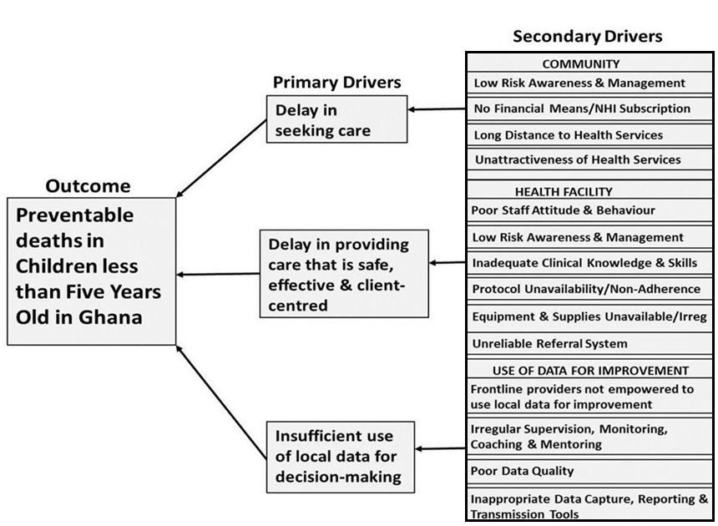
Example: Preventable Child Deaths in Ghana
- Twum-Danso, et al., 2012, International Journal for Quality in Health Care
Notes:
How can we use this tool for national level?
Lets review another example here for a Driver diagram of preventable child deaths in Ghana for the National Level
3. Read Quote From the Article: “We used a ‘driver diagram’ to anchor the development of the change ideas to be tested, adapted or implemented in the project. We assembled the primary drivers––the underlying causes of under-five mortality––in the rural Ghanaian context, each of which became a focal point for the development of change ideas to be tested. This driver diagram was initially based on the available published data and the findings of the contextual assessment conducted in Phase 0. It underwent significant iterative changes during subsequent phases of the project, as the QI teams verified the relevance of the drivers and the associated change ideas”
-Article in Binder from Phase One
A Nationwide Quality Improvement Project to Accelerate Ghana’s Progress Toward Millennium Development Goal Four: Design and implementation
-In this article they also have list of changes that were tested and adapted-

Slide 17
Example: Notification of STI Test Results
Primary Drivers
Change Ideas
Aim
Ability to contact
Ask for cell number
Ask for alternate number
Get e-mail address
Increase the percent of women with an STI who are notified of their test results within seven days
Systematic approach to follow-up
Algorithm
Assigned person to follow-up
Alter time of day that calls are made
Dedicated phone number
Give NPs a cell phone for patients to call
Patient-provider communication
Modify EMR home going info “You had STI Testing”
Card with info regarding what happened & what to expect
Adolescent behavior
Encourage teens to give a confidential number
Encourage teens to call for results
Primary Drivers

Slide 19
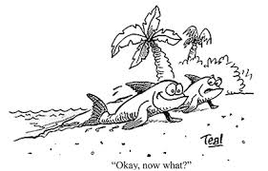
Generating Change Ideas
“It is not the strongest of the species that survive, nor the most intelligent, but the ones most responsive to change.”
- Charles Darwin

Slide 20
How to you create Change Ideas?
Literature reviews and evidence base
Professional networks and associations
Stealing, borrowing and collaborations
Review of failed ideas
Creative brainstorming methods
Other suggestions?
Notes:
Explore ‘best practices’ for team utilizing different methods to generate possible change ideas to select and prioritize.

Slide 21
Facility Level Change Ideas
Eliminate redundant steps
Minimize handoffs
Use multiple reminders, job aids, checklists
Move steps in the process closer together
Create closed-loop communication
Remove bottlenecks
Do tasks in parallel, use “coordinators”
Increase access to information
Use cross-training and optimize supportive supervision and mentoring
Notes:
This are examples that the QIC sites can do and will list by the end of this session!

Slide 22
Change Ideas: Examples to borrow!
Redesign processes
Update and standardized treatment guidelines
Reorganize staff and supervision
New technology
New guidelines adoption
Engage clients and communities
Notes:
This are examples that they cant control but may be responsible for implementation at their site

Slide 23
Change Ideas: Examples to Borrow!
Task-shifting and sharing
Prioritizing funding based on need
Linking payments and performance, for example performance-based financing
Notes:
This are examples that they cant control but may be responsible for implementation at their site

Slide 24
Change Idea Selection for Today
QI teams will use Fishbone diagrams and Process maps to develop change ideas from the Root Causes that were identified.

Slide 25
How do you make your tea?

Slide 26
The Importance of How
The initiative “I made a cup of black tea”
Only describes what was done not how it was done
PDSA Cycles help teams to clearly articulate the HOW of change ideas
This helps teams to learn how to work smarter not harder
Use the 5 How’s when designing your change ideas

Slide 27
Common Examples that teams need to know- How???

Slide 28
Documenting the How
Why is documenting the ‘how’ important?
Include enough detail that an outsider, who is unfamiliar with improvement methods, would be able to visualize and understand how the improvement activity was executed

Slide 29
Group Work
Teams will work together for 60 minutes to develop a list of change interventions (at least 10) using their fishbone diagrams and process maps
Notes:
DO NOT PRINT

Slide 30
Driver diagram for a new healthier me!
Aim
Primary drivers
Secondary drivers
Tests of change
Track calories
Limit daily intake
CALORIES
IN
Plan meals
Substitute low
calorie
Limit alcohol
Drink water not coke
A NEW
HEALTHIER
ME!!
Gym 5 x per week
Exercise
CALORIES
OUT
Cycle to work
Fidgeting
Chi balls

Slide 31
THANK YOU
info@ampathkenya.org | www.ampathkenya.org | @ampathkenya

