Slide 1
Performance Measurement Principles of QI – Focus on Data:
Quality Improvement Training
Bunyala Sub county
March 2021

Slide 2
LEARNING OBJECTIVES
By the end of this session, participants will be able to:
Link measurement and Aim statements and drivers
Compare and contrast process, outcome and balancing indicators
Explain the importance of measuring quality of care and usefulness of data
Explain the methods to measuring quality
Define indicators and mention their characteristics

Slide 3
Principles of QI
Systems approach to management
Process orientation
Total Quality Management
Leadership
Customer Orientation and Stakeholder involvement
This session will focus on methods to make evidence based decisions as one of the core principles of QI.
Measurement of data allows us to quantify the current level of compliance with expected standards and guidelines of care as well as client needs and expectations...
… and monitor whether quality improvement resulted from the change intervention
Continuous Quality Improvement
Evidence Based Decision Making

Slide 4
What ‘IS’ and ‘SHOULD’ be the situation at the facility
Notes:
Measurement is useful in quality
improvement efforts in order to:
Identify and analyze problems
Verify possible causes of problems
Monitor change to ensure improvement is maintained over time
Make decision based upon fact, not opinion

Slide 5
Performance measurement is a culture shift
From
“These measures are draining valuable resources and are a data burden”
“I can’t measure my outcomes I can only measure activities”
“I need these measures because my employees feel it is important”
“You can’t measure my program.”
To
We are committed to tracking measures that matter most.
We are accountable for delivering our outputs and our intermediate outcomes.
We are responsible for our end outcomes.

Slide 6
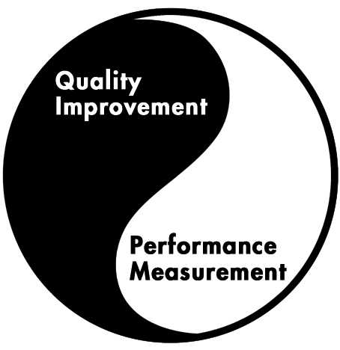
Balance between Performance Measurement and Quality Improvement Activities
Quality Management Program

Slide 7
SOURCES OF DATA FOR MEASURING QUALITY
Various tools can be used to measure structures, processes and outcomes.
Sources of data are shown on the next slide.

Slide 8
Reference: KHQIF Chapter 3- Performance Measurement, Table 3.2
Activity (grouped) | Source | Method of collection | Review Period | Level of Data Use
Facility QI Organizational Assessment | Facility staff | Interview/FGD using OA checklist | Annually | Facility, County and National
County/ National QI Organizational Assessment | County/ National Staff | Interview/FGD using OA checklist | Annually | County, National
Staff feedback | Facility staff | Staff meetings, | Monthly | Facility
 |  | Staff survey (anonymous) | Annually | Facility
Client/ consumer/ community feedback | Clients | Focus group discussions during clinic visits | Ongoing | Facility
 | Community | Community Meetings | Varies | Facility
 | Clients | Support group discussions | Ongoing | Facility
 | Clients | Exit interviews | Every 6 months | Facility
 | Clients/ community | Suggestion boxes | Ongoing | Facility
Routine reports/ HIS data, including routine cohort analysis (ART, HEI/HCA, EWI) | Registers, reports-DHIS | Daily/routine facility documentation of services | Varies – daily, monthly, quarterly, annually | Facility, County, and National
File Reviews | Patient files, EMR database | Chart abstraction for predefined sample (95%CI) or All eligible clients for facilities with EMR systems | 6 Monthly | Facility, County, National
Notes:
Examples of performance measurement/data sources.

Slide 9
Quality Dimensions | Data/types for identifying, prioritizing, and measuring change in QI projects
Safety | Adverse events and incidents (Side effects and Toxicity) Sentinel Events ( Early Warning Indicators) Benchmarking against other services/departments
Accessibility | Service utilization Client Feedback (e.g. client focus groups, exit surveys) Waiting times
Effectiveness | Clinical indicators, medical file reviews Morbidity and mortality meetings/reports
Efficiency | Finance/Expenditure data Audits of equipment/resource usage Waiting times
Acceptability/ patient-centeredness | Service utilization data Client Feedback
Equity | Clinical indicators, medical file reviews Service utilization data and service mapping

Slide 10
DEFINITION OF INDICATORS
Indicators are quantitative measures used to monitor and evaluate the quality of important governance, management, clinical, and support functions that affect patient outcomes.

Slide 11
Indicators
Indicators are used to track progress and evaluate change initiatives towards meeting an aim or objective.
Answers the question:
How will we know if a change leads to an improvement?
Primary purpose for measurement in QI is for learning
Notes:
I reiterate that measurements are done to find out if progress is being made towards the aim. Indicators are devised that allow teams to recognize whether the change/intervention is leading to an improvement.
The PRIMARY purpose of measure for Quality Improvement: is for LEARNING
NOT comparison or judgment or accountability…
QI teams need to measures to give them feedback that the changes they are making are having the desired impact.
Keep in mind QI has a different approach or goal for data collection or analysis from other activities such as program monitoring and research

Slide 12
COMPONENTS OF INDICATORS
A numerator
The part of a common fraction appearing above the line, representing the number of parts of the whole that are being considered
A denominator
The number below the line in a simple fraction, which indicates the number of parts making up the whole
Time over which the event may take place

Slide 13
CHARACTERISTICS OF INDICATORS
S – Specific
M – Measurable
A – Achievable
R – Realistic
T – Time bound

Slide 14
Selecting Appropriate Indicators
Skilled QI practitioners are able to:
Determine the appropriate balance of indicators
Identify a reasonable number of indicators
Select the appropriate type of indicators
Ensure that indicators are robust
Notes:
The rest of this part of the session will focus on these four domains

Slide 15
Ensuring Robust Indicators
In addition to being SMART, robust indicators:
Are precise
Are consistent over time
Use realistic time frames
Are valid
Are reliable

Slide 16
Robust Indicators Are Precise
Use clear, well-defined language and terms
Are not open to interpretation
Which indicator is more precise?
Number of people who seek testing
Number of women, ages to 15-49, who reside in the district and present to the clinic for testing in the first two quarters of 2013
Notes:
Precise, clear, well-defined language and terms:
In addition to being specific (concrete, detailed, and well defined so that you know where you are going and what to expect when you arrive) as in SMART, it is very important that the language and terms used when writing out an indicator are not vague and clearly state what is being measured.
Indicators that do not use clear and precise language are open to interpretation and will affect the quality of data collected.
People will measure their interpretation of what the indicator assesses and there will most probably be variation in interpretation and understanding, leading to variation and inconsistency in measurement.

Slide 17
Robust Indicators Are Consistent
Dropping or modifying indicators during a project weakens the measurement process
For example:
Consider an indicator such as the percent of women adequately linked to services
If the definition of “adequately linked” changes from “linked to 3 of 5 services” in year 1 to “linked to 5 of 10 services” in year 3, performance may appear to weaken, even if women are referred to more services over time
Notes:
Consistent over time: The way an indicator is defined, for the purposes of data collection and measurement, should be the same throughout quality and quality improvement efforts.
It is unfortunately not unusual for indicators to be modified or dropped as a project evolves, however, this means that the substance of what is collected might change over time. This makes it difficult to take the same measurement over time and to correctly assess how and if progress towards an aim is being made.
Consider the following indicator:
For example, an indicator that is defined as:
Percent of women ages 15-49 who are adequately linked to services might be defined as a checklist of three out of seven services that health workers must provide to women ages 15-49.
However, what happens if the checklist is changed?
The same indicator might later be re-defined using a checklist of five out of seven services that health workers must provide to women.
Since it might theoretically be harder to provide people with five services instead of three, data may later show that fewer women are being adequately linked to services.
Reviewing the indicator measurements without keeping the changed definition of the indicator in mind might lead one to think that the quality of services and care have fallen, whereas the actual reason might be that the changed definition (five services instead of three) might be telling a different story about the quality of care, the range of services available to women or the more comprehensive care that might be provided due to linkages being made to five instead of three services.

Slide 18
Robust Indicators Use Realistic Time Frames
Match the time frame to the intervention
Assessing the number of health workers trained to provide PMTCT will take less time than assessing CTX coverage of HIV-exposed infants
If a program takes 9 months to launch, measuring outcomes at month 12 may underestimate its impact
If an intervention is rolled out to facilities at different times, measuring an indicator in the same month at each site will tell the wrong story
Notes:
Realistic time frame: Indicators are time-bound as they meet the criteria laid out in the SMART acronym.
As indicators are tied to the aims, the length of time allotted to meeting the aim should reflect the complexity of the project.
Some aims can be attained in a year while others might require several years.
The indicators delineate the various efforts that must be made to meet the aim– some can be short term (such as training a certain number of people by the end of the year) and others might be long term (such as reducing disease incidence within the target population).
It is important to ensure that the indicators reflect reasonable time frames as expecting to see change over a time period that is unrealistic may make the project look ineffective (whereas measuring the same indicator over a different time period may show improved results).

Slide 19
Robust Indicators Are Valid
Validity is the extent to which an indicator actually measures what it is intended to measure
Notes:
Some indicators measure complex concepts, such as “improved quality of care”, “strengthened referral systems” and so forth.
It is difficult to measure such concepts correctly (validity of the indicator):
Improving validity: To have indicators that fully measure a concept, it is important to make sure that all possible dimensions and meanings of a concept are reflected in the indicator definition and actual measurement.
For example, to measure “improved quality of care”, the different meanings and dimensions of care must be captured.
This might mean looking at not only whether patients are linked to all relevant services but also examining the quality of their interactions with health workers (do the health workers explain things well to patients, do patients feel they are treated respectfully by health workers etc).
Thus, the indicator measuring “improved quality of care” might actually consist of a series of indicators/measurements that examine the length of health worker-patient interactions, topics and issues discussed and covered, range of services offered, number of services taken up by patient etc

Slide 20
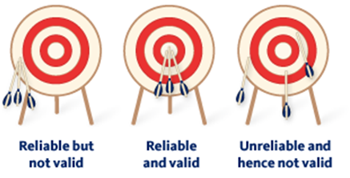
Robust Indicators are Reliable
Reliability is the extent to which an indicator measures the same thing in the same way every time it is used
Notes:
To have indicators that measure a concept in the same way over time, by different people etc., it is best to:
have indicators that assess and examine the relationship between two indicators that measure different meanings of a concept.
For example, in the case of “improved quality of care”, you can measure patient perception of how they are treated by health workers and patient uptake of services they are referred to.
Measuring different aspects of the concept an indicator assesses makes it possible to determine to what extent different aspects of a concept are related/affect each other.
Ask the same question in different ways so as to check the consistency of responses.
Collect data at different times and check how consistent responses are.

Slide 21
The Logic Model Approach
Inputs | Activities | Outputs | Outcomes | Impact
Resources and Contributions | Work Conducted | Products & Services Delivered | Changes in Individuals, Groups or Communities
Input
Impact
Outcome
Output
Activity
Notes:
Select indicators along the pathway from inputs to activities to outputs to outcomes…

Slide 22
Types of Indicators
INPUT
Human and financial resources
Development of training materials
PROCESS
Conduct one PMTCT training workshop in each district for providers
OUTPUT
Providers trained in updated PMTCT service provision
OUTCOME
Increased use of PMTCT services
IMPACT
Reduced perinatal transmission of HIV
Indicator: percent of infants HIV+ born to HIV+ women
Indicator: # of staff working in facility
Indicator: # of trainings conducted
Indicator: # of providers who have completed clinical training
Indicator: percent of HIV+ women receiving a complete course of ARV prophylaxis
Indicator: % of pregnant women who are HIV tested
Notes:
Speaker Notes
This example demonstrates how indicators are related to logic models.

Slide 23
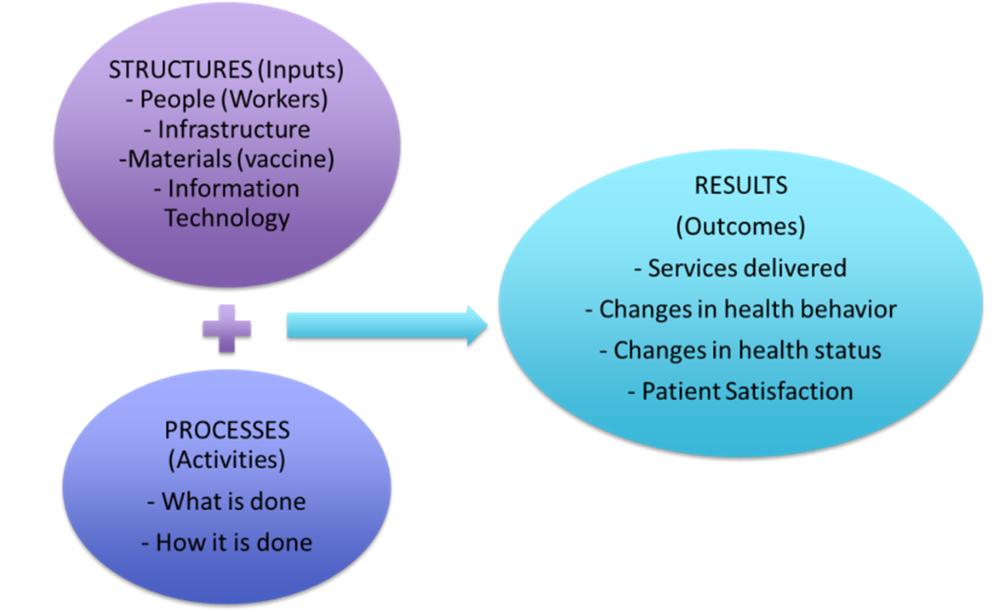
Donabedian Model
Quality of care can be measured on the basis of the following four aspects based on the Donabedian Model
Structure
Process
(Output)**
Outcome
**the Donabedian model mainly refers to structure, process and outcome.

Slide 24
QI Approach: Indicators
Process Indicators
Balancing Indicators
Outcome Indicators
Structure indicators
Notes:
Therefore we identify a family of measures, process outcome and balancing indicators. These are designed to capture the functioning of the CAS in which QI I being implemented.
No single measure will suffice.
Health care systems are very complex- Health care processes are all so interrelated
These Represent the different dimensions of a systems performance.
Any single measure used at the sole means of determining improvement is inadequate
When working to improve a system, multiple measures are usually necessary to better evaluate the impact of our initiatives on the many facets of a system.
QI activities are conducted in a dynamic rather then static population-

Slide 25
Outcome Indicators
Outcome indicators examine how
a project affects individuals, populations
or systems
They describe how a program influences health and/or health systems
Examples include:
Surgical site infection rates
Outbreak investigations
Percent of HCWs demonstrating competency in IPC skills
TB treatment success rates
Notes:
QA indicators The outcome indicator is closely related to the aim statement. Here are some examples
Outcome indicators examine how a project affects individuals, populations or systems

Slide 26
Outcome Indicators for Improvement Measurement
How is the system performing? What is the result?
Patient and staff satisfaction with the system
Notes:
QI Here are some additional examples. Note that these all relate to one of the six quality dimensions of the IOM
Cost: Charges, staff hours, materials
Patient Satisfaction: complaints and surveyThe voice of the client

Slide 27
Process Indicators
Process indicators for traditional public health programming can describe program implementation activities.
Examples include:
Number of HCW’s trained
Number of supportive supervision visits
Number of functional wash bins
Number of sharps boxes available
Number of IPC staff trained per nursing shift
Notes:
Self explanatory
This type of measurement is more about measuring for accountability and judgment.
-Volume and number of patients
Timeliness
Time between stock outs

Slide 28
Process Indicators for Improvement Measurement
Examine how health care services are provided and how a process is working, answer the question:
Are the parts or steps in a system working as planned?
Examples include:
Percent of hand washing compliance
Percent of vital sign measurement compliance
Percent of wound care compliance
Percent prophylactic antibiotic administration pre-surgery
Notes:
Remember that the process indicators are measures that show that progress is being made towards the aim. Here are some examples
Process measures for QI are logically connected to the outcome measure and ideally start to show improvement before the outcome indicator.
Sometimes called performance indicators

Slide 29
Balancing Indicators
Used to detect potential negative or unintended consequences of a change initiative
QI tools can help identify possible negative consequences of change ideas
Balancing indicators can help determine if these negative consequences are happening
Notes:
We want to be sure that improvement in one part of the CAS does not cause deterioration in another part.
These measures help to track and detect such possibilities.
Here is this previously seen illustration.
Staff satisfaction: surveys, absenteeism, turnover
Cost,
Accuracy
Increased mistakes

Slide 30
Example: Balancing Indicators
QI project designed to increase utilization of services may want to monitor service quality and/or patient satisfaction
Balancing indicators:
Average clinic wait time
Frequency of stock outs
Percent of patients correctly initiated on TB treatment
Patient satisfaction surveys
Notes:
In essence we want to review all collected indicators to be sure that the others have not deteriorated

Slide 31
Example: Balancing Indicators
QI Project aim statement: Improve retention rates in TB clinic by 10%
Balancing indicators:
TB clinic wait time
TB drug stock outs
HR shortages due to work overload

Slide 32
Balancing Indicators: Examples
QI Project aim statement: Increase injection safety compliance
Balancing indicators:
Needle stock outs
Sharps container overfill and stock outs

Slide 33
Group Work
Teams will work together to develop a “Family of Indicators” with one or two:
Structure indicators
Outcome indicators
Process indicators
Balancing indicators
Notes:
Participants are not restricted to existing data sources but can, if they want, create “in a perfect world” indicators even if it is data they currently have no mechanism to collect.

Slide 34
THANK YOU
info@ampathkenya.org | www.ampathkenya.org | @ampathkenya

