Slide 1
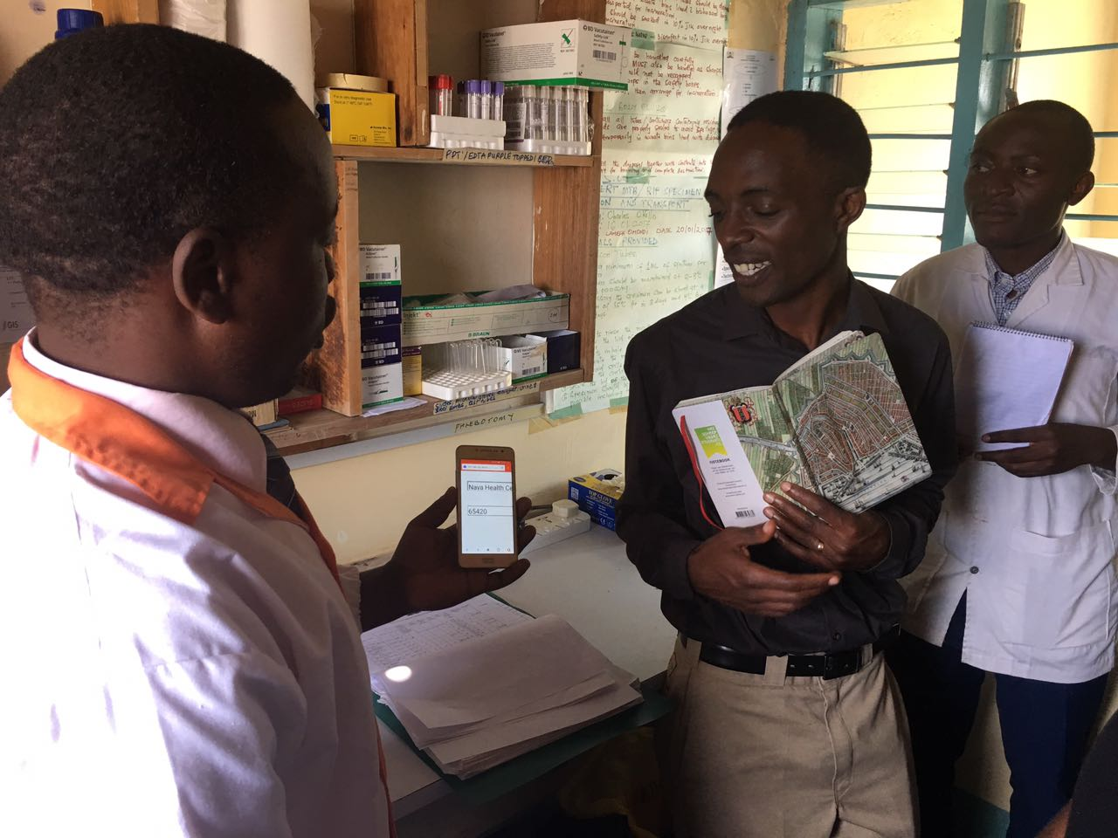
QI M&E Framework
Quality Improvement Training
Trans Nzoia County
June 2022

Slide 2
LEARNING OBJECTIVES
How to monitor QI activities within an HF/Sub county
Learn how teams carry out QI meetings
Learn about QI coaching and mentorship

Slide 3
Monitoring of QI activities
A good M&E framework is essential in QI monitoring at a higher level.
Monitoring includes:
QI structures
QI teams Functionality
QI activities outcomes

Slide 4
QI Structures
QI Team in place -with clear defined roles.
QI charter in place
Structured meeting schedule for the team
QI File – QI tools and materials
Scoring metric (Yes/No/Partial)
Yes – 2 point
Partial – 1 point
No – 0 point

Slide 5
QI Team Functionality
QI meeting minutes filed
QI project AIM and objectives understood by team.
QI tools in use, evident from the QI file.
Run charts showing tracking of QI activity.
PDSA cycles documented on the PDSA sheets.
Scoring metric (Yes/No/Partial)
Yes – 2 point
Partial – 1 point
No – 0 point

Slide 6
QI project outcomes
This is specific to the HF QI project e.g.
Teams working on MCH indicators can track;
No. of skilled deliveries
Proportion of 4th ANC delivering at HF
No. of 1st ANC visits
No of pregnant women getting ANC profiles done
Scoring metric
Doesn’t require one
Dependent of the HF goal
Run charts and facility data can reflect this

Slide 7
QI meetings
Who uses: | WIT/QIT
When | Every meeting (at least monthly)
Purpose: | Assist team in running meeting and documenting minutes
Reported upward? | No, but should be kept in WIT files and reviewed by QIT/quality coaches.
Scheduled (Dependent on project)
Fortnight
Monthly
Weekly
Agenda sent ahead of time
Shared responsibilities
Meeting minutes

Slide 8
THANK YOU
info@ampathkenya.org | www.ampathkenya.org | @ampathkenya

