Slide 1
Accelerating Improvements in healthcare
Quality Improvement Training
Trans Nzoia County
July 2022

Slide 2
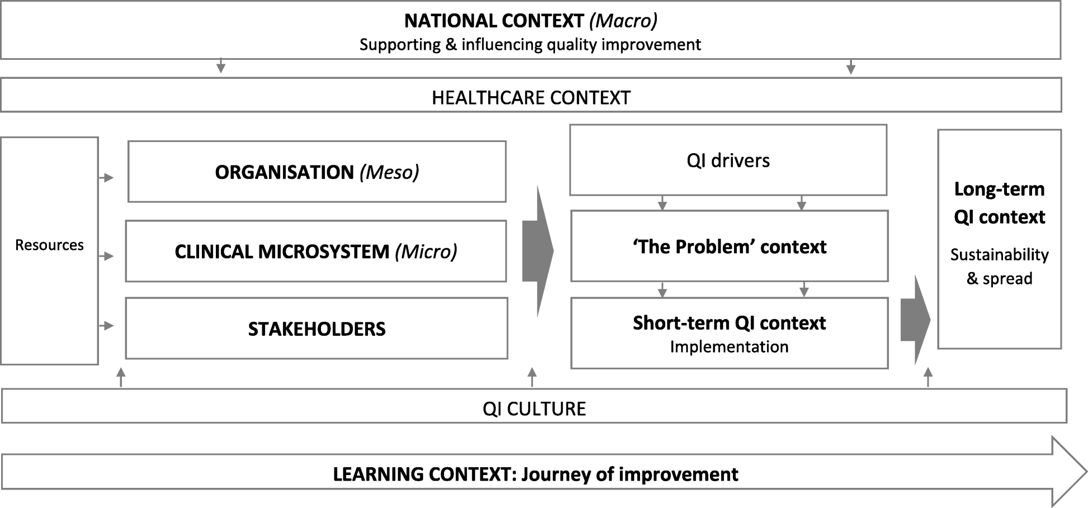

Slide 3
How do we accelerate Improvements in healthcare?
Leadership and management to ensure support and advocacy, with key components including:
  Setting up appropriate governance and management mechanisms;
  Development of accountability agreements, where multiple collaborating partners and organizations are involved;
  Development of performance agreements, including the use of sanctions for breaching processes and procedures; and
  Provision of sustained support to participating organizations.

Slide 4
How do we accelerate Improvements in healthcare?
II. Widespread stakeholder involvement, including key and front-line staff, most often in the context of developing structures, guidelines and indicators in order to secure ‘buy-in’ from participating staff, in particular physicians, Clinicians, Nurses and organizations.
III. Dedicated and continuing resources in the form of:
    A design and implementation team to guide implementation;
    Allocation of funding to strengthen capabilities and readiness (although this isn’t always seen as a key factor that facilitates implementation);
    Sufficient time to enable organizations and services to learn to work in new ways; and
    Strategic investment in staff and capacity-building.

Slide 5
How do we accelerate Improvements in healthcare?
IV. Adaptation to local context by building on local relationships and local capacity, thereby allowing a focus on what is relevant and what works locally. Wider spread of innovative ideas beyond the local area will likely require some modification to enable take up. For this to be successful requires building strong foundations of political support at the different tiers of the system and, likely, adapting funding models.

Slide 6
How do we accelerate Improvements in healthcare?
V. Ongoing monitoring and feedback through the systematic collection of data to assess performance and identify opportunities for improving access, quality, efficiency and patient experience. Monitoring may also include efforts to identify problems to be fed back to participating organizations. Lack of strategic investment into effective communication may lead to suboptimal implementation, and, possibly, performance of the service innovation.
VI. Demonstration of effect through systematic and ongoing evaluation in terms of processes and outcomes as well as utilization and cost. Evidence of effectiveness was vital for the wider diffusion and dissemination of successful initiatives.

Slide 7
How do we accelerate Improvements in healthcare?
leadership and management at different tiers that are supportive of and committed to change, including the articulation of a clear and compelling vision;
Early and widespread stakeholder involvement, including staff and service users;
Dedicated and ongoing resources, including funding, staff, infrastructure and time;
Effective communication across the organization(and, where relevant, between organizations);
adaptation of the innovation to the local context and integration with existing programmes and policies;
ongoing monitoring and timely feedback about progress; and
evaluation and demonstration of (cost-)effectiveness of the innovation being introduced, including assessment of health benefits.

Slide 8
HOW CAN WE ACCELERATE QI IN POUR HF/CONTEXT?

Slide 9
THANK YOU
info@ampathkenya.org | www.ampathkenya.org | @ampathkenya

