Slide 1
Diabetes type 2
Kacheliba
November 2023

Slide 2
November 14th is the WHO World Diabetes Day

Slide 3
In Africa: Tropical diseases dicrease - NCD increase

Slide 4
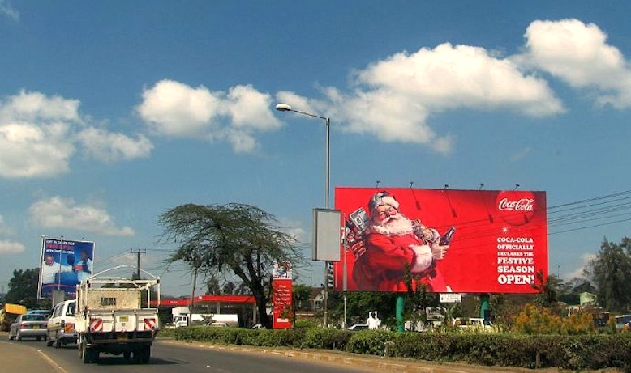

Slide 5
Symtoms of diabetes
Type 1 Quick onset
Type 2 Slowly, sometimes no signs

Slide 6
Lab for diagnose
Blood sugar
Urine sugar
HbA1c

Slide 7
HbA1c
HbA1c is your average blood glucose (sugar) levels for the last two to three months. If you have diabetes, an ideal HbA1c level is 48mmol/mol (6.5%) or below. If you're at risk of developing type 2 diabetes, your target HbA1c level should be below 42mmol/mol (6%).

Slide 9
Treatment
Food
Fysical activity
Treat HTN, dyslipidemia
Check for complications: Eyes, kidneys, feet
Drugs: Metformin
Glibenclamid
Insulin
Many new drugs coming!

Slide 10
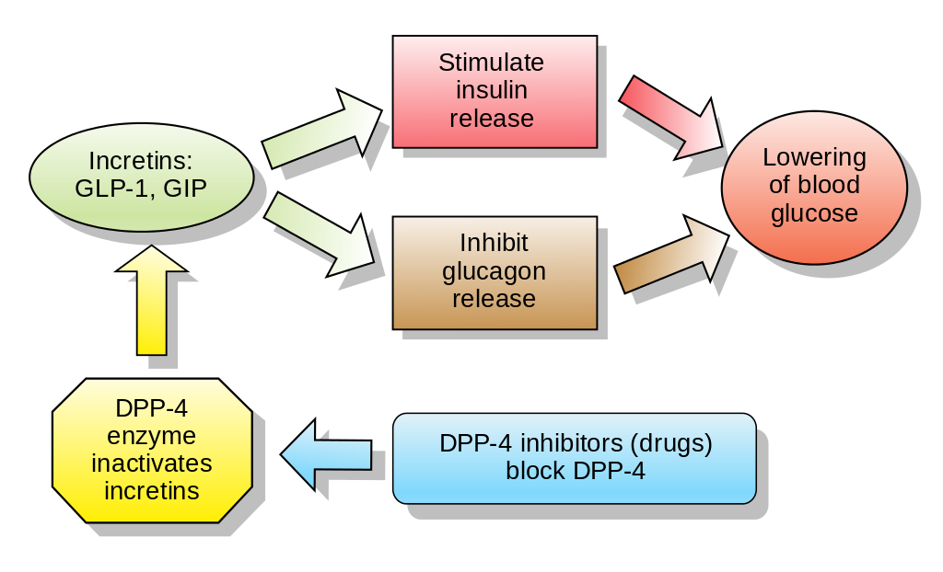

Slide 11
