Slide 1
EXAMINATION OF A newborn + APGAR SCORE

Slide 2
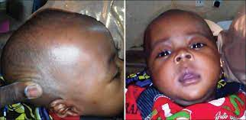
Head to Toe examination
FONTANELLE- bulging? Sunken?
HEAD- shape, symmetry

Slide 3
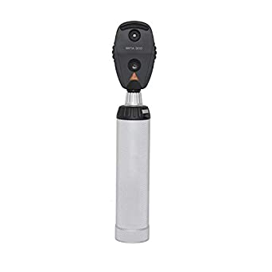
HEAD TO TOE EXAMINATION
EYES- symmetric pupils? Normal reflex?

Slide 4
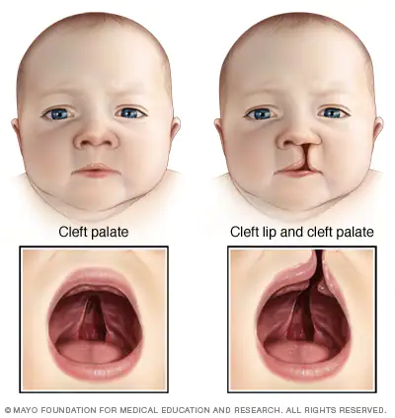
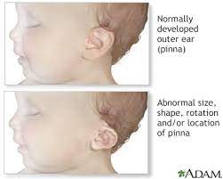
HEAD TO TOE EXAMINATION
PALATE-palpate- cleft palate?
EARS- present? Abnormalities

Slide 5
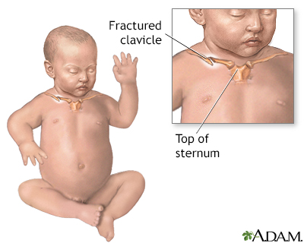
HEAD TO TOE EXAMINATION
CLAVICLES- palpate- defect?
HEART- murmurs? Regular?
ABDOMEN- hepatosplenomegaly? Umbilicus?
FEMORAL PULSE- present on both sides

Slide 6
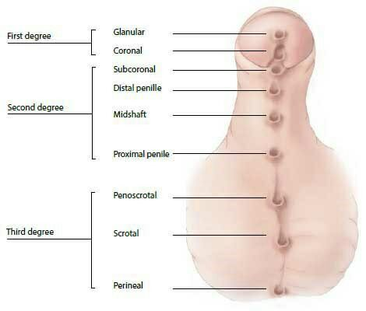
HEAD TO TOE EXAMINATION
GENITALS- present? Urethra? Testes?

Slide 7
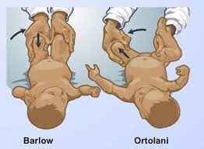
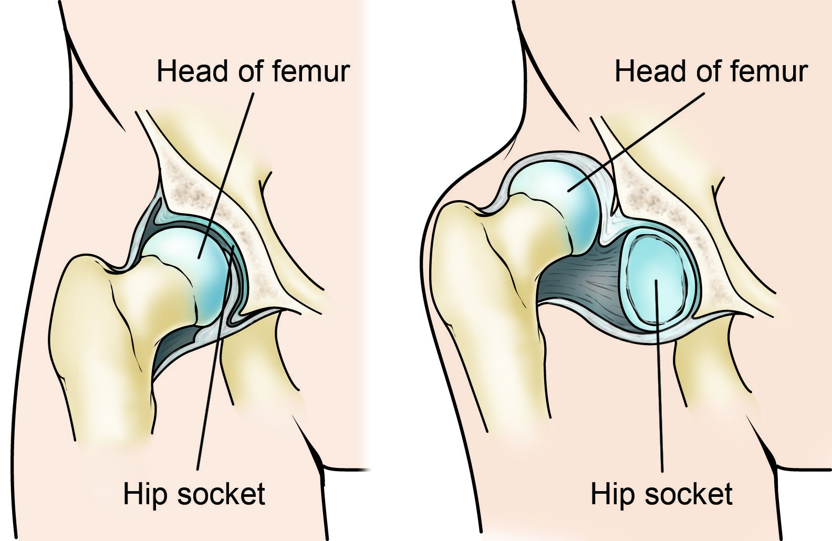
HEAD TO TOES EXAMINATION
HIPS EXAMINATION- assymetry? Length?

Slide 8
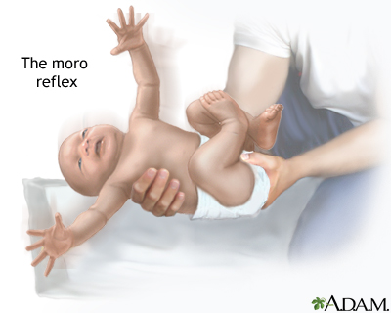
Head to toe examination
TONUS
MOROREFLEX
BABINSKI

Slide 9
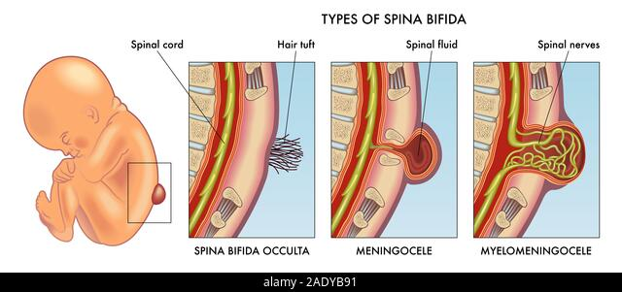
Head to toe examination
SPINE- symmetric? Tuft of hair?
LUNGS- breathsounds? Symmetry?
ANUS- present?

Slide 10
HEAD TO TOE EXAMINATION
IN SUMMARY

Slide 11
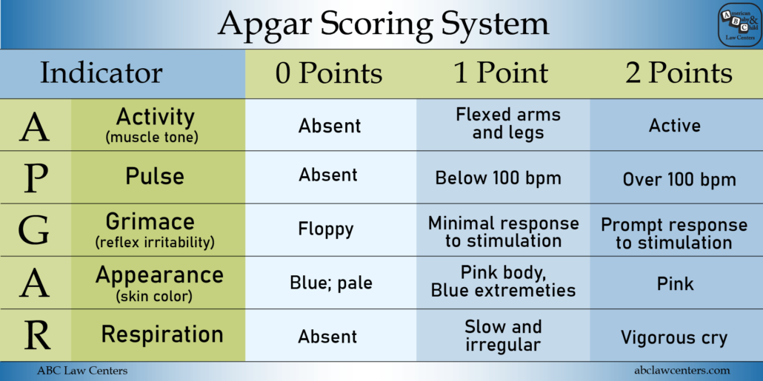
APGAR ScORE At: 1 MIN + 5 MIN AFTER BIRTH

