Slide 1
Fractures and their treatment
Tobias Wirén MD
Orthopedic surgeon

Slide 2
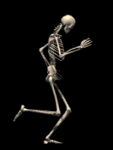
Bones
206 to 220 bones in an adult body
Largest: Femur (thigh bone)
Smallest: Os stapes (stirrup) in the inner ear
(size of a grain of rice)
All can be broken but extremities more vulnerable

Slide 3
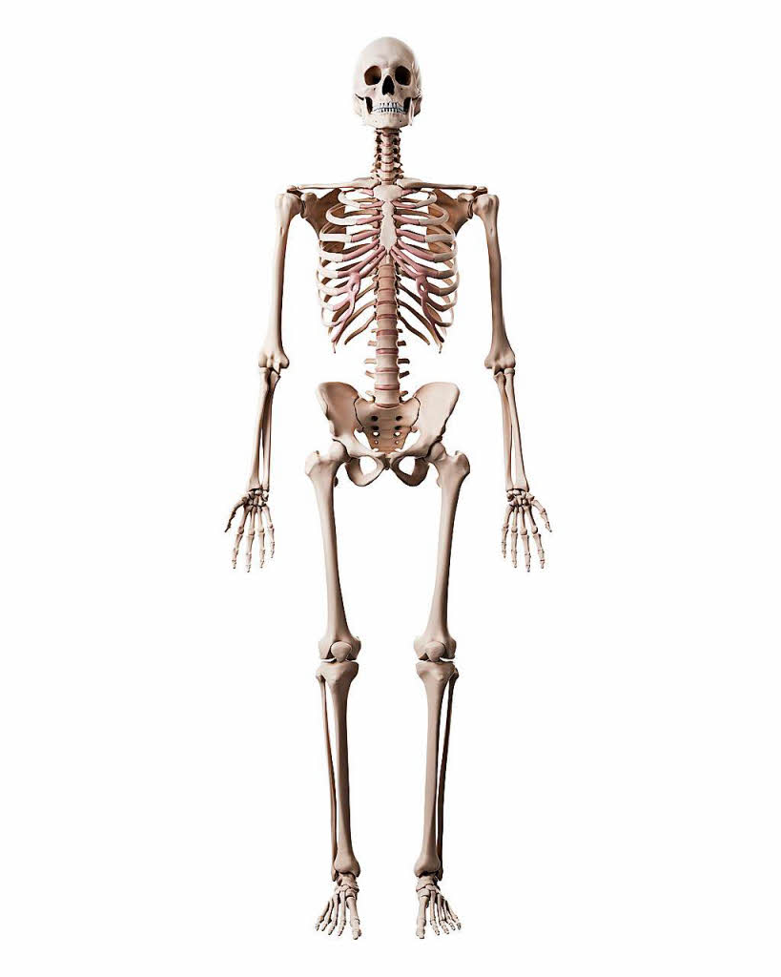
Most common fractures
Wrist fractures (radius)
Upper arm fractures (humerus)
Ankle fractures (tibia and fibula)
Collar bone fractures (clavicle)
Fractures of the hip and femur
Fractures of the vertebra

Slide 4
The cause of fractures
Trauma
Osteoporotic fractures (hip, vertebra, wrist, upper arm)
Genetic disorders with fragile skeleton

Slide 5
”Fractures are soft tissue injuries complicated by a broken bone”

Slide 6
Management of soft tissue injuries
Inspection of perforating wound
Debridement
Remove dead pieces of bone and soft tissue
Lavage
Repair soft tissue injury if clean and within 12 hours or leave open for second look/suture
Antibiotics and antitetanus

Slide 7
Types of fracture
Open fractures (skin injured) vs. Closed fractures (skin unharmed)
Simple fractures vs. Complex fractures
Fractures of the shaft of the bone or fractures affecting the joint.

Slide 8
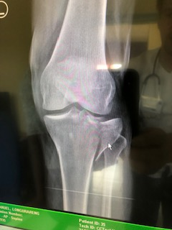
Fractures affecting joints
Risk of secondary osteoarthritis, pain and stiff joints
Cartilage damage
Uneven joint surface
Soft tissue injury
Altered load in the joint

Slide 9
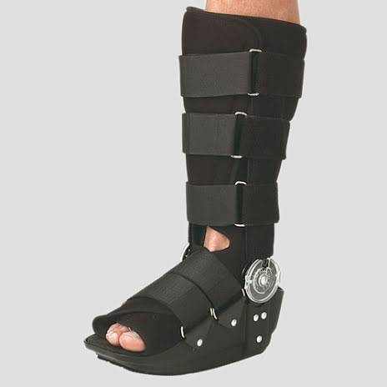
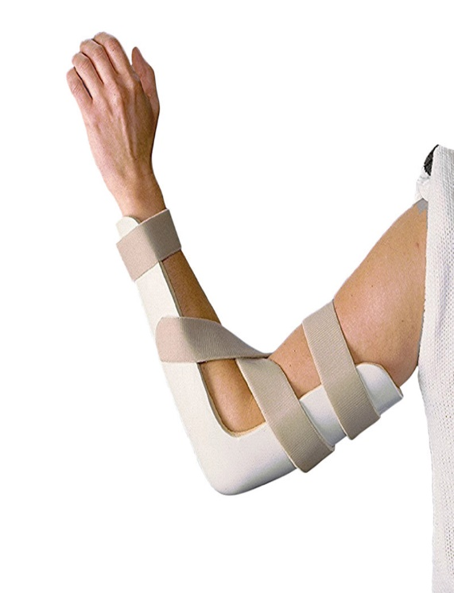
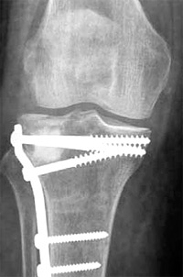
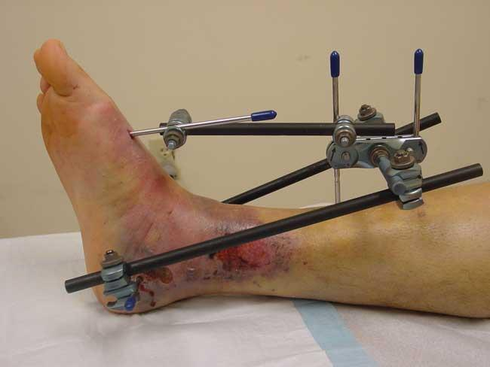
Fracture treatment
Conservative treatment
Early mobilisation
Splinting/Casts
Braces
Operative treatment
Internal fixation
External fixation

Slide 10
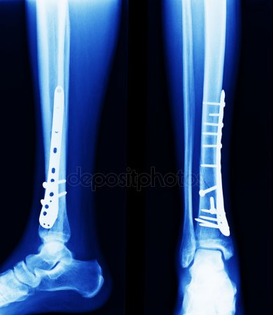
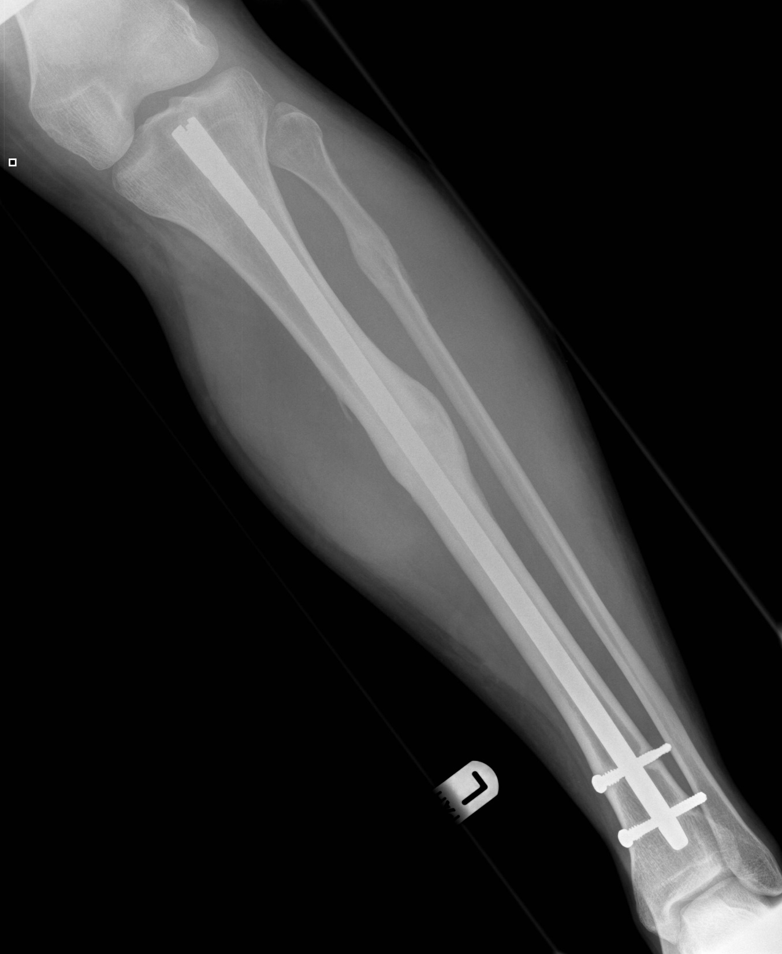
Operative treatment –internal fixation
Rigid fixation – no movement
Heals without callus – direct bone healing
Non rigid fixation – movement
Heals with callus – indirect bone healing

Slide 11
External fixation

Slide 12
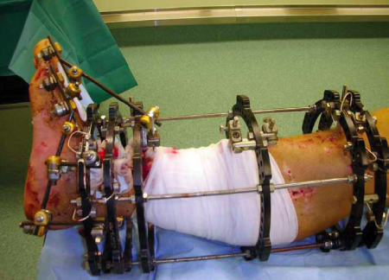
Illizarow and TSF circular frames

Slide 13
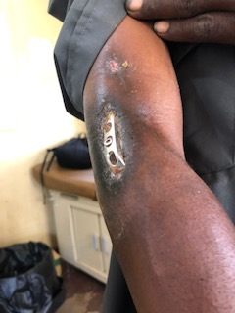
Internal fixation
Possibility to get a very good joint repair and straight extremity
…..but only….
If skin without infection or wounds
If ultraclean operating room
If sterile equipment
If possible to monitor the wound
….Otherwise more problems than solutions

Slide 14
Why do some fractures have worse outcome?
…and why do some have better than expected?
High energy injuries with
Blood supply disturbed
Soft tissue damaged
Displaced pieces or joint surface
Soft tissues between fracture pieces
Incomplete healing and transformation inte new bone doesn´t happen
Infection
Immobilisation for long time

Slide 15
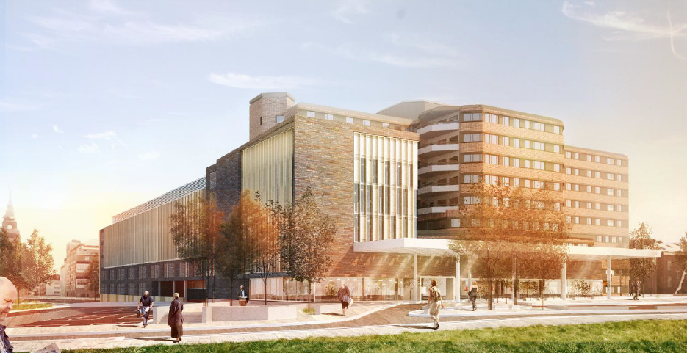
Capio S:t Görans Sjukhus – Stockholm, Sweden

Slide 16
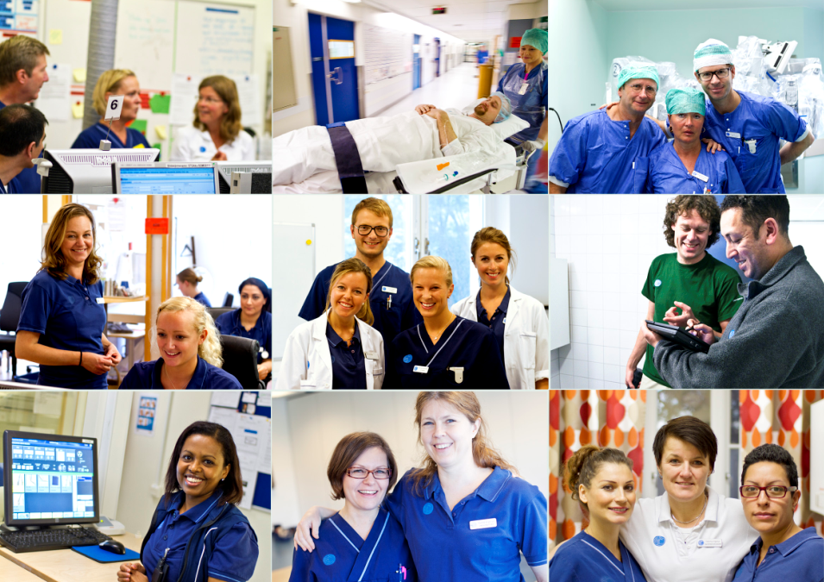
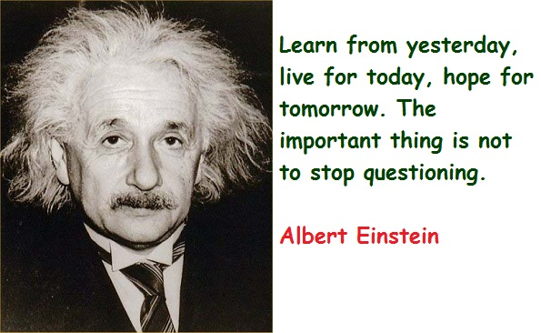
Thank You!

