Slide 1

Heart failure

Slide 2
Heart failure
A clinical syndrome due to lack of the heart to pump enough blood into the body.

Slide 3
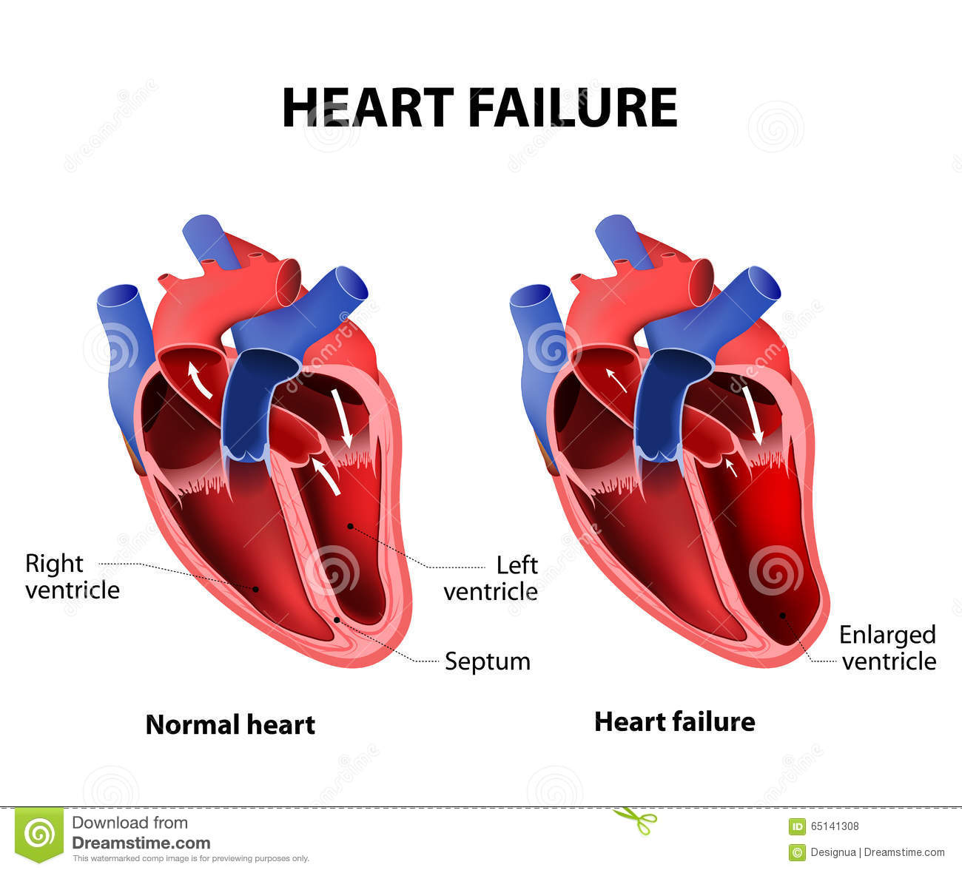

Slide 4
Forward heart failure
Results from inadequate discharge of blood into arterial system
leeding to poor tissue perfusion and excess reabsorption of natrium
through hormonell activation.

Slide 5
Backward heartfailure
Results from failure of one or both ventricles causing back pressure on the atria and venous system.

Slide 6
Causes of heart failure
Hypertension
Coronary heart disease
Heart muscle disease ( cardiomyopathi, myocarditis,infiltrative diseases, Chagas disease, beriberi,
Valvular heart disease
Pericardial disease
Congenital disease
Other causes: prolonged tachycardy, thyreotoxicosis, alcohol, cocaine,
pregnancy, severe anemia.

Slide 7
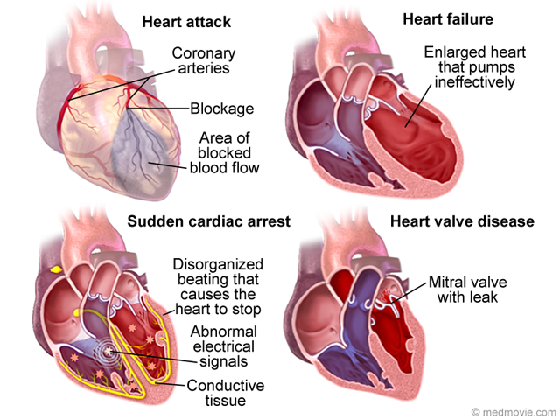

Slide 8
Clinical symtoms of heart failure
Leftsided:
Pulmonary oedema, dyspne, ortohpnoea, cough and fatigue.
Signs: tachypnoae, tachycardy, basal lung crackles, third heart sound,
perifer cyanos.
Rightsided:
Oedoma in legs, abdominal discomfort, nausea, fatigue, increased
jugular venous pressure, hepatomegaly.

Slide 9
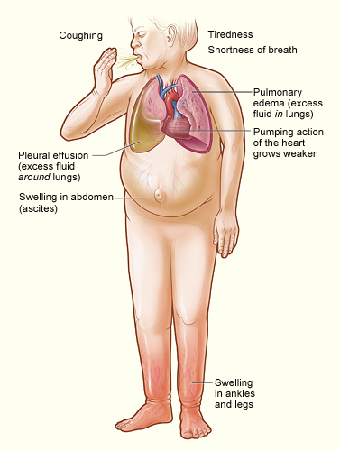
Right sided heart failure

Slide 10
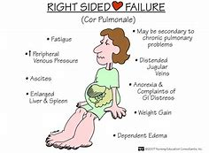

Slide 11
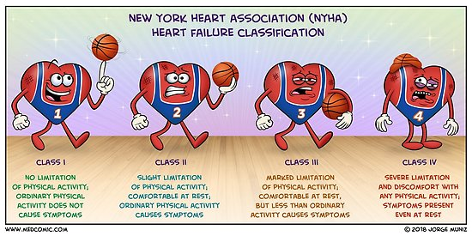

Slide 12
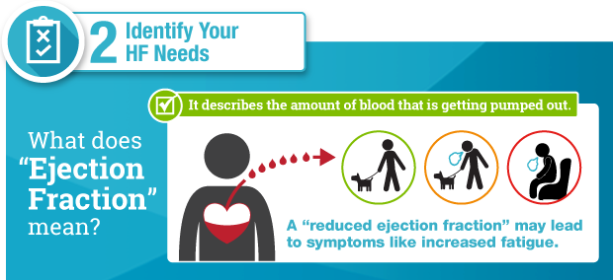

Slide 13
Management
Heart failure is not a diagnos its a clinical syndrom due to a cardial
abnormality,
Find and treat the cause of heart failure if possible.( anemia, arrhytmia, electrolyte disturbance, infection, non-adherence to treatment).
Restrict alcohol and salt intake.
Avoid NSAID:s as they cause fluid retention.

Slide 14
Drug treatment
Start with a diuretic treatment and monitor weight or reduce of clinical signs such as ortophnae, dyspnae and / or reduce of periferal oedoma.
Aldosterone antagonist is preferable to add when rightsided heart failure.
ACE-inhibitor (will reduce the demand of diuretics and give the patient a better life quality and also reduce worsening of heart failure.
Beta blockers will also reduce the hearts demand of oxygen from bloodflow.

Slide 15
Life style changement.
Take your medications regularly.
Fysical activity.
Stop smoking.
Reduce saltintake.
Reduce waterintake if severe heart failure.
Stop overuse of alkoholic drugs (cardiomyopathy).

Slide 16
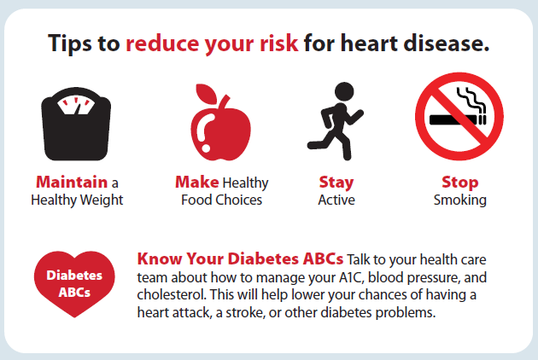

Slide 17
