Slide 1
Hypertension and diabetes
Åsa Lundgren, Rotary Doctors,
June 2024

Slide 2
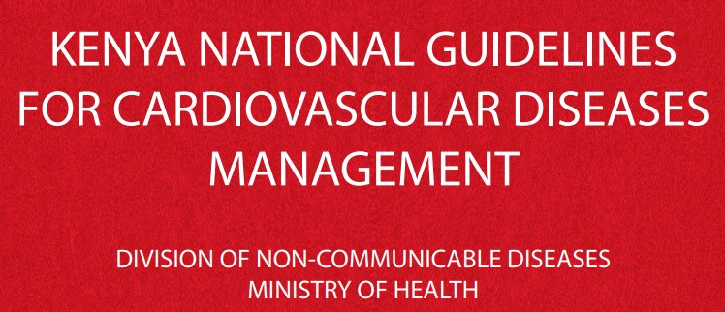

Slide 3
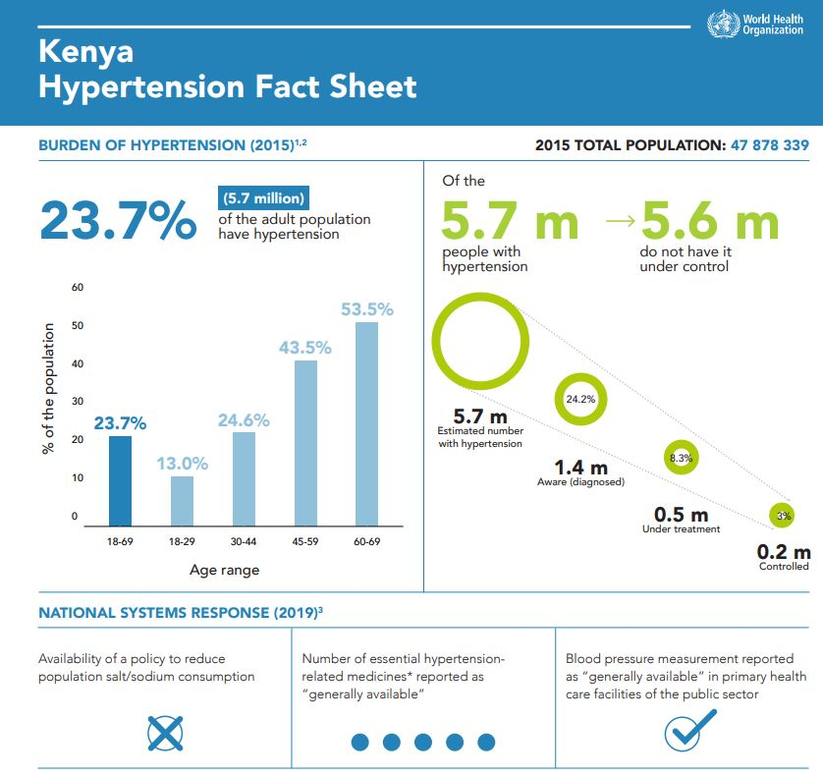

Slide 4
What is blood pressure?
The pressure of the circulating blood on the vessels.
Systolic: When the heart contracts.
Diastolic: When the heart rests between two beats.

Slide 5
What is high blood pressure/hypertension?
>140/>90
Persistently elevated blood pressure in the arteries.
Increased pressure on the vessel walls. Hardening and thickening of the arteries = stiff arteries.
The heart needs to work harder.

Slide 6
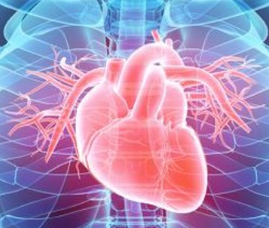
Why is hypertension dangerous?
Increased risk för heart disease, including infarction
Increased risk of stroke
Increased risk of hypertensive renal failure
Retinpathy
Vascular dementia

Slide 7
Causes of primary (essential) hypertension
Hereditary
Overweight
NaCl-consumtion
Stress
Age
Atherosclerosis
Diabetes

Slide 8
Secondary hypertension 5-10%
Caused by another disease:
Diabetes
Kidney disease
Pregnancy
Endocrine dieseases
Hyperaldosteronism
Medication (steroids, NSAID etc)

Slide 9
Symtoms of hypertension
Most often no symtoms!
Headache
Shortness of breath
Nosebleed
Blurred vision
Buzzing in the ears

Slide 10
To measure blood pressure
Sit or lay down
3-5 minutes rest
No coffee or tobacco for 30 min
At least once in both arms
Recheck if high
Pulse? Irregular?

Slide 11
Diabetes in Kenya
Prevalence: 4,5% (of this 10-15% is type 1 diabetes). Rising!
About 50% are undiagnosed.
10 000 deaths/year.

Slide 12
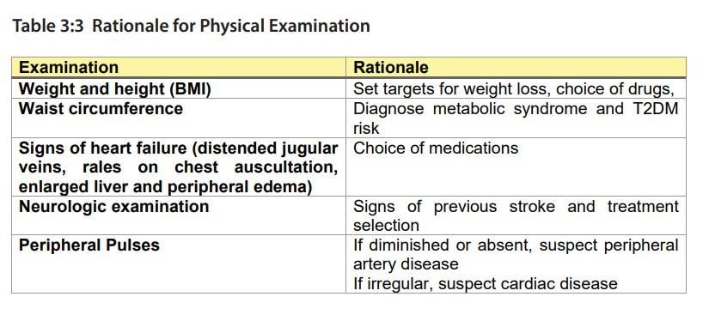

Slide 15
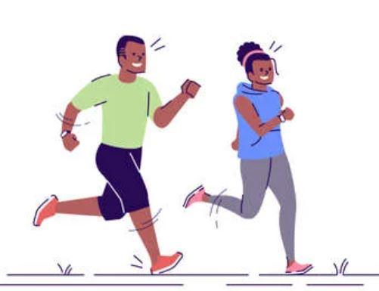
What can the patient do?
Reduce weight if BMI > 25
Physical activity
Fruits and vegetables
Reduce salt intake
Reduce alcohol

Slide 16
What to start with?
Start with 1-2 from these 3 groups:
Calcium-antagonists (Amlodipin, Felodipin)
Thiaziddiuretics (Hydrochlortiazid)
ACE-inhibitors (Enalapril, Ramipril) och ARB (Losartan)

Slide 17
Follow-up
Every month until <140/<90 is reached.
Increase doses and add medicines until maximal doses of the three groups.
Then every 4th – 6th month (Kenyan guidelines)

Slide 18
If <140/<90 is not reached
Betablockers (metoprolol, atenolol): Blocking the effect of adrenalin/noradrenalin. Especially when chronic ischemic heart disease.
Loopdiuretics (furosemid): Especially if fluid retention.
Aldosteronantagonists (spironolacton)
Alfablockers

Slide 19
How to succeed?
A well-informed patient!
What medicine should I take?
Why?
Life long medication
What can I do myself?

Slide 20
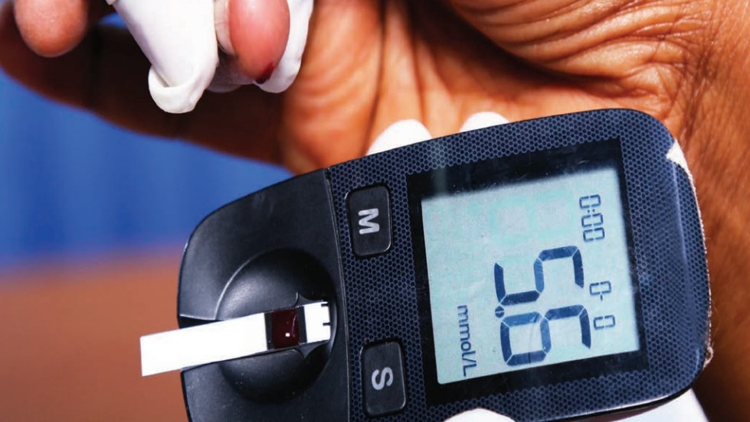
Diabetes

Slide 22
Type 1 diabetes
Chronic autoimmune disease.
Beta-cells in pancreas are destroyed. No insulin production.
Mostly children and young adults.

Slide 23
Type 2 diabetes
Reduced insulin producation
Peripheral insulin resistance
Have detectable insulin in the blood.

Slide 24
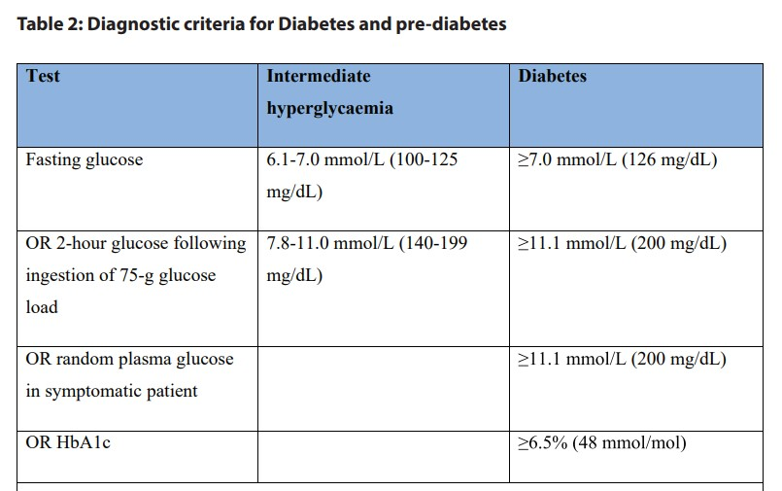

Slide 25
Why is elevated blood-glucos dangerous?

Slide 26
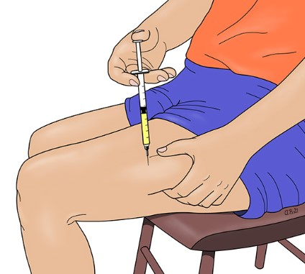
Type 1 diabetes
Insulin!
Often sudden onset
Weightloss
Thirst, polyuria
Nausea
Abdominal pain
Frequent vomiting
Fatigue

Slide 27
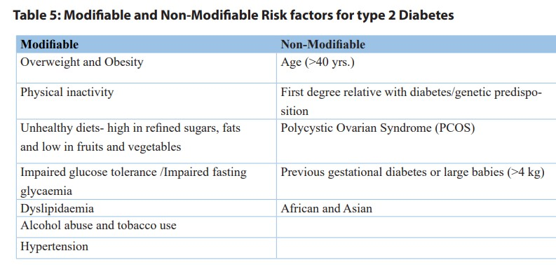

Slide 28
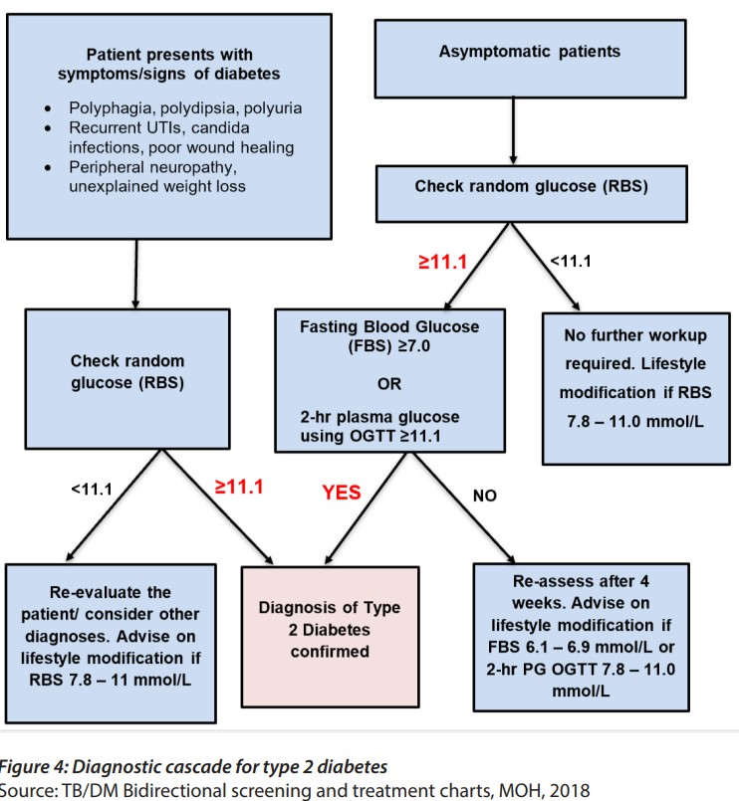

Slide 29
Insulin
Short/rapid-acting: Humalog, Novo rapid
Intermediate-acting: Humulin N, Insulatard
Long-acting: Levermir, Lantus
Pre-mix short-acting and intermediate-acting: Mixtard 70/30, Humulin 70/30

Slide 30
Treatment of type 1 diabetes
Insulin: Most common regimes:
Short/rapid-acting before meals 3 times a day + intermediate- or long-acting once or twice daily.
Twice-daily pre-mixed.
Blood glucose testing! Before each meal, at bedtime, prior and following exercise.
If not possible: Check frequently for 2-3 days.

Slide 31
Treatment of type 2 diabetes

Slide 32
Treatment of diabetes type 2
Metformin: First line. 500 mg OD. Increase doses to maximum 1000 mg BD.
Add second drug: (Glibenclamide)
Insulin

Slide 33
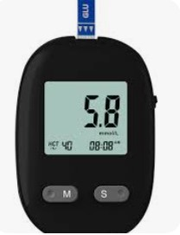
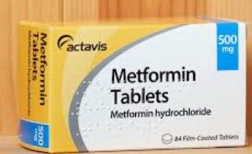
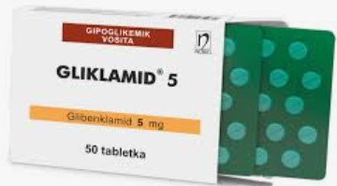
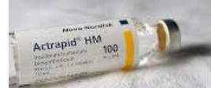
How to succeed?
A well-informed patient!
What medicine should I take?
Why?
Life long medication
What can I do myself?

