Slide 1
Hypertension
Åsa Lundgren, Rotary Doctors
October 2022

Slide 3
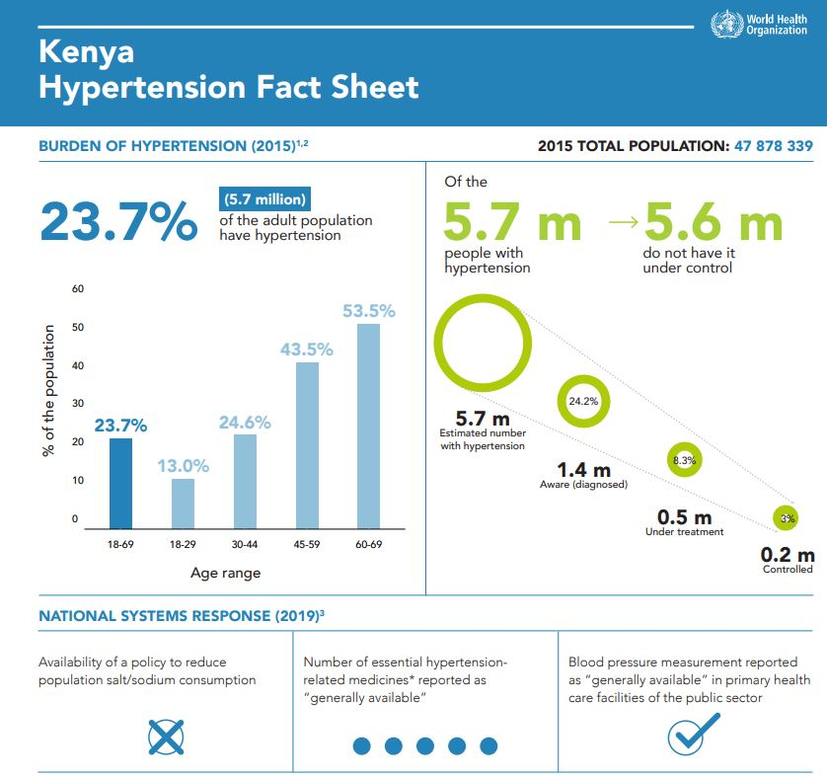

Slide 4
What is blood pressure?
The pressure of the circulating blood on the vessels.
Systolic: When the heart contracts.
Diastolic: When the heart rests between two beats.

Slide 5
What is high blood pressure/hypertension?
>140/>90
Persistently elevated blood pressure in the arteries.
Increased pressure on the vessel walls. Hardening and thickening of the arteries = stiff arteries.
The heart needs to work harder.

Slide 6
Why is hypertension dangerous?
Increased risk för heart disease, including infarction
Increased risk of stroke
Increased risk of hypertensive renal failure
Retinpathy
Vascular dementia

Slide 7
Causes of primary (essential) hypertension
Hereditary
Overweight
NaCl-consumtion
Stress
Age
Atherosclerosis
Diabetes

Slide 8
Secondary hypertension 5-10%
Caused by another disease:
Diabetes
Kidney disease
Pregnancy
Endocrine dieseases
Hyperaldosteronism
Medication (steroids, NSAID etc)

Slide 9
Symtoms of hypertension
Most often no symtoms!
Headache
Shortness of breath
Nosebleed
Blurred vision
Buzzing in the ears

Slide 10
To measure blood pressure
Sit or lay down
5 minutes rest
No coffee or tobacco for 30 min
At least once in both arms
Recheck if high
Pulse? Irregular?

Slide 11
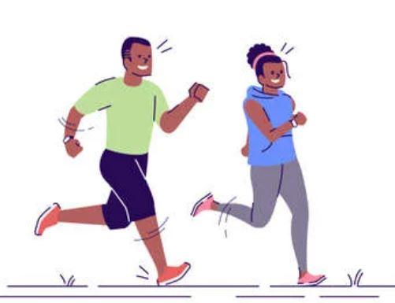
What can the patient do?
Reduce weight if BMI > 25
Physical activity
Fruits and vegetables
Reduce salt intake
Reduce alcohol

Slide 12
When to start medication?
> 180/110 (check again after some rest): Amlodipin 5-10 mg OD. Control after 1-2 days.
When patient has tried diet, physical activity etc and still….
< 80 years: > 140/90
> 80 years: > 160/90.
If known cardiovascular disease, diabetes, kidney disease > 130/85

Slide 13
Before starting treatment
Blood tests: Na, K, creatinine, lipids, HbA1c/fasting B-glucose
Urine dipstick
ECG
Treatment should start even if testing is not available.

Slide 14
What to start with?
Start with 1-2 from these 3 groups:
Calcium-antagonists (Amlodipin)
Thiaziddiuretics (Hydrochlortiazid)
ACE-inhibitors (Enalapril, Ramipril) och ARB (Losartan)

Slide 15
Calcium-antagonists
Relaxes the muscles in the vessel walls. The safest if blood tests can’t be taken.
Amlodipin 5 – 10 mg OD
Felodipin 5 – 10 mg OD

Slide 16
Thiazidduiretics
Makes the kidneys get rid of water and salt and widens the small blood vessels.
Risk: Too high doses can reduse potassium.
Hydrochlortiazid 12,5 – 25 mg OD
Bendroflumethiazid 2,5 mg OD

Slide 17
ACE-inhibitor or ARB
Diabetes, heart failure, renal failure. Widens vessels.
Angiotensin converting enzyme inhibitor (enalapril 5 – 20 mg OD, ramipril, captopril): Common side-effect: Coughing.
Angiotensin II receptor blockers (losartan 50 – 100 mg OD, candesartan):

Slide 18
Follow-up
Every month until <140/<90 is reached.
Increase doses and add medicines until maximal doses of the three groups.
Then every 3rd – 6th month (WHO).
Yearly (Sweden): Blood tests.

Slide 19
If <140/<90 is not reached
Betablockers (metoprolol, atenolol): Blocking the effect of adrenalin/noradrenalin. Especially when chronic ischemic heart disease.
Loopdiuretics (furosemid): Especially if fluid retention.
Aldosteronantagonists (spironolacton)
Alfablockers

Slide 20
How to succeed?
A well-informed patient!
What medicine should I take?
Why?
Life long medication
What can I do myself?

