Slide 1
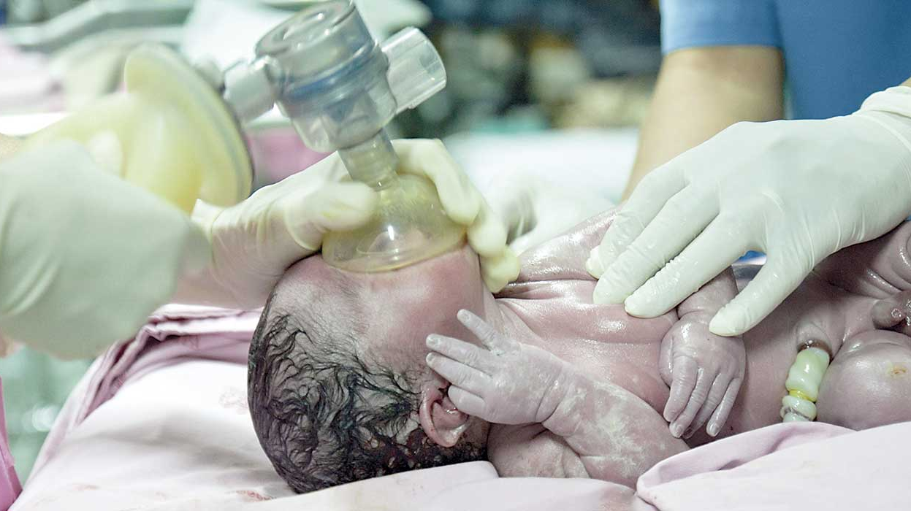
Neonatal resucitation

Slide 2
NEWBORN BABY
ASSESS BREATHING AND TONUS AFTER BIRTH
APNEA OR INSUFFICIENT BREETHING ➡️ GO TO A

Slide 3
A - AIRWAY
WITHIN 60 SECONDS YOU DO ALL BELOW
⬇️
CREATE FREE AIRWAY
STIMULATE THE BABY
DRY THE BABY
COUTERACT COOLING

Slide 4
B – BREATHING
MAKE SURE THE BABY IS IN CORRECT POSITION
MAKE SURE THE MASK IS IN CORRECT SIZE
START VENTILATION WITH AIR 21 % O2
60 BREATHS PER MINUTE
CHECK IF THE CHEST IS RISING AND LISTEN FOR BREATHING SOUNDS
THE FIRST SIGN ON CORRECT VENTILATION IS THE PULSE GOING UP

Slide 5
MAKE SURE THE MASK HAS THE CORRECT SIZE
z

Slide 6
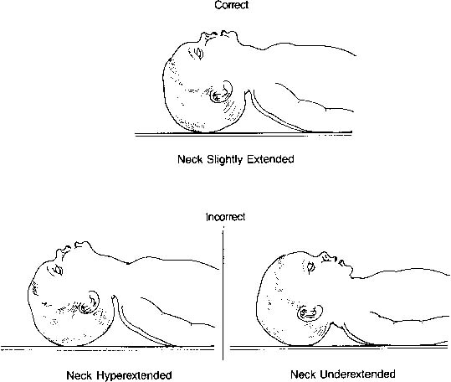
MAKE SURE THE POSITION OF THE HEAD IS CORRECT
z

Slide 7
IF THE HEARTRATE STILL IS <60 DESPITE CORRECT VENTILATION FOR 60 SECONDS GO TO C

Slide 8
C - CIRCULATION
CONTINUE WITH VENTILATION
START WITH CHEST COMPRESSIONS 3:1
PUT IN A LINE
EVALUATE VENTILATION AND HEARTRATE EVERY 30 SECONDS

Slide 9
D - DRUGS
CONTINUE WITH VENTILATION AND CHESTCOMPRESSIONS
CONSIDER MEDICATION

