Slide 1
Nosocomial infections
C.M.E Kacheliba
Dr. Bugra Merdol
August 2024

Slide 2
Our school of medicine
Hippocrates of Cos

Slide 3
Our school of medicine
Hippocrates of Cos
”Primo non nocere”: First, do not harm!

Slide 4
Our school of medicine
Hippocrates of Cos
”Primo non nocere”: First, do not harm!
To know the difference between things that are under control and other things that are not.

Slide 5
Nosocomial infections- definition
“Nosocomial infections also referred to as healthcare-associated infections (HAI), are infection(s) acquired during the process of receiving health care that was not present during the time of admission. They may occur in different areas of healthcare delivery, such as in hospitals, long-term care facilities, and ambulatory settings, and may also appear after discharge. HAIs also include occupational infections that may affect staff.”
( Nosocomial infections, Anna Sikora, Farah Zahra, National library of medicine, www.ncbi.nlm.nih.gov )

Slide 6
Nosocomial infections- in Kenya
Hospital acquired infections in a private paediatric hospital in Kenya: a retrospective cross-sectional study
(Rohini Kalagouda Patil, Beatrice Kabera, Charles Kiilu Muia, Boni Maxime Ale, PAMJ, www.panafrican-med-journal.com )

Slide 7
Nosocomial infections- in Kenya
The factors responsible for this are multiple
Severity of illness
Relative immunocompromised state
Prior administration of antibiotics
The use of invasive devices and invasive procedures
The resource limited settings combined with these nosocomial infections, lead to a poor outcome

Slide 8
Nosocomial infections- in Kenya
The incidence of nosocomial infections ranges from 2.8% to 21.6%

Slide 9
Nosocomial infections- in Kenya
The incidence of nosocomial infections ranges from 2.8% to 21.6%
They are likely to be more frequent and serious in developing countries, with possible risk factors being malnutrition, delayed presentation to referral centres and multi-organ involvement at admission

Slide 10
Nosocomial infections- in Kenya
The incidence of nosocomial infections ranges from 2.8% to 21.6%
They are likely to be more frequent and serious in developing countries, with possible risk factors being malnutrition, delayed presentation to referral centres and multi-organ involvement at admission
The gastrointestinal infections were the commonest hospital acquired infections followed by blood stream infections and respiratory tract infections in our study

Slide 11
Nosocomial infections- in Kenya
Multi-drug Resistance organisms pose the greatest threat to infection control measures in the hospital and give rise to frequent hospital outbreaks
Increased antibiotic resistance has been associated with transmission of resistant bacteria within hospitals by cross contamination and colonisation of patients via the hands of healthcare staff and subsequent spread between hospitals by transfer of such colonised patients

Slide 12
Nosocomial infections- in Kenya
Conclusion: “In summary, HAI were common in our setup with gastrointestinal infections as the commonest followed by blood stream infections. Thus, the infection control priorities in our hospital should focus in controlling and preventing them”

Slide 13
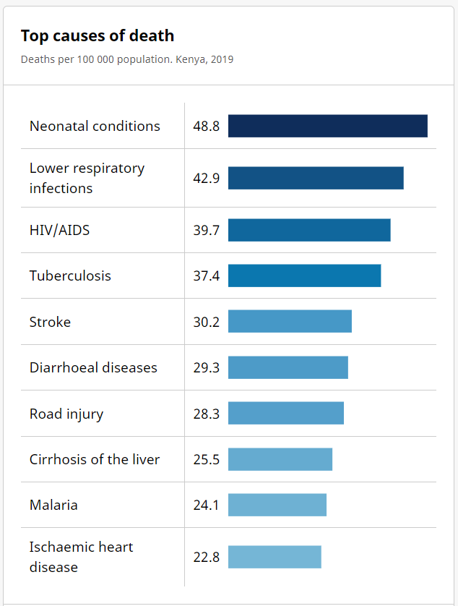
Top causes of death in Kenya
Neonatal conditions
Prematurity.
Respiratory disorders.
Low blood sugar (glucose)
Severe infections (for example, sepsis)
Heart problems.
Metabolic disorders.
Birth defects that require specialized care or surgery.

Slide 14
Top causes of death in Kenya
How to prevent preventable infections?
MCH monitoring
Immunisation
Fighting malnutrition
Reasonable use of antibiotics
Avoiding unnecessary, invasive treatments
Strict hygiene rules at hospitals and healthcare centres

Slide 15
What is actually under our control
Discussion

