Slide 1
ROTARY DOCTORS PROJECTS-KENYA
BY:
JACINTA KARIMI

Slide 2
BRIEF INTRODUCTION OF RDS
The RDS has had activities in Kenya since more than 30yrs.
Has a population of about 54 Million (2022 census)
Has 47 tribes.
The activities are mostly in Western Kenya.

Slide 3
OUR PROJECT AREAS
TRANSZOIA COUNTY
WEST POKOT COUNTY

Slide 4
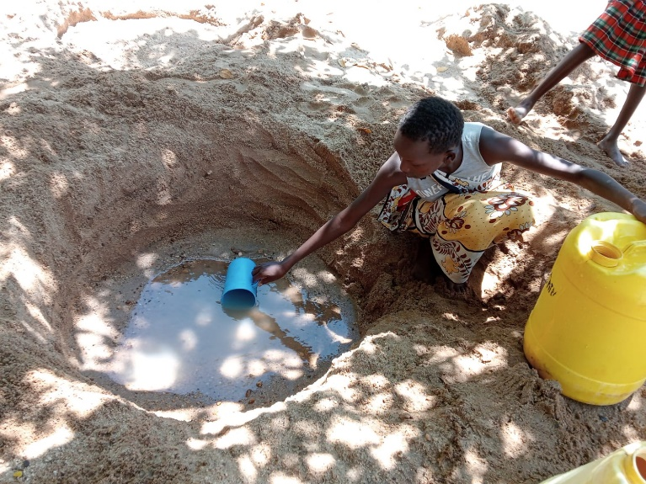
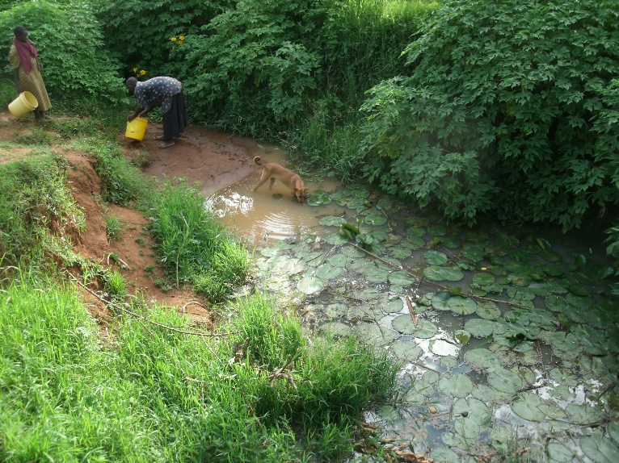
THE WATER SITUATION IN KENYA
Kenya has a population of about 54 million people(2022 census)
About a half (28 million) lack access to clean and safe drinking water.
The greater % of those who lack access to clean water are those living in slums, rural areas because inability to connect to piped water.

Slide 5
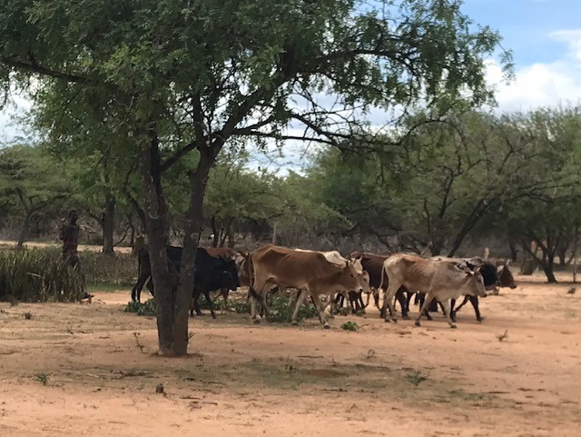
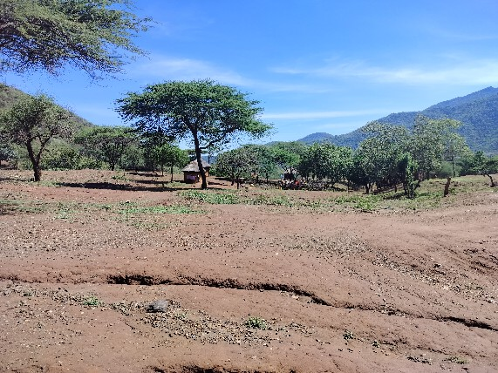
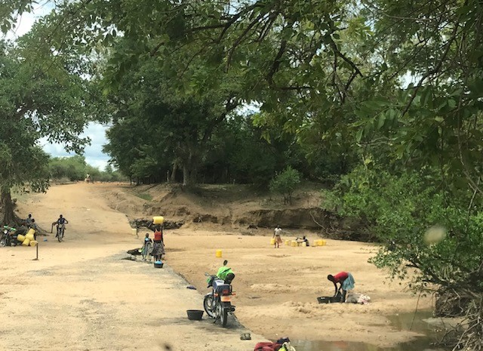
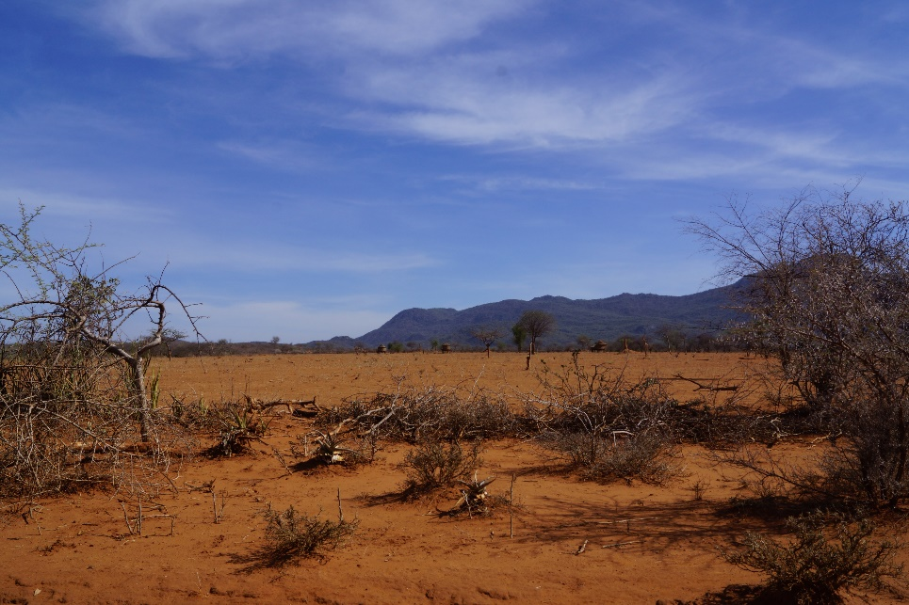
REASONS FOR LACK OF ACCESS TO CLEAN & SAFE WATER
Poor management of water resources and water bodies.
Unequal distribution of resources.
Water pollution
Population growth.
Urbanization.
Climate change.

Slide 6
THE RDS WATER PROJECTS
FUNDS FROM ROTARY CLUBS
One spring cost an average 15,000sek.
One springs serves an average of 130 household.
An average household has 6 persons.
It costs 20Sek to give one person clean water source lasting more than 10 years.

Slide 7
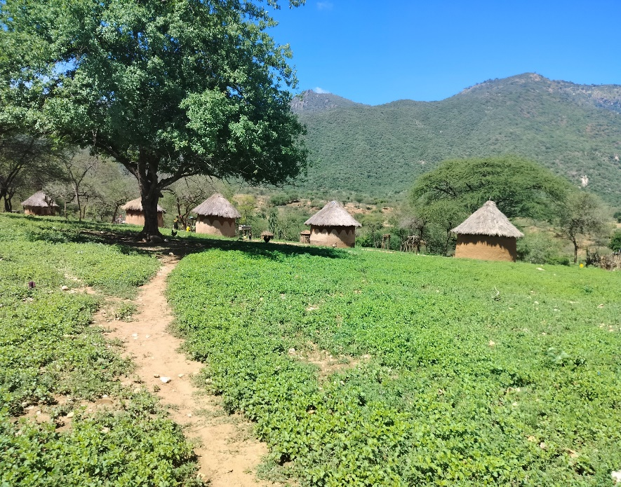
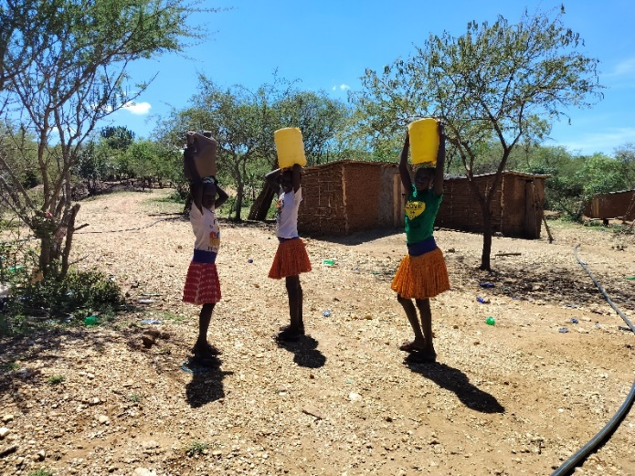
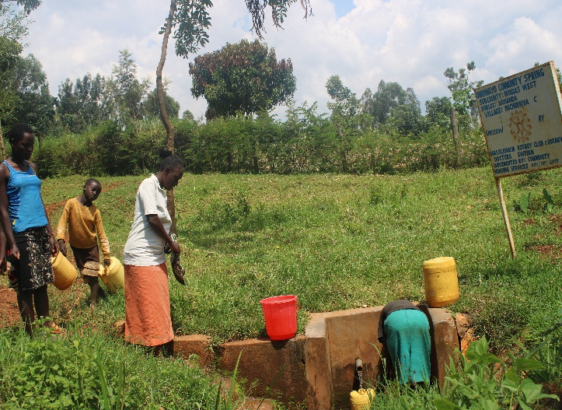
BENEFITS OF ORUST RC CONTRIBUTION TO A KENYAN FAMILY
Access clean and safe drinking water.
Improved economy – no spending on water related diseases.
Saved time to walk so far in search of water.
Saved the environment – no need to boil water.
Secured the future of a girl in Kenya- no need to miss school.

Slide 8
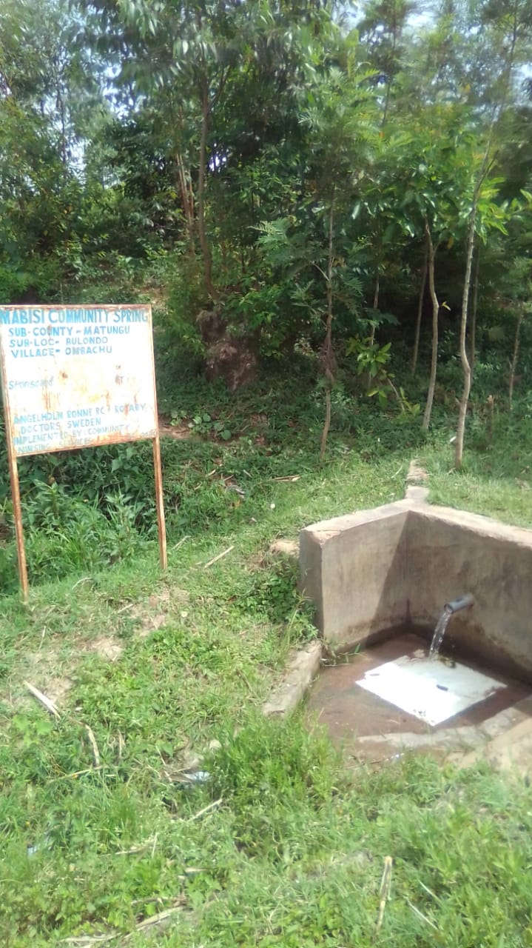
WATER PROJECT TECHNOLOGY
SPRING
Water seeping to the surface through semi permeable rocks.
No Pump needed, flow is by gravity.
No complicated filtration needed.
Very low overhead needed.
Community Maintained.

Slide 9
TOTAL ORUST RC PROTECTED SPRING AND STATUS
NO | SPRING NAME | NO. H/H | YEAR DONE | AGE | CURENT STATUS
1 | UHESIA COMMUNITY SPRING | 171 | JUNE 2011 | 12 | FUNCTIONAL
2 | HALALA COMMUNITY SPRING | 151 | DEC 2011 | 12 | FUNCTIONAL
3 | NABULINDO COMMUNITY SPRING | 204 | JAN 2013 | 11 | FUNCTIONAL
4 | OKELO COMMUNITY SPRING | 137 | JUNE 2013 | 10 | FUNCTIONED 1YRS
5 | KOYULE COMMUNITY SPRING | 184 | NOV 2013 | 10 | FUNCTIONAL
6 | EMULUGUNGA COMMUNITY SPRING | 123 | SEPT 2020 | 3 | FUNCTIONAL
7 | HAMISI COMMUNITY SPRING | 82 | SEPT 2021 | 2 | FUNCTIONAL
8 | SIMIYU COMMUNITY SPRING | 56 | SEPT 2022 | 1 | FUNCTIONAL
9 | NABANYILA COMMUNITY SPRING | 80 | JULY 2023 | 8M | FUNCTIONAL
 |  | 1,188

Slide 10
SUMMARY
TOTAL SPRING PROTECTED = 9
TOTAL NUMBER OF H/H REACHED 1,188
TOTAL POPULATION 7,128 (= almost a location)
TOTAL FAILURE RATE = 1

Slide 11
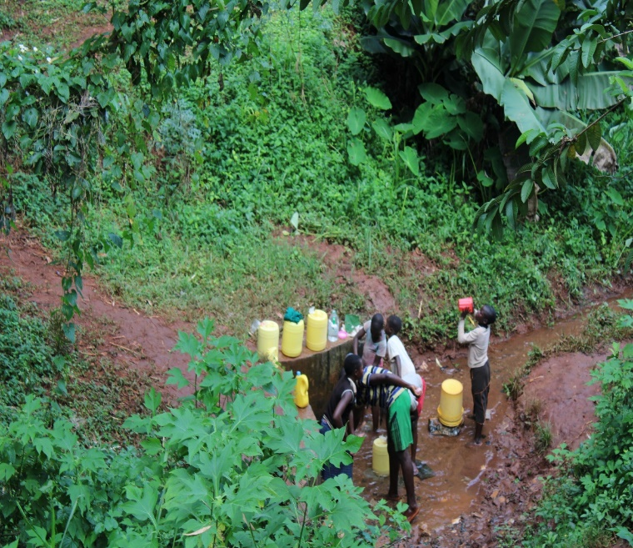
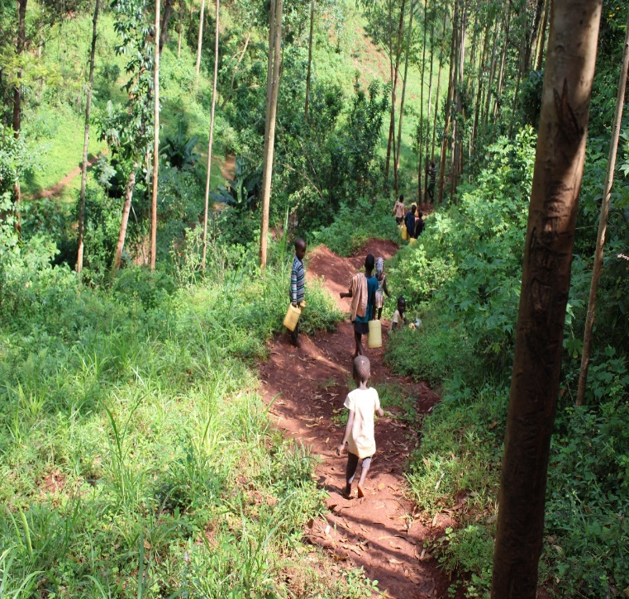
REVIEW OF SPRING MARCH 2024
HALALA SPRING @2024-12 years old
UHESIA @2024- 12 years old

Slide 12
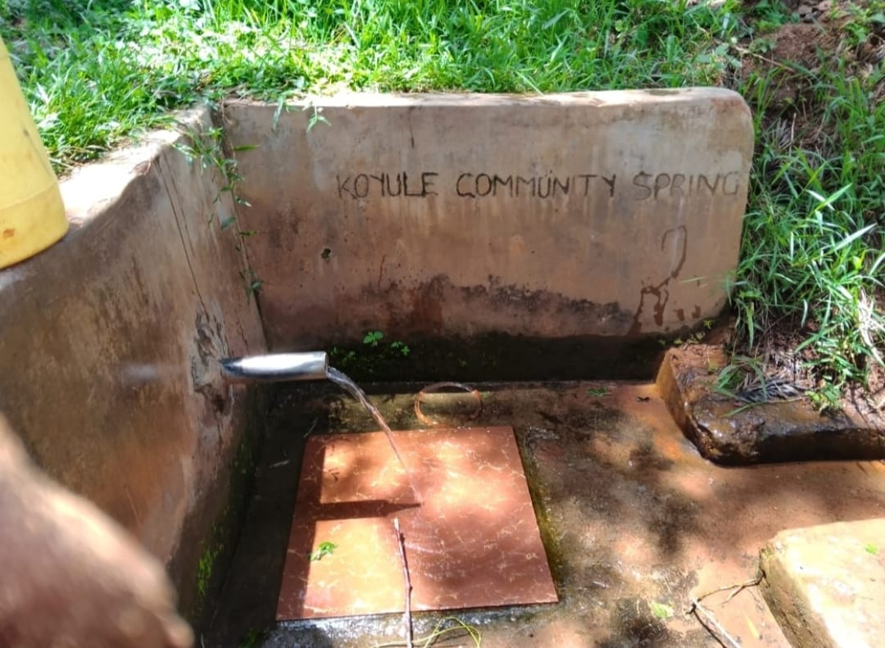
NABULINDO@2024-11 years old
KOYULE@2024 -10years old

Slide 13
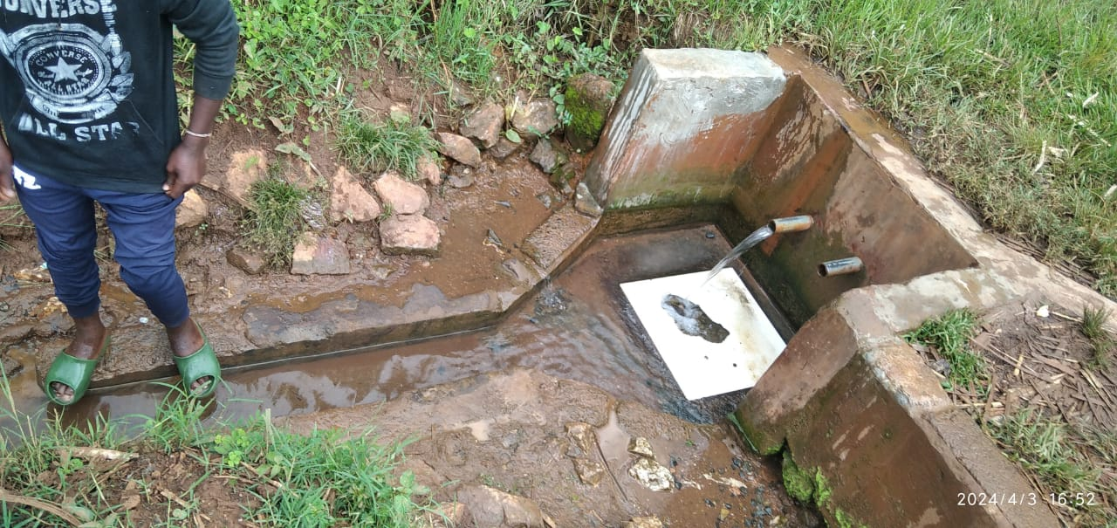
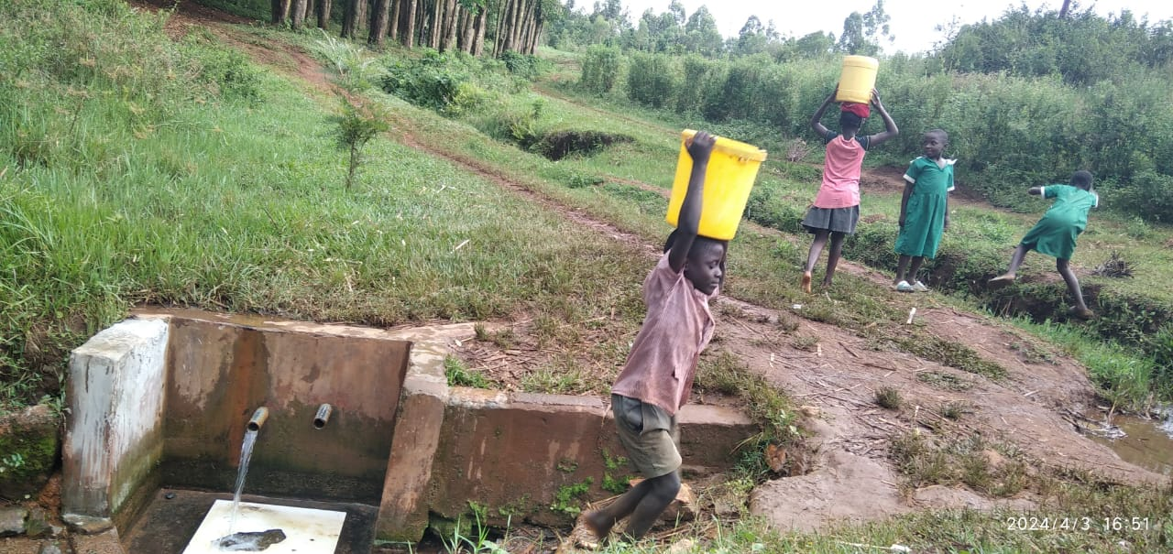
SIMIYU@2024-1 year old
EMULUGUNGA@2024 -3years old

Slide 14
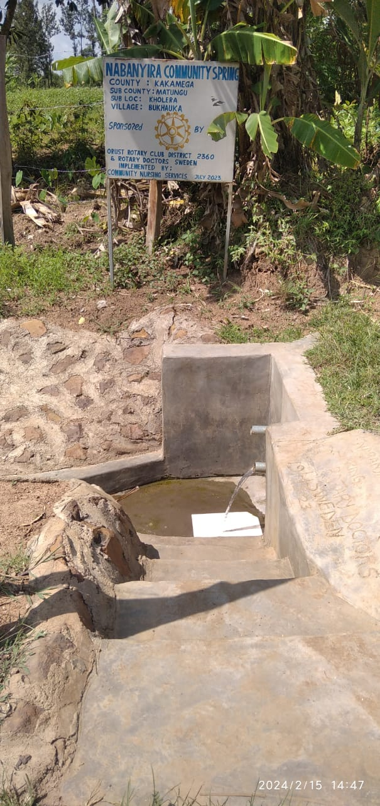
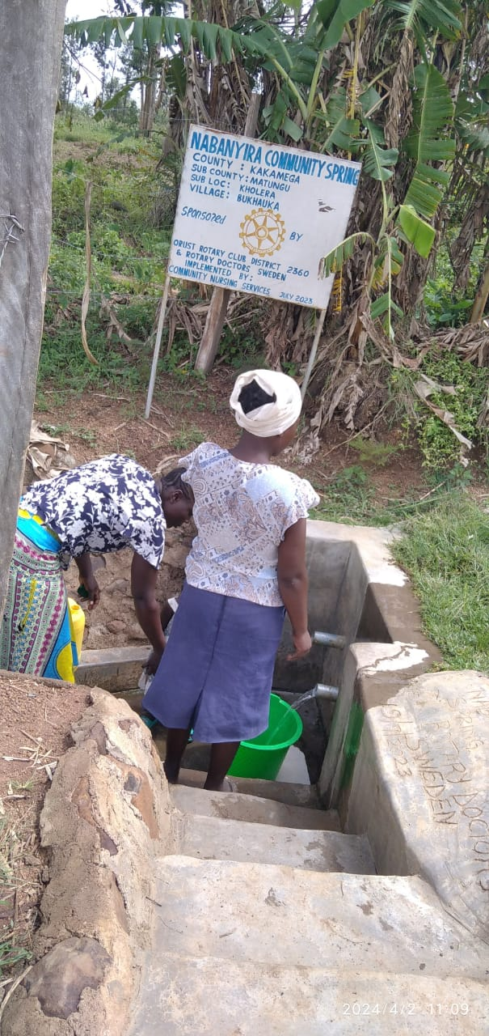
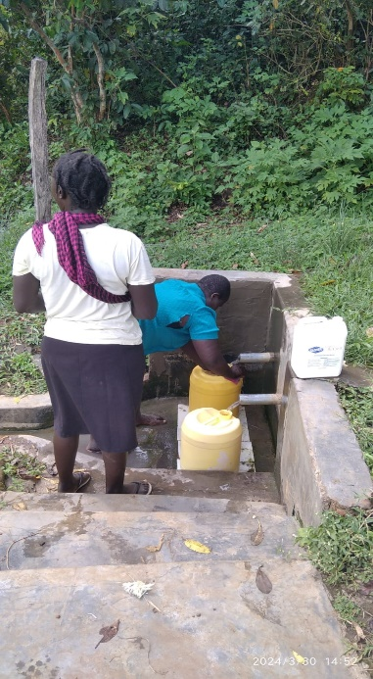
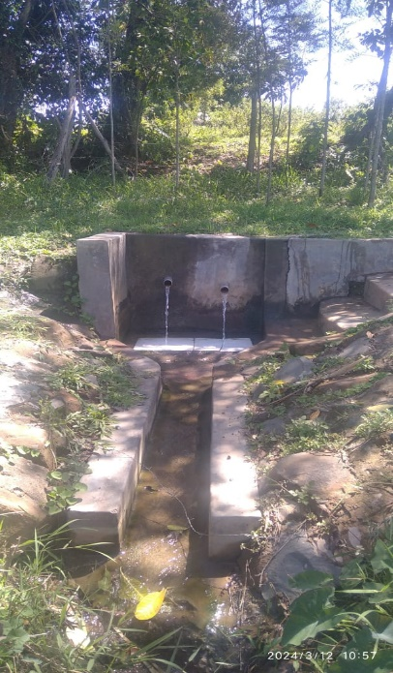
HAMISI@2024-2 years old
NABANYILA@2024-8months old

Slide 15
RDS PROJECTS OUTCOMES()
MCH(IMMUNIZATION COVERAGE (Transzoia County)
SPECIAL PROJECTS
Together with other sanitation projects like community lead total sanitation dealing with community building latrines and using basic hand washing technology, we have achieved reduction of water borne and washed related disease by up to 60% in the communities we serve.
Given access to safe and clean drinking water to 185,640 people () of total Kenyan pop of 54million.(0.35%)
Out of the above7,128 People access clean and safe drinking water courtesy of your support!

Slide 16
CHALLANGES
SPRING AREA
Possible solutions.
Stealing of Sign Posts.
Sustainability of fencing posts.
Sift of focus to more dry areas where there are no springs and the water need is greater.
Engrave the Sponsoring club and RDS on a block wall.
Still use the timber fence temporarily and educate community on need to protect water source with live fence.
Clubs to join for bigger water projects like drilled well and tapping water from the hills.

Slide 17
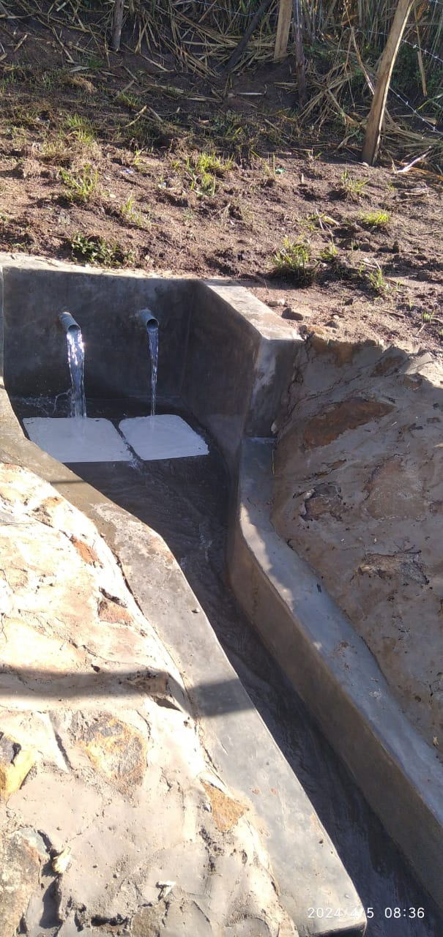

Slide 18
https://youtu.be/-LsGdfMyxZA

Slide 19
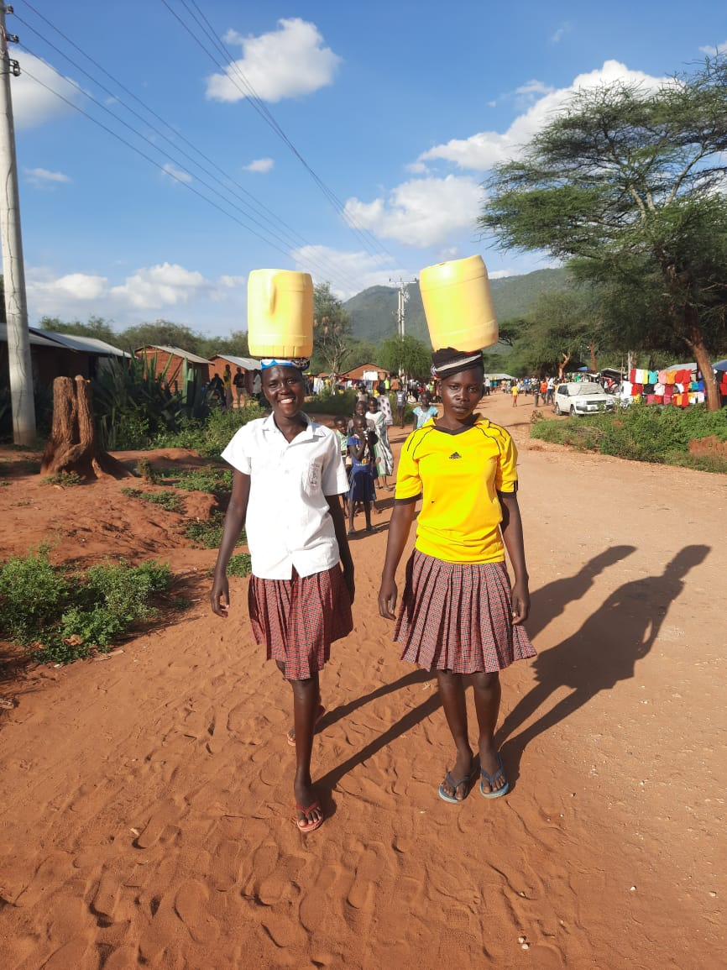
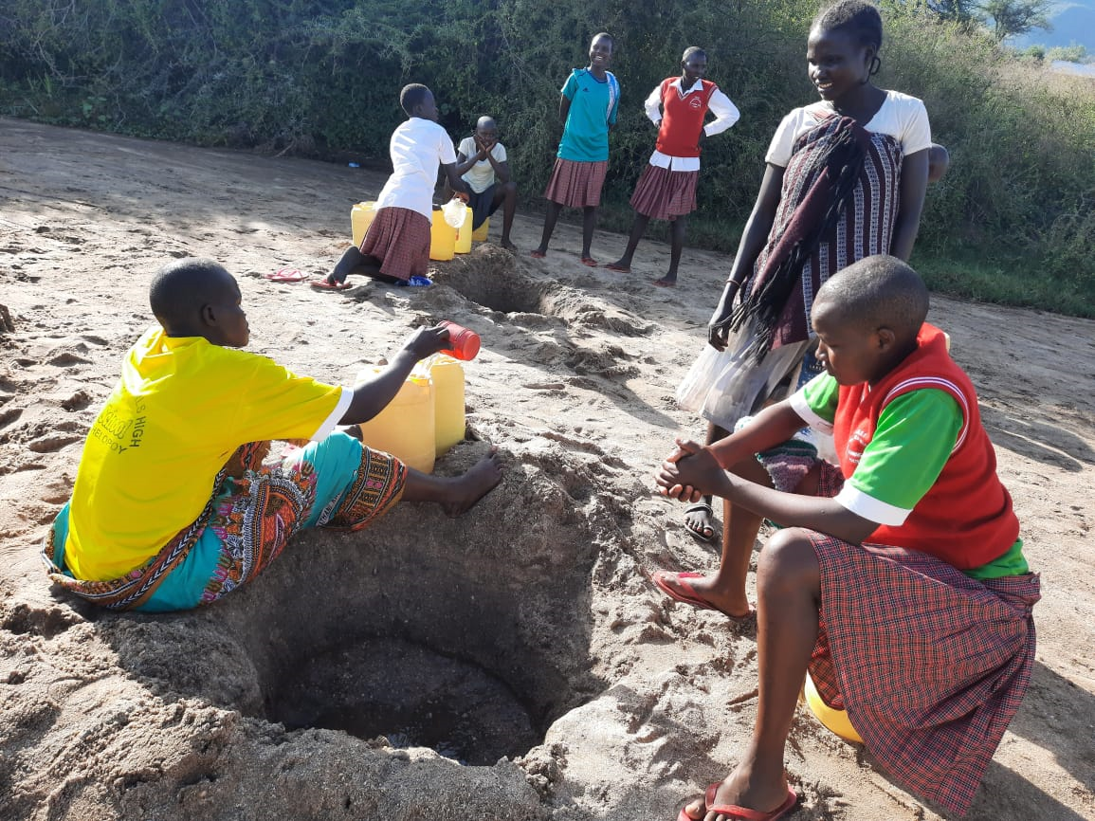
FUTURE PLANS
RDS TO FOCUS MORE IN WEST POKOT
Is a semi-arid area.
More sandy and rocky.
Very hilly/mountainous.
Water table very low.
The need for clean and safe drinking water is much greater.

Slide 20
STRATEGIC PLANNING
DRILLED WELLS
The only viable option is drilling.
Need for RCs to join hand and support drilling.
Drilling is expensive about 2.3million ksh (170 000 SEK)

