Slide 1
REVIEW OF WATER PROJECT SPONSORED BY: AHUS AND WATER FOR ALL
REVIEW BY:
JACINTA KARIMI NICASIO

Slide 2
INTRODUCTION
Water: important resource for sustaining life. Clean and safe drinking water, hygiene and sanitation is important part in maintaining good health.
Rotary Doctors Sweden has been able to support communities’ access clean water through support of various RCs.
The Community makes request, form water project committee who oversee the protection of the spring, use and maintenance for sustainability for the project.

Slide 3
THE FOLLOWING WATER PROJECT HAS BEEN SUPPORTED BY YOUR CLUB
NO | WATER PROJECTS
1 | BAHARIN COMMUNITY SHALLOW WELL
2 | BONDENI COMMUNITY SHALLOW WELL
3 | CHIEF MUTENDE PRIMARY AND COMMUNITY SHALLOW WELL
4 | KAMWANA SHALLOW COMMUNITY SHALLOW WELL.
5 | KHALWENGE DISPENSARY AND COMMUNITY SHALLOW WELL
6 | KIMASE COMMUNITY SHALLOW WELL
7 | KORONGA COMMUNITY SHALLOW WELL

Slide 4
NO | WATER PROJECTS
8 | LUNYU COMMUNITY SHALLOW WELL.
9 | LUSHEYA COMMUNITY SHALLOW WELL.
10 | MAJI MAZURI COMMUNITY SHALLOW WELL.
11 | MARINDA DISPENSARY AND COMMUNITY SHALLOW WELL.
12 | MWANGAZA COMMUNITY SHALLOW WELL.
13 | NYANGERA COMMUNITY SHALLOW WELL.
14 | ST. EMANUEL PRIMARY AND COMMUNITY SHALLOW WELL.
15 | SUWO COMMUNITY SHALLOW WELL.
16 | TWIGA COMMUNITY SHALLOW WELL.
17 | ZEA DISPENSARY AND COMMUNITY SHALLOW WELL.

Slide 5
NO | WATER PROJECTS
18 | MOWLEMN CENTER COMMUNITY SHALLOW WELL
19 | ST. EMMANUEL COMMUNITY SHALLOW WELL
20 | TEMBELELA COMMUNITY SHALLOW WELL

Slide 6
NYANGERA COMMUNITY SHALLOW WELL
PERIOD OF SINKING:
July 2015.
AGE:
5years
CATCHMENT POPULATION:
250 Households, approximately 1500persons.

Slide 7
NYANGERA WELL REVIEW
NO | PARAMENTERS OF REVIEW | REPORT
1 | FUNCTIONALITY | Water, throughout the year round, well maintained by the committee. Pump working well
2 | FENCE | Not there, fencing posts eaten by ants
3 | SIGN POST | Still standing, visible and readable.
4 | USAGE | Very well used by the community members as they rely on this well for their safe source of water.
5 | ANY OTHER REPORT | Well maintained. Encouraged the community to keep up with the maintainance.

Slide 8
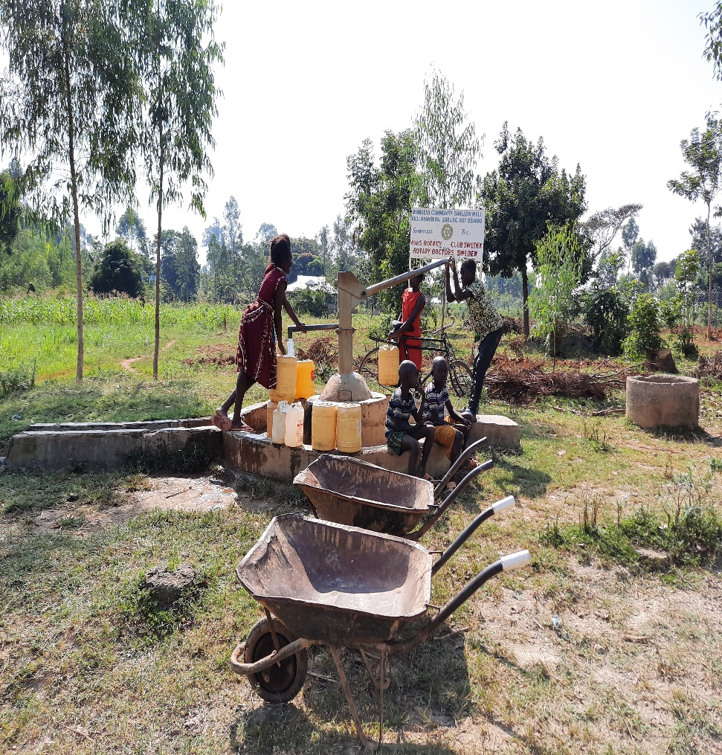
Status of Nyangera shallow well

Slide 9
Status nyangera shallow well

Slide 10
SUWO COMMUNITY SHALLOW WELL
PERIOD OF SINKING:
July/August 2016
AGE:
4years
CATCHMENT POPULATION:
150 Households, approximately 900persons.

Slide 11
SUWO WELL REVIEW
NO | PARAMENTERS OF REVIEW | REPORT
1 | FUNCTIONALITY | Water, throughout the year round, well maintained by the committee. Pump working well
2 | FENCE | Not there there.
3 | SIGN POST | Still standing, visible and readable.
4 | USAGE | Very well used by the community members as they rely on this well for their safe source of water.
5 | ANY OTHER REPORT | Well maintained. Encouraged the community to keep up with the maintenance.

Slide 12
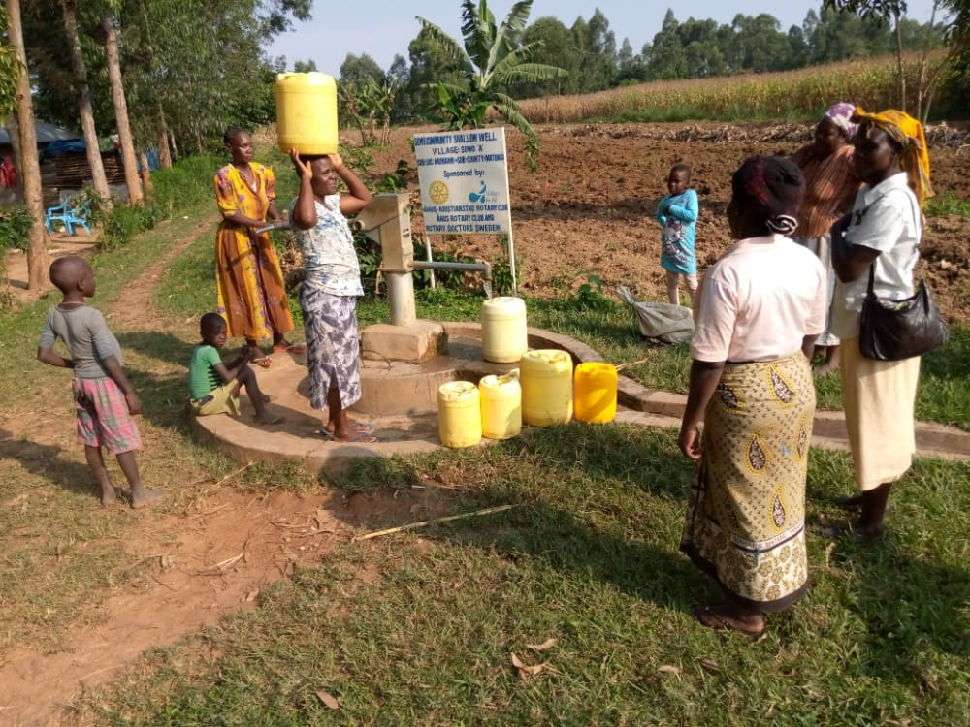
Status suwo shallow well

Slide 13
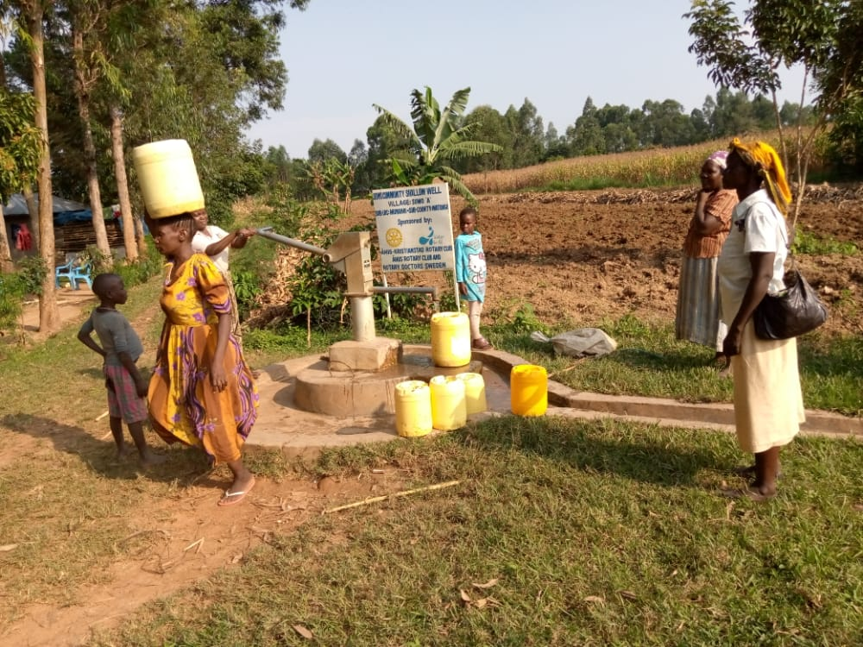
Suwo status

Slide 14
KHALWENGE DISPENSARY&COMMUNITY SHALLOW WELL
PERIOD OF SINKING:
Jan/feb 2016
AGE:
4years 7months
CATCHMENT POPULATION:
260 Households&a dispensary approximately 1380persons.

Slide 15
KHALWENGE DISPand COMMUNITY WELL REVIEW
NO | PARAMENTERS OF REVIEW | REPORT
1 | FUNCTIONALITY | Water, throughout the year round, well maintained by the committee. Pump working well
2 | FENCE | Not there there.
3 | SIGN POST | Still standing, visible and readable.
4 | USAGE | Very well used by the community members and for the daily operations of the dispensary.
5 | ANY OTHER REPORT | Well maintained. Encouraged the community to keep up with the maintenance.

Slide 16
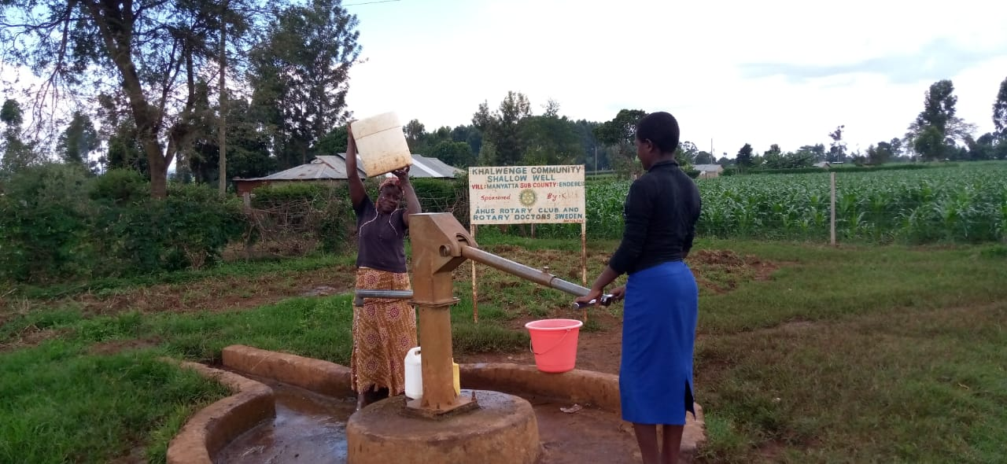
Status of khalwenge shallow well

Slide 17
UMOJA COMMUNITY SHALLOW WELL
PERIOD OF SINKING:
Sept 2016
AGE:
3years 10months
CATCHMENT POPULATION:
100 Households&a dispensary approximately persons and a market

Slide 18
UMOJA COMMUNITY WELL REVIEW
NO | PARAMENTERS OF REVIEW | REPORT
1 | FUNCTIONALITY | Water, throughout the year round, well maintained by the committee. Pump working well
2 | FENCE | Still there
3 | SIGN POST | Still standing, visible and readable.
4 | USAGE | Very well used by the community members
5 | ANY OTHER REPORT | Well maintained.

Slide 19
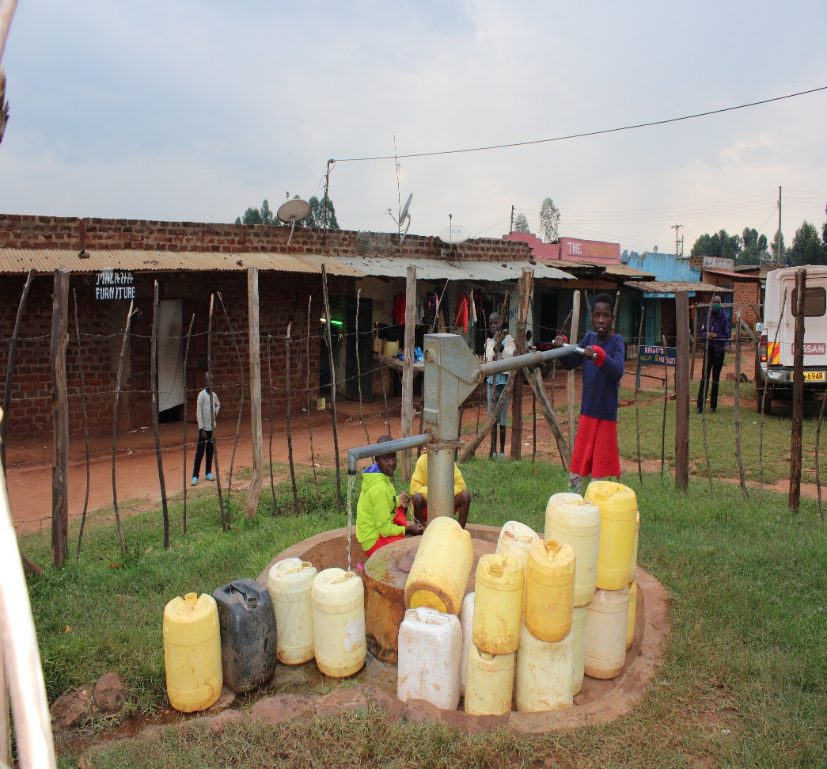
Umoja shallow well status

Slide 20
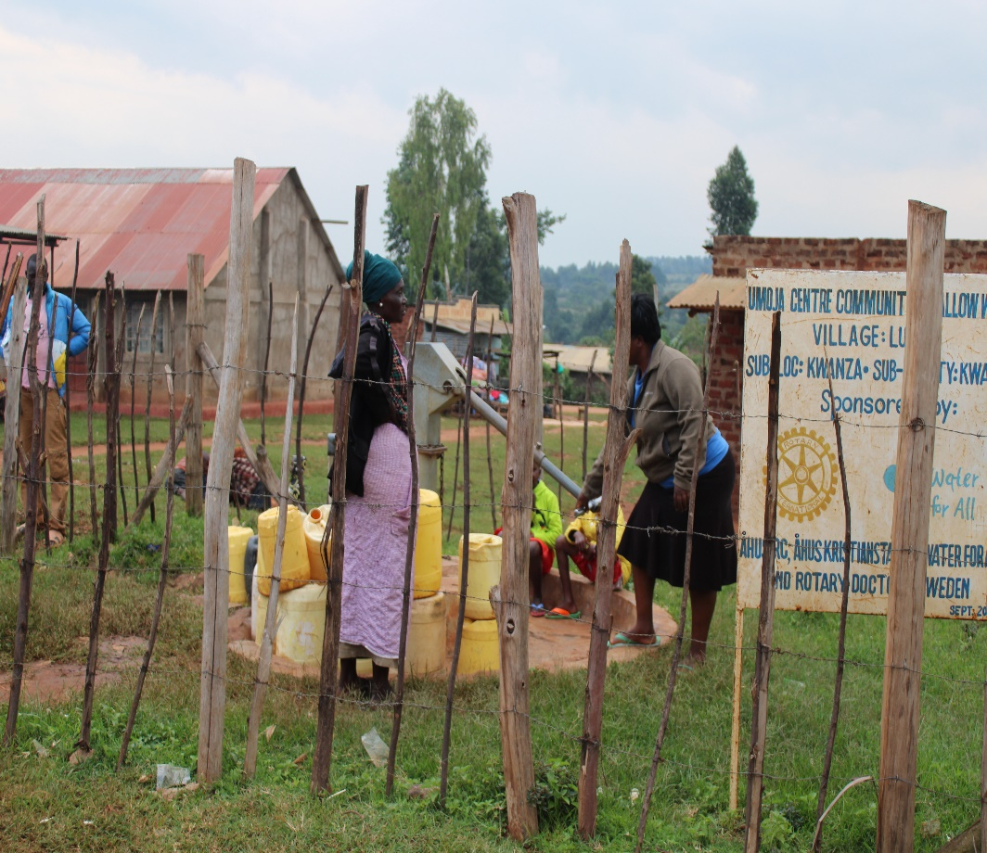

Slide 21
KORONGA PRIMARY &COMMUNITY SHALLOW WELL
PERIOD OF SINKING:
Sept/Oct 2016
AGE:
3years 10months
CATCHMENT POPULATION:
60 Households approximately 600persons & primary school ove 400 pupils

Slide 22
Koronga primary and community well
NO | PARAMENTERS OF REVIEW | REPORT
1 | FUNCTIONALITY | Water, throughout the year round, well maintained by the committee. Pump working well
2 | FENCE | Not there there.
3 | SIGN POST | Still standing, visible and readable.
4 | USAGE | Very well used by the community members and primary school when schools are open.
5 | ANY OTHER REPORT | Well maintained.

Slide 23
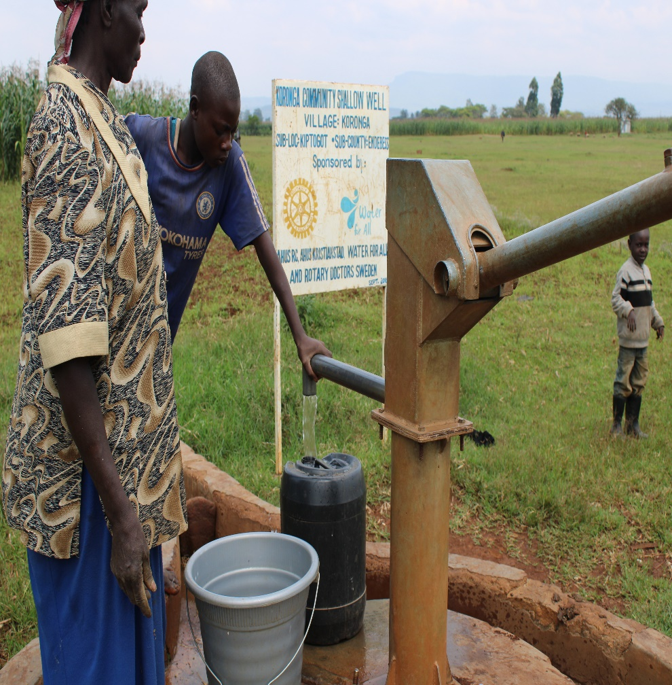
Status of the Koronga shallow well

Slide 24
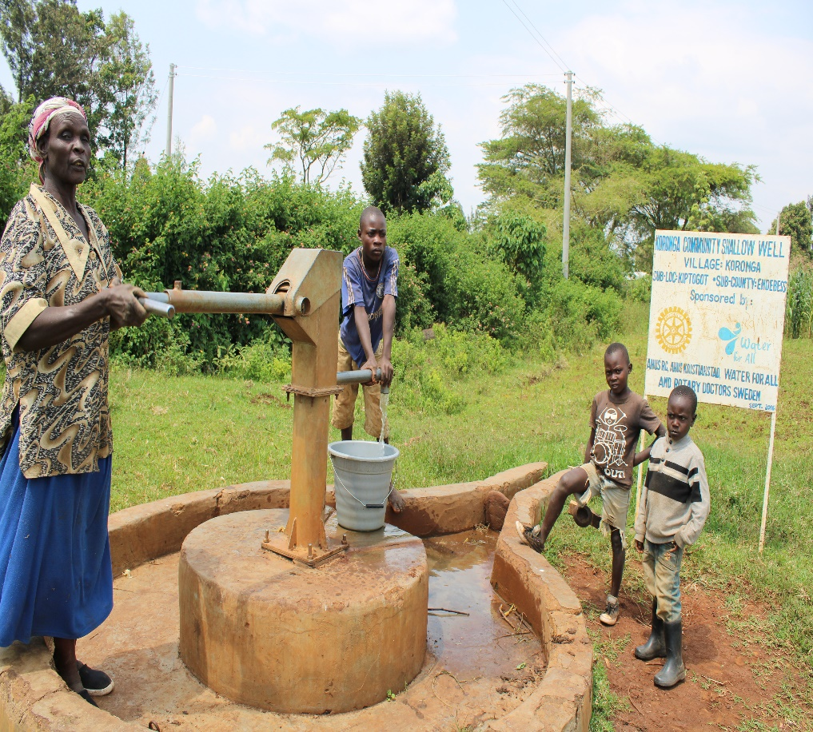
Status Koronga primary shallow well

Slide 25
KORONGA SECONDARY &COMMUNITY SHALLOW WELL
PERIOD OF SINKING:
Sept/Oct 2016
AGE:
3years 10months
CATCHMENT POPULATION:
80 Households approximately 480persons & sec school over 320student

Slide 26
Koronga secondary and community well
NO | PARAMENTERS OF REVIEW | REPORT
1 | FUNCTIONALITY | Water, throughout the year round, well maintained by the committee. Pump working well
2 | FENCE | Good, the community and school replaced the old one.
3 | SIGN POST | Still standing, visible and readable.
4 | USAGE | Very well used by the community members and secondary school when schools are open.
5 | ANY OTHER REPORT | Well maintained.

Slide 27
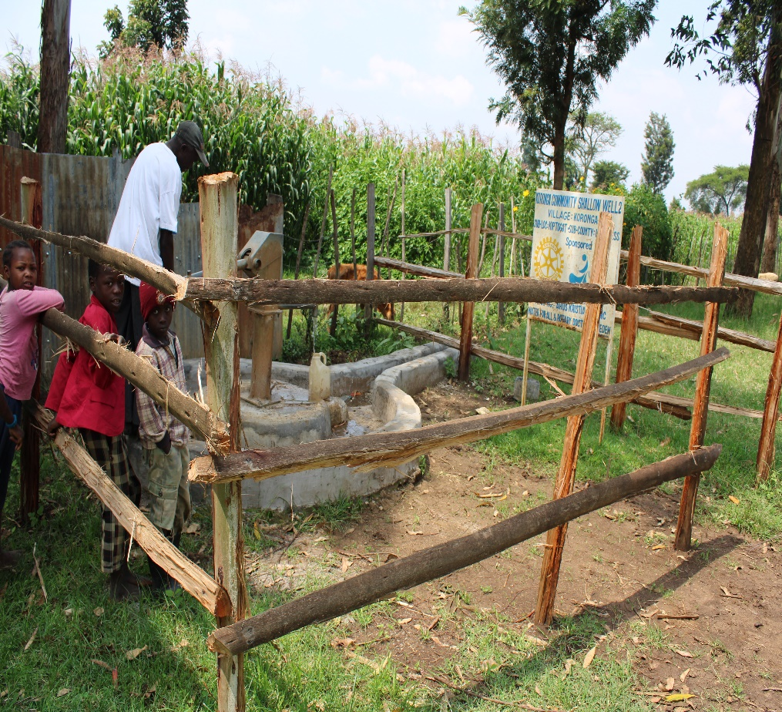
Status Koronga shallow well

Slide 28
MARINDA DISPENSARY &COMMUNITY SHALLOW WELL
PERIOD OF SINKING:
March/April 2016
AGE:
4years 3months
CATCHMENT POPULATION:
290 Households approximately 1740persons

Slide 29
MARINDA DISPand COMMUNITY WELL REVIEW
NO | PARAMENTERS OF REVIEW | REPORT
1 | FUNCTIONALITY | Water, throughout the year round, well maintained by the committee. Pump working well
2 | FENCE | Not there there.
3 | SIGN POST | Still standing, visible and readable.
4 | USAGE | well used by the community members and for the daily operations of the dispensary.
5 | ANY OTHER REPORT | Well maintained.

Slide 30
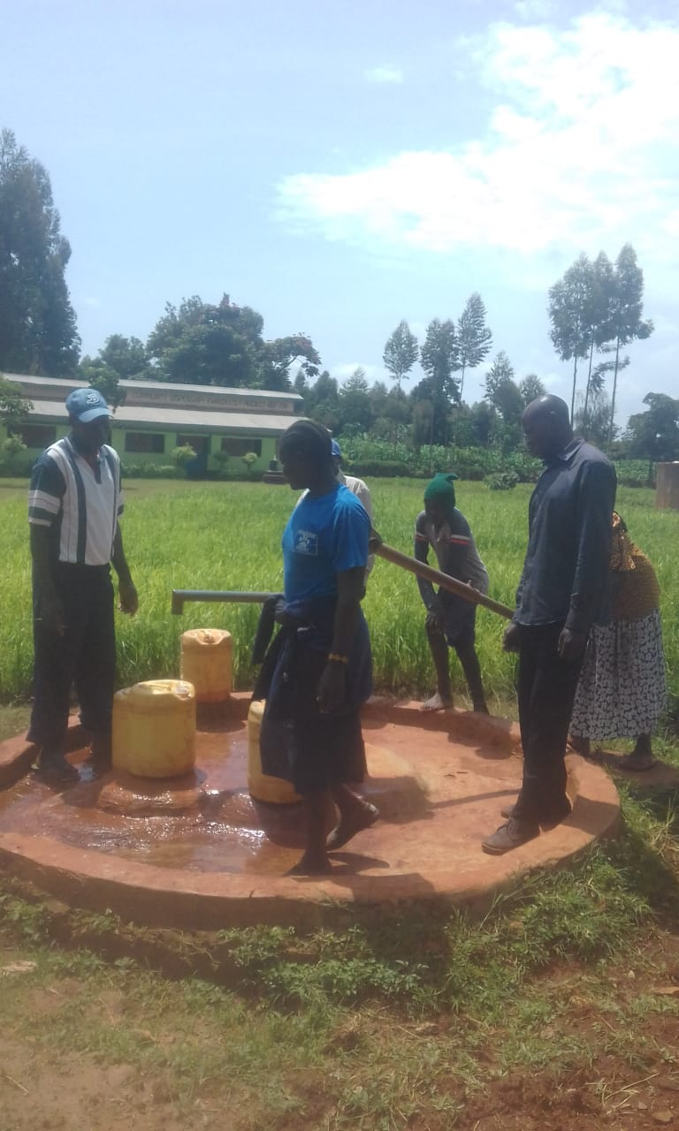
Status Marinda shallow well

Slide 31
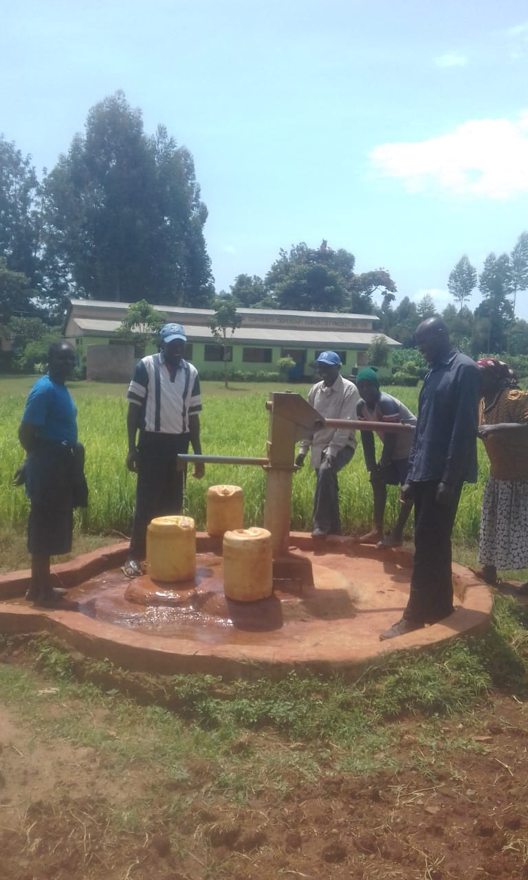

Slide 32
LUSHEYA PRIMARY and COMMUNITY SHALLOW WELL
PERIOD OF SINKING:
July/Aug 2017
AGE:
3years
CATCHMENT POPULATION:
300 Households approximately 1800persons and a primary school

Slide 33
LUSHEYA PRIMARYand COMMUNITY WELL REVIEW
NO | PARAMENTERS OF REVIEW | REPORT
1 | FUNCTIONALITY | Water, throughout the year round, well maintained by the committee. Pump working well
2 | FENCE | Not there there.
3 | SIGN POST | Still standing, visible and readable.
4 | USAGE | well used by the community members and for the primary school.
5 | ANY OTHER REPORT | Well maintained.

Slide 34
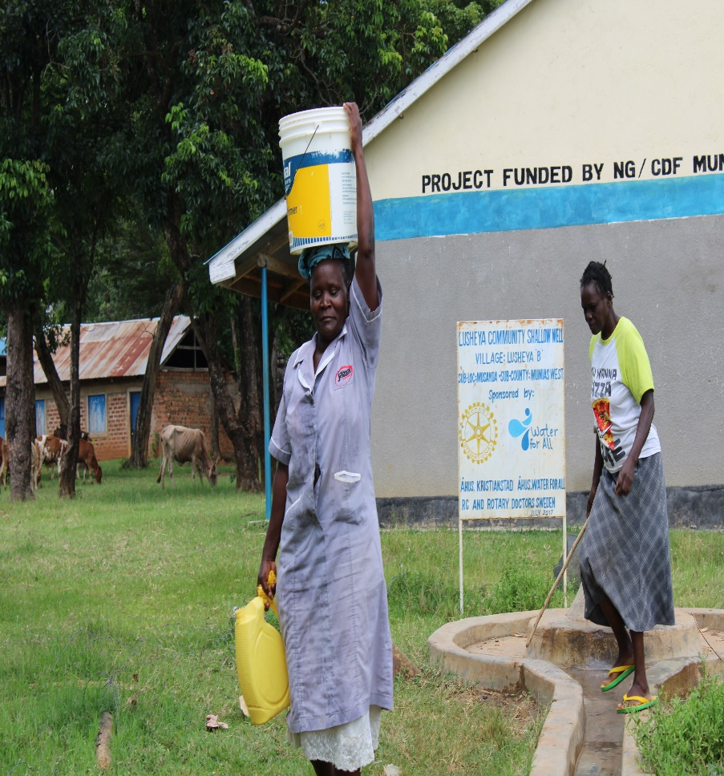
Status lusheya shallow well

Slide 36
BAHARINI COMMUNITY SHALLOW WELL
PERIOD OF SINKING:
FEB/MAR 2018.
AGE:
2 years and 3months
CATCHMENT POPULATION:
122 Households, approximately 732persons.

Slide 37
BAHARINI WELL REVIEW
NO | PARAMENTERS OF REVIEW | REPORT
1 | FUNCTIONALITY | Water, throughout the year round, well maintained by the committee.
2 | FENCE | Fence has been destroyed by the ants, the effort of the community to put up another also ended up being brought down.
3 | SIGN POST | Still standing, visible and readable.
4 | USAGE | All the community members rely on this well for their safe source of water.
5 | ANY OTHER REPORT | Well maintained.

Slide 38
BAHARINI WELL REVIEW PICS

Slide 39
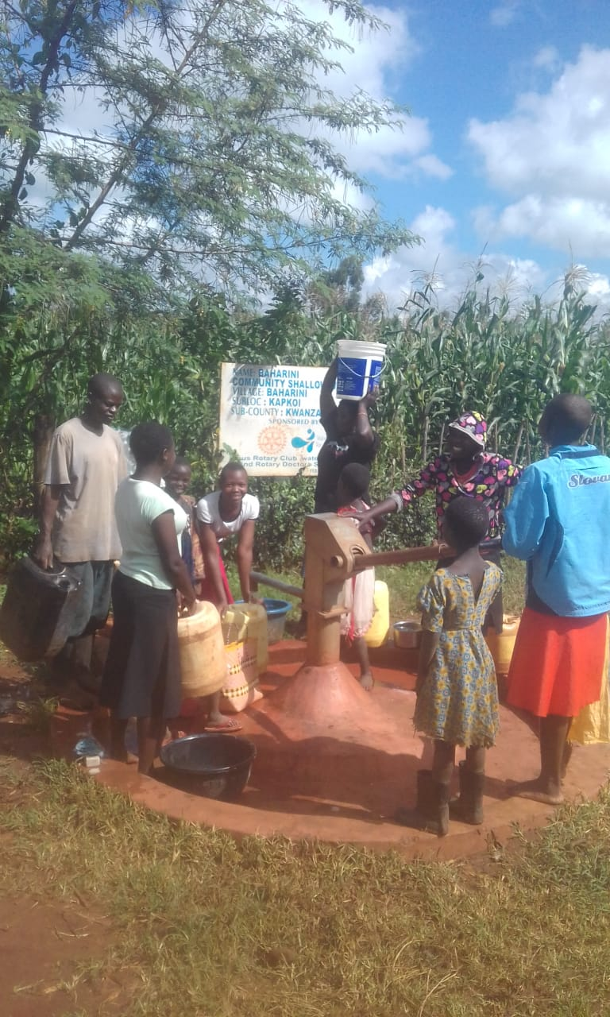

Slide 40
BONDENI COMMUNITY SHALLOW WELL
PERIOD OF SINKING:
Sept/Oct 2017.
AGE:
2 years and 9months
CATCHMENT POPULATION:
130 Households, approximately 780persons.

Slide 41
BONDENI WELL REVIEW
NO | PARAMENTERS OF REVIEW | REPORT
1 | FUNCTIONALITY | Water, throughout the year round, well maintained by the committee. Pump working well
2 | FENCE | Still there though some posts needs replacement
3 | SIGN POST | Still standing, visible and readable.
4 | USAGE | Very well used by the community members as they rely on this well for their safe source of water.
5 | ANY OTHER REPORT | Well maintained.

Slide 42
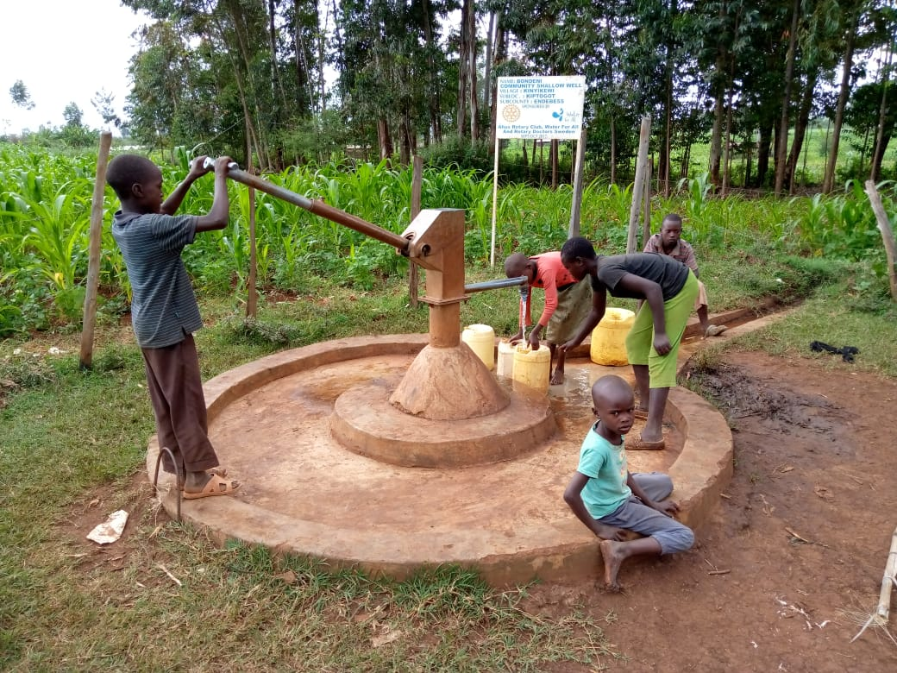
Status Bondeni well

Slide 43
BONDENI WELL REVIEW PICS

Slide 44
ST.EMMANUEL PRIMARY &COMMUNITY SHALLOW WELL
PERIOD OF SINKING:
Feb/March2017.
AGE:
3 years and 4months
CATCHMENT POPULATION:
70Households, approximately 420persons & a primary school of 1581

Slide 45
ST.EMMANUEL PRIMARY& COMMUNITY WELL REVIEW
NO | PARAMENTERS OF REVIEW | REPORT
1 | FUNCTIONALITY | Water, throughout the year round, well maintained by the committee. Pump working well
2 | FENCE | There was no fence from the beggining
3 | SIGN POST | Still standing, visible and readable.
4 | USAGE | Very well used by the community members and the primary school when schools are open as they rely on this well for their safe source of water.
5 | ANY OTHER REPORT | Well maintained.

Slide 46
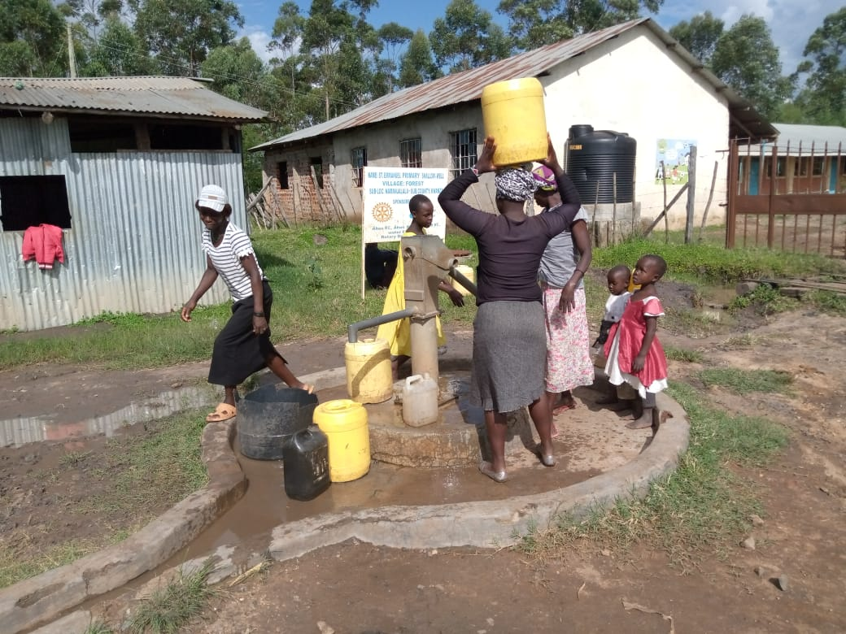
Status st.Emmauel primary and community well

Slide 48
ST.EMMANUEL COMMUNITY SHALLOW WELL
PERIOD OF SINKING:
Feb/March2017.
AGE:
3 years and 4months
CATCHMENT POPULATION:
650Households, approximately 3600person

Slide 49
ST.EMMANUEL COMMUNITY WELL REVIEW
NO | PARAMENTERS OF REVIEW | REPORT
1 | FUNCTIONALITY | Not functional for over four months now! The pump handle was broken and has not be repaired.
2 | FENCE | No fence
3 | SIGN POST | Still standing, visible and readable.
4 | USAGE | Not being used for the past five months
5 | ANY OTHER REPORT | The committee is not functional and therefore no one has been managing the well. The issue was addressed with the community volunteer who is working now with the area chief to form another committee and see the well repaired. For follow up.

Slide 50
Status of St Emmanuel community well

Slide 51
ZEA DISPENSARY$ COMMUNITY SHALLOW WELL
PERIOD OF SINKING:
Dec/Jan2018
AGE:
2 years and 7months
CATCHMENT POPULATION:
62 Households, approximately 372person and dispensary.

Slide 52
ZEA DISPENSARY &COMMUNITY WELL REVIEW
NO | PARAMENTERS OF REVIEW | REPORT
1 | FUNCTIONALITY | Water, throughout the year round, well maintained by the committee. Pump working well
2 | FENCE | Fence still maintained
3 | SIGN POST | Still standing, visible and readable.
4 | USAGE | Very well used by the community members and the dispensary for its daily operations .
5 | ANY OTHER REPORT | Well maintained.

Slide 53
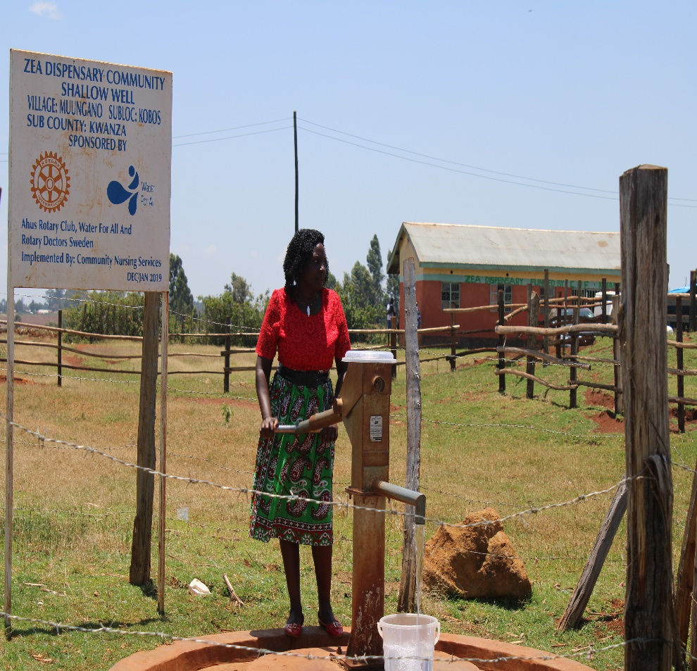
Status of Zea dispensary & community well

Slide 54
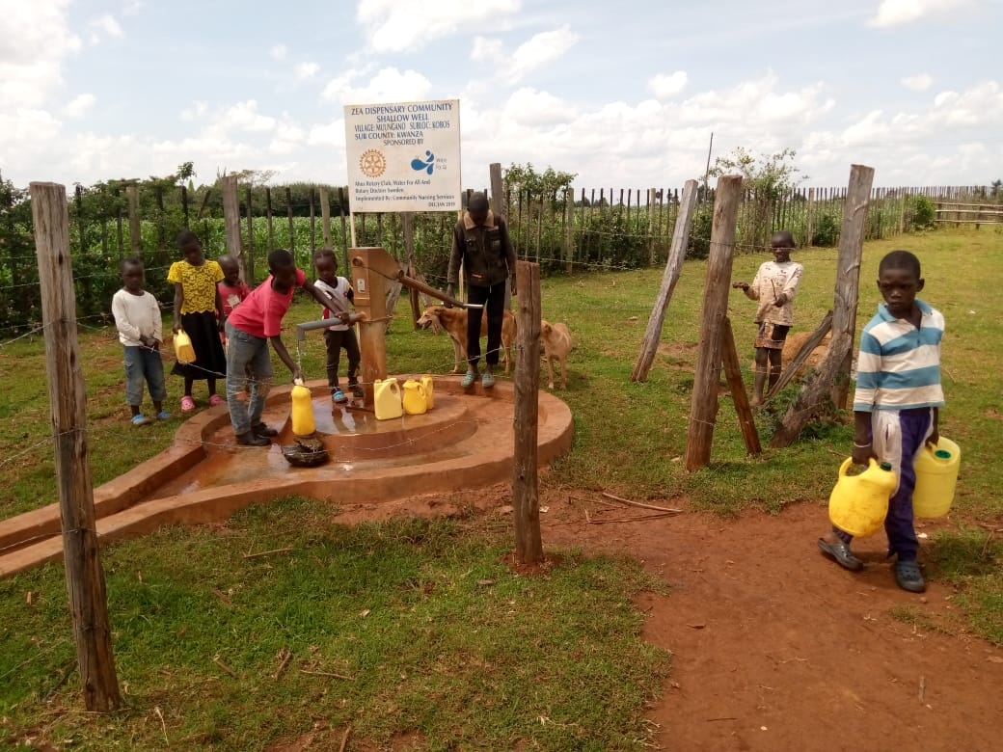

Slide 55
KIMASE COMMUNITY SHALLOW WELL
PERIOD OF SINKING:
July/August2018
AGE:
2 years
CATCHMENT POPULATION:
150 Households, approximately 900person.

Slide 56
KIMASE COMMUNITY WELL REVIEW
NO | PARAMENTERS OF REVIEW | REPORT
1 | FUNCTIONALITY | Water, throughout the year round, Not very well maintained by the committee. Pump working well
2 | FENCE | Fence not there
3 | SIGN POST | Still standing, visible and readable.
4 | USAGE | Very well used by the community members .
5 | ANY OTHER REPORT | Committee need to be encouraged to keep the environment clean as seemed dirty.

Slide 57
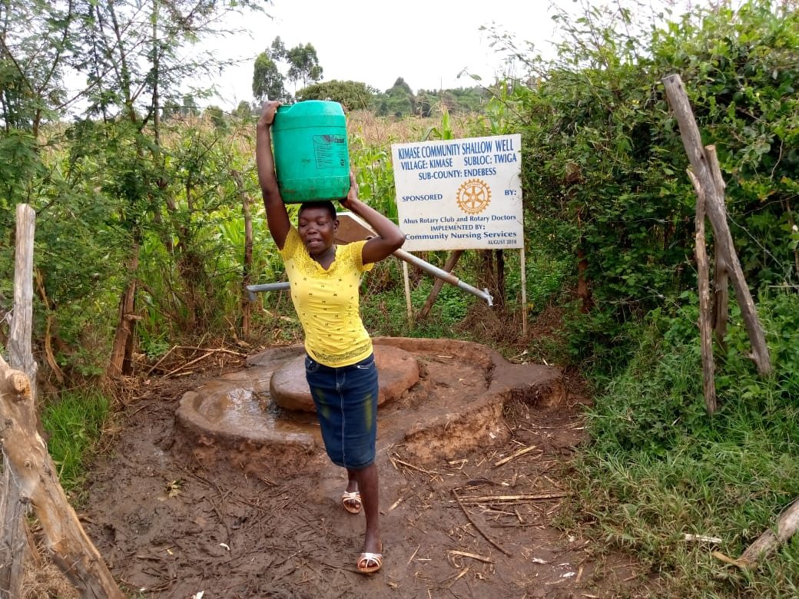
Status of kimase community shallow well

Slide 59
KAMWANA COMMUNITY SHALLOW WELL
PERIOD OF SINKING:
August/Sept 2018
AGE:
1 years 10Months
CATCHMENT POPULATION:
158 Households, approximately 946person

Slide 60
KAMWANA COMMUNITY WELL REVIEW
NO | PARAMENTERS OF REVIEW | REPORT
1 | FUNCTIONALITY | Water, throughout the year round, Well maintained by the committee. Pump working well
2 | FENCE | There
3 | SIGN POST | Still standing, visible and readable.
4 | USAGE | Very well used by the community members .
5 | ANY OTHER REPORT | For future followup

Slide 61
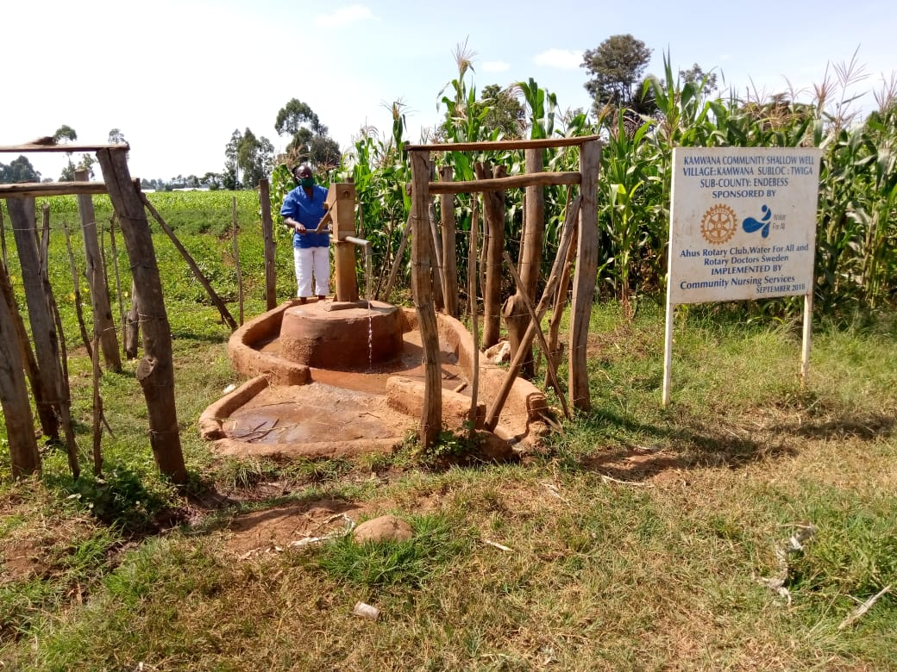
Status of Kamwana shallow well

Slide 62
CHIEF MUTENDE PRIMARY& COMMUNITY SHALLOW WELL
PERIOD OF SINKING:
Feb/Marc 2018
AGE:
2 years 4Months
CATCHMENT POPULATION:
80 Households, approximately 480persons and 300 pupils when schools are open.

Slide 63
CHIEF MUTENDE PRIMARY &COMMUNITY WELL REVIEW
NO | PARAMENTERS OF REVIEW | REPORT
1 | FUNCTIONALITY | Water, throughout the year round, Well maintained by the committee. Pump working well
2 | FENCE | Not there, well within school compound.
3 | SIGN POST | Still standing, visible and readable.
4 | USAGE | Very well used by the community members and the pupils when schools are open.
5 | ANY OTHER REPORT | For future follow up.

Slide 64
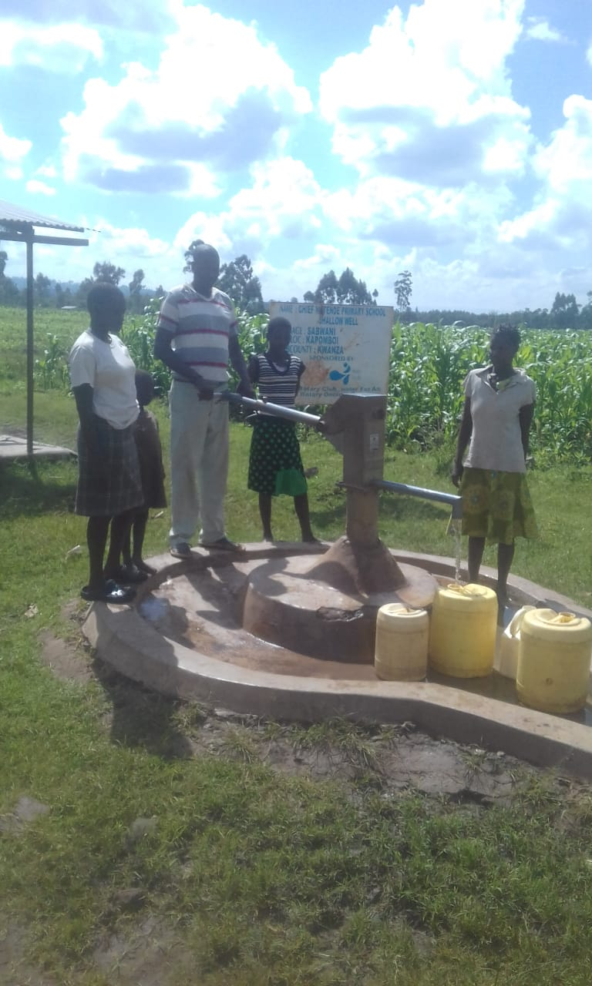
Status of the chief Mutende well

Slide 65
TWIGA COMMUNITY SHALLOW WELL
PERIOD OF SINKING:
Feb/Marc 2019
AGE:
1Year 4Months
CATCHMENT POPULATION:
198 Households, approximately 1188persons

Slide 66
TWIGA COMMUNITY WELL REVIEW
NO | PARAMENTERS OF REVIEW | REPORT
1 | FUNCTIONALITY | Water, throughout the year round, Well maintained by the committee. Pump working well
2 | FENCE | Still there
3 | SIGN POST | Still standing, visible and readable.
4 | USAGE | Very well used by the community members and the pupils when schools are open.
5 | ANY OTHER REPORT | Still very new less than 2 years.For future follow up.

Slide 67
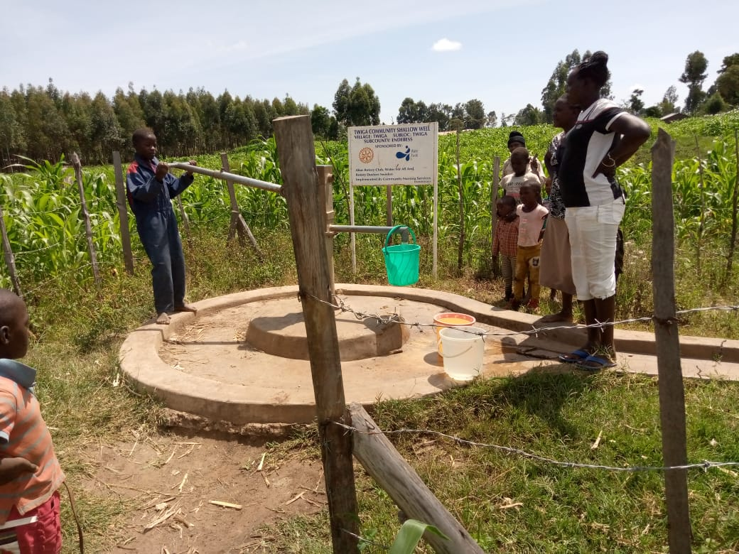
Status of Twiga shallow well

Slide 68
MAJI MAZURI COMMUNITY SHALLOW WELL
PERIOD OF SINKING:
May2019
AGE:
1Year 2Months
CATCHMENT POPULATION:
110Households, approximately 660persons

Slide 69
MAJI MAZURI COMMUNITY WELL REVIEW
NO | PARAMENTERS OF REVIEW | REPORT
1 | FUNCTIONALITY | Water, throughout the year round, Well maintained by the committee. Pump working well
2 | FENCE | Still there
3 | SIGN POST | Still standing, visible and readable.
4 | USAGE | Very well used by the community members and the pupils when schools are open.
5 | ANY OTHER REPORT | Still very new less than 2 years.For future follow up.

Slide 70
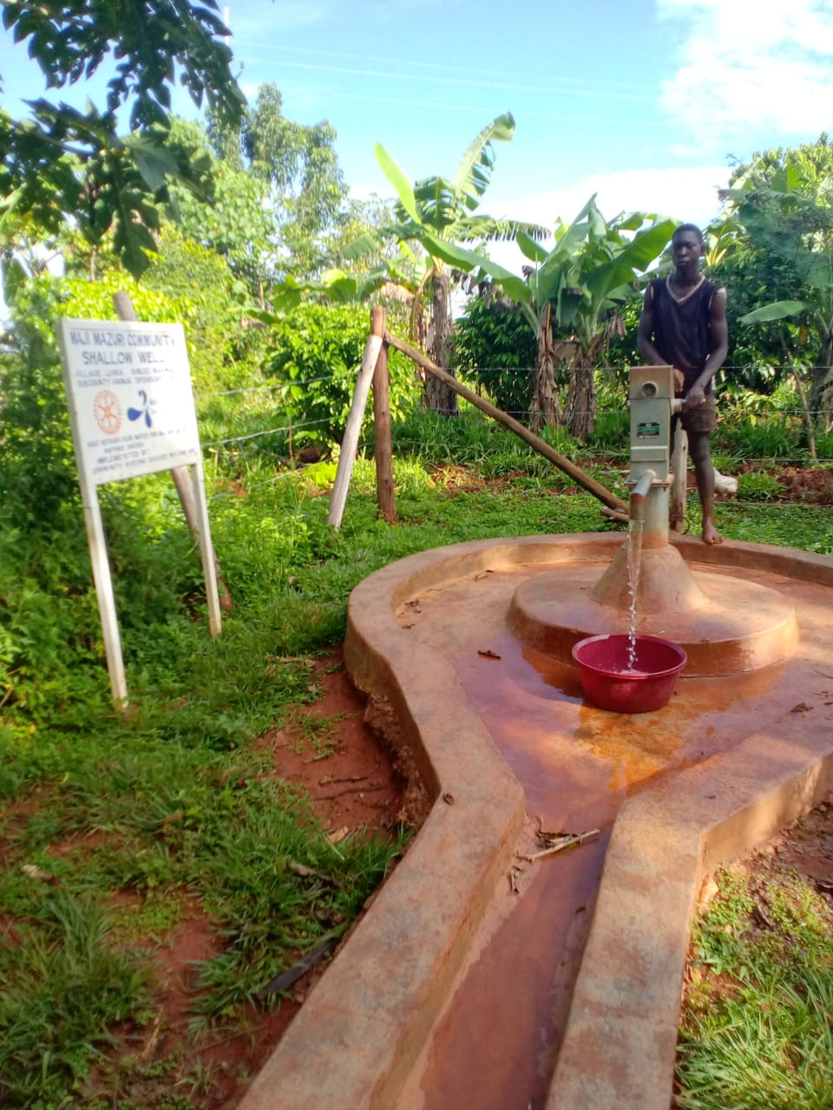
Status of the spring Maji mazuri

Slide 71
LUNYU COMMUNITY SHALLOW WELL
PERIOD OF SINKING:
June/July 2019
AGE:
1Year
CATCHMENT POPULATION:
78 Households, approximately 468persons

Slide 72
LUNYU COMMUNITY WELL REVIEW
NO | PARAMENTERS OF REVIEW | REPORT
1 | FUNCTIONALITY | Water, throughout the year round, Well maintained by the committee. Pump working well
2 | FENCE | Still there
3 | SIGN POST | Still standing, visible and readable.
4 | USAGE | Very well used by the community members and the pupils when schools are open.
5 | ANY OTHER REPORT | Still very new less than 2 years. For future follow up.

Slide 73
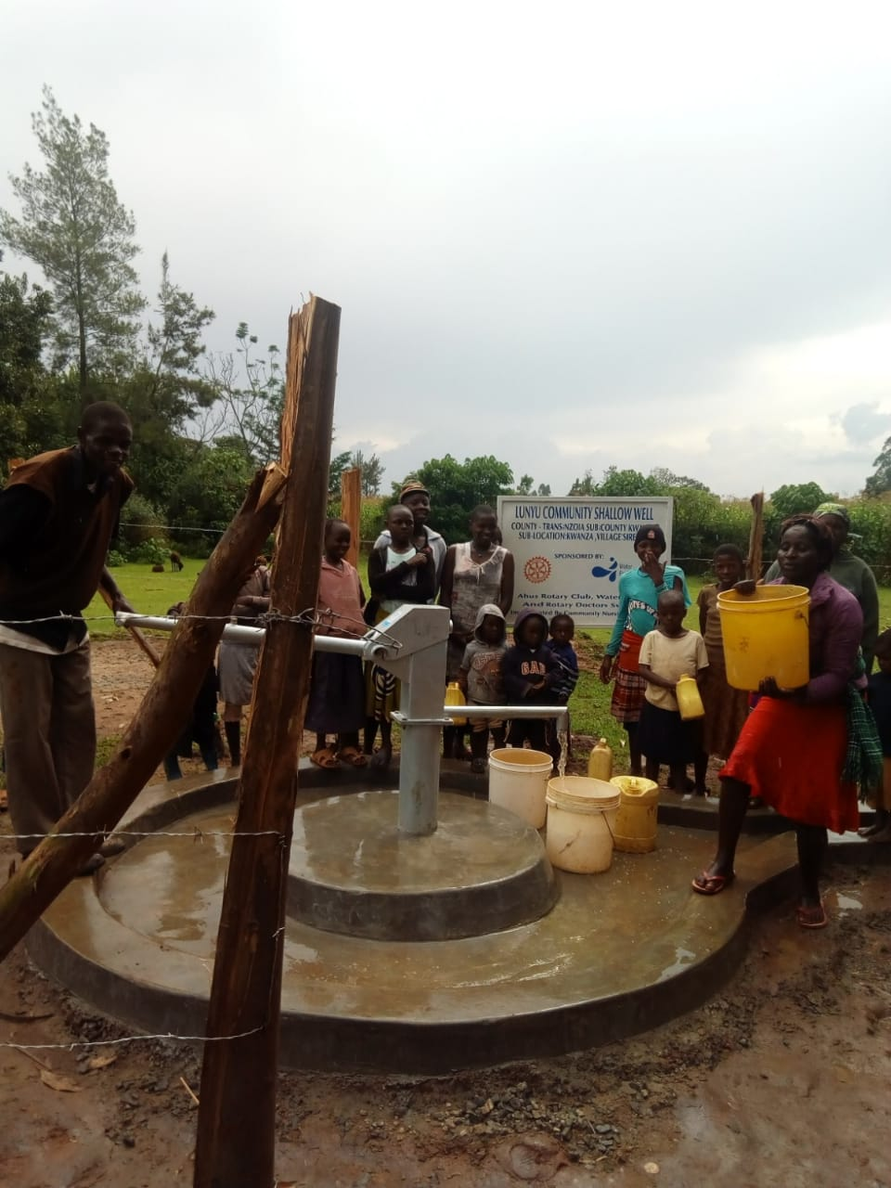
Status Lunyu community well

Slide 75
COMMENTS
The community shallow wells visited are doing good except one St.Emmanuel community which the pump handle broke down, no functional committee to foresee the repair.
We have scheduled for a follow-up meeting with the area chief and community to form a new committee. For future follow-up
The main challenge is fallen fencing posts in some wells.
Five or so projects have not been visited, three are just very new and once I visit them I will update the club.
It was encouraging to see most of the projects are doing well, the community is committed to maintaining them and using them.

Slide 76
VOTE OF THANKS
To Ahus and water for all RC Sweden, on behalf of the Community, The Rotary Doctors Sweden and the Community Nursing Services. Thank you so much for this support and you can see how you have transformed the health of many in the community through safe drinking water!
THANK YOU and STAY SAFE FROM CORONA
JACINTA K. NICASIO

