Slide 1
REVIEW OF LERUM RC SPONSORED PROJECTS
BY.
JACINTA K. NICASIO

Slide 2
INTRODUCTION.
Water: important resource for sustaining life. Clean and safe drinking water, hygiene and sanitation is important part in maintaining good health.
Rotary Doctors Sweden has been able to support communities’ access clean water through support of various Rotary Clubs.
The Community makes request, form water project committee who oversee the protection of the spring, use and maintenance for sustainability for the project.

Slide 3
PARAMETERS OF REVIEW
Checking if the spring is still protected or destroyed, if the well is still working.
The fence is still there or not.
Sign post showing the sponsoring club.
Water flow
Drainage system working or not.
Sign of community usage.
Any other issues that need to be addressed and who is responsible

Slide 4
LERUM RC SPONSORED WATER PROJECTS
ONE SPRING.
MAKUTANO COMMUNITY SPRING.
THREE SHALLOW WELLS.
BALONGO COMMUNITY SHALLOW WELL.
SOYMINING COMMUNITY DISPENSARY SHALLOW WELL.
WERE COMMUNITY SHALLOW WELL

Slide 5
MAKUTANO COMMUNITY SPRING
PERIOD OF PROTECTED:
NOV. 2017
AGE:
2 year and 11months
CATCHMENT POPULATION:
170 Households, approximately 1020 persons.

Slide 6
MAKUTANO COMMUNITY SPRING REVIEW
 | PARAMETOR OF REVIEW | REPORT
1 | FUNCTIONALITY | Good, Never dries up even in dry seasons. Drainage well maintained and the water is flowing well.
2 | FENCE | Eaten by ants already and missing.
3 | SIGN POST | The sign post is still on and is readable.
4 | USAGE | The community use this as the only source of clean water. It used for drinking and house chores.
5 | ANY OTHER REPORT | Functional committee.

Slide 7
CURRENT STATUS OF MAKUTANO SPRING

Slide 8
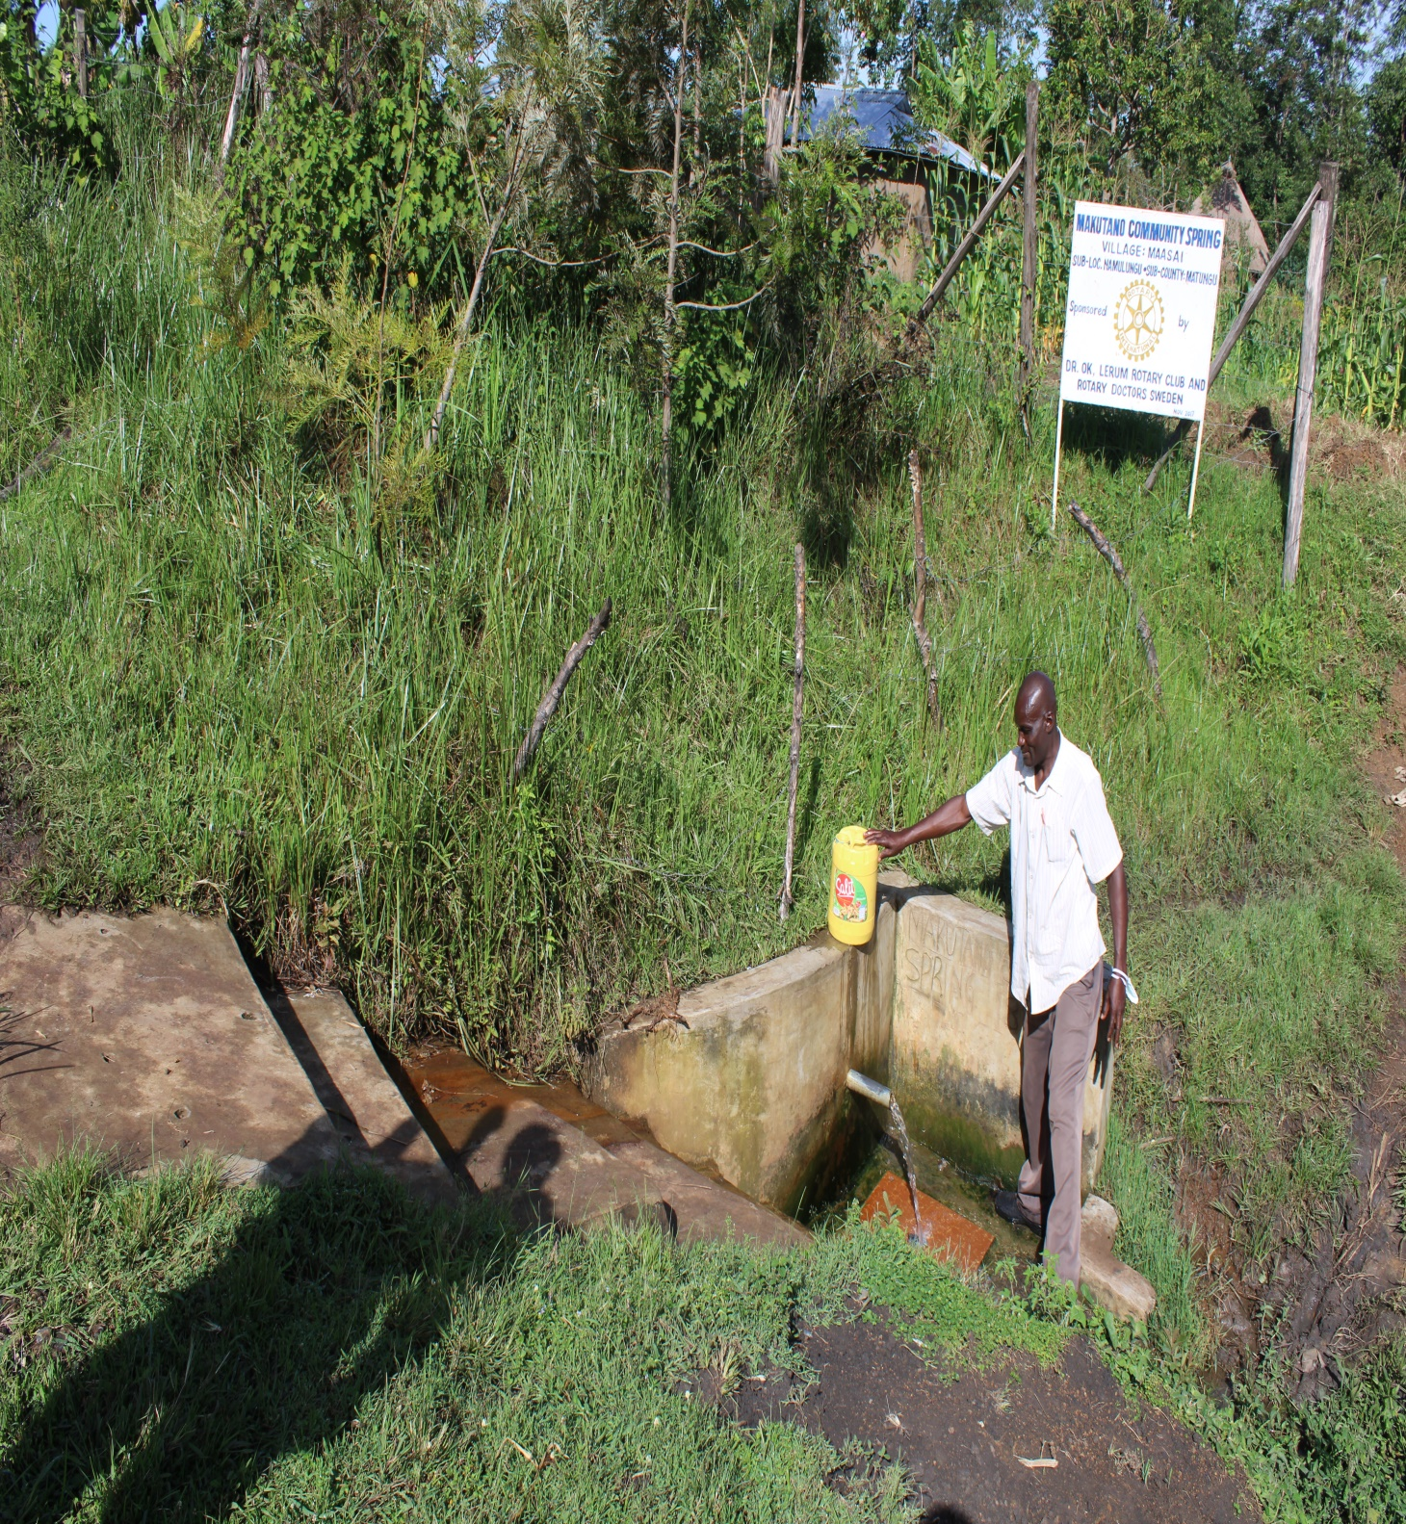

Slide 9
SOYMINING COMMUNITY SHALLOW WELL
PERIOD OF PROTECTED:
Nov. 2018
AGE:
About 2 years old.
CATCHMENT POPULATION:
108 Households, approximately 648 persons.

Slide 10
SOYMING COMMUNITY SHALLOW WELL REVIEW REPORT
 | PARAMETOR OF REVIEW | REPORT
1 | FUNCTIONALITY | Good, Never dries up, the pump is functioning well. Poor drainage. Have organized for a meeting with the committee.
2 | FENCE | Not existing.
3 | SIGN POST | The sign post is still on and is readable.
4 | USAGE | The well was dug in the compound of Soyming Dispensary, the community is still using the well and the nurse in the dispensary oversees it.
5 | ANY OTHER REPORT | The Committee is none-functional and needs to be re formed.

Slide 11
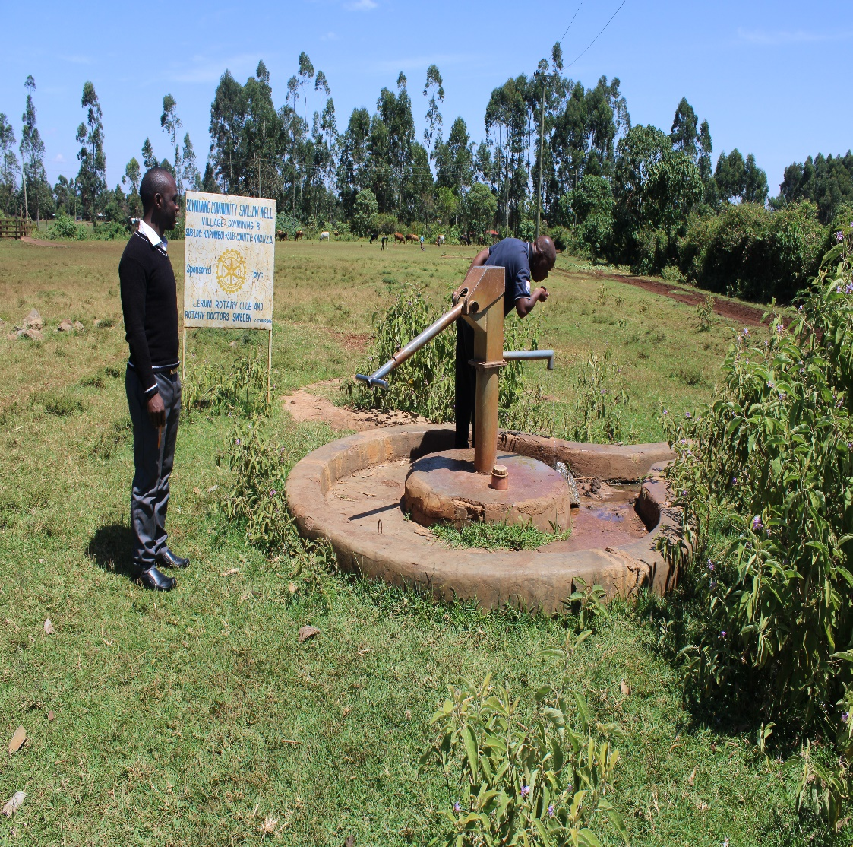
Current status of Soymining dispensary and community well.

Slide 12
WERE COMMUNITY SHALLOW WELL
PERIOD OF PROTECTED:
OCT. 2016
AGE:
About 4 years old.
CATCHMENT POPULATION:
140 Households, approximately 840 persons.

Slide 13
WERE COMMUNITTY SHALLOW WELL REVIEW REPORT
 | PARAMETOR OF REVIEW | REPORT
1 | FUNCTIONALITY | Well maintained well, never dries up, the pump is functioning well. drainage.
2 | FENCE | Fence is present and intact.
3 | SIGN POST | The sign post is still on and is readable.
4 | USAGE | Used by all household within the village and the area is kept very clean.
5 | ANY OTHER REPORT | The Committee is very active and well functioning.

Slide 14
CURRENT STATUS OF THE WELL

Slide 15
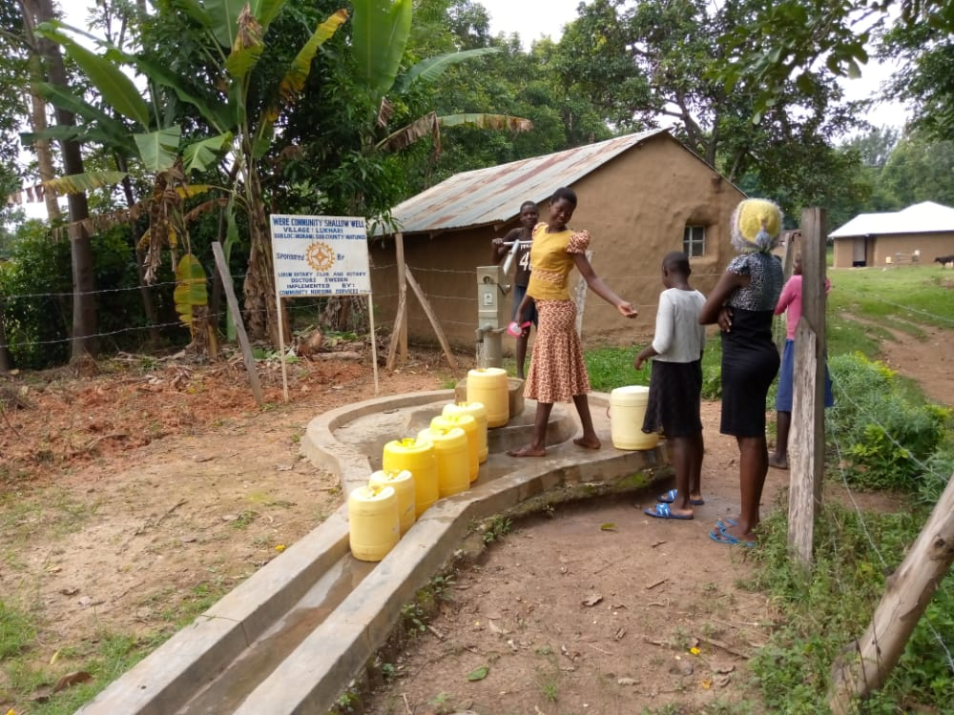
The community members found fetching water were very greatful for the project saying it has reduced the time used before searching for clean water and its has reduced water related disease in the village.

Slide 16
BALONGO COMMUNITY SHALLOW WELL
PERIOD OF PROTECTED:
NOV/DEC. 2019
AGE:
9 Months old.
CATCHMENT POPULATION:
97 Households, approximately 582 persons.

Slide 17
BALONGO COMMUNITY SHALLOW WELL REVIEW REPORT
 | PARAMETOR OF REVIEW | REPORT
1 | FUNCTIONALITY | Well maintained well, never dries up, the pump is functioning well. drainage. Has been handed over to the community.
2 | FENCE | Fence is present and intact since it is only some months old.
3 | SIGN POST | The sign post is still on and is readable.
4 | USAGE | Used by all the villagers as a source of clean drinking water and household water needs.
5 | ANY OTHER REPORT | The Committee is very active and well functioning.

Slide 18
Status of Balongo community well

Slide 19
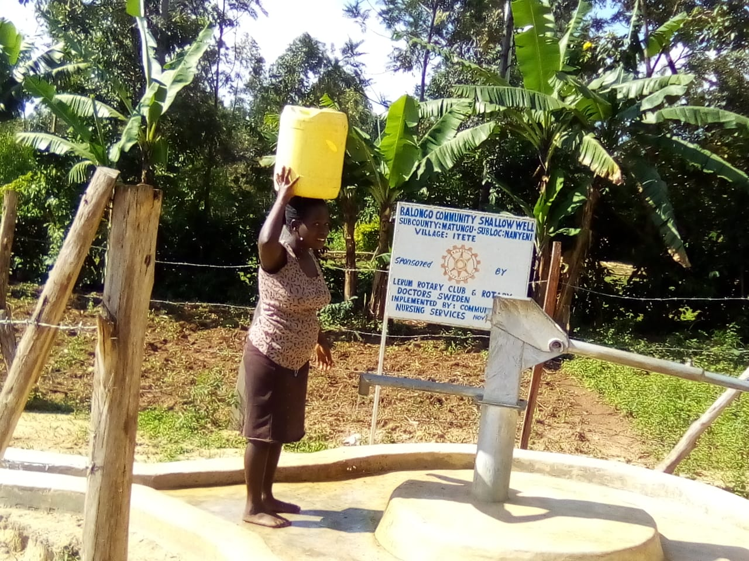

Slide 20
FINAL COMMENTS
Despite of the few maintenance challenges, all the projects are all working well and serving the purpose.
We will follow up with the formation of the committee for Soyming Dispensary and Community well.
We encourage the community to ensure the water projects are well maintained for sustainability.
The chairman of the volunteers will continue to do a follow up and update us.
Its worth the sacrifice of supporting the community to access clean and safe water.

Slide 21
VOTE OF THANKS
To LERUM RC , on behalf of the Community, The Rotary Doctors Sweden and the Community Nursing Services. Thank you so much for this support and you can see how you have transformed the health of many in the community through safe drinking water!
THANK YOU and STAY SAFE FROM CORONA
JACINTA K. NICASIO

