Slide 1
WATER PROJECTS: MUKOMARI AND KOYONZO COMMUNITY SAHLLOW WELL
SPONSORING CLUBS.
ANGELHOLM 4’s ROTARY CLUB

Slide 2
INTRODUCTION
Water: important resource for sustaining life. Clean and safe drinking water, hygiene and sanitation is important part in maintaining good health.
Rotary Doctors Sweden has been able to support communities’ access clean water through support of various RCs.
The Community makes request, form water project committee who oversee the sinking of the well, use and maintenance for sustainability for the project.

Slide 3
PARAMETERS OF REVIEW
Is the well is still functional.
Does it have fence.
Is the Sign post showing the sponsoring club.
Is the drainage system working.
Is it being used by the community.
Any other issues that need to be addressed and who is responsible

Slide 4
MUKOMARI COMMUNITY SHALLOW WELL
PERIOD OF SINKING:
Sept/Oct 2018.
AGE:
1 year 9 months.
CATCHMENT POPULATION:
78 Households, approximately 468 persons.

Slide 5
MUKOMARI WELL REVIEW REPORT
 | PARAMETORS OF REVIEW | REPORT
1 | FUNCTIONALITY | Well maintained and functioning
2 | FENCE | Well fenced
3 | SIGN POST | Present and readable
4 | USAGE | Heavily used through the year
5 | ANYOTHER REPORT

Slide 6
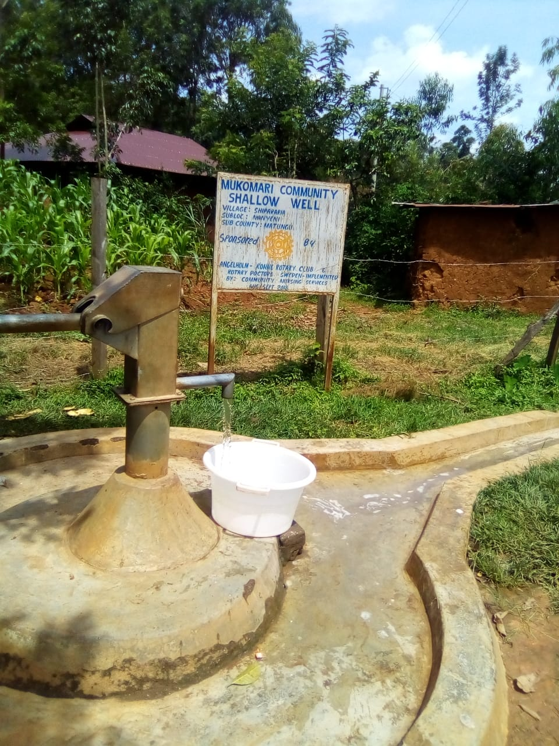
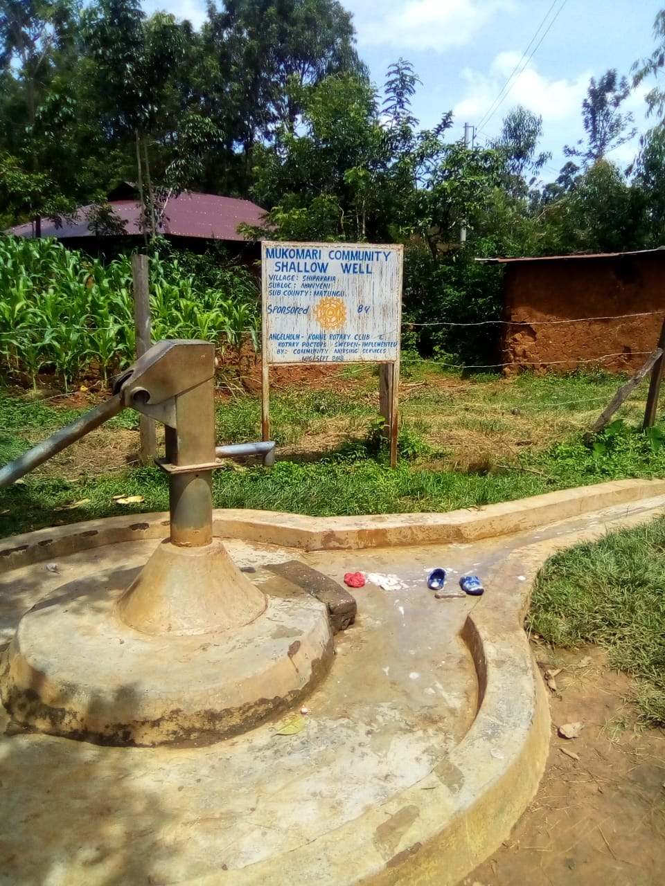
PICTURES OF THE WELL NOW

Slide 7
KOYONZO COMMUNITY SHALLOW WELL
PERIOD OF SINKING:
March/April 2019.
AGE:
1 year 2 months.
CATCHMENT POPULATION:
79 Households, approximately 471 persons.

Slide 8
KOYONZO WELL REVIEW REPORT
 | PARAMETORS OF REVIEW | REPORT
1 | FUNCTIONALITY | Well maintained and functioning
2 | FENCE | Well fenced
3 | SIGN POST | Present and readable
4 | USAGE | Heavily used through the year
5 | ANYOTHER REPORT

Slide 9
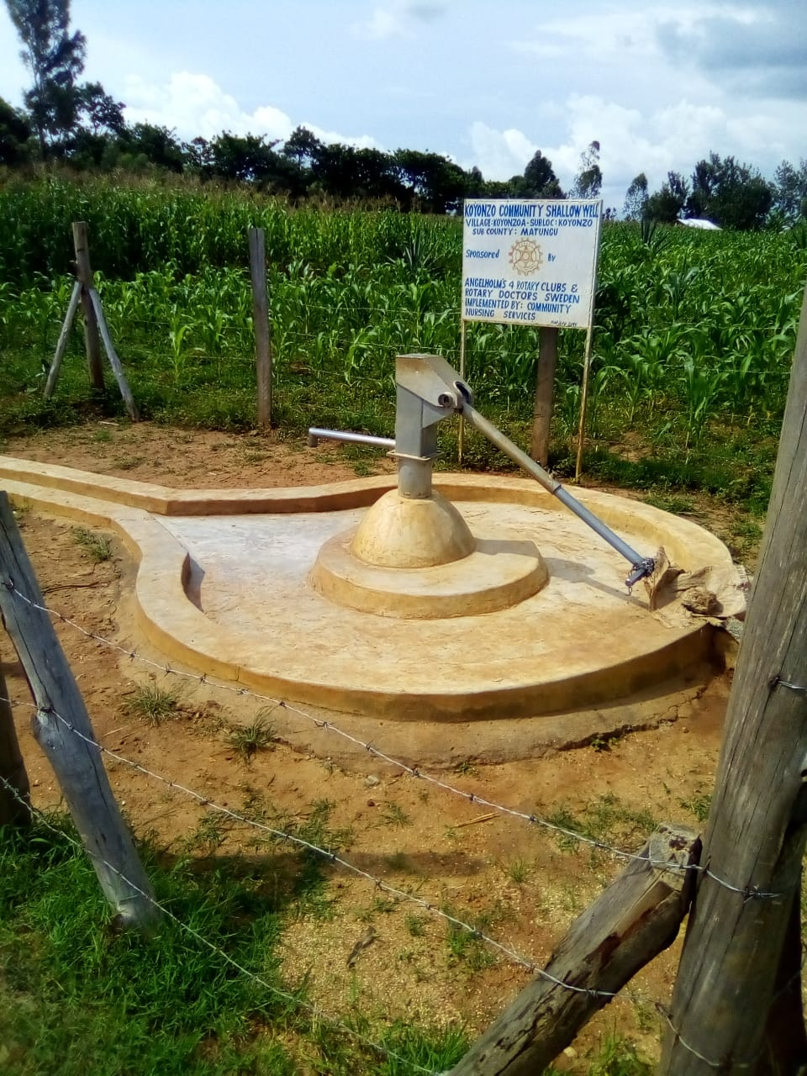
PICTURES OF CURRENT STUTUS OF THE WELL

Slide 10
GENERAL COMMENTS
Both wells, well functioning.
Has water all the year round.
Well functioning water committee.
Community contributing 50ksh per household for maintenance every month.

Slide 11
THANK YOU
Our apperception to your continued support to Rotary Doctors Sweden
REPORT BY:
JACINTA KARIMI

