Slide 1
REVIEW OF WATER PROJECTS SPONSORED
BY FALKENBERG RC’s
REVIEW BY: JACINTA K. NICASIO

Slide 2
INTRODUCTION
Water: important resource for sustaining life. Clean and safe drinking water, hygiene and sanitation is important part in maintaining good health.
Rotary Doctors Sweden has been able to support communities’ access clean water through support of various RCs.
The Community makes request, form water project committee who oversee the protection of the spring, use and maintenance for sustainability for the project.

Slide 3
THE FOLLOWING WATER PROJECT HAS BEEN SUPPORTED BY YOUR CLUB
KOMALA COMMUNITY SPRING
KURESOI COMMUNITY SPRING.
MUGANDA COMMUNITY SPRING
OKACHO COMMUNITY SPRING
SHAHAYA COMMUNITY SPRING
EMUTANGUCOMMUNITY SPRING
KOBIERO COMMUNITY SPRING
KABINGA COMMUNITY SPRING

Slide 4
SPRINGS SPONSORED BY YOUR CLUBS
KAKETCH COMMUNITY SPRING
ABUTI COMMUNITY SPRING
NAUTOKOMA COMMUNITY SPRING
PARANA COMMUNITY SPRING
MANGONGO COMMUNITY SPRING
NJEREMANI COMMUNITY SPRING
WAMANYA COMMUNITY SPRING
EBUSHIKAMMI COMMUNITY SPRING
ESHIKHUIRO COMMUNITY SPRING
KHENDWA COMMUNITY SPRING

Slide 5
SPRINGS SPONSORED BY YOUR CLUBS
KHULUTHA COMMUNITY SPRING
KISAR MUNITY SPRING
NAMBAKA COMMUNITY SPRING
USHITENDE COMMUNITY SPRING
KAMNARA COMMUNITY SPRING
KADUNYA COMMUNITY SPRING
MAPAO COMMUNITY SPRING
MUSENDA COMMUNITY SPRING
EMKWEN COMMUNITY SHALLOW WELL
UMALA GUL COMMUNITY SHALLOW WELL
KUNYU COMMUNITY SPRING

Slide 6
KOMALA COMMUNITY SPRING
PERIOD PROTECTED:
NOV2015
AGE:
4years and 8months
CATCHMENT POPULATION:
200 Households, approximately 1200persons.

Slide 7
KOMALA SPRING REVIEW REPORT
 | PARAMETOR OF REVIEW | REPORT
1 | FUNCTIONALITY | Good water flow good can take less than 2 min to fill a 20 water bucket . Drainage well maintained The spring never dries up.
2 | FENCE | Destroyed, post eaten by termites..
3 | SIGN POST | Was rusted and not readable and was taken away.
4 | USAGE | Used by lots of community members
5 | ANY OTHER REPORT | Functional committee, encouraged to repair the fence. For future follow-up.

Slide 8
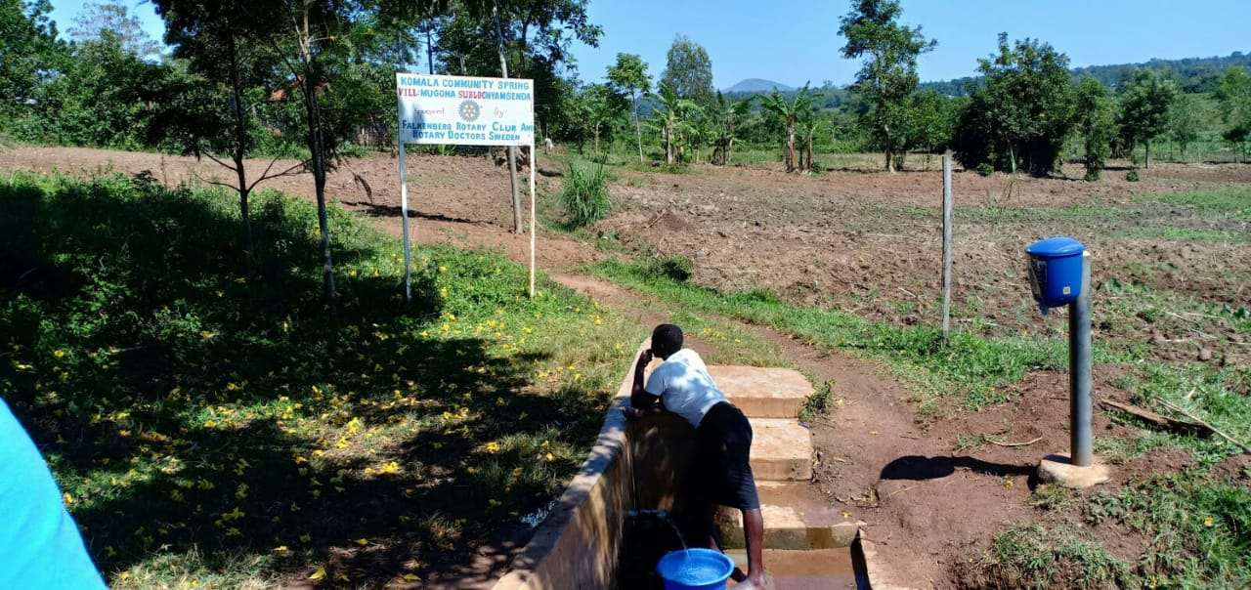
Status Komala spring

Slide 9
KURESOI COMMUNITY SPRING
PERIOD PROTECTED:
SEP/OCT 2015
AGE:
4yrs 10 months
CATCHMENT POPULATION:
140Households, approximately 840persons.

Slide 10
KURESOI SPRING REVIEW REPORT
 | PARAMETOR OF REVIEW | REPORT
1 | FUNCTIONALITY | Good water flow, fills a 20 water bucket within 30 seconds, Drainage well maintained Spring never dries up
2 | FENCE | Not there. But the catchment tress growing well
3 | SIGN POST | Not there, the community just woke up one day and didn’t find it.
4 | USAGE | Well used by the community for drinking, cooking, washing and laundry and for animals.
5 | ANY OTHER REPORT | Functional committee, well protected source with the seedlings already grown. The committee encouraged to do the fencing to protect the animals from grazing at the catchment area. For future follow-up

Slide 11
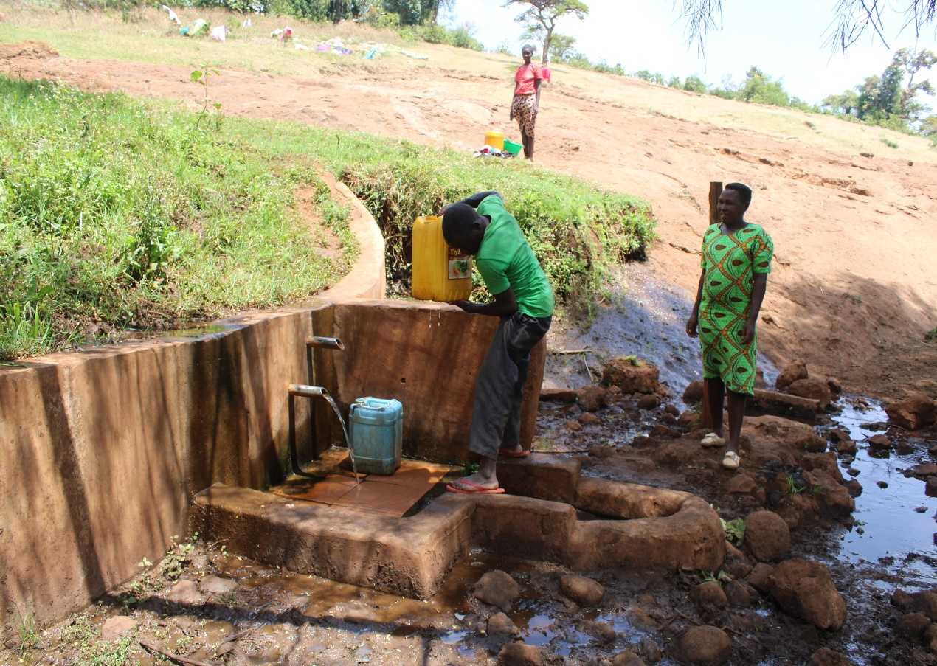
Status of Kuresoi spring

Slide 12
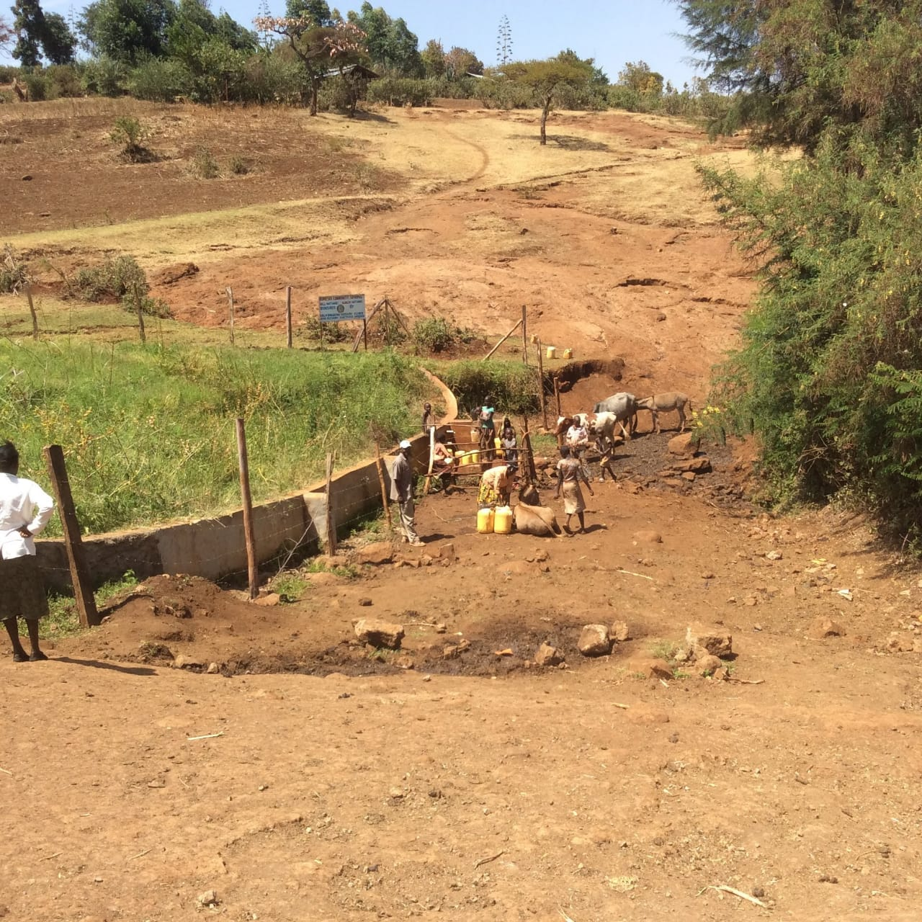
Status of kuresoi spring 2018.

Slide 13
MUGANDA COMMUNITY SPRING
PERIOD PROTECTED:
SEPT2016
AGE:
3Yrs and 9Months
CATCHMENT POPULATION:
64Households, approximately 372 persons.

Slide 14
MUGANDA SPRING REVIEW REPORT
 | PARAMETOR OF REVIEW | REPORT
1 | FUNCTIONALITY | Water flow throughout the year and fills a20 liter container in less than 30sec The drainage well maintained The spring never dries up
2 | FENCE AND DRAINAGE | No fence, the posts were eaten by ants
3 | SIGN POST | Still standing and readable.
4 | USAGE | Heavily used by all the house hold for drinking, cooking, washing and laundry and for animals.
5 | ANY OTHER REPORT | The community still happy and appreciates the project

Slide 15
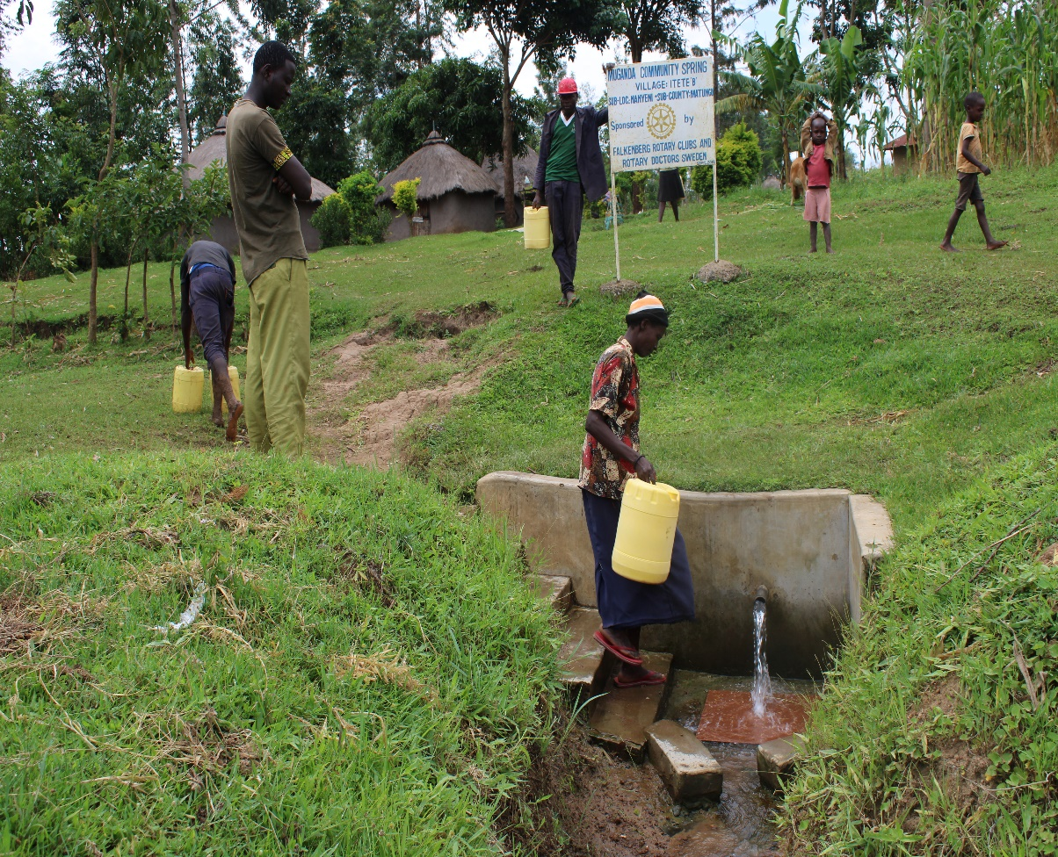
Status of muganda spring

Slide 16
OKACHO COMMUNITY SPRING
PERIOD PROTECTED:
JULY 2016
AGE:
4YRS
CATCHMENT POPULATION:
50Households, approximately 300 persons.

Slide 17
OKACHO SPRING REVIEW REPORT
 | PARAMETOR OF REVIEW | REPORT
1 | FUNCTIONALITY | Water flow throughout the year and fills a20 liter container in less than 2min .The drainage well maintained The spring never dries up. The pipe slightly worn out.
2 | FENCE AND DRAINAGE | No fence, the posts were eaten by ants
3 | SIGN POST | Still there and readable
4 | USAGE | Well used by the community for drinking, cooking, washing and laundry and for animals.
5 | ANY OTHER REPORT | The committee still functional. The community encouraged through the committee to replace the pipe. For future follow-up.

Slide 18
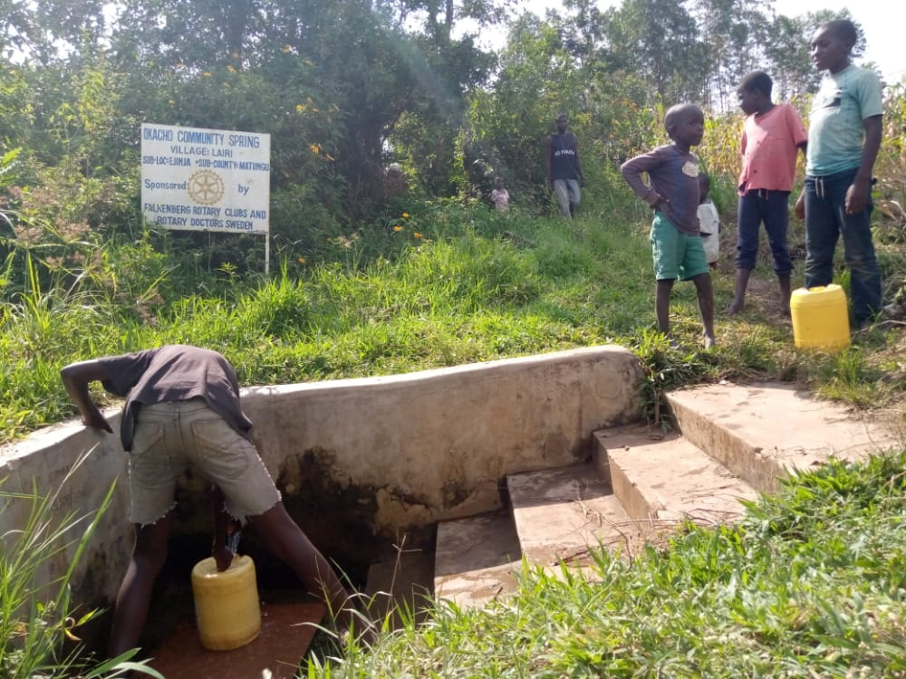
Status Okacho spring

Slide 19
SHAHAYA COMMUNITY SPRING
PERIOD PROTECTED:
JULY 2016
AGE:
4YRS
CATCHMENT POPULATION:
70Households, approximately420 persons.

Slide 20
SHAHAYA SPRING REVIEW REPORT
 | PARAMETOR OF REVIEW | REPORT
1 | FUNCTIONALITY | Water flow throughout the year and fills a20 liter container in less than 5min Drainage well maintained The spring never dries up.
2 | FENCE AND DRAINAGE | No fence, the posts were eaten by ants
3 | SIGN POST | Not there, rusted and was removed by the spring committee chairman.
4 | USAGE | Well used by the community for drinking, cooking, washing and laundry and for animals.
5 | ANY OTHER REPORT | The committee still functional. For future follow-up.

Slide 21
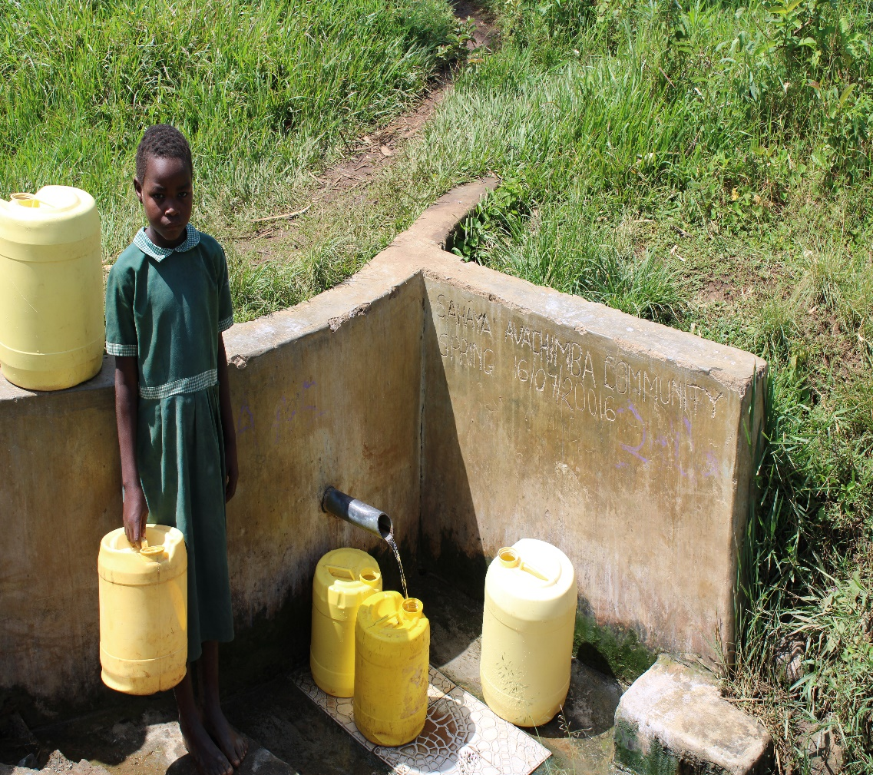
Status of Shahaya spring

Slide 22
EMUTANGU COMMUNITY SPRING
PERIOD PROTECTED:
JULY 2016
AGE:
4YRS
CATCHMENT POPULATION:
105 Households, approximately 630 persons.

Slide 23
EMUTANGU’ SPRING REVIEW REPORT
 | PARAMETOR OF REVIEW | REPORT
1 | FUNCTIONALITY | Water flow throughout the year and fills a20 liter container in less than 3min Drainage well maintained The spring never dries up.
2 | FENCE AND DRAINAGE | Fence still there
3 | SIGN POST | Standing and readable
4 | USAGE | Well used by the community for drinking, cooking, washing and laundry and for animals.
5 | ANY OTHER REPORT | The committee still functional. For future follow-up.

Slide 24
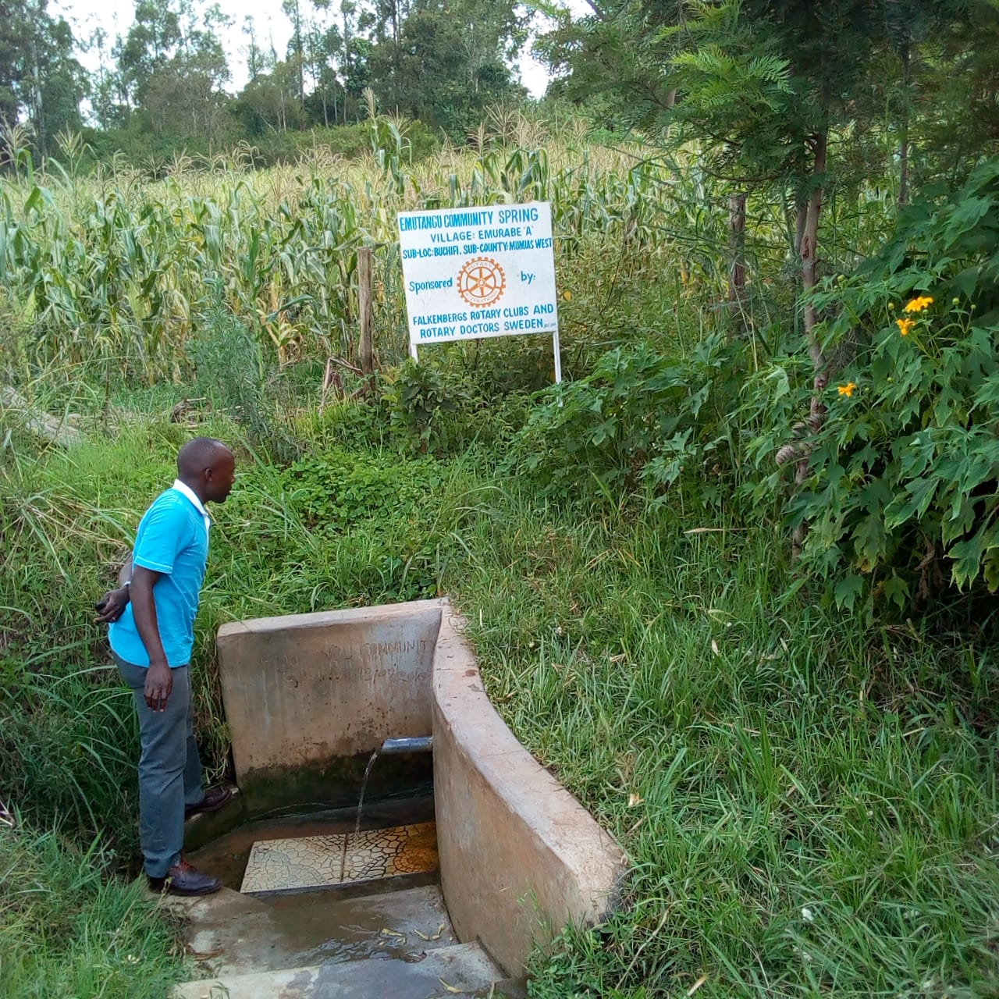
Status Emutangu’ spring

Slide 25
KOBIERO COMMUNITY SPRING
PERIOD PROTECTED:
MAY 2016
AGE:
4YRS
CATCHMENT POPULATION:
397 Households, approximately almost 2000 persons.

Slide 26
KOBIERO SPRING REVIEW REPORT
 | PARAMETOR OF REVIEW | REPORT
1 | FUNCTIONALITY | Water flow throughout the year and fills a20 liter container in less than 4min Drainage well maintained The spring never dries up.
2 | FENCE AND DRAINAGE | Fence still there
3 | SIGN POST | Standing and readable
4 | USAGE | Well used by the community for drinking, cooking, washing and laundry and for animals.
5 | ANY OTHER REPORT | The committee still functional. For future follow-up.

Slide 27
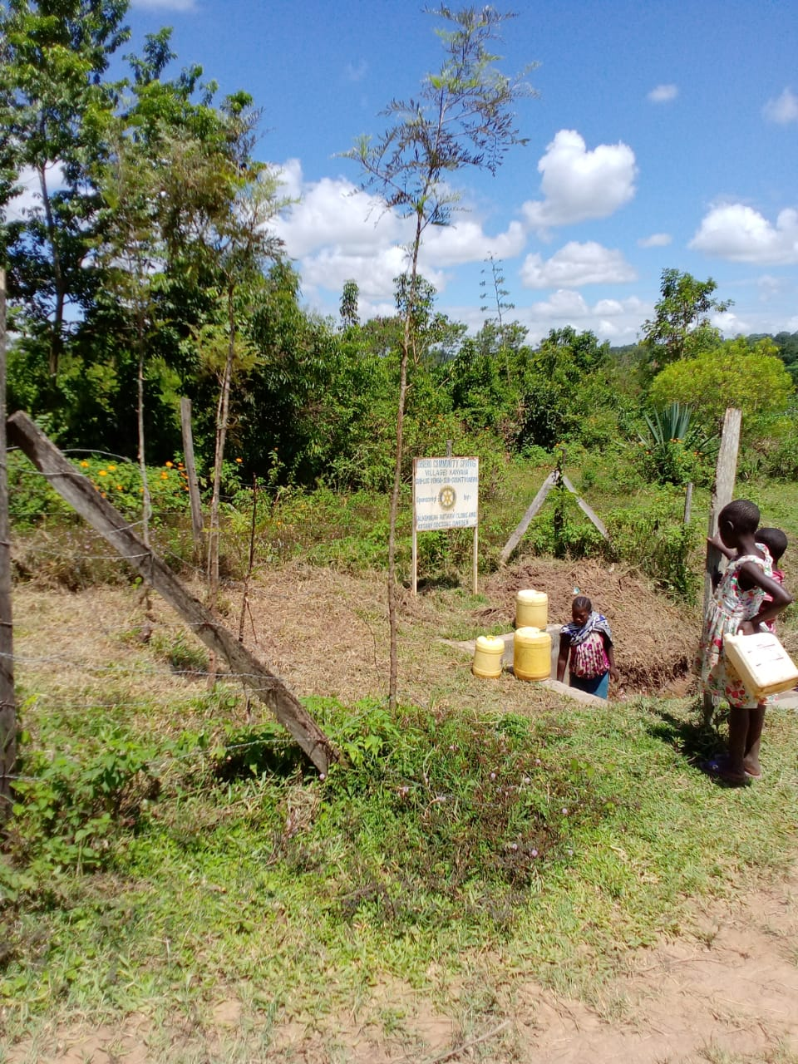
Status of Kobiero spring

Slide 28
KABINGA COMMUNITY SPRING
PERIOD PROTECTED:
APRIL 2016
AGE:
4YRS and 3M
CATCHMENT POPULATION:
280 Households, approximately almost 2000 persons.

Slide 29
KABINGA SPRING REVIEW REPORT
 | PARAMETOR OF REVIEW | REPORT
1 | FUNCTIONALITY | Water flow throughout the year and fills a20 liter container in less than 3min Drainage well maintained Pipe worn-out needs replacement. The spring never dries up.
2 | FENCE AND DRAINAGE | Fence not there, fencing posts eaten by ants and fallen.
3 | SIGN POST | Standing and readable
4 | USAGE | Well used by the community for drinking, cooking, washing and laundry and for animals.
5 | ANY OTHER REPORT | The committee still functional. For future follow-up.

Slide 30
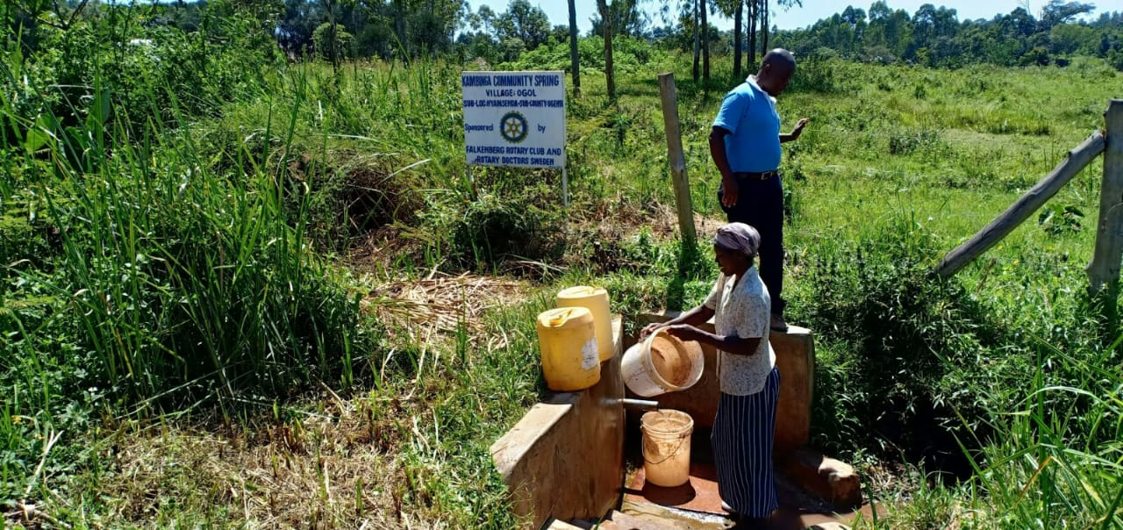
Status of Kabinga spring

Slide 31
ABUTI COMMUNITY SPRING
PERIOD PROTECTED:
JAN/FEB 2016
AGE:
4YRS and 7M
CATCHMENT POPULATION:
100 Households, approximately almost 600 persons.

Slide 32
ABUTI SPRING REVIEW REPORT
 | PARAMETOR OF REVIEW | REPORT
1 | FUNCTIONALITY | Water flow throughout the year and fills a 20 little container in less than 10sec Drainage well maintained The spring never dries up.
2 | FENCE AND DRAINAGE | Fence not there, fencing posts eaten by ants and fallen.
3 | SIGN POST | Standing and readable
4 | USAGE | Heavily used by the community for drinking, cooking, washing and laundry and for animals.
5 | ANY OTHER REPORT | The committee still functional. For future follow-up.

Slide 33
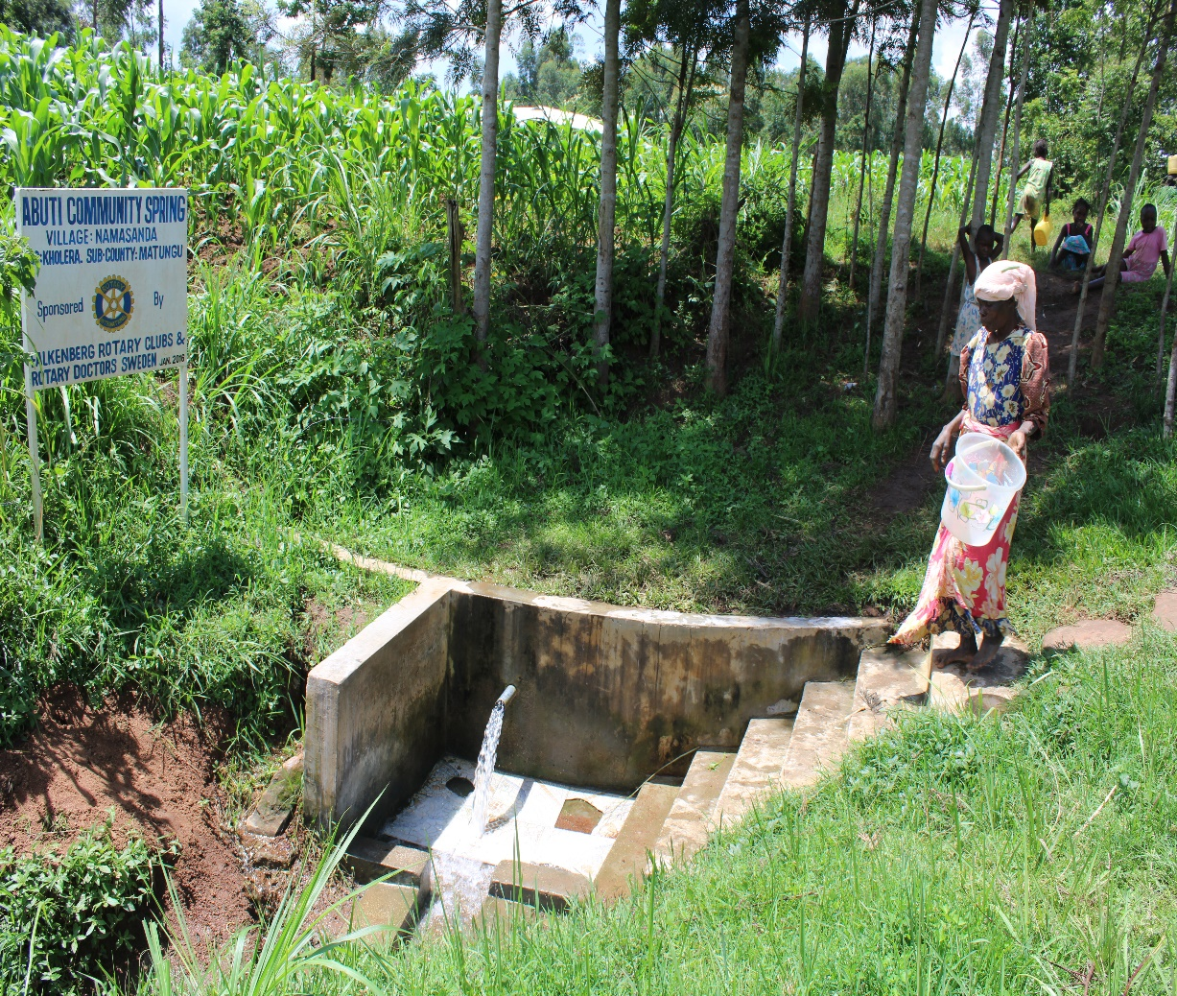
Status of the spring

Slide 34
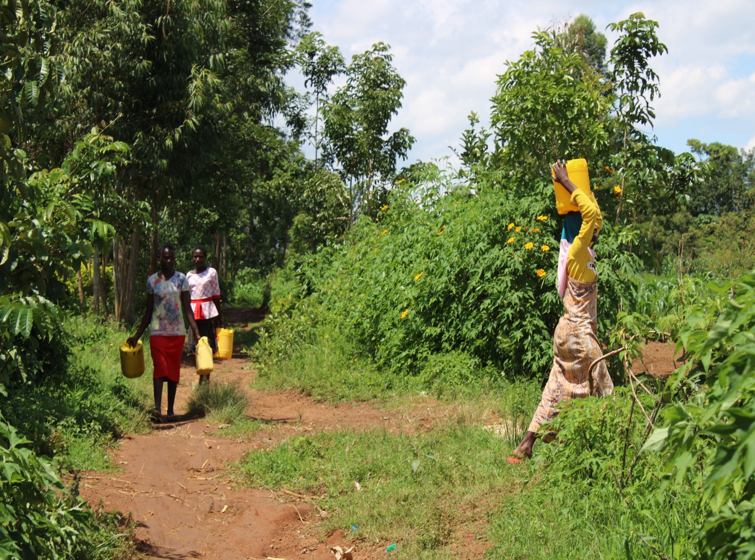

Slide 35
NAUTOKOMA COMMUNITY SPRING
PERIOD PROTECTED:
OCT 2018
AGE:
4YRS and 7M
CATCHMENT POPULATION:
107 Households, approximately almost 642 persons.

Slide 36
NAUTOKOMA SPRING REVIEW REPORT
 | PARAMETOR OF REVIEW | REPORT
1 | FUNCTIONALITY | Water flow throughout the year and fills a 20 litter container in less than 30sec Drainage well maintained The spring never dries up.
2 | FENCE AND DRAINAGE | Fence not there, fencing posts eaten by ants and fallen.
3 | SIGN POST | Standing and readable
4 | USAGE | Heavily used by the community for drinking, cooking, washing and laundry and for animals.
5 | ANY OTHER REPORT | The committee still functional. For future follow-up.

Slide 37
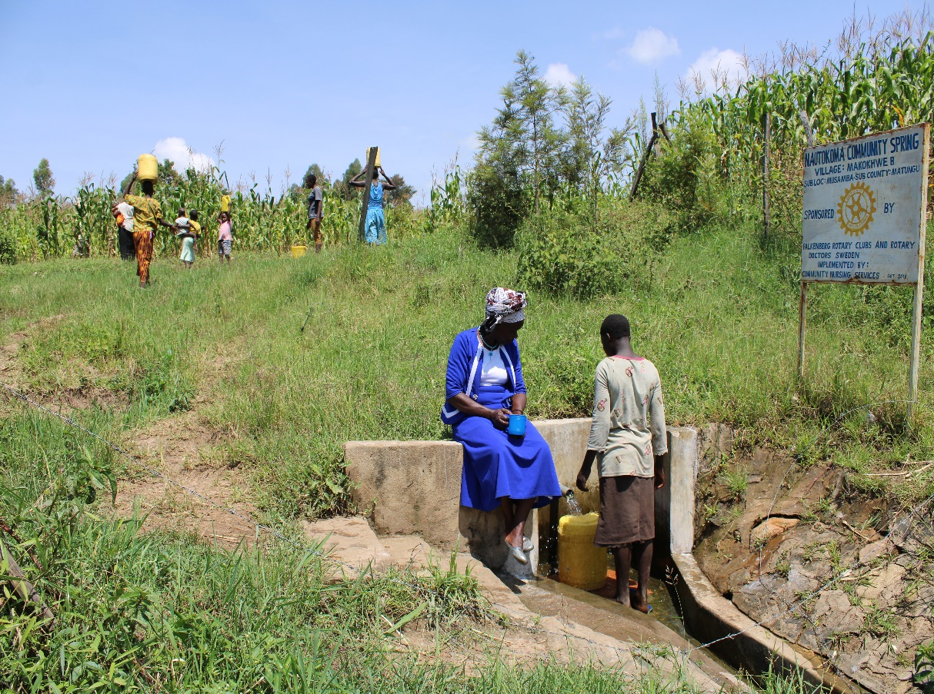
Status of the spring

Slide 38
PARANA COMMUNITY SPRING
PERIOD PROTECTED:
MAY 2018
AGE:
2YRS and 2M
CATCHMENT POPULATION:
100 Households, approximately almost 600 persons.

Slide 39
PARANA SPRING REVIEW REPORT
 | PARAMETOR OF REVIEW | REPORT
1 | FUNCTIONALITY | Water flow throughout the year and fills a 20 litter container in less than 5MIN Drainage well maintained The spring never dries up.
2 | FENCE AND DRAINAGE | Fence still there
3 | SIGN POST | Standing and readable
4 | USAGE | Heavily used by the community for drinking, cooking, washing and laundry and for animals.
5 | ANY OTHER REPORT | The committee still functional. For future follow-up.

Slide 40
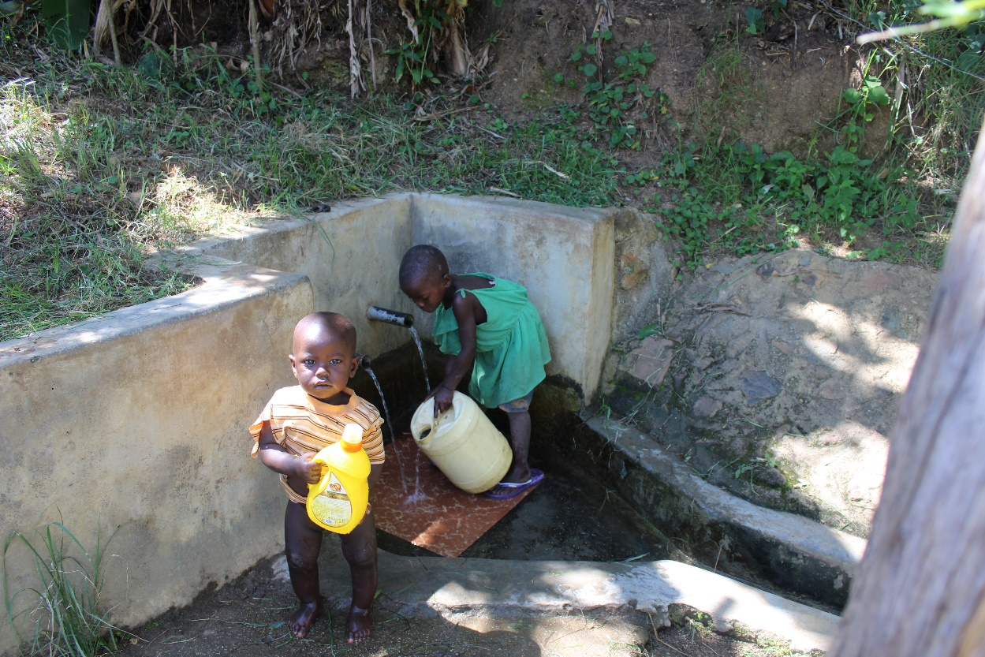
Status parana spring

Slide 41
Status parana spring

Slide 42
MANGONGO COMMUNITY SPRING
PERIOD PROTECTED:
FEB/MARC 2018
AGE:
2YRS and 2M
CATCHMENT POPULATION:
133 Households, approximately almost 700 persons.

Slide 43
MANGONGO SPRING REVIEW REPORT
 | PARAMETOR OF REVIEW | REPORT
1 | FUNCTIONALITY | Water flow throughout the year and fills a 20 litter container in less than 3min Drainage well maintained The spring never dries up.
2 | FENCE AND DRAINAGE | Fence still there and overgrown shrubs to protect the water source
3 | SIGN POST | Standing and readable
4 | USAGE | Heavily used by the community for drinking, cooking, washing and laundry and for animals.
5 | ANY OTHER REPORT | The committee still functional. For future follow-up.

Slide 44
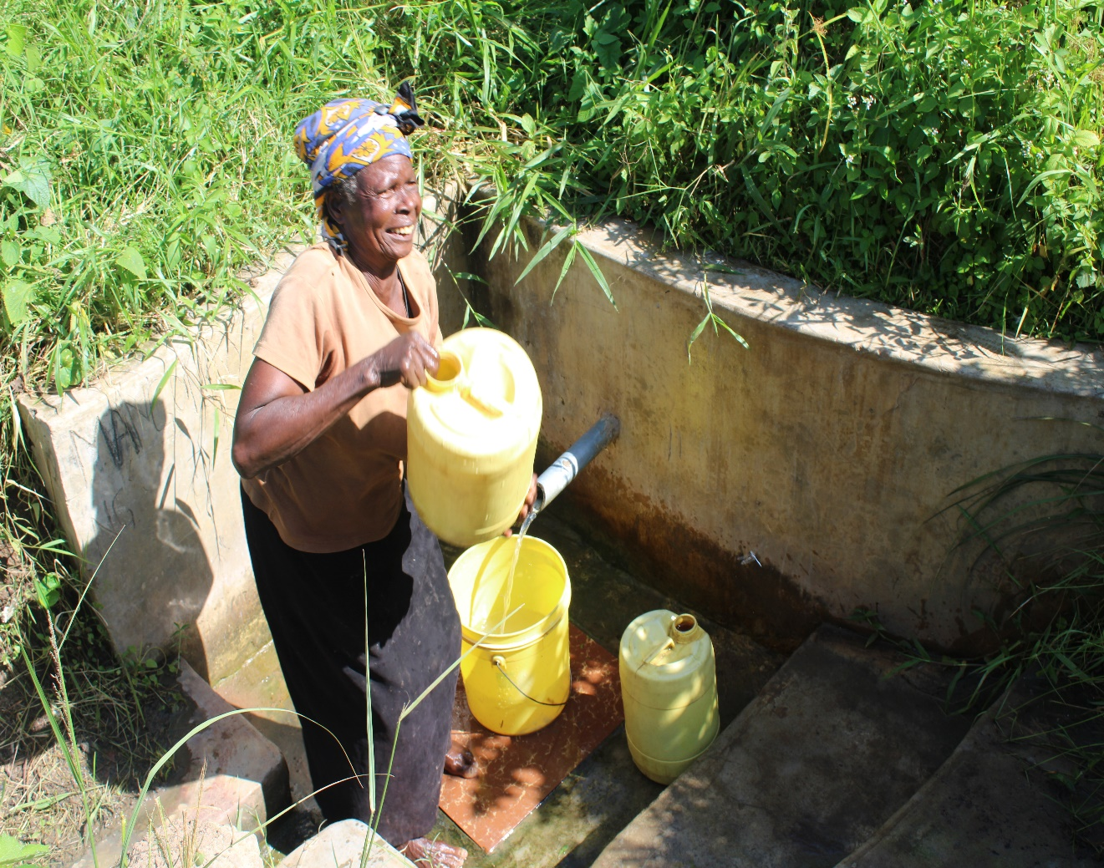
Status of the spring

Slide 45
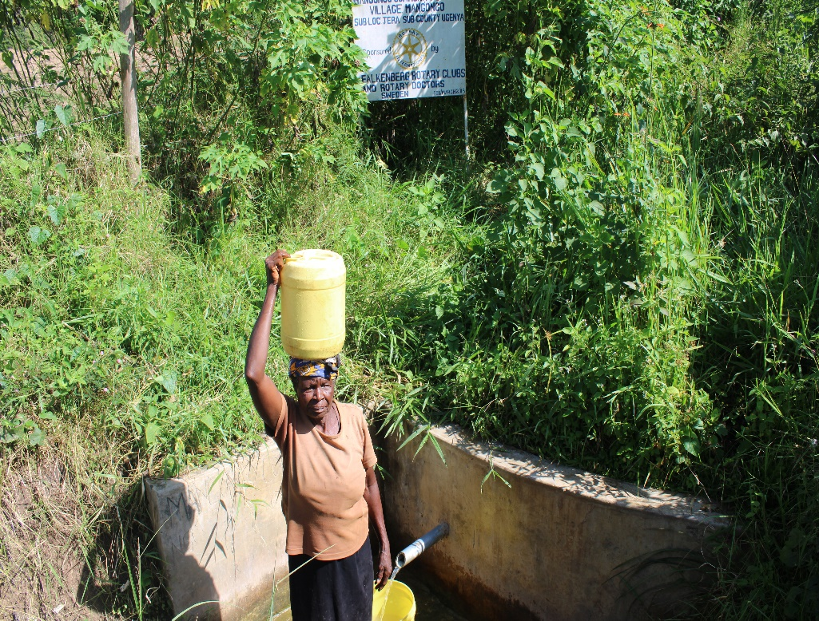

Slide 46
NJEREMANI COMMUNITY SPRING
PERIOD PROTECTED:
FEB/MARC 2018
AGE:
2YRS and 2M
CATCHMENT POPULATION:
55 Households, approximately almost 330 persons.

Slide 47
NJEREMANI SPRING REVIEW REPORT
 | PARAMETOR OF REVIEW | REPORT
1 | FUNCTIONALITY | Slightly not heavy water flow and fills a 20 litter container in less than 5min Drainage well maintained The spring never dries up.
2 | FENCE AND DRAINAGE | Fence still there and shrubs growing well to protect the water source
3 | SIGN POST | Standing and readable
4 | USAGE | Well used by the community for drinking, cooking, washing and laundry and for animals.
5 | ANY OTHER REPORT | The committee still functional. For future follow-up.

Slide 48
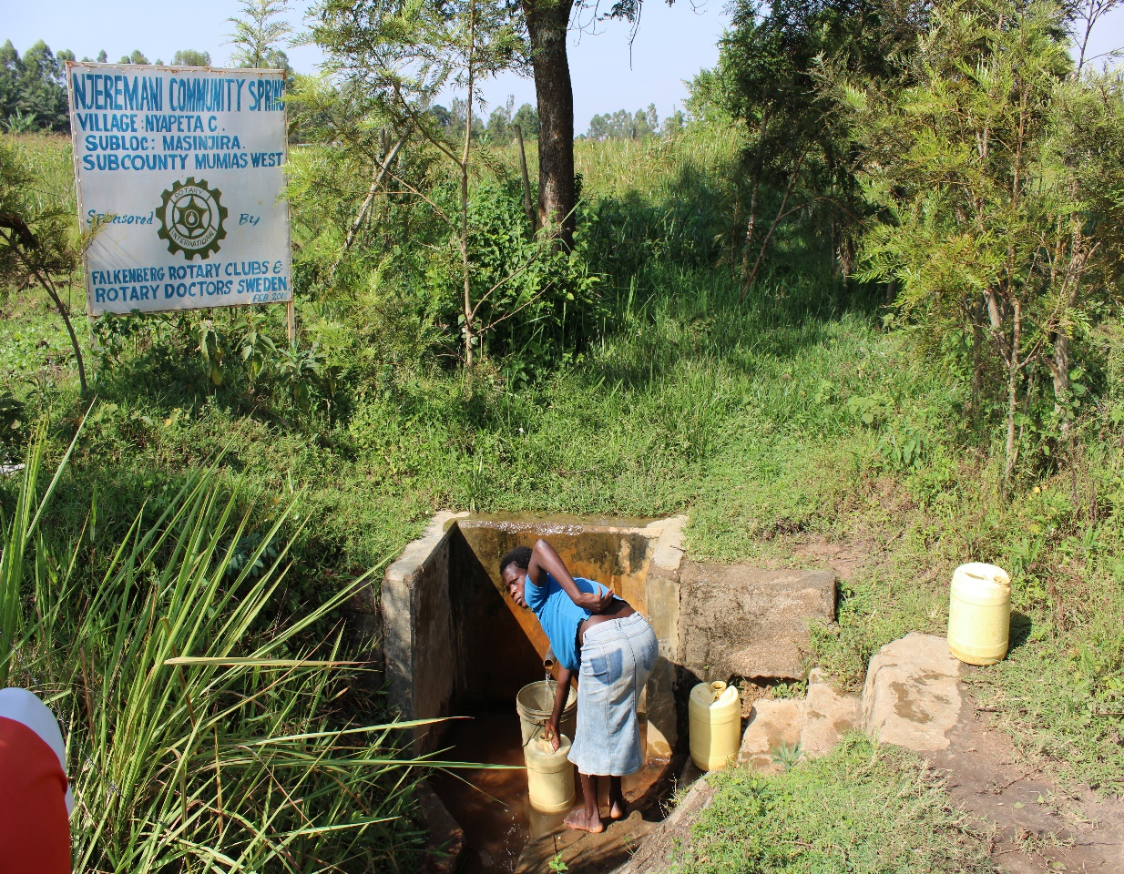
Status of the spring njeremani

Slide 49
WAMANYA COMMUNITY SPRING
PERIOD PROTECTED:
FEB/MARC 2018
AGE:
2YRS and 2M
CATCHMENT POPULATION:
98 Households, approximately almost 588 persons.

Slide 50
WAMANYA SPRING REVIEW REPORT
 | PARAMETOR OF REVIEW | REPORT
1 | FUNCTIONALITY | Slightly not heavy water flow and fills a 20 litter container in less than 5min Drainage well maintained The spring never dries up.
2 | FENCE AND DRAINAGE | Fence still there and shrubs growing well to protect the water source
3 | SIGN POST | Standing and readable
4 | USAGE | Well used by the community for drinking, cooking, washing and laundry and for animals.
5 | ANY OTHER REPORT | The committee still functional. For future follow-up.

Slide 51
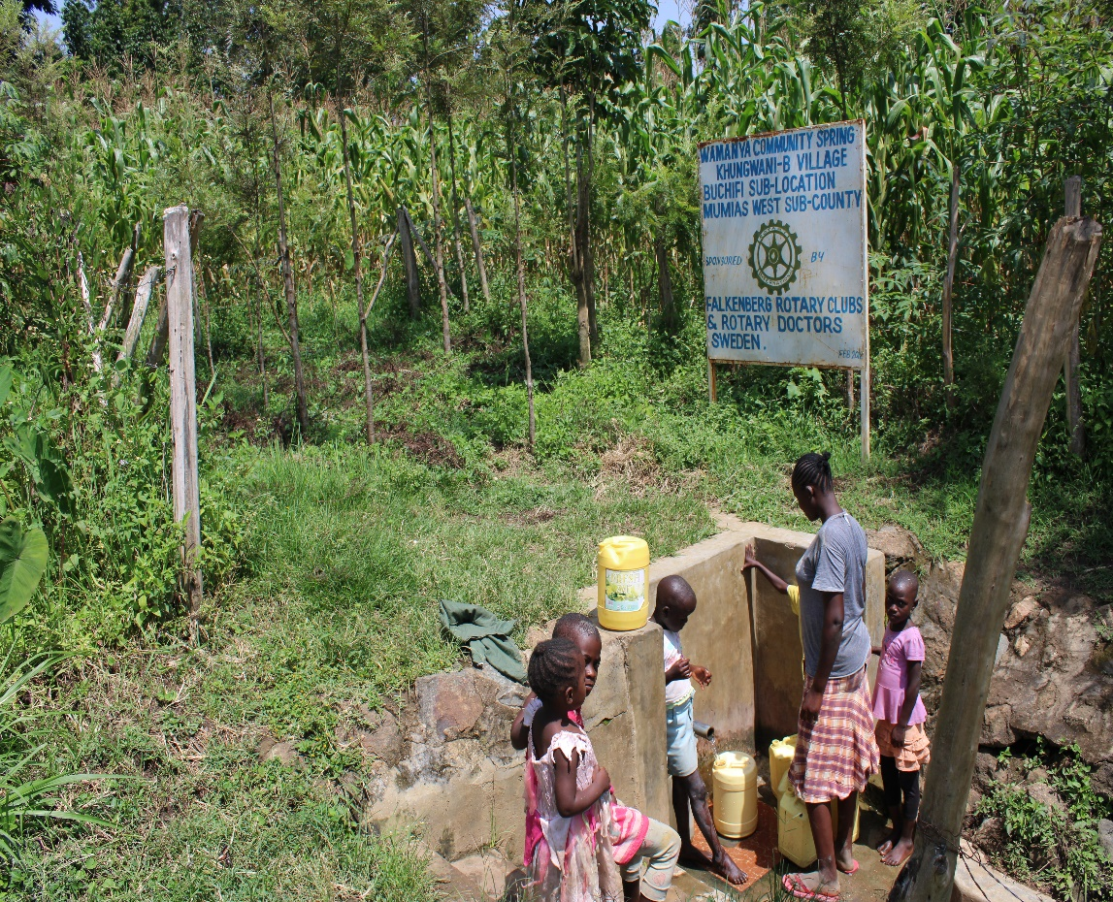
Status wamanya spring

Slide 52
EBUSHIKAMI COMMUNITY SPRING
PERIOD PROTECTED:
April/May 2019
AGE:
1yr and 2M
CATCHMENT POPULATION:
68 Households, approximately almost 340 persons.

Slide 53
EBUSHIKAMI SPRING REVIEW REPORT
 | PARAMETOR OF REVIEW | REPORT
1 | FUNCTIONALITY | Slightly not heavy water flow and fills a 20 litter container in less than 5min Drainage well maintained The spring never dries up.
2 | FENCE AND DRAINAGE | Fence still there and shrubs growing well to protect the water source
3 | SIGN POST | Standing and readable
4 | USAGE | Well used by the community for drinking, cooking, washing and laundry and for animals.
5 | ANY OTHER REPORT | The committee still functional. For future follow-up.

Slide 54
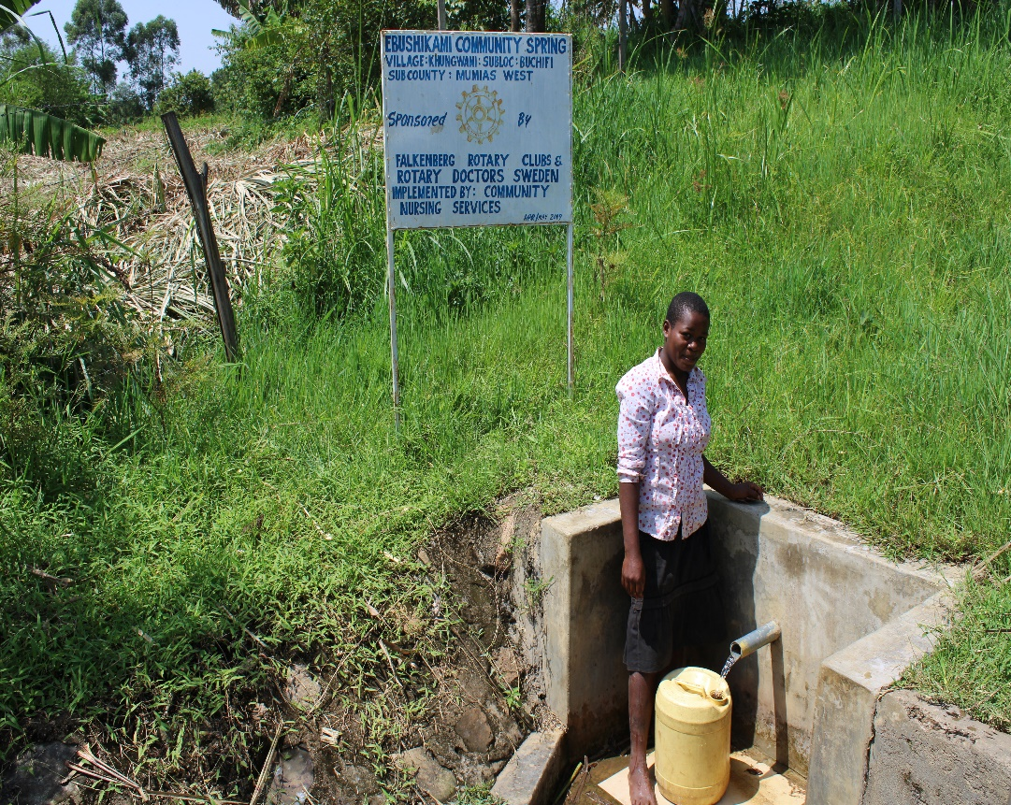
Status of Ebushikami spring

Slide 55
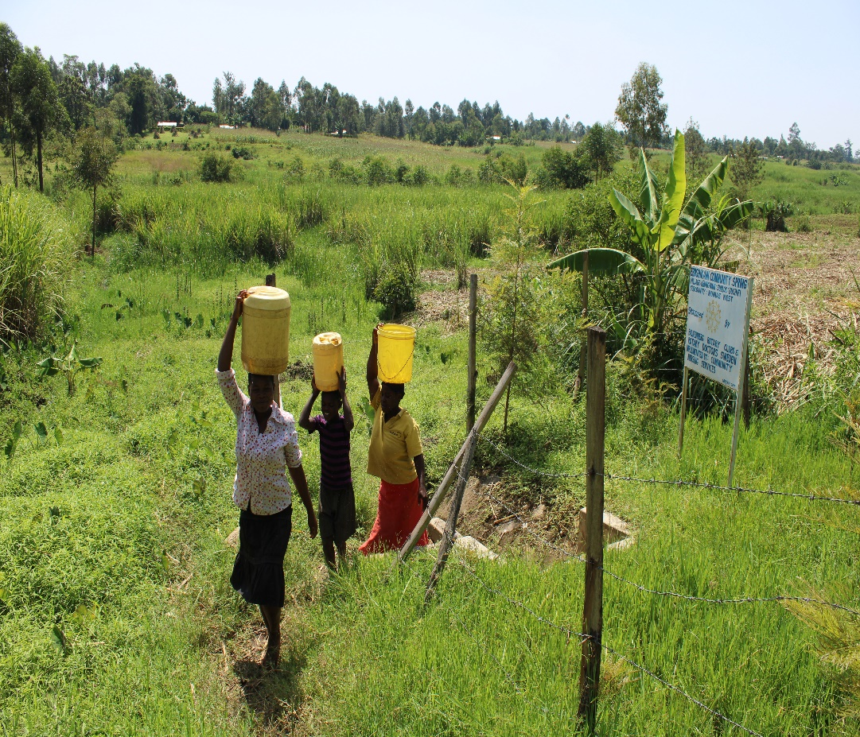

Slide 56
KHENDWA COMMUNITY SPRING
PERIOD PROTECTED:
Oct /Nov 2019
AGE:
9Months
CATCHMENT POPULATION:
120 Households, approximately almost 720 persons.

Slide 57
KHENDWA SPRING REVIEW REPORT
 | PARAMETOR OF REVIEW | REPORT
1 | FUNCTIONALITY | Good water flow and fills a 20 litter container in less than 5 sec Drainage well maintained The spring never dries up.
2 | FENCE AND DRAINAGE | Fence still there and shrubs growing well to protect the water source
3 | SIGN POST | Standing and readable
4 | USAGE | Well used by the community for drinking, cooking, washing and laundry and for animals.
5 | ANY OTHER REPORT | The committee still functional. Some members of the community using the fence as cloth line, it was discussed that should stop. Still very new ,For future follow-up.

Slide 58
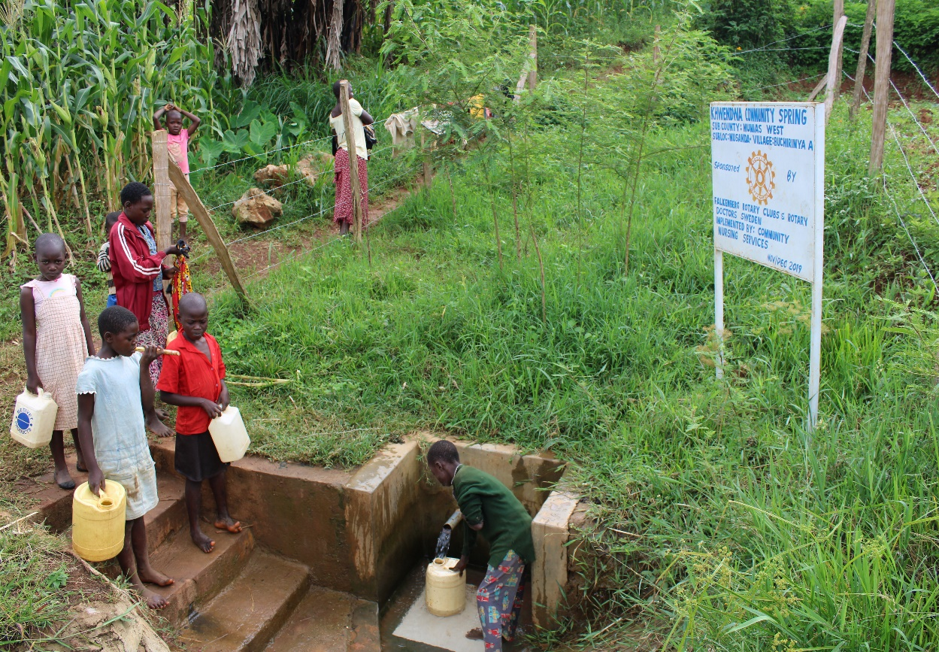
Status of Khendwa spring

Slide 59
KHULUTHA COMMUNITY SPRING
PERIOD PROTECTED:
April/May 2019
AGE:
1Yr 2Months
CATCHMENT POPULATION:
180 Households, approximately almost 720 persons.

Slide 60
KHULUTHA SPRING REVIEW REPORT
 | PARAMETOR OF REVIEW | REPORT
1 | FUNCTIONALITY | Good water flow Drainage well maintained The spring never dries up.
2 | FENCE AND DRAINAGE | Fence still there and shrubs growing well to protect the water source
3 | SIGN POST | Standing and readable
4 | USAGE | Well used by the community for drinking, cooking, washing and laundry and for animals though at the time of visit we didn’t get anyone fetching. Wrong timing!
5 | ANY OTHER REPORT | The committee still functional. Still very new ,For future follow-up.

Slide 61
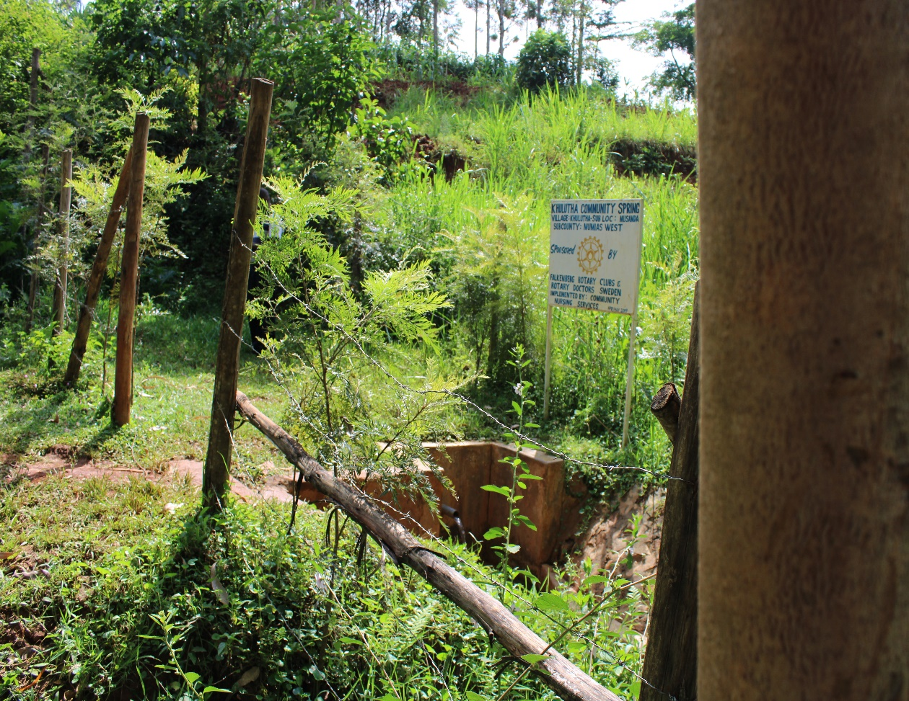
Status Khulutha spring

Slide 62
KISAR COMMUNITY SPRING
PERIOD PROTECTED:
JAN/FEB 2019
AGE:
1Yr 5Months
CATCHMENT POPULATION:
80 Households, approximately almost 420 persons.

Slide 63
KISAR SPRING REVIEW REPORT
 | PARAMETOR OF REVIEW | REPORT
1 | FUNCTIONALITY | Good water flow Drainage well maintained The spring never dries up.
2 | FENCE AND DRAINAGE | Fence still there and shrubs growing well to protect the water source
3 | SIGN POST | Standing and readable
4 | USAGE | Well used by the community for drinking, cooking, washing and laundry and for animals though at the time of visit we didn’t get anyone fetching. Wrong timing!
5 | ANY OTHER REPORT | The committee still functional. Still very new ,For future follow-up.

Slide 64
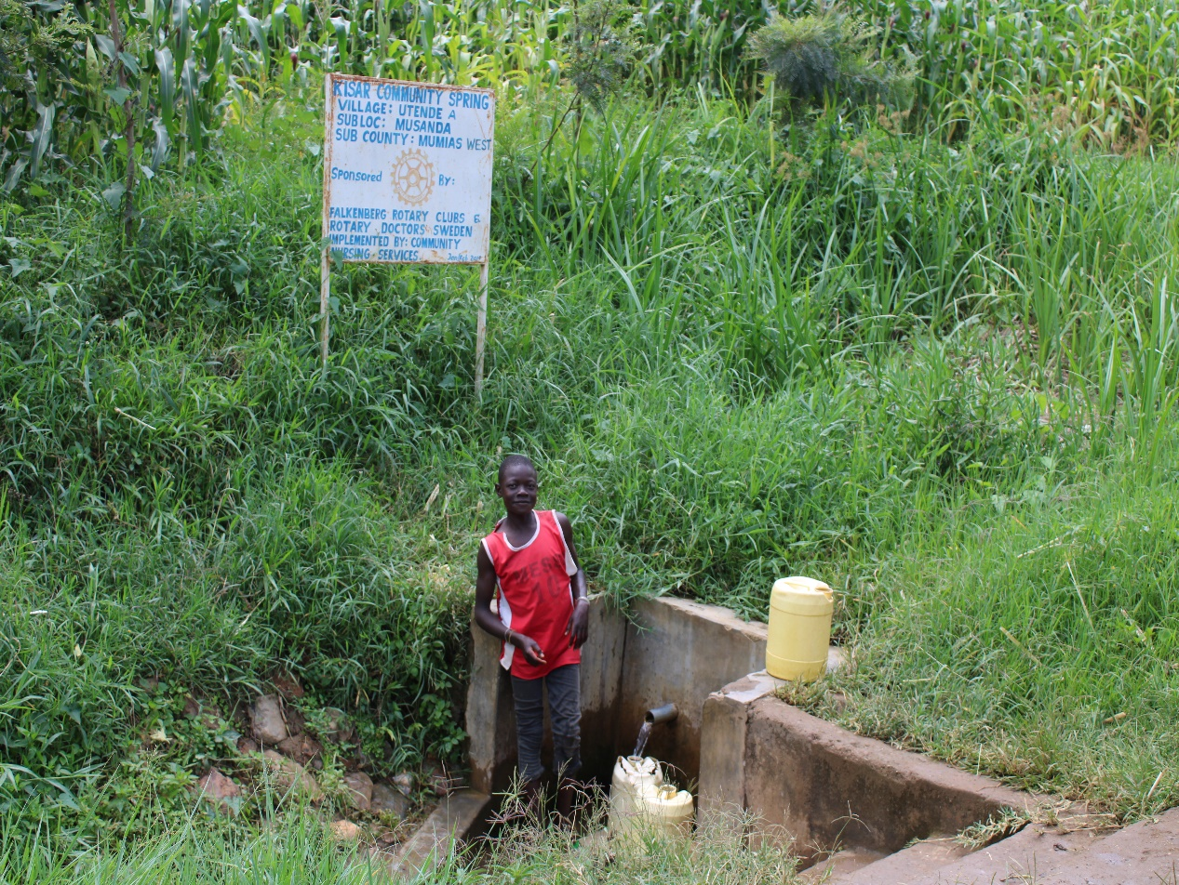
Status of Kisar spring

Slide 65
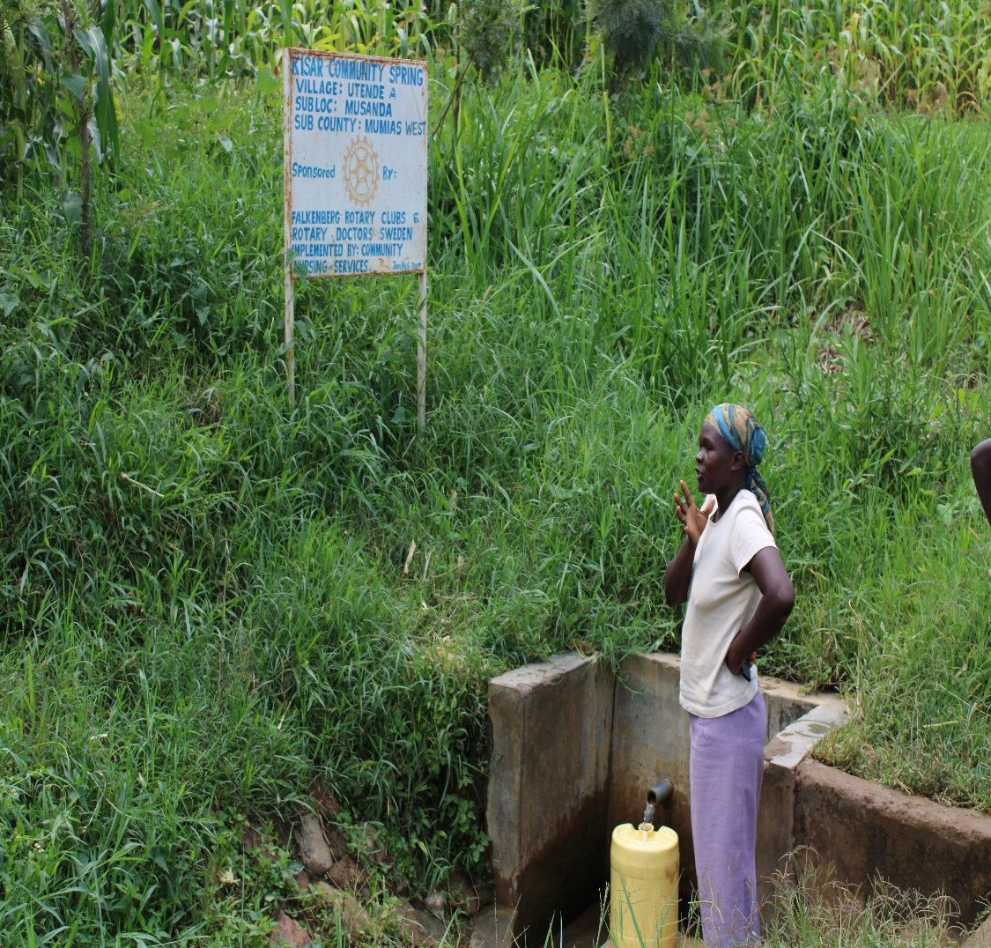

Slide 66
NAMBAKA COMMUNITY SPRING
PERIOD PROTECTED:
Oct/Nov 2019
AGE:
10Months
CATCHMENT POPULATION:
59 Households, approximately almost 356 persons.

Slide 67
NAMBAKA SPRING REVIEW REPORT
 | PARAMETOR OF REVIEW | REPORT
1 | FUNCTIONALITY | Good water flow Drainage well maintained The spring never dries up.
2 | FENCE AND DRAINAGE | Fence still there and shrubs growing well to protect the water source
3 | SIGN POST | Standing and readable
4 | USAGE | Well used by the community for drinking, cooking, washing and laundry and for animals though at the time of visit we didn’t get anyone fetching. Wrong timing!
5 | ANY OTHER REPORT | The committee still functional. Still very new ,For future follow-up.

Slide 68
Status of Nambaka spring

Slide 69
USHITENDE COMMUNITY SPRING
PERIOD PROTECTED:
April/May 2019
AGE:
1Yr 2Months
CATCHMENT POPULATION:
78 Households, approximately almost 468 persons.

Slide 70
USHITENDE SPRING REVIEW REPORT
 | PARAMETOR OF REVIEW | REPORT
1 | FUNCTIONALITY | Good water flow Drainage well maintained The spring never dries up.
2 | FENCE AND DRAINAGE | Fence still there and shrubs growing well to protect the water source
3 | SIGN POST | Standing and readable
4 | USAGE | Well used by the community for drinking, cooking, washing and laundry and for animals though at the time of visit we didn’t get anyone fetching. Wrong timing!
5 | ANY OTHER REPORT | The committee still functional. Still very new ,For future follow-up.

Slide 71
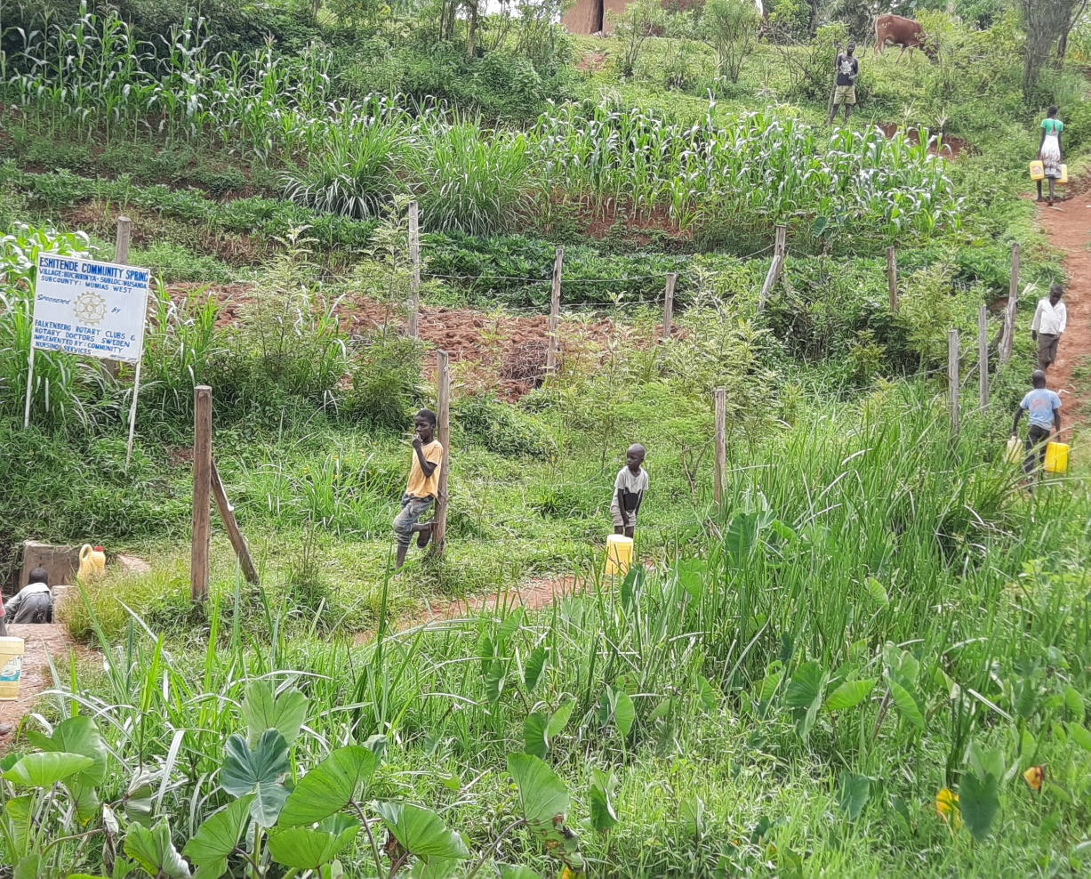
Status of ushitende spring

Slide 72
KAMNARA COMMUNITY SPRING
PERIOD PROTECTED:
Oct 2017
AGE:
2 yrs 10Months
CATCHMENT POPULATION:
150 Households, approximately almost 900 persons.

Slide 73
KAMNARA SPRING REVIEW REPORT
 | PARAMETOR OF REVIEW | REPORT
1 | FUNCTIONALITY | Good water flow Drainage well maintained The spring never dries up.
2 | FENCE AND DRAINAGE | Fence still there and shrubs growing well to protect the water source
3 | SIGN POST | Standing and readable
4 | USAGE | Well used by the community for drinking, cooking, washing and laundry and for animals though at the time of visit we didn’t get anyone fetching. Wrong timing!
5 | ANY OTHER REPORT | The committee still functional. Still very new ,For future follow-up.

Slide 74
Status of Kamnara spring

Slide 75
KADUNYA COMMUNITY SPRING
PERIOD PROTECTED:
Sept 2017
AGE:
2Yrs 11months
CATCHMENT POPULATION:
105 Households, approximately almost 630 persons.

Slide 76
KADUNYA SPRING REVIEW REPORT
 | PARAMETOR OF REVIEW | REPORT
1 | FUNCTIONALITY | Good water flow Drainage well maintained The spring never dries up.
2 | FENCE AND DRAINAGE | Fence still there and shrubs growing well to protect the water source
3 | SIGN POST | Standing and readable
4 | USAGE | Well used by the community for drinking, cooking, washing and laundry and for animals though at the time of visit we didn’t get anyone fetching. Wrong timing!
5 | ANY OTHER REPORT | The committee still functional.

Slide 77
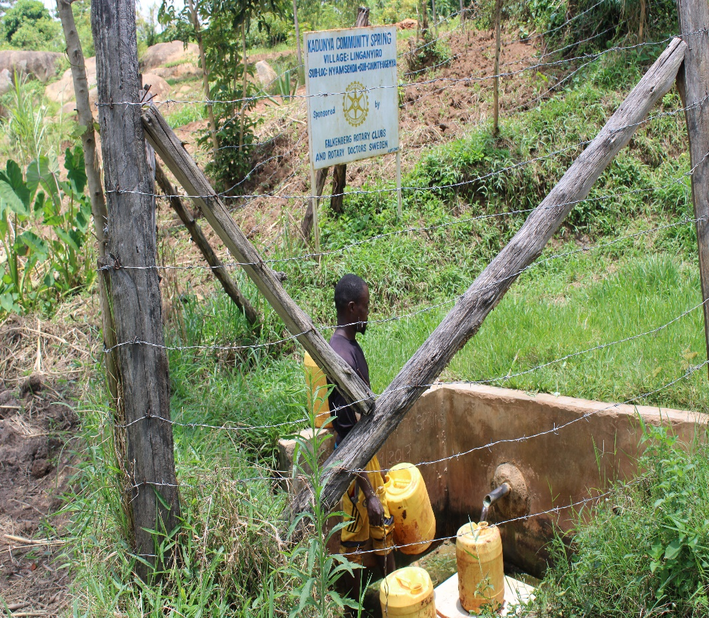
Status Kadunya spring

Slide 78
MAPAO COMMUNITY SPRING
PERIOD PROTECTED:
April2017
AGE:
2Yrs 11months
CATCHMENT POPULATION:
303 Households, approximately almost 1800 persons.

Slide 79
MAPAO SPRING REVIEW REPORT
 | PARAMETOR OF REVIEW | REPORT
1 | FUNCTIONALITY | Good water flow Drainage slightly blocked The spring never dries up.
2 | FENCE AND DRAINAGE | Fence still there and shrubs growing well to protect the water source
3 | SIGN POST | Standing and readable
4 | USAGE | Well used by the community for drinking, cooking, washing and laundry and for animals though at the time of visit we didn’t get anyone fetching. Wrong timing!
5 | ANY OTHER REPORT | The committee still functional. The committee encouraged to maintain the spring

Slide 80
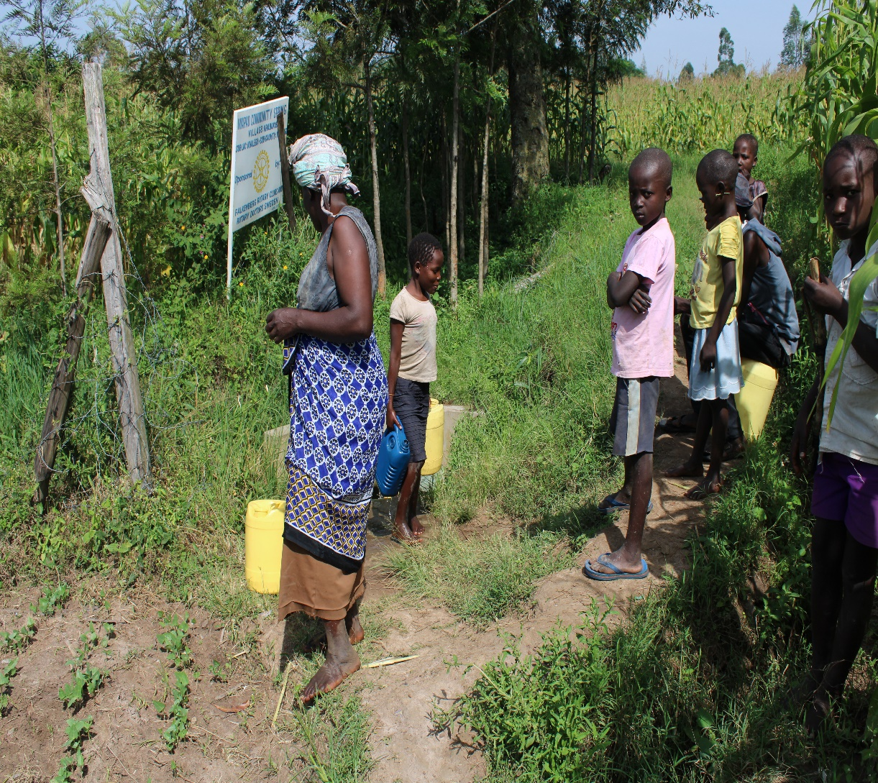
Status of Mapao spring

Slide 81
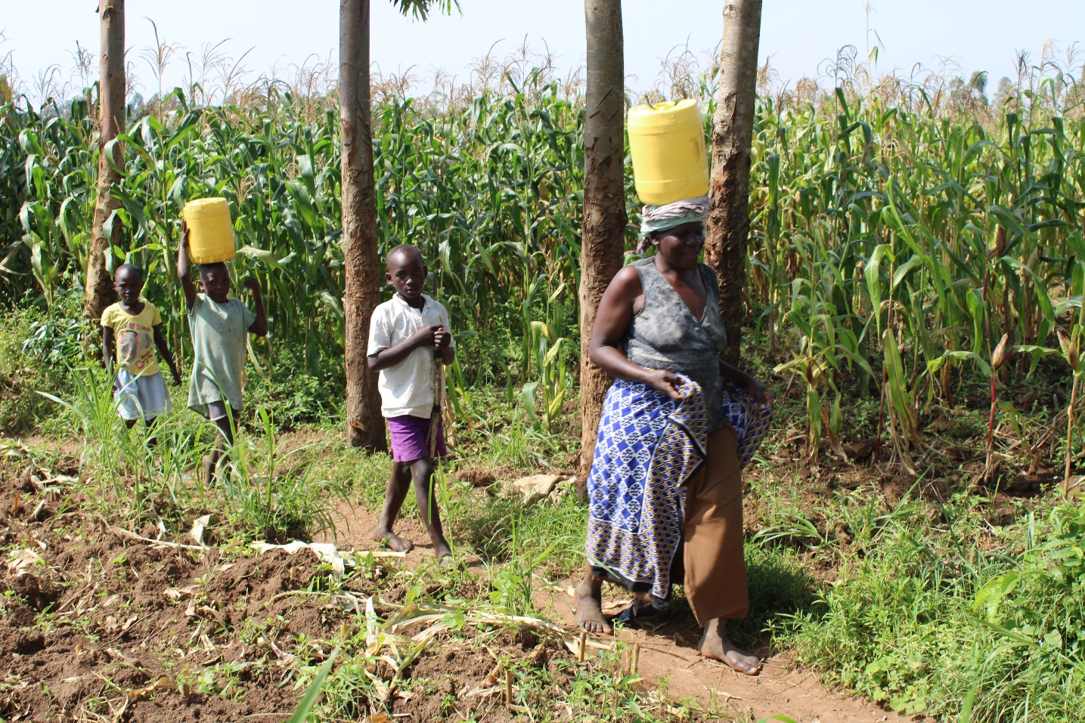

Slide 82
MUSENDA COMMUNITY SPRING
PERIOD PROTECTED:
Feb2017
AGE:
2Yrs 11months
CATCHMENT POPULATION:
265 Households, approximately almost 1700persons.

Slide 83
MUSENDA SPRING REVIEW REPORT
 | PARAMETOR OF REVIEW | REPORT
1 | FUNCTIONALITY | Good water flow Drainage well maintained The spring never dries up.
2 | FENCE AND DRAINAGE | Fence still there and shrubs growing well to protect the water source
3 | SIGN POST | Standing and readable
4 | USAGE | Well used by the community for drinking, cooking, washing and laundry and for animals though at the time of visit we didn’t get anyone fetching. Wrong timing!
5 | ANY OTHER REPORT | The committee still functional. The committee encouraged to maintain the spring

Slide 84
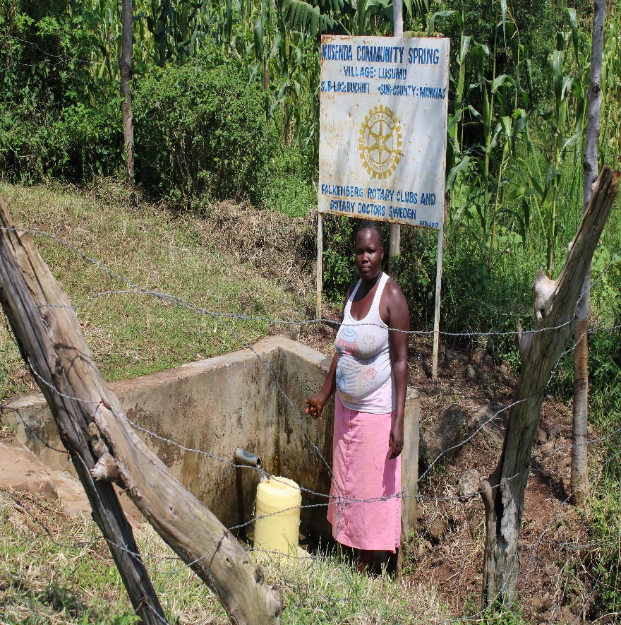
Status Musenda spring

Slide 86
COMMENTS
The springs visited are doing well .
The main challenge is fallen fencing posts in some spring.
Four projects have not been visited and once I visit them I will update the club, they includes: Eshikwiro, Kunyu, Kaketch community springs and Emkwen and Umala gul togo community shallow wells.
It was encouraging to see most of the projects are doing well, the community is committed to maintaining them and using them.

Slide 87
VOTE OF THANKS
To Falkenberg RC Sweden, on behalf of the Community, The Rotary Doctors Sweden and the Community Nursing Services. Thank you so much for this support and you can see how you have transformed the health of many in the community through safe drinking water!
THANK YOU and STAY SAFE FROM CORONA
JACINTA K. NICASIO

