Slide 1
REVIEW OF WATER PROJECTS SPONSORED
BY HALMSTAD RC.
REVIEW BY: JACINTA K. NICASIO

Slide 2
INTRODUCTION
Water: important resource for sustaining life. Clean and safe drinking water, hygiene and sanitation is important part in maintaining good health.
Rotary Doctors Sweden has been able to support communities’ access clean water through support of various RCs.
The Community makes request, form water project committee who oversee the protection of the spring, use and maintenance for sustainability for the project.

Slide 3
THE FOLLOWING WATER PROJECT HAS BEEN SUPPORTED BY YOUR CLUB
YENGA COMMUNITY SHALLOW WELL
NDALALA COMMUNITY SHALLOW WELL
ANGATIA COMMUNITY SHALLOW WELL
INGUSI COMMUNITY SHALLOW WELL
NYAPETA COMMUNITY SHALLOW WELL
SOYMINING COMMUNITY SHALLOW
LUKA COMMUNITY SPRING

Slide 4
MAKHOKWE COMMUNITY SHALLOW WELL
PAPA GORI COMMUNITY SHALLOW WELL
NAMASANDA COMMUNITY SHALLOW WELL
BUBALA COMMUNITY SHALLOW WELL
EBULANDA COMMUNITY SHALLOW WELL

Slide 5
YENGA COMMUNITY SHALLOW WELL
PERIOD OF PROTECTED:
JAN/FEB 2016
AGE:
4 years 7months
CATCHMENT POPULATION:
77Households, approximately 467 persons.

Slide 6
YENGA SHALLOW WELLREVIEW REPORT
 | PARAMETOR OF REVIEW | REPORT
1 | FUNCTIONALITY | Good, Pump working well. Never dries up even in dry seasons.
2 | FENCE | Well maintained.
3 | SIGN POST | Still standing and readable
4 | USAGE | Used by lots of community members
5 | ANY OTHER REPORT | Functional committee.

Slide 7
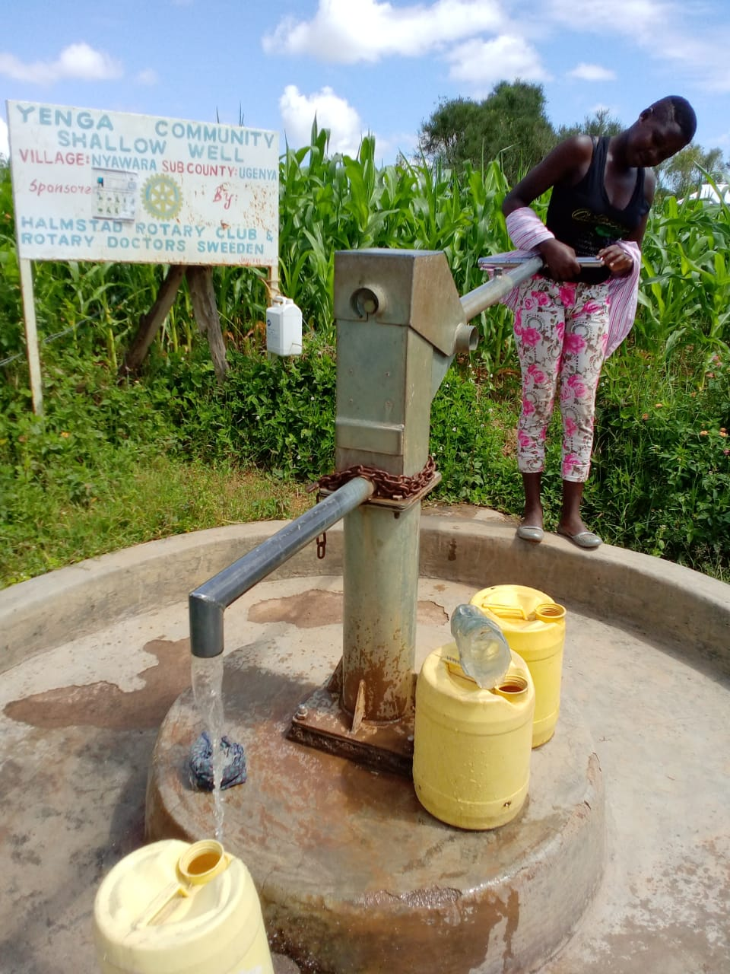
Status Yenga shallow well

Slide 8
NDALALA COMMUNITY SPRING
PERIOD OF PROTECTED:
DEC/JAN 2017
AGE:
3 years and 8months
CATCHMENT POPULATION:
360 Households, approximately 1600persons.

Slide 9
NDALALA SHALLOW WELLREVIEW REPORT
 | PARAMETOR OF REVIEW | REPORT
1 | FUNCTIONALITY | Good, Pump working well. Never dries up even in dry seasons.
2 | FENCE | Not there, poles were eaten by Ants
3 | SIGN POST | Still standing and readable
4 | USAGE | Used by lots of community members
5 | ANY OTHER REPORT | Functional committee.

Slide 10
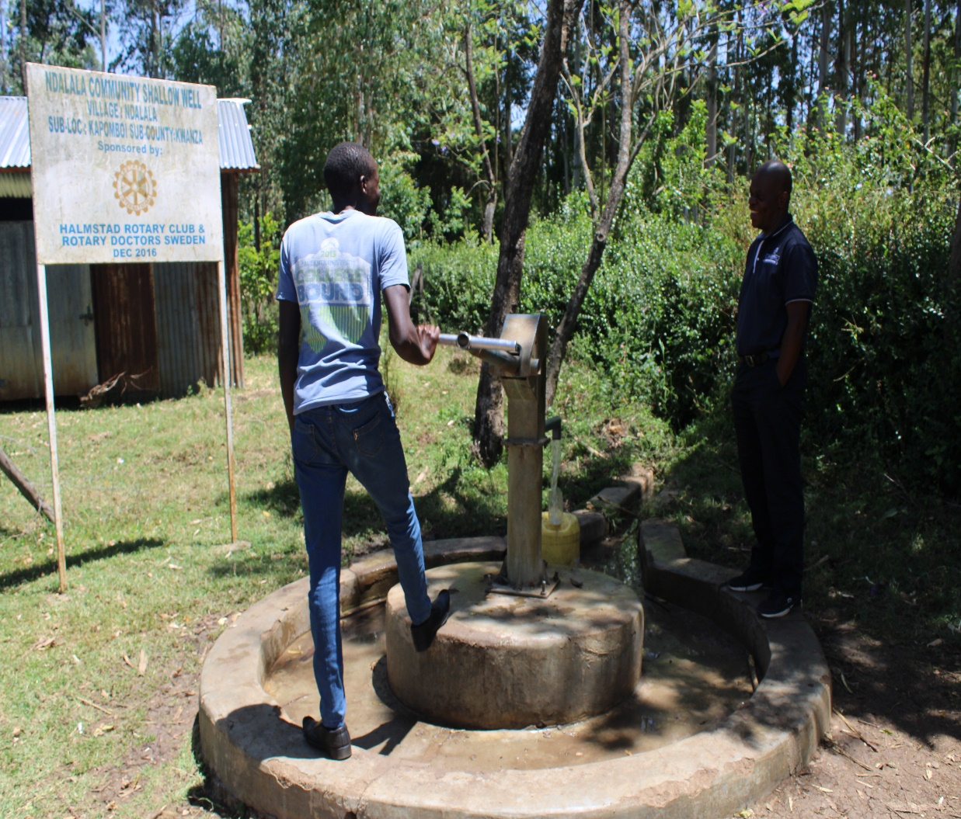
Status ndalala community shallow well

Slide 11
ANGATIA COMMUNITY SHALLOW WELL
PERIOD OF PROTECTED:
NOV 2017
AGE:
2years &10months
CATCHMENT POPULATION:
70 Households, approximately 420persons.

Slide 12
ANGATIA SHALLOW WELLREVIEW REPORT
 | PARAMETOR OF REVIEW | REPORT
1 | FUNCTIONALITY | Good, Pump working well. Never dries up even in dry seasons.
2 | FENCE | Standing strong
3 | SIGN POST | Still standing and readable
4 | USAGE | Well used by community members
5 | ANY OTHER REPORT | Functional committee.

Slide 13
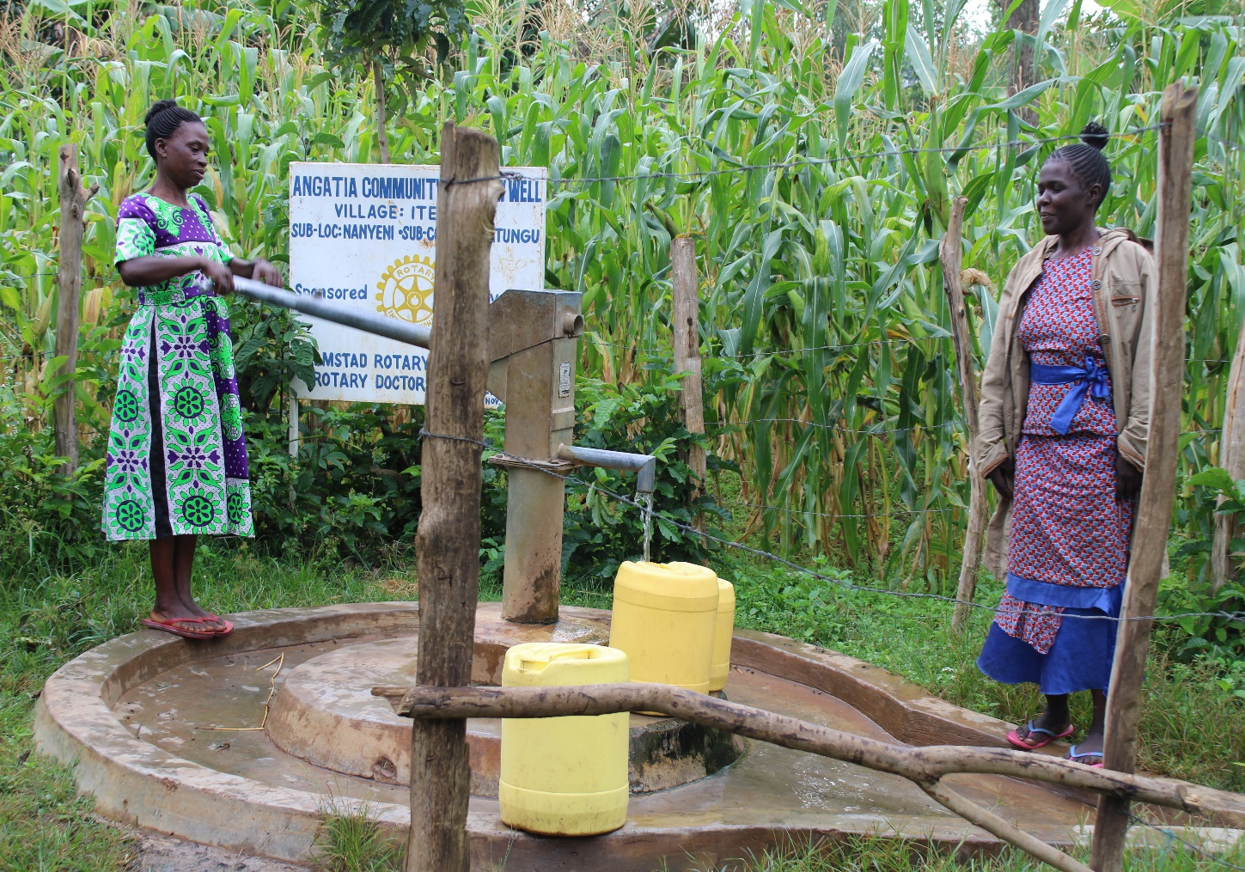
Status of the well Angatia community well

Slide 14
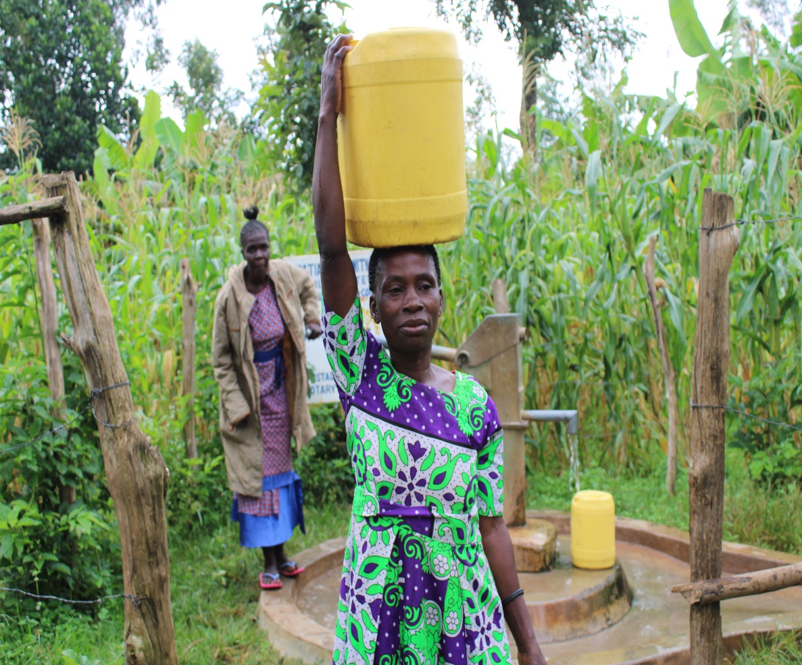

Slide 15
INGUSI COMMUNITY SHALLOW WELL
PERIOD OF PROTECTED:
JULY/AUG 2017.
AGE:
3 years
CATCHMENT POPULATION:
186 Households, approximately 1116 persons.

Slide 16
INGUSI SHALLOW WELLREVIEW REPORT
 | PARAMETOR OF REVIEW | REPORT
1 | FUNCTIONALITY | Good, Pump working well. Never dries up even in dry seasons.
2 | FENCE | Standing strong
3 | SIGN POST | Still standing and readable
4 | USAGE | Well used by community members
5 | ANY OTHER REPORT | Functional committee.

Slide 17
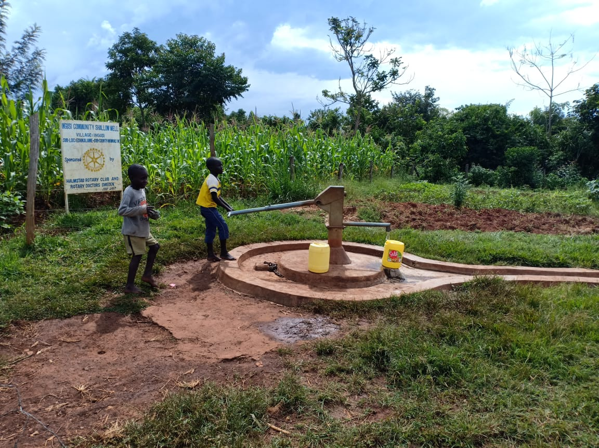
Status Ingusi community well

Slide 18
NYAPETA COMMUNITY SHALLOW WELL
PERIOD OF PROTECTED:
FEB/APRIL 2017
AGE:
3years &3months
CATCHMENT POPULATION:
70 Households, approximately 420persons.

Slide 19
NYAPETA SHALLOW WELLREVIEW REPORT
 | PARAMETOR OF REVIEW | REPORT
1 | FUNCTIONALITY | Good, Pump working well. Never dries up even in dry seasons.
2 | FENCE | Standing strong
3 | SIGN POST | Still standing and readable
4 | USAGE | Serves the dispensary and the community well
5 | ANY OTHER REPORT | Functional committee.

Slide 20
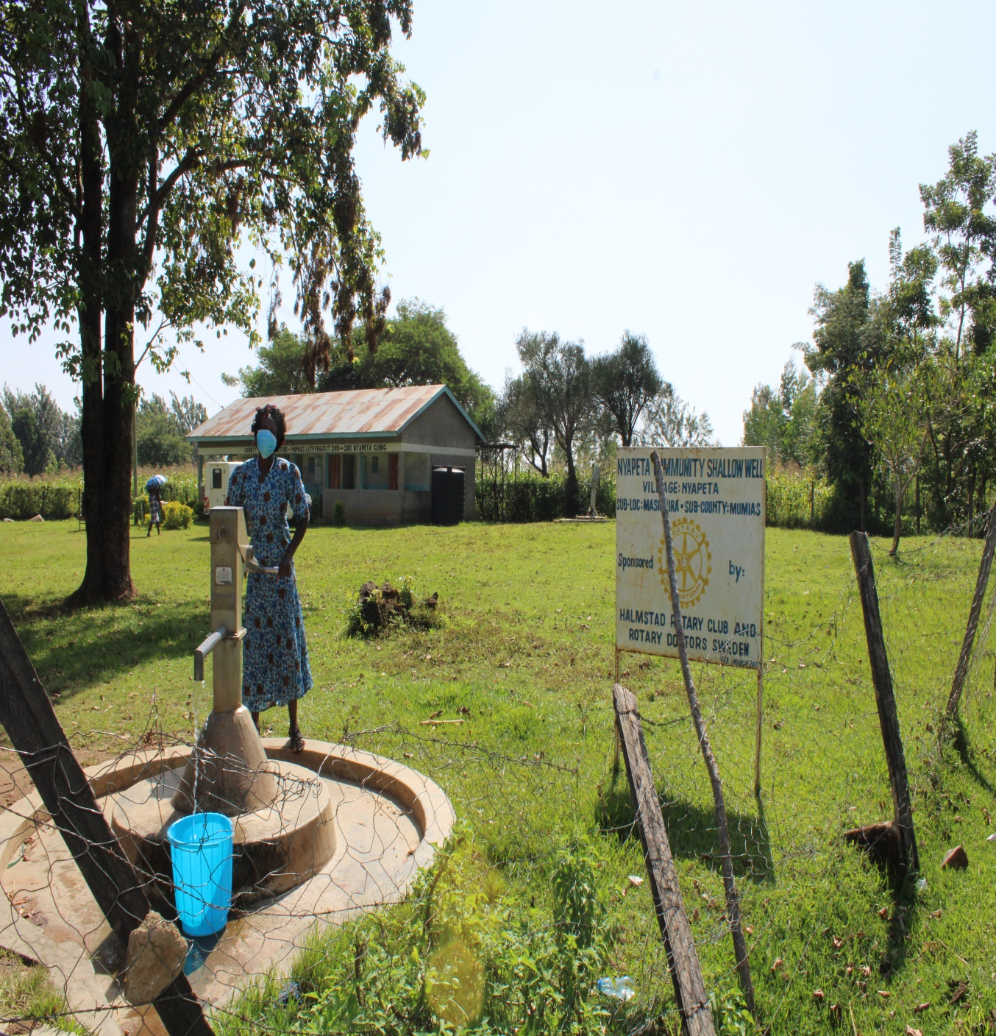
Status nyapeta shallow well

Slide 21
SOYMINING COMMUNITY SHALLOW WELL
PERIOD OF PROTECTED:
MAY/JUN2018
AGE:
2years
CATCHMENT POPULATION:
80 & 500 students Households, approximately 900persons.

Slide 22
SOYMINING C& SEC SCHOOL SHALLOW WELLREVIEW REPORT
 | PARAMETOR OF REVIEW | REPORT
1 | FUNCTIONALITY | Good, Pump working well. Never dries up even in dry seasons. Drainage slightly blocked.
2 | FENCE | Standing strong
3 | SIGN POST | Still standing and readable
4 | USAGE | Serves the secondary school and the community well
5 | ANY OTHER REPORT | Functional committee.

Slide 23
Status of Soymining community and secondary school well

Slide 24
MAKHOKWE COMMUNITY SHALLOW WELL
PERIOD OF PROTECTED:
NOV/DEC 2019
AGE:
7MONTHS
CATCHMENT POPULATION:
80 Households, approximately 480persons.

Slide 25
MAKHOKWE SHALLOW WELLREVIEW REPORT
 | PARAMETOR OF REVIEW | REPORT
1 | FUNCTIONALITY | Good so far Pump working well. Never dries up even in dry seasons.
2 | FENCE | Standing strong
3 | SIGN POST | Still standing and readable
4 | USAGE | Serves the community well
5 | ANY OTHER REPORT | Functional committee ,Still very new .For future followup.

Slide 26
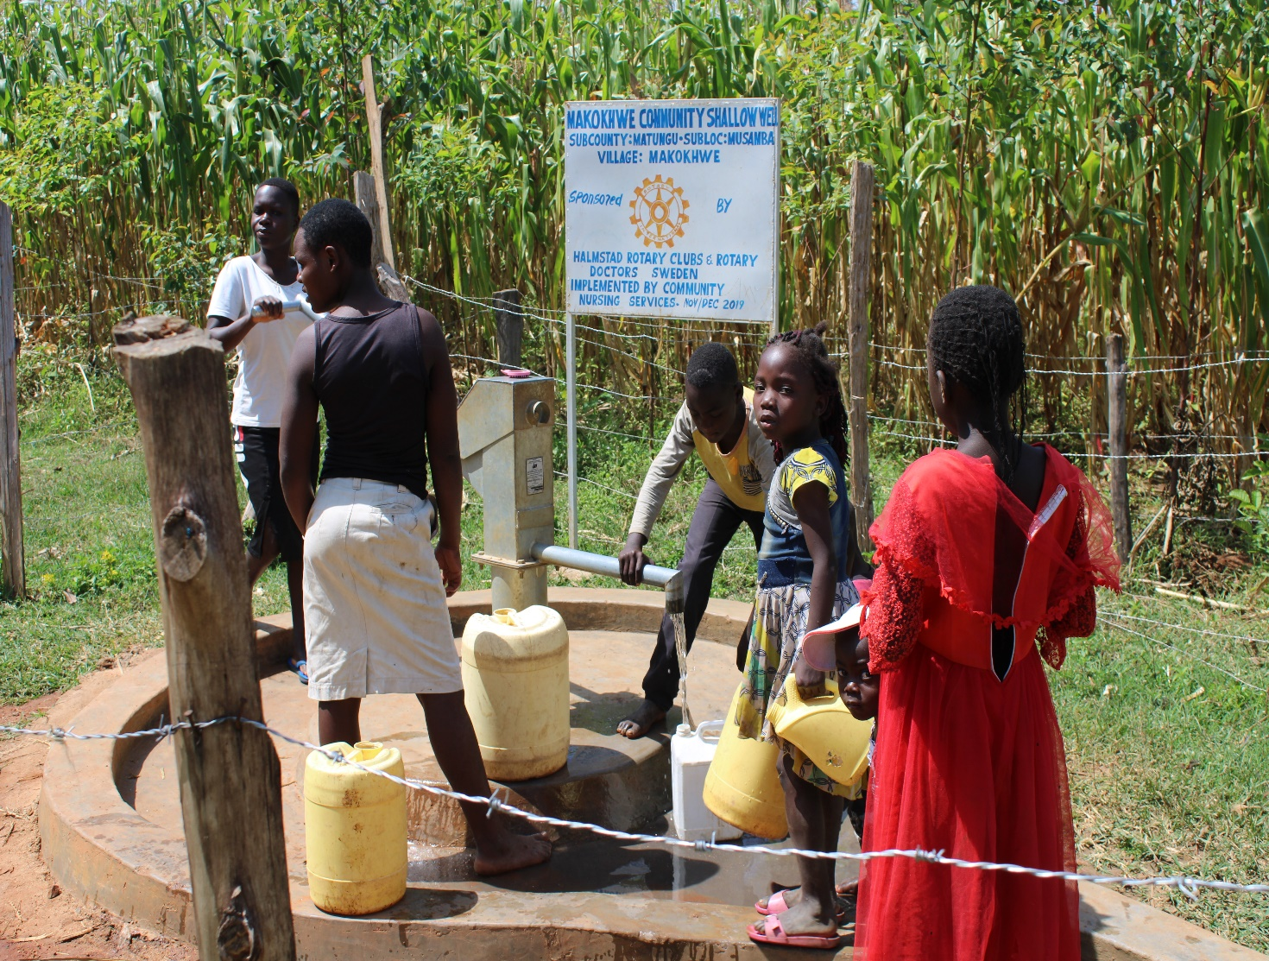
Status Makhokwe community well

Slide 28
NAMASANDA DISPENSARY& COMMUNITY SHALLOW WELL
PERIOD OF PROTECTED:
FEB/APRIL 2019
AGE:
1YEAR& 3 MONTHS
CATCHMENT POPULATION:
83 Households, approximately 498persons.

Slide 29
NAMASANDA SHALLOW WELLREVIEW REPORT
 | PARAMETOR OF REVIEW | REPORT
1 | FUNCTIONALITY | Good, Pump working well. Never dries up even in dry seasons.
2 | FENCE | Standing one side
3 | SIGN POST | Still standing and readable
4 | USAGE | Serves the community well and the dispensary.
5 | ANY OTHER REPORT | Functional committee. Very useful now with the running of the dispensary.

Slide 30
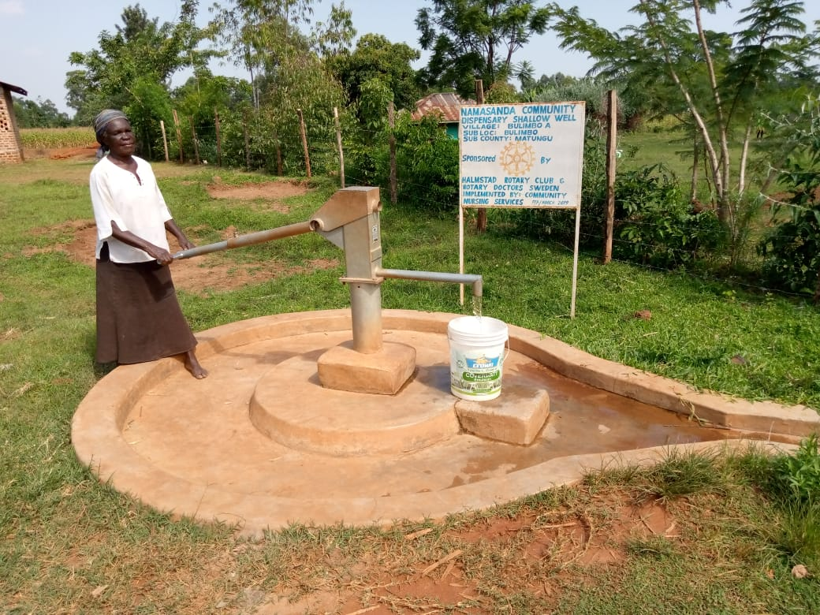
Status of Namasanda

Slide 32
LUKA COMMUNITY SPRING
PERIOD OF PROTECTED:
DEC 2017
AGE:
2YEAR& 7 MONTHS
CATCHMENT POPULATION:
78 Households, approximately 468 persons.

Slide 33
LUKA SPRING REVIEW REPORT
 | PARAMETOR OF REVIEW | REPORT
1 | FUNCTIONALITY | Water flow good, Never dries up even in dry seasons. Drainage well maintained.
2 | FENCE | Standing strong
3 | SIGN POST | Still standing and readable
4 | USAGE | Serves the community well but unfortunately didn’t get someone fetching at the time of visit.
5 | ANY OTHER REPORT | Functional committee. For future followup.

Slide 34
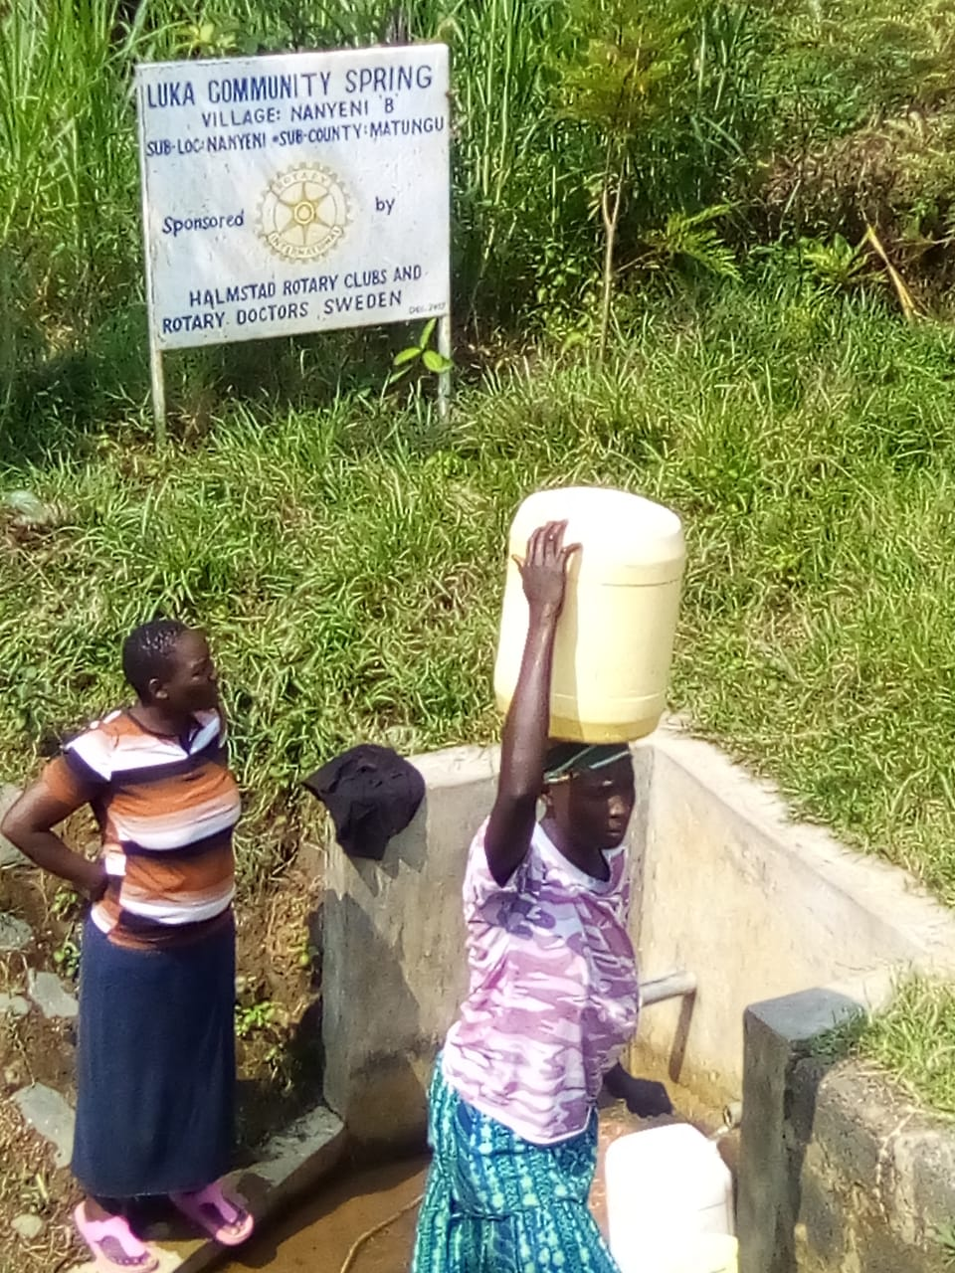
Status of luka spring

Slide 35
Status of luka spring

Slide 36
COMMENTS
Most of the wells visited are functioning well, the greater challenge is on the fence. The termites eats up and destroy the fence even after several community effort to replace them. Also some drainages were slightly blocked.
There are three projects that am yet to visit and report,Ebulanda community shallow well,Bubala community shallow well and Pap gori community shallow well.

Slide 37
VOTE OF THANKS
To Halmstad Rc of Sweden, on behalf of the Community, The Rotary Doctors Sweden and the Community Nursing Services. Thank you so much for this support and you can see how you have transformed the health of many in the community through safe drinking water!
THANK YOU and STAY SAFE FROM CORONA
JACINTA K. NICASIO

