Slide 1
REVIEW OF WATER PROJECTS SPONSORED
BY HASSLEHOLM RC
REVIEW BY: JACINTA K. NICASIO

Slide 2
INTRODUCTION
Water: important resource for sustaining life. Clean and safe drinking water, hygiene and sanitation is important part in maintaining good health.
Rotary Doctors Sweden has been able to support communities’ access clean water through support of various RCs.
The Community makes request, form water project committee who oversee the protection of the spring, use and maintenance for sustainability for the project.

Slide 3
THE FOLLOWING WATER PROJECT HAS BEEN SUPPORTED BY YOUR CLUB
OMBWAYO COMMUNITY SPRING

Slide 4
OMBWAYO COMMUNITY SHALLOW SPRING
PERIOD OF PROTECTED:
Nov/Dec2019
AGE:
7months
CATCHMENT POPULATION:
90Households, approximately 560persons.

Slide 5
OMBWAYO REVIEW REPORT
 | PARAMETOR OF REVIEW | REPORT
1 | FUNCTIONALITY | Good water flow, can take less than 1min to fill a 20 water bucket .Well maintained. The committee encouraged to keep up
2 | FENCE | Well maintained.
3 | SIGN POST | Still standing and readable but not very clear
4 | USAGE | Used by lots of community members
5 | ANY OTHER REPORT | Functional committee, Still very new less than a year. For future follow-up.

Slide 6
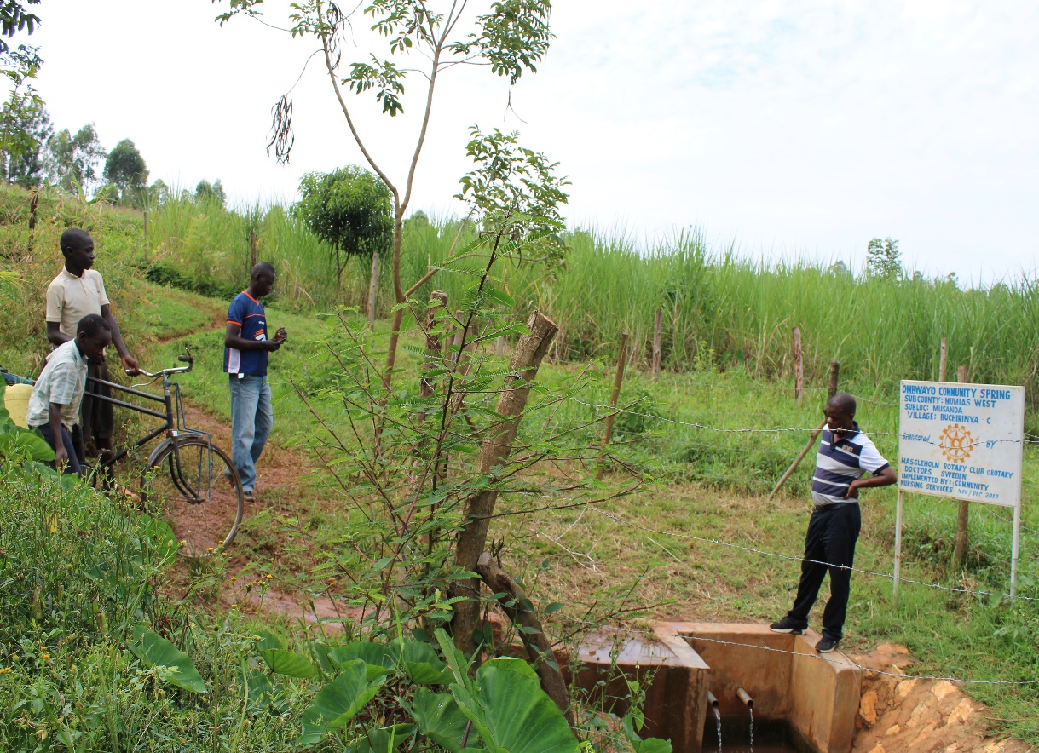
Status Ombwayo community spring

Slide 7
COMMENTS
The spring is so far doing well. We hope to do follow up in the future to see community utilization and maintainance.

Slide 8
VOTE OF THANKS
To Hassleholm RC Sweden, on behalf of the Community, The Rotary Doctors Sweden and the Community Nursing Services. Thank you so much for this support and you can see how you have transformed the health of many in the community through safe drinking water!
THANK YOU and STAY SAFE FROM CORONA
JACINTA K. NICASIO

