Slide 1
REVIEW OF WATER PROJECTS SPONSORED
BY LILLA EDET RC
REVIEW BY: JACINTA K. NICASIO

Slide 2
INTRODUCTION
Water: important resource for sustaining life. Clean and safe drinking water, hygiene and sanitation is important part in maintaining good health.
Rotary Doctors Sweden has been able to support communities’ access clean water through support of various RCs.
The Community makes request, form water project committee who oversee the protection of the spring, use and maintenance for sustainability for the project.

Slide 3
THE FOLLOWING WATER PROJECT HAS BEEN SUPPORTED BY YOUR CLUB
USDIU COMMUNITY SPRING
KAPKATET COMMUNITY SPRING.
MUDAHO COMMUNITY SPRING

Slide 4
USDIU COMMUNITY SHALLOW SPRING
PERIOD OF PROTECTED:
Nov/Dec2013.
AGE:
6years and 7months
CATCHMENT POPULATION:
138 Households, approximately 828persons.

Slide 5
USDIU REVIEW REPORT
 | PARAMETOR OF REVIEW | REPORT
1 | FUNCTIONALITY | Good water flow, can take less than 1min to fill a 20 water bucket .Well maintained. The committee encouraged to keep up
2 | FENCE | Well maintained.
3 | SIGN POST | Still standing and readable but not very clear
4 | USAGE | Used by lots of community members
5 | ANY OTHER REPORT | Functional committee.

Slide 6
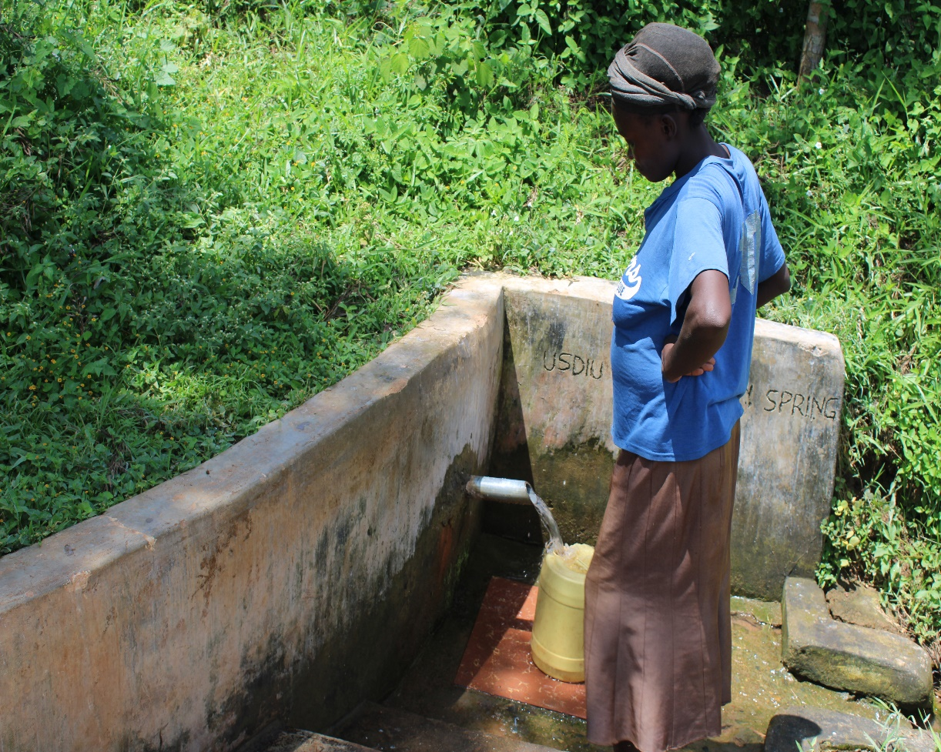
Pictures of Usdiu spring

Slide 7
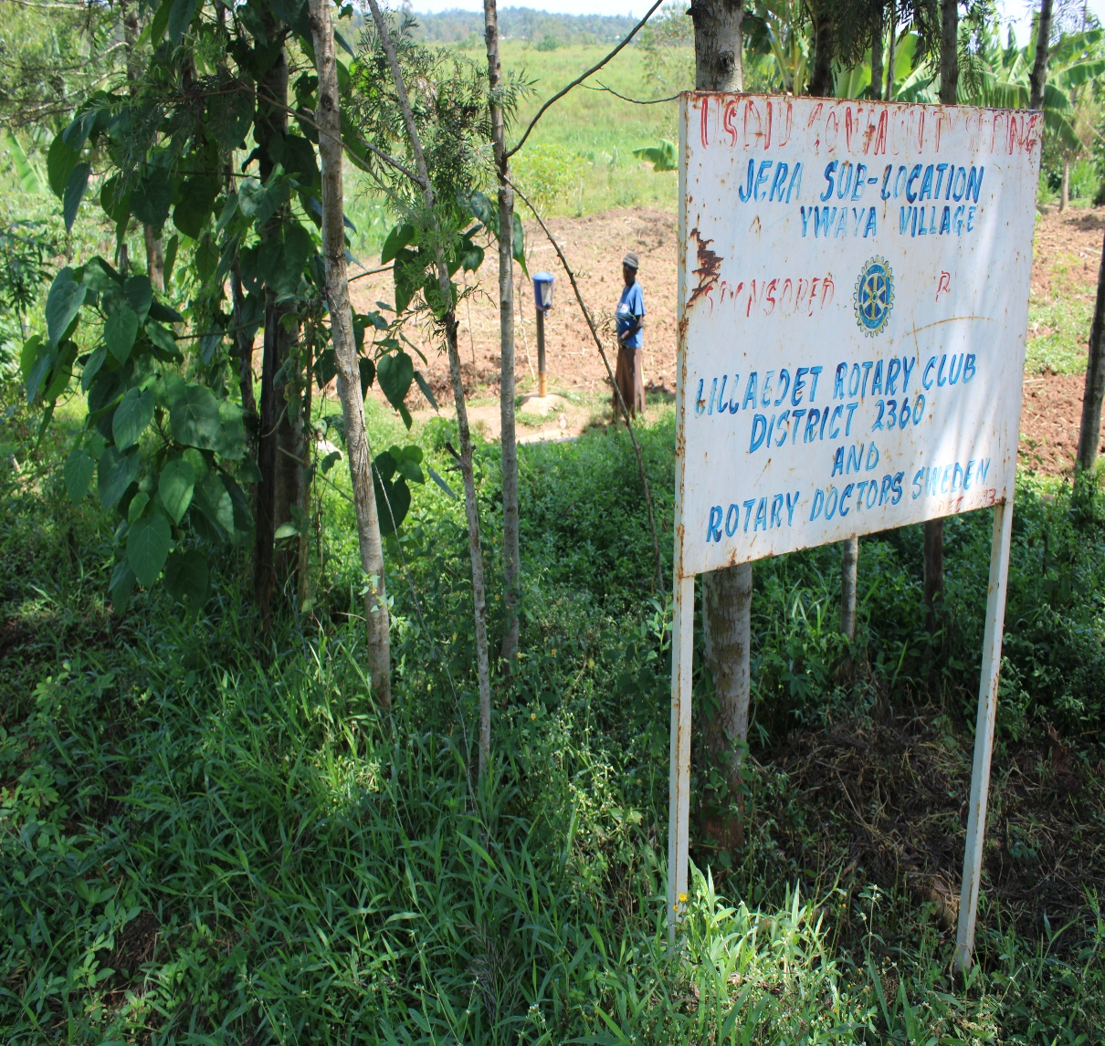

Slide 8
KAPKATET COMMUNITY SPRING
PERIOD OF PROTECTED:
Oct 2012.
AGE:
7 years and 10months
CATCHMENT POPULATION:
350Households, approximately 1750persons.

Slide 9
KAPKATET SPRING REVIEW REPORT
 | PARAMETOR OF REVIEW | REPORT
1 | FUNCTIONALITY | Good water flow, fills a 20 water bucket within two minutes, Pipe seems worn out
2 | FENCE | Poles not there but the catchment well protected and bushy.
3 | SIGN POST | Still standing and readable.
4 | USAGE | Used by all the house hold for drinking, cooking, washing and laundry and for animals.
5 | ANY OTHER REPORT | Functional committee, well protected source with the seedlings already grown.

Slide 10
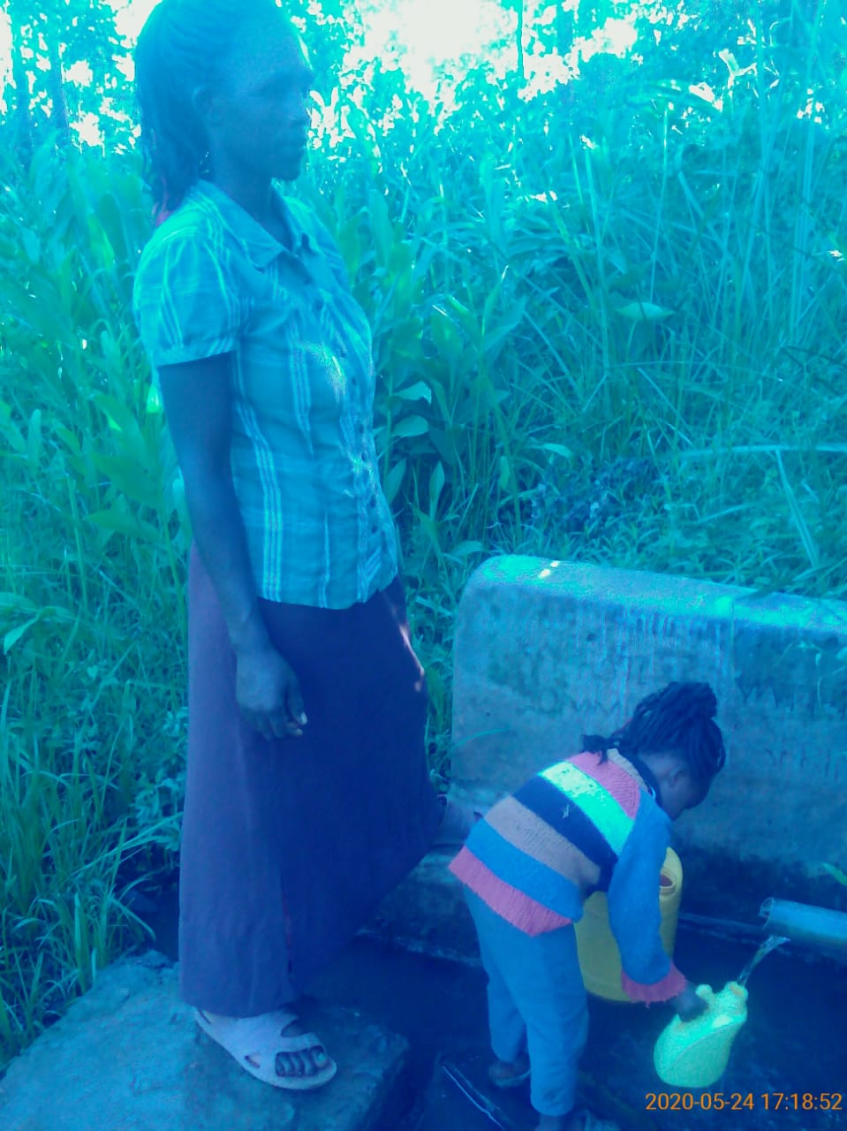
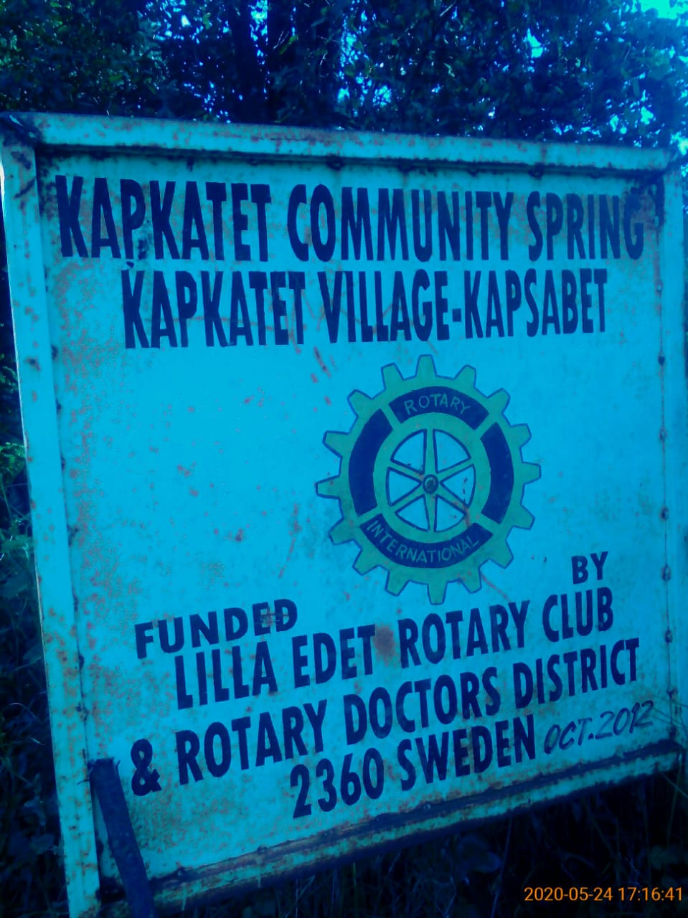
Kapkatet spring status

Slide 11
MUDAHO COMMUNITY SPRING
PERIOD OF PROTECTED:
NOV 2011
AGE:
9 years.
CATCHMENT POPULATION:
250 Households, approximately 1500 persons.

Slide 12
MUDAHO REVIEW REPORT
 | PARAMETOR OF REVIEW | REPORT
1 | FUNCTIONALITY | Water flow throughout the year, well protected source with grown vegetation and NOT well maintained. The drainage was blocked by the time of visit.
2 | FENCE AND DRAINAGE | No, fence ,Drainage blocked and needed clearance.
3 | SIGN POST | Still standing , rusted but readable.
4 | USAGE | Well used by all the house hold for drinking, cooking, washing and laundry and for animals.
5 | ANY OTHER REPORT | No functional committee, drainage needs a little clearance, discussed with the community to form another committee to oversee the maintenance. For follow up

Slide 13
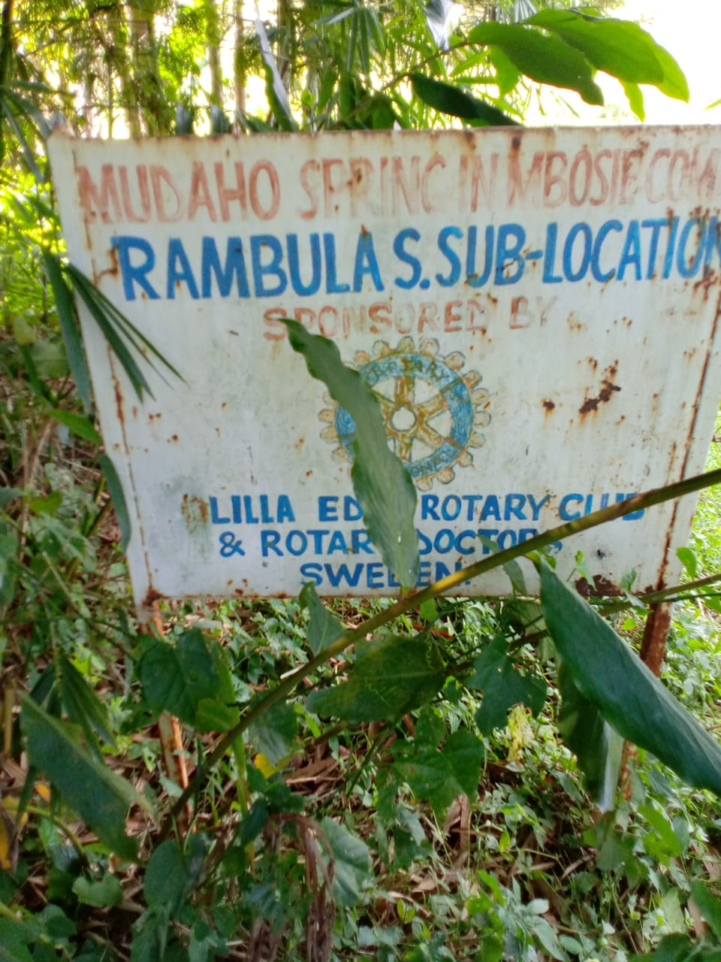
MUDAHO SPRING STATUS

Slide 14
COMMENTS
The springs visited are doing well except for Mudaho which the drainage was blocked and the committee is not functional.
The issue was addressed and is to be followed up.

Slide 15
VOTE OF THANKS
To Lilla Edet RC Sweden, on behalf of the Community, The Rotary Doctors Sweden and the Community Nursing Services. Thank you so much for this support and you can see how you have transformed the health of many in the community through safe drinking water!
THANK YOU and STAY SAFE FROM CORONA
JACINTA K. NICASIO

