Slide 1
REVIEW OF WATER PROJECTS SPONSORED
BY LJNGSKILE UFOUNDATION DISTRICT 2360.
REVIEW BY: JACINTA K. NICASIO

Slide 2
INTRODUCTION
Water: important resource for sustaining life. Clean and safe drinking water, hygiene and sanitation is important part in maintaining good health.
Rotary Doctors Sweden has been able to support communities’ access clean water through support of various RCs.
The Community makes request, form water project committee who oversee the protection of the spring, use and maintenance for sustainability for the project.

Slide 3
THE FOLLOWING WATER PROJECT HAS BEEN SUPPORTED BY YOUR CLUB
BUTENYO COMMUNITY SPRING
GAMA COMMUNITY SPRING
KAYOMBI COMMUNITY SPRING
KOGUTU COMMUNITY SPRING
KOMBOYA COMMUNITY SPRING.
KWA BARAZA COMMUNITY SPRING

Slide 4
OBEWA COMMUNITY SPRING
OGANGA COMMUNITY SPRING
POCHO COMMUNITY SPRING
SANGARA COMMUNITY SPRING
WANGARA COMMUNITY SPRING

Slide 5
BUTENYO COMMUNITY SHALLOW WELL
PERIOD OF PROTECTED:
June/July 2016.
AGE:
4 years.
CATCHMENT POPULATION:
140 Households, approximately 840 persons.

Slide 6
BUTENYO REVIEW REPORT
 | PARAMETOR OF REVIEW | REPORT
1 | FUNCTIONALITY | Slightly, not a heavy flow, can take about 5min to fill a 20 water bucket well maintained. Needs repair the committee will take the repair up.
2 | FENCE | Well maintained.
3 | SIGN POST | Still standing and readable.
4 | USAGE | Used by lots of community members, at the time of taking photos no one was at the spring. Wrong timing!
5 | ANY OTHER REPORT | Functional committee.

Slide 7
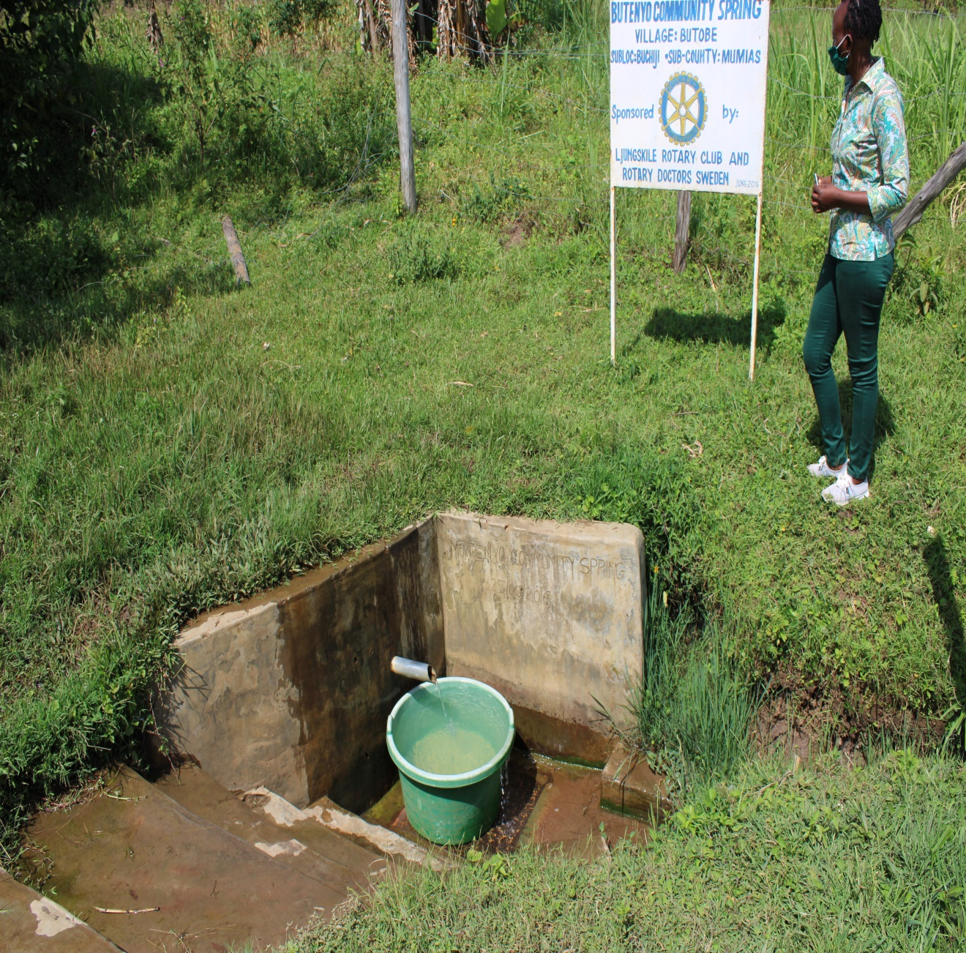
PICTURES OF THE SPRING

Slide 8
OBEWA COMMUNITY SPRING
PERIOD OF PROTECTED:
Nov/Dec 2015.
AGE:
4 years and 8months
CATCHMENT POPULATION:
135 Households, approximately 810 persons.

Slide 9
OBEWA REVIEW REPORT
 | PARAMETOR OF REVIEW | REPORT
1 | FUNCTIONALITY | Good water flow, fills a 20 water bucket within two minutes, no problems raised since hand over to community.
2 | FENCE | Poles eaten down by terminates, the community put on a new and too was brought down.
3 | SIGN POST | Still standing and readable.
4 | USAGE | Heavily used by all the house hold for drinking, cooking, washing and laundry and for animals.
5 | ANY OTHER REPORT | Functional committee, well protected source with the seedlings already grown.

Slide 10
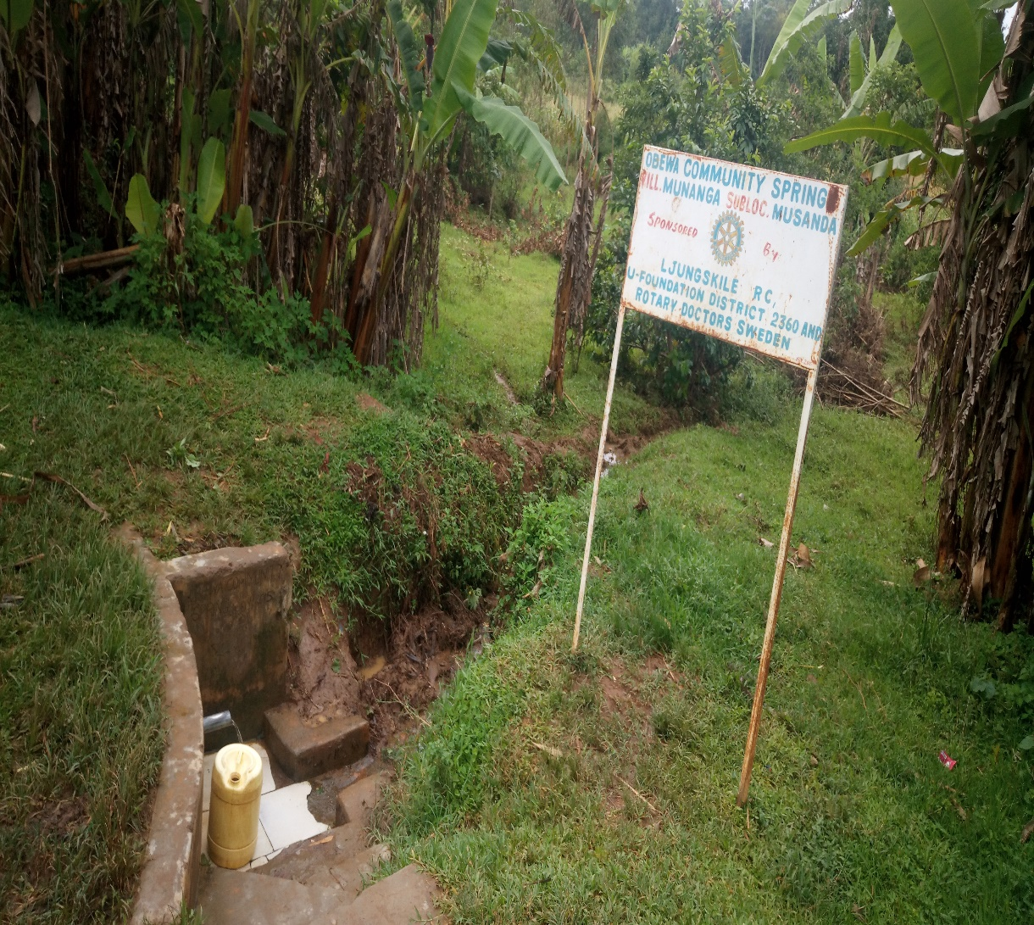
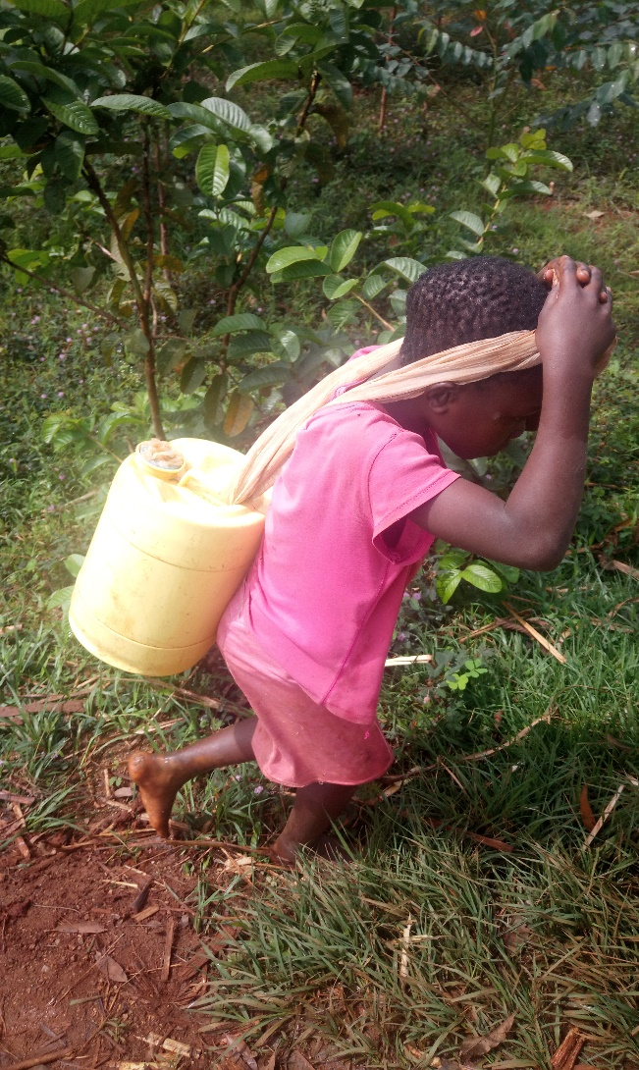
Obewa spring status

Slide 11
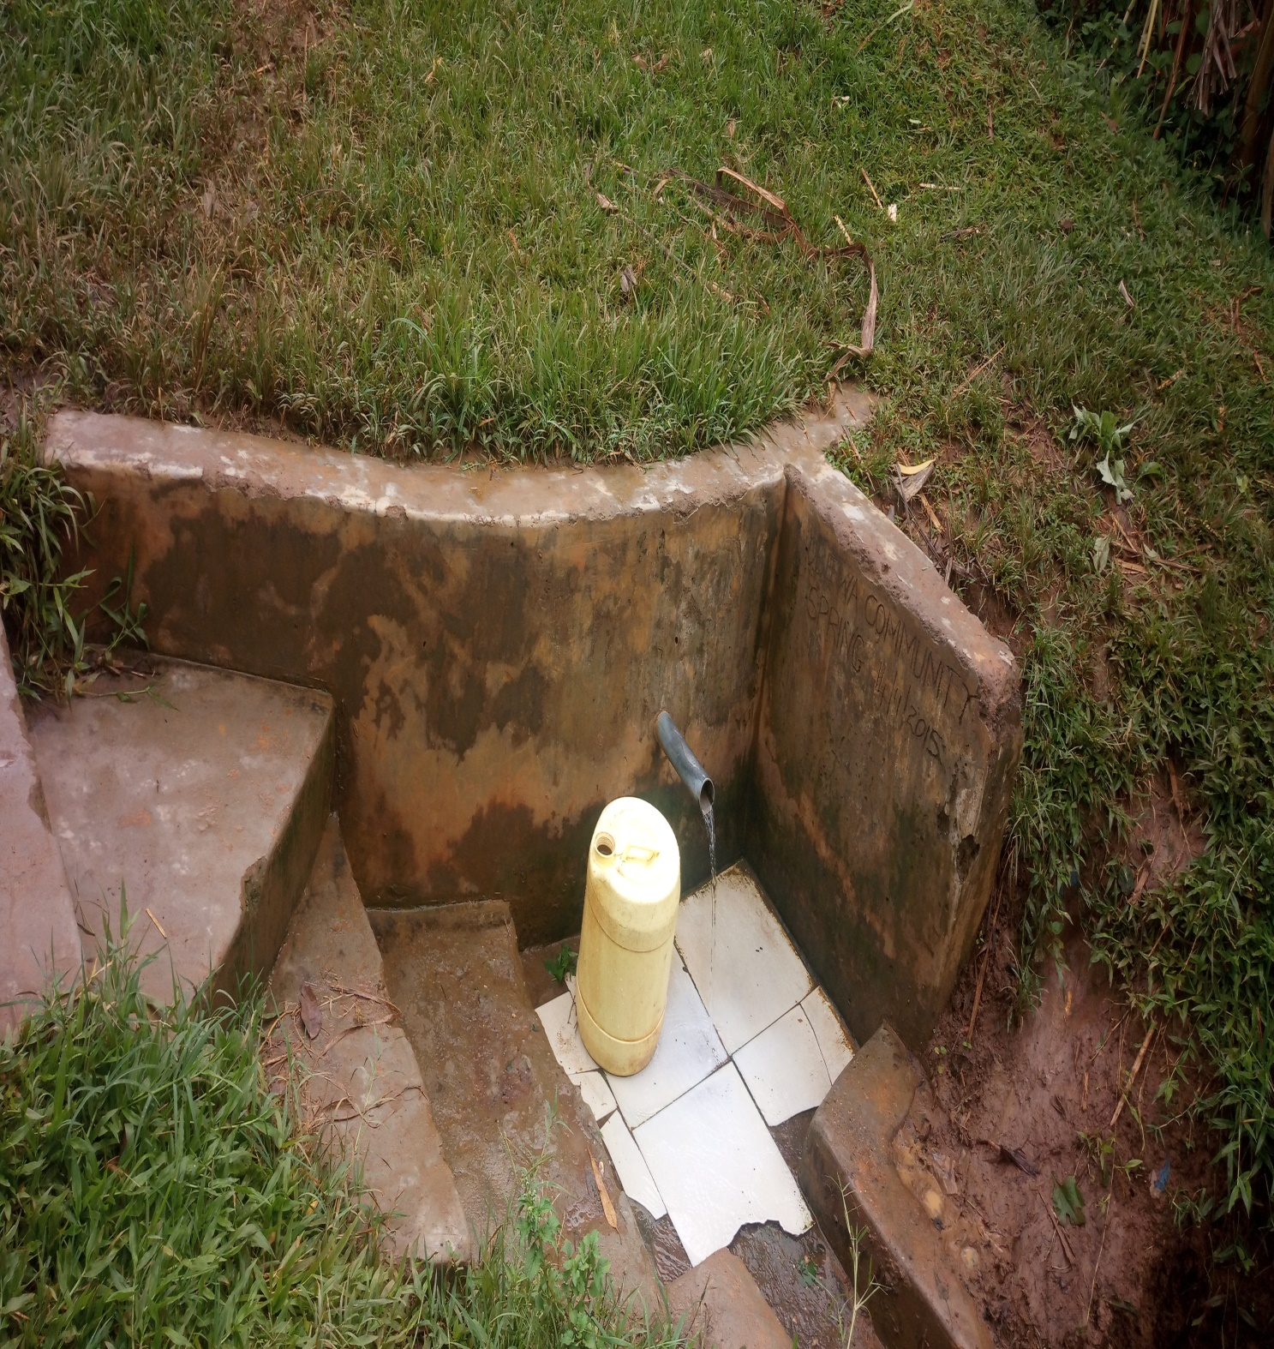

Slide 12
SANGARA COMMUNITY SPRING
PERIOD OF PROTECTED:
June/July 2015.
AGE:
5 years.
CATCHMENT POPULATION:
121 Households, approximately 726 persons.

Slide 13
SANGARA REVIEW REPORT
 | PARAMETOR OF REVIEW | REPORT
1 | FUNCTIONALITY | High yield throughout the year, well protected source with grown vegetation and well maintained.
2 | FENCE | No, fence but well protected by the community.
3 | SIGN POST | Still standing , rusted but readable.
4 | USAGE | Heavily used by all the house hold for drinking, cooking, washing and laundry and for animals.
5 | ANY OTHER REPORT | Functional committee, drainage needs a little clearance, discussed with the community.

Slide 14
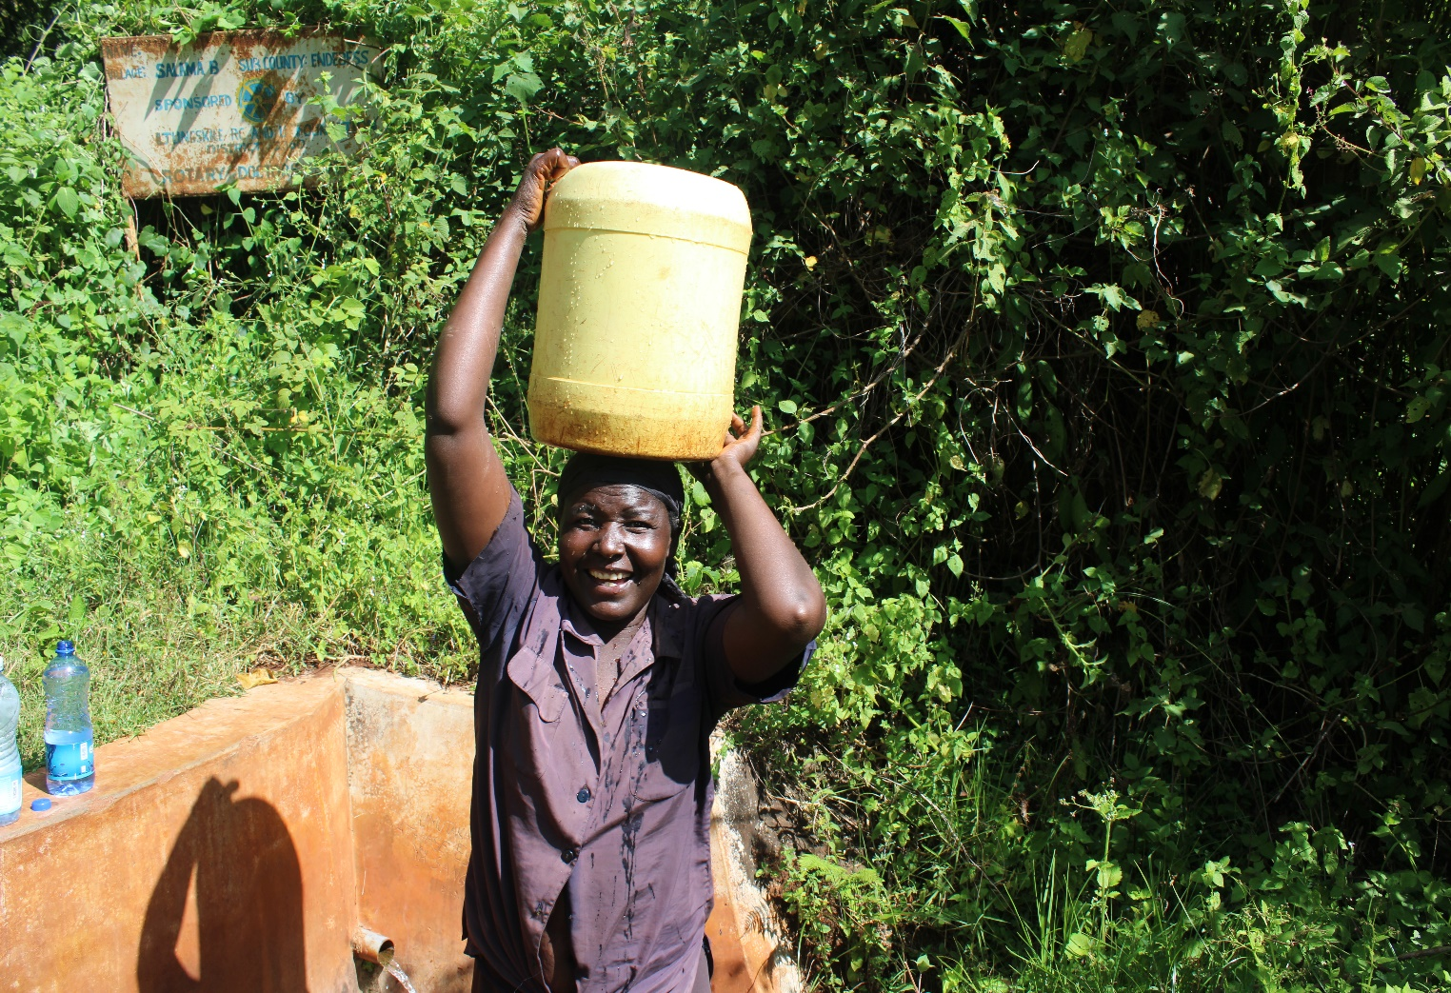
Sangara spring review photos.

Slide 15
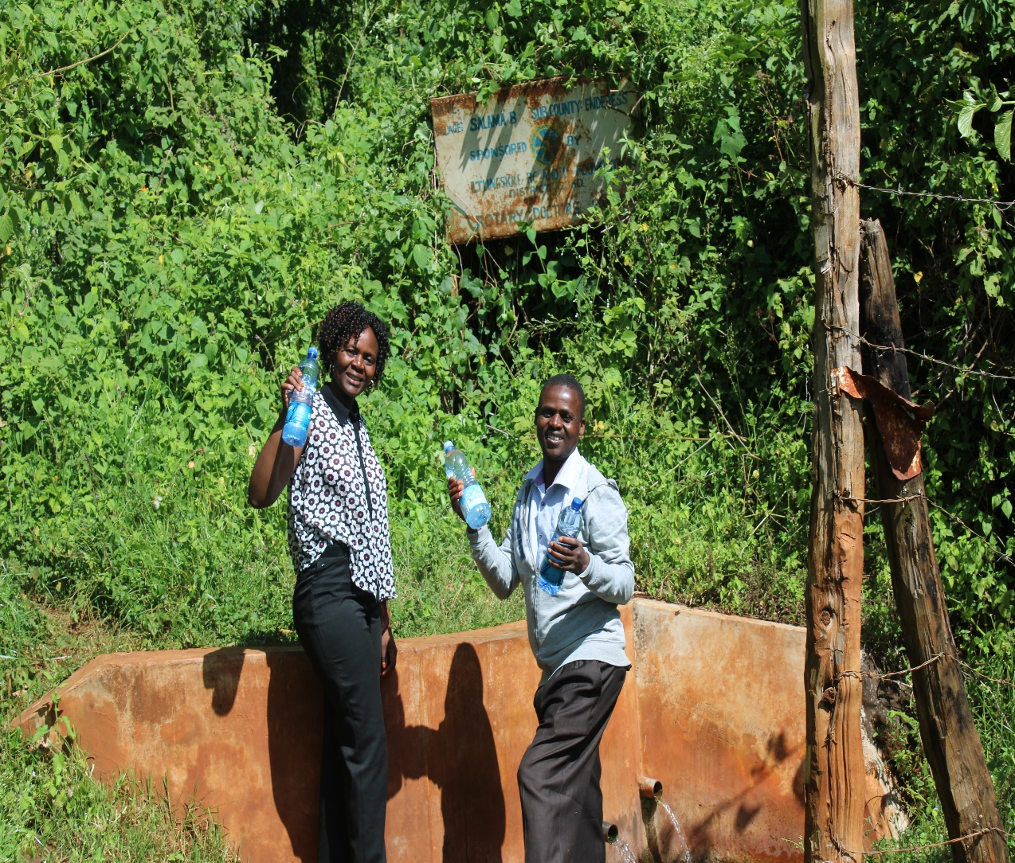
Enjoying a natural dew!!! Refreshing!

Slide 16
KOMBOYA COMMUNITY SPRING
PERIOD OF PROTECTED:
Nov/Dec 2014.
AGE:
5 years 8months.
CATCHMENT POPULATION:
108 Households, approximately 648 persons.

Slide 17
KOMBOYA REVIEW REPORT
 | PARAMETOR OF REVIEW | REPORT
1 | FUNCTIONALITY | High yield spring throughout the year, water sprouting from the two pipes Drainage well maintained.
2 | FENCE | Destroyed by the termites, though well protected source with over grown vegetation.
3 | SIGN POST | Sign post still standing, though very rusty and not easy to read.
4 | USAGE | Used by the community members though at the time of visit we didn’t get anyone fetching. Wrong timimg
5 | ANY OTHER REPORT | A lot of silt in the stair case, needs to be cleared!

Slide 18
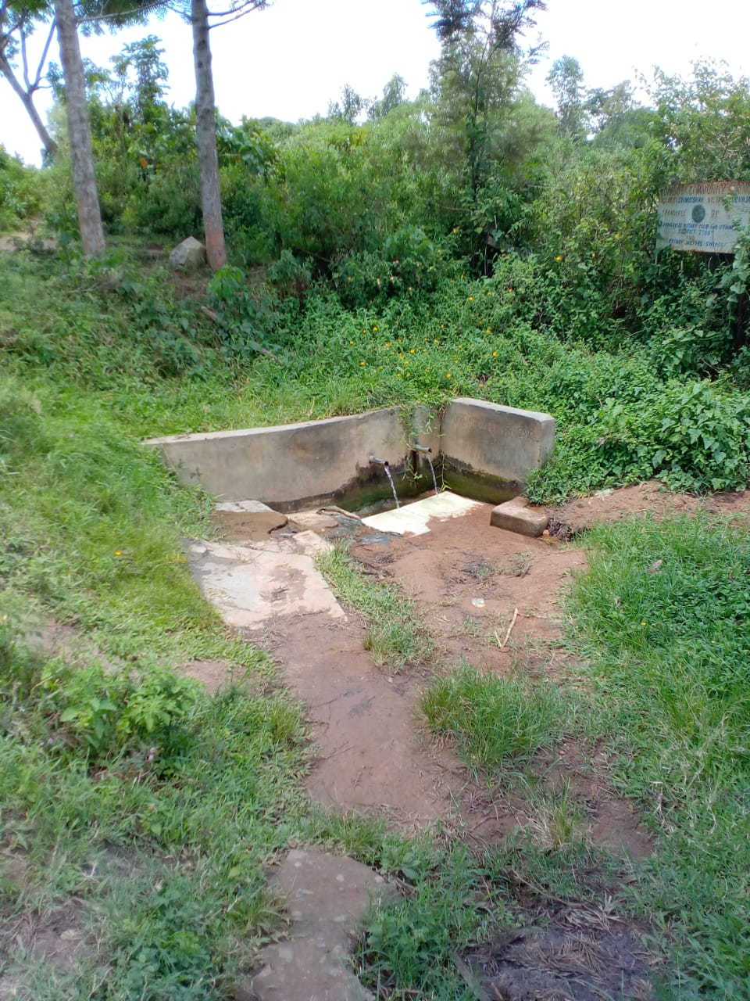
Komboya spring photos

Slide 19
GAMA COMMUNITY SPRING
PERIOD OF PROTECTED:
Nov/Dec 2018.
AGE:
1 year 8 months.
CATCHMENT POPULATION:
118 Households, approximately 708 persons.

Slide 20
GAMA REVIEW REPORT
 | PARAMETOR OF REVIEW | REPORT
1 | FUNCTIONALITY | High yield throughout the year, takes less than 1 minute to fill a 20 water bucket.
2 | FENCE | Fence still standing firm and source well protected with overgrown shrubs and bushes.
3 | SIGN POST | Standing firm and readable.
4 | USAGE | Used for all purpose, drinking, cooking, washing and for animals to drink.
5 | ANY OTHER REPORT | Great work by the spring committee.

Slide 21
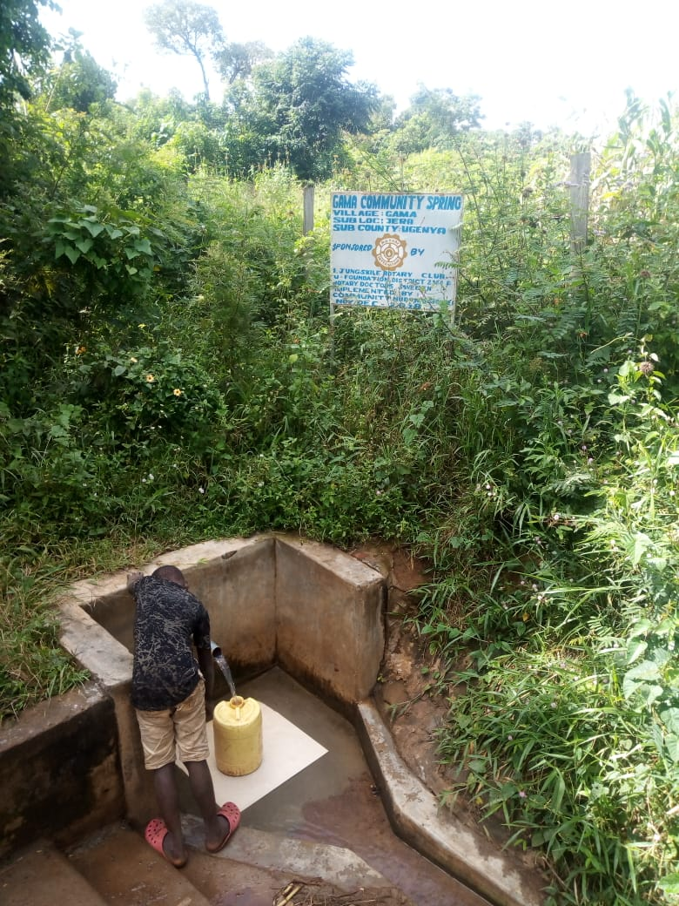
Photos, sample collection for analysis and young boy fetching water for family use.

Slide 22
KOGUTU COMMUNITY SPRING
PERIOD OF PROTECTED:
July/June 2018.
AGE:
2 years
CATCHMENT POPULATION:
62 Households, approximately 372 persons.

Slide 23
KOGUTU REVIEW REPORT
 | PARAMETOR OF REVIEW | REPORT
1 | FUNCTIONALITY | Great water yield throughout the year. Drainage well maintained.
2 | FENCE | One side intact, the other side brought down due to land dispute, the spring is though used despite the dispute.
3 | SIGN POST | Still standing, clear and readable.
4 | USAGE | Used by all members of the community!
5 | ANY OTHER REPORT | For future follow-up.

Slide 24
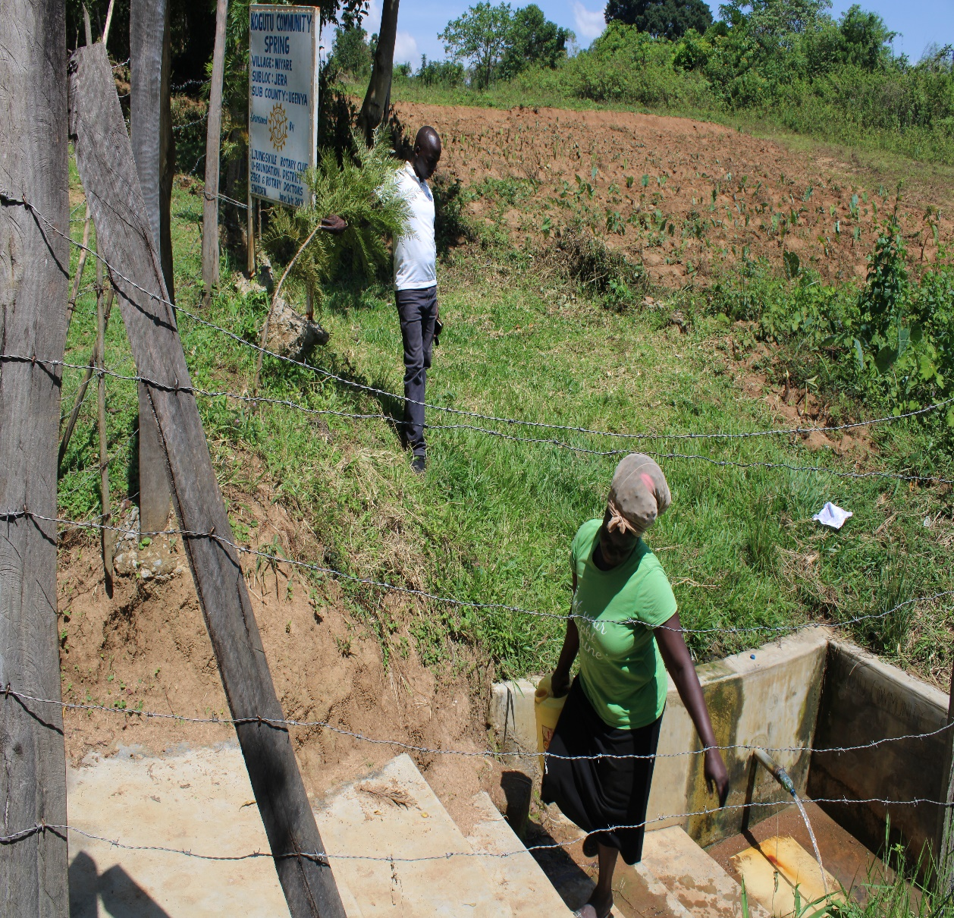
A community member fetching water from Kogutu spring

Slide 25
KAYOMBI COMMUNITY SPRING
PERIOD OF PROTECTED:
Aug/Sept 2011.
AGE:
About 10 years old.
CATCHMENT POPULATION:
201 Households, approximately 1,206 persons.

Slide 26
KAYOMBI REVIEW REPORT
 | PARAMETOR OF REVIEW | REPORT
1 | FUNCTIONALITY | High yield for about ten years now, well functioning spring One time repair by the community. Drainage well maintained.
2 | FENCE | Not present brought down by termites.
3 | SIGN POST | Rusted, but still present.
4 | USAGE | Highly used with a big population.
5 | ANY OTHER REPORT | Well maintained by the community members Encouraging to see the 10year project still serving good. Needs stone pitching cause of erosion.

Slide 27
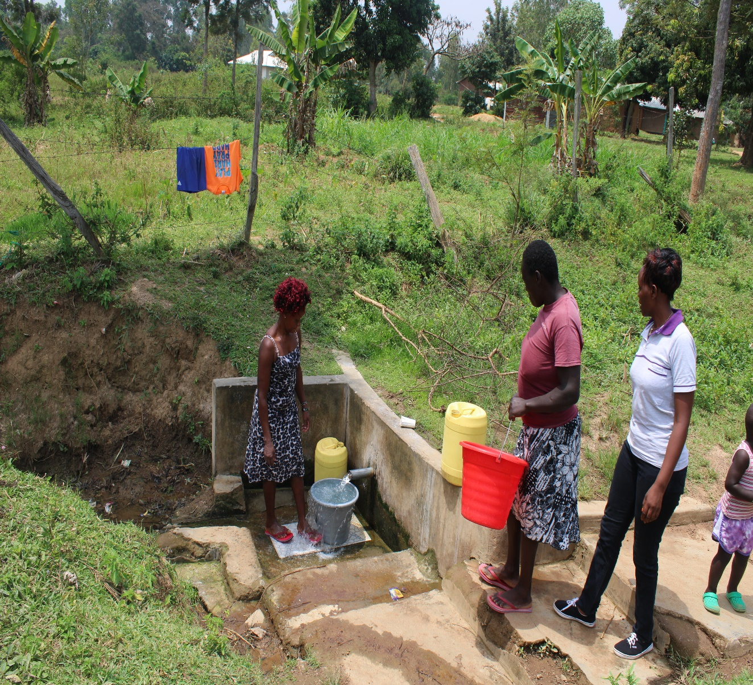
Status of the Kayombi spring.

Slide 28
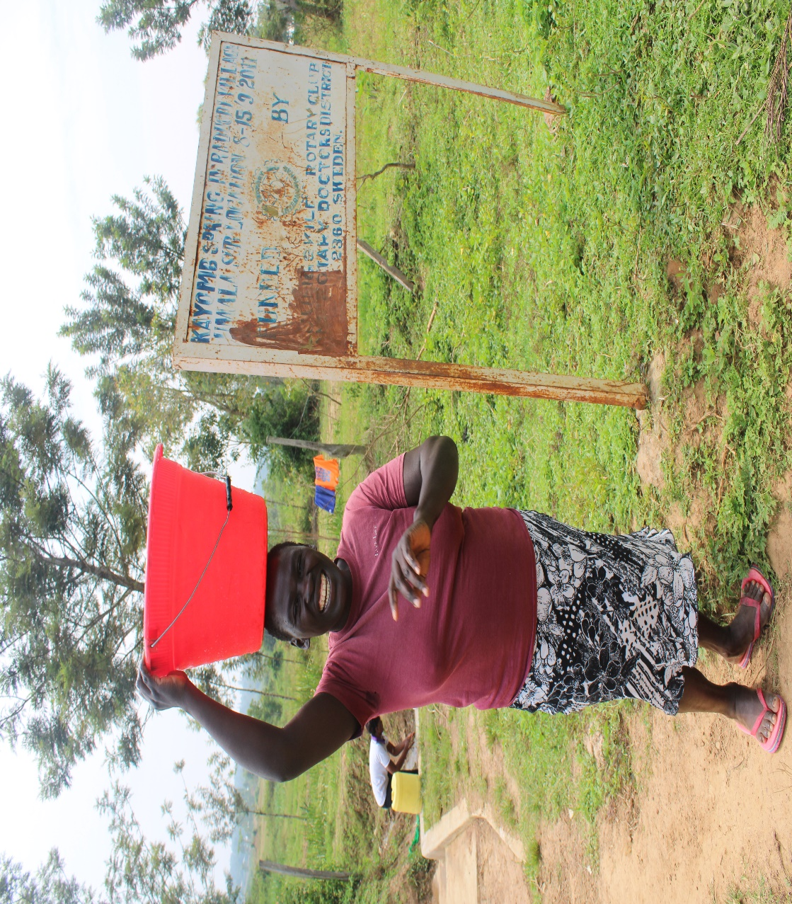
Community members fetching from Kayombi spring

Slide 29
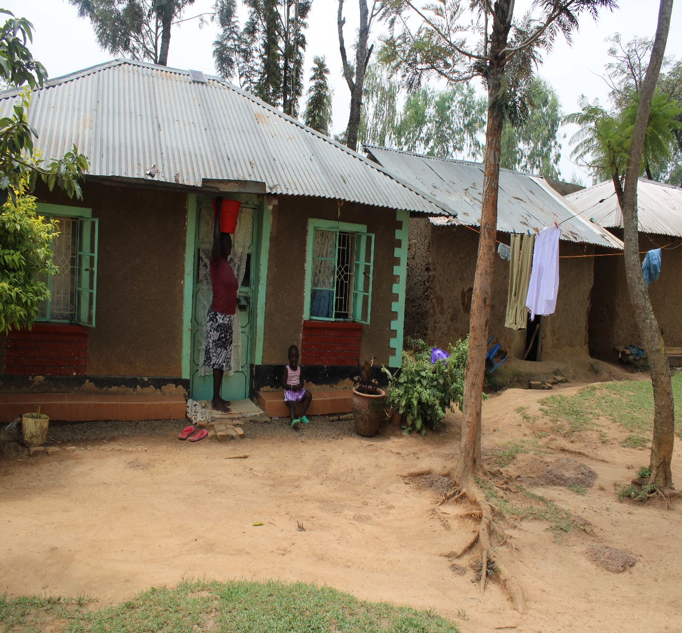

Slide 30
POCHO COMMUNITY SPRING
PERIOD OF PROTECTED:
June/July 2012.
AGE:
9 years old.
CATCHMENT POPULATION:
160 Households, approximately 960 persons.

Slide 31
POCHO REVIEW REPORT
 | PARAMETOR OF REVIEW | REPORT
1 | FUNCTIONALITY | High water yield throughout the whole year! Drainage good.
2 | FENCE | Fence gone, though the source is well protected with grown bushes.
3 | SIGN POST | Rusty and not readable!
4 | USAGE | Highly used even by the market nearby!
5 | ANY OTHER REPORT | Well maintained. So encouraging for a nine year project! Community encouraged to keep up.

Slide 32
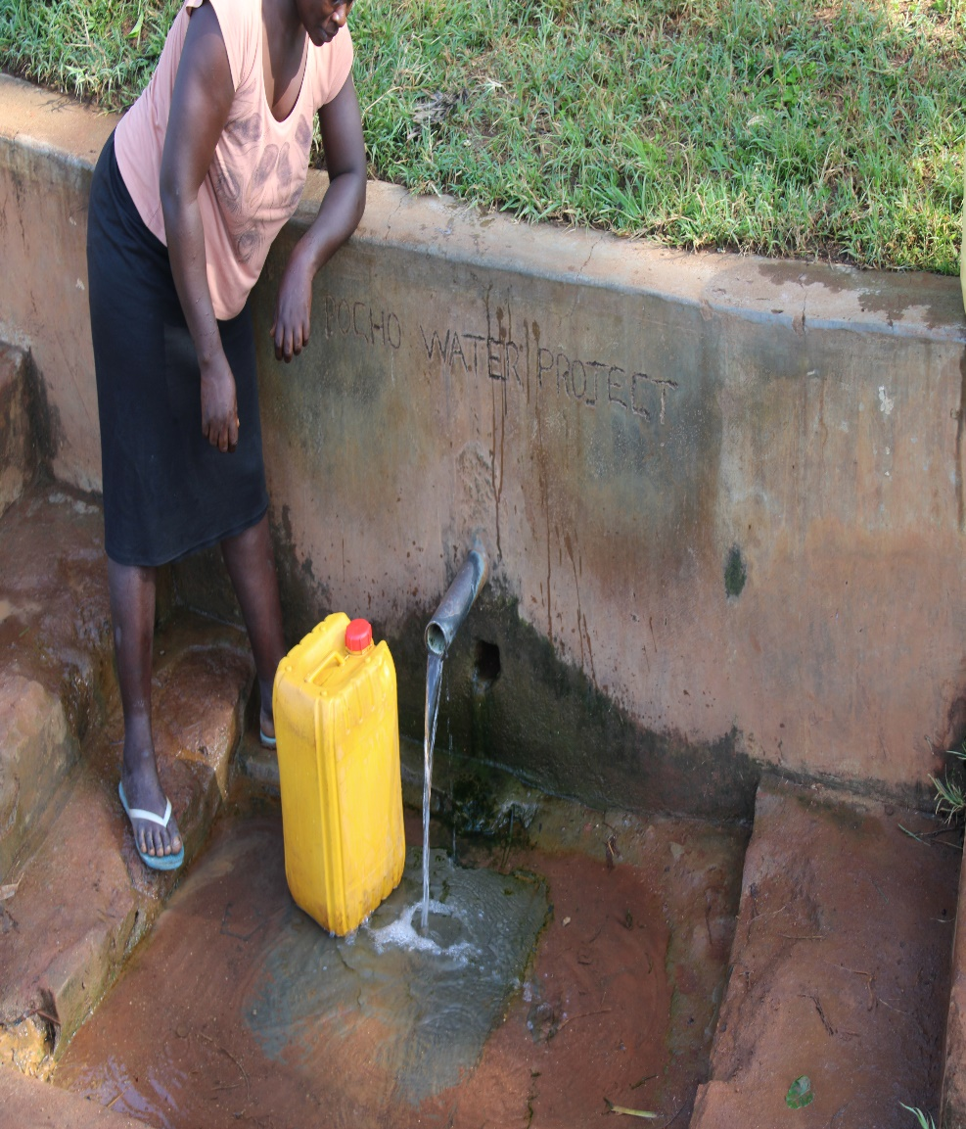
Pocho spring in use.

Slide 33
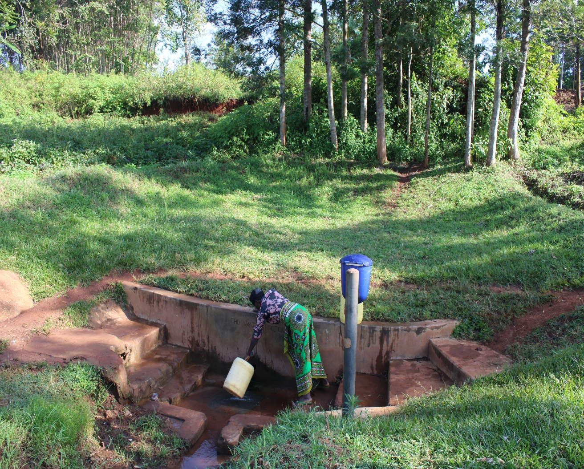
They even come from Sweden to enjoy the natural freshness!!!

Slide 34
WANGARA COMMUNITY SPRING
PERIOD OF PROTECTED:
June/July 2016.
AGE:
4 years old.
CATCHMENT POPULATION:
113 Households, approximately 678 persons.

Slide 35
WANGARA SPRING REVIEW REPORT
 | PARAMETOR OF REVIEW | REPORT
1 | FUNCTIONALITY | High yield throughout the year, a 20 water bucket fills up within less than 30 seconds. Overgrown shrubs very good for catchment protection.
2 | FENCE | Fence still intact.
3 | SIGN POST | Sign post standing and very clear.
4 | USAGE | Highly used even with schools nearby!
5 | ANY OTHER REPORT | Well kept, great committee.

Slide 36
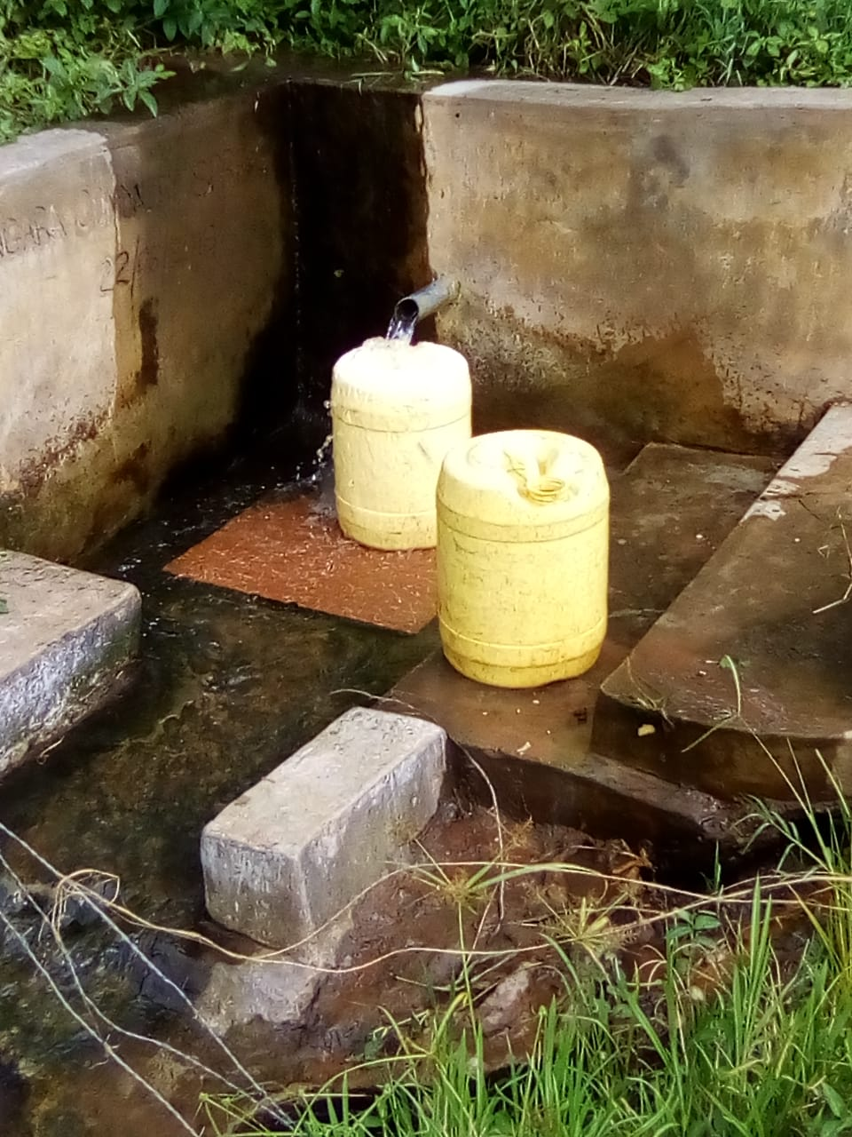
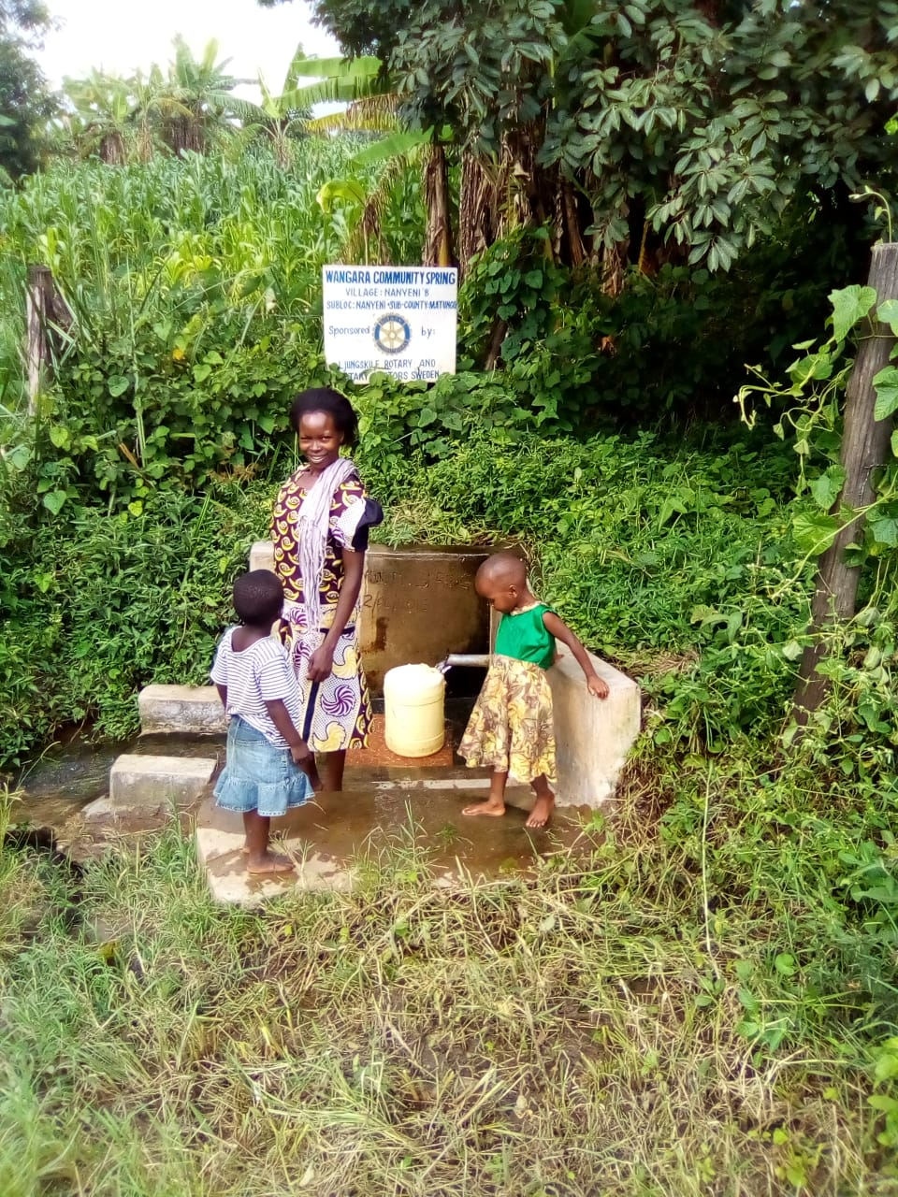
status of wangara spring as at 2020

Slide 37
KWA BARAZA SPRING
PERIOD OF PROTECTED:
Oct/Nov 2016.
AGE:
3 years old and 9.
CATCHMENT POPULATION:
113 Households, approximately 678 persons, 2schools 1,200.

Slide 38
KWA BARAZA SPRING REVIEW REPORT
 | PARAMETOR OF REVIEW | REPORT
1 | FUNCTIONALITY | Well maintained spring, high water yield throughout the whole year. Two full pipes throwing out water at the same time. The community had to add a third pipe to help in over flow!
2 | FENCE | The fence is intact.
3 | SIGN POST | Sigh post intact and readable.
4 | USAGE | Heavily used, by one boarding secondary school, primary school and the community.
5 | ANY OTHER REPORT | Well maintained, good committee.

Slide 39
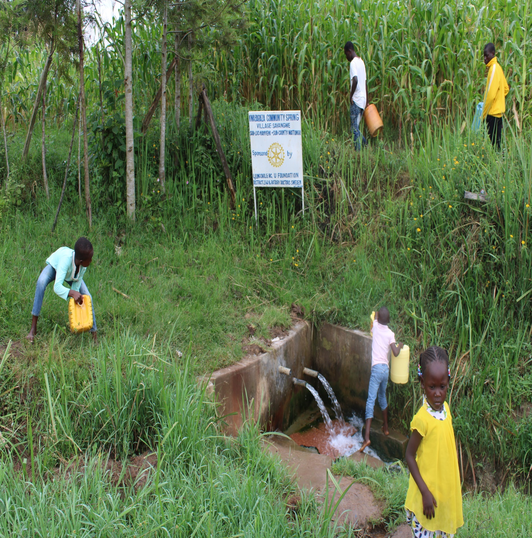
CURENT PHOTOS OF USE

Slide 40
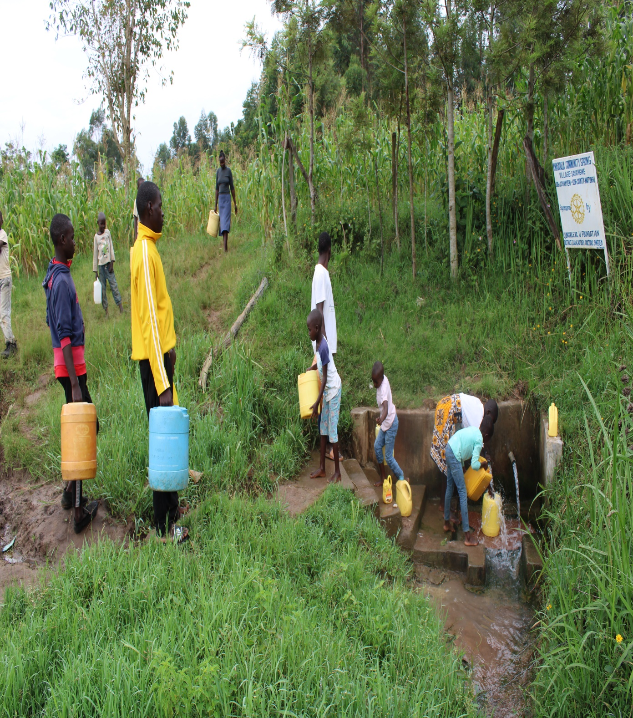
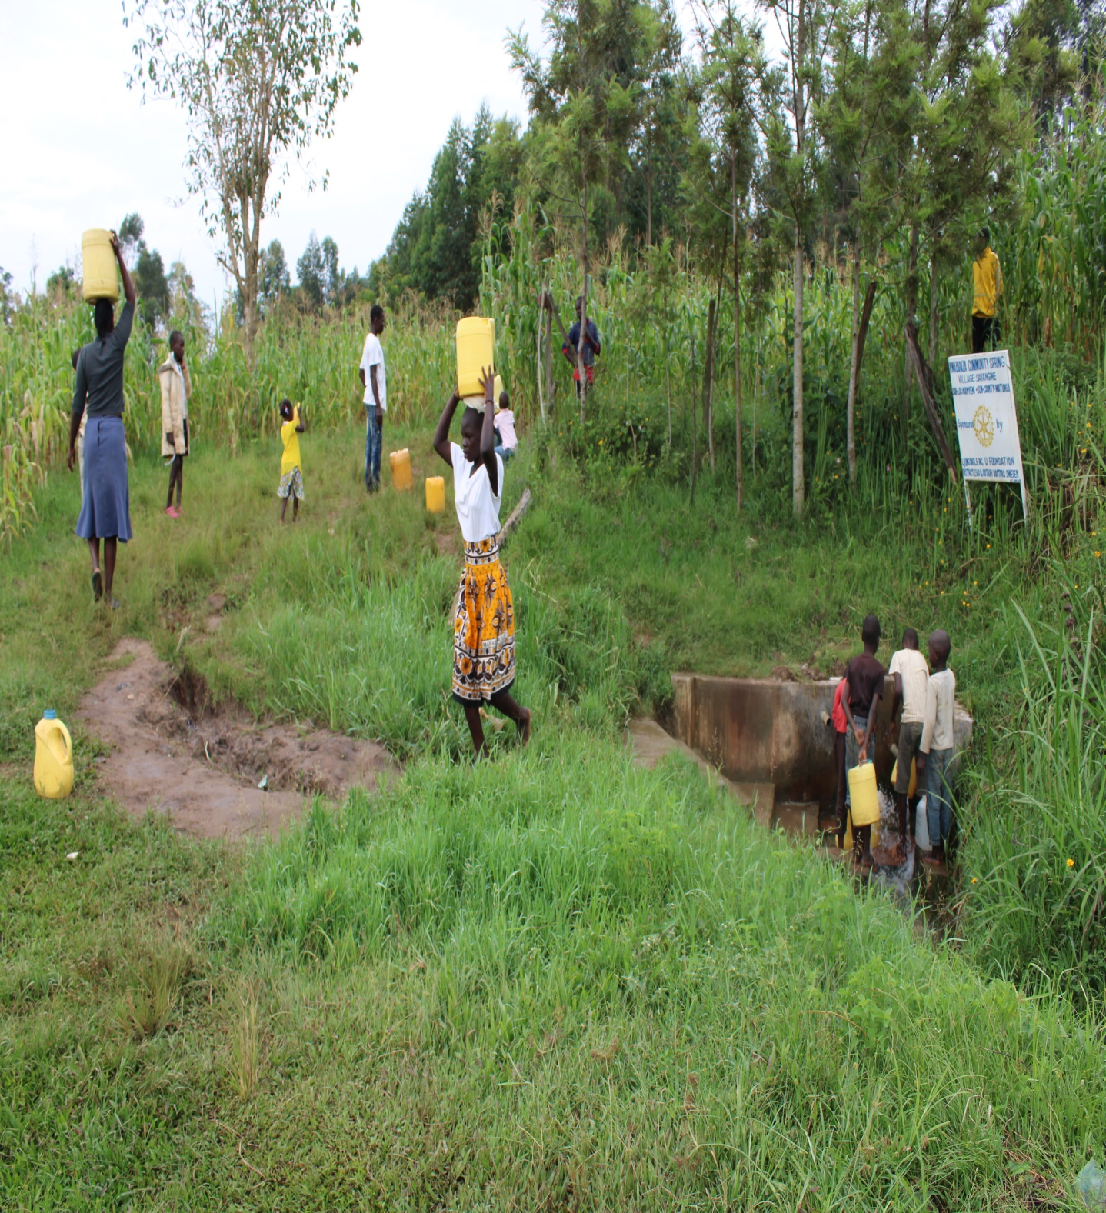

Slide 41
OGANGA SPRING
PERIOD OF PROTECTED:
MARCH 2014.
AGE:
6 years old and 3months.
CATCHMENT POPULATION:
203 Households, approximately 1,218.

Slide 42
OGANGO SPRING REVIEW REPORT
 | PARAMETOR OF REVIEW | REPORT
1 | FUNCTIONALITY | The spring has a good yield throughout the year round, the drainage is partially blocked, clogging the water on the spring box.
2 | FENCE | Fence has been brought down by the terminates, through source is protected well with the overgrown trees.
3 | SIGN POST | Sigh post was missing, it was vandalized or stolen and sold to metal dealers.
4 | USAGE | It is though used by the community members and the school nearby.
5 | ANY OTHER REPORT | Community instructed to form a new committee and organize to clear the drainage.

Slide 43
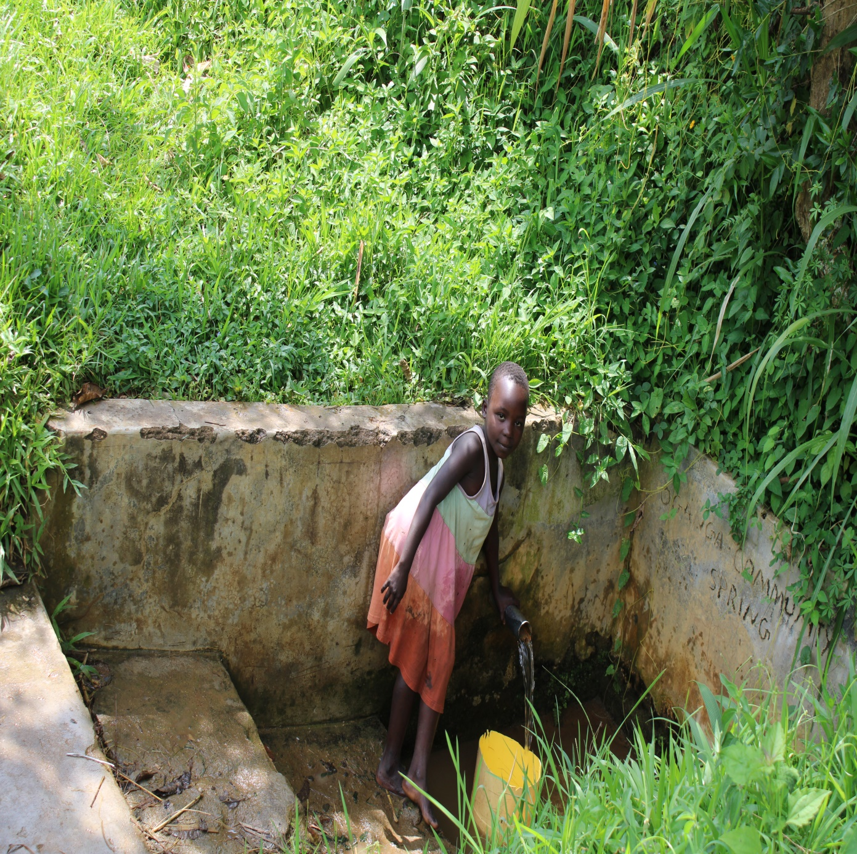
PHOTOS OF OGANGA SPRING

Slide 44
NABULOLO COMMUNITY SPRING
Out of the success story, there is also one failed project.
The 2019 drought reduced the water levels in Nabulolo spring and therefore it failed.
The community opened up and to access the water.
We have discussed with the community they have some funds to repair it.
Pictures will be sent after repair.

Slide 45
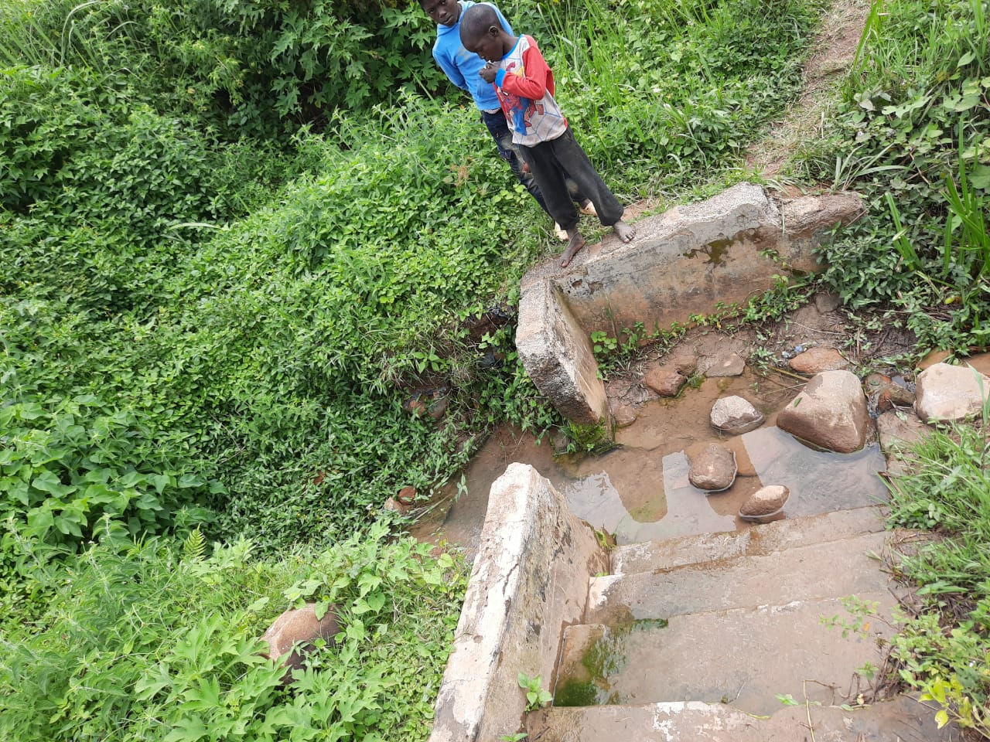
PHOTOS OF THE FAILED SPRING

Slide 46
COMMENTS
Most of the springs visited are function well, the greater challenge is on the fence. The termites eats up and destroy the fence even after several community effort to replace them. Also some drainages were blocked.
There is also one failed project after several years, it will be redone through community efforts.
It was great to see even 10 years old springs still very functional.

Slide 47
VOTE OF THANKS
To Ljungskile RC,U foundation, Distrcit 2360 of Sweden, on behalf of the Community, The Rotary Doctors Sweden and the Community Nursing Services. Thank you so much for this support and you can see how you have transformed the health of many in the community through safe drinking water!
THANK YOU and STAY SAFE FROM CORONA
JACINTA K. NICASIO

