Slide 1
REVIEW OF WATER PROJECTS SPONSORED
BY MALMO CITY RC
REVIEW BY: JACINTA K. NICASIO

Slide 2
INTRODUCTION
Water: important resource for sustaining life. Clean and safe drinking water, hygiene and sanitation is important part in maintaining good health.
Rotary Doctors Sweden has been able to support communities’ access clean water through support of various RCs.
The Community makes request, form water project committee who oversee the protection of the spring, use and maintenance for sustainability for the project.

Slide 3
THE FOLLOWING WATER PROJECT HAS BEEN SUPPORTED BY YOUR CLUB
NYAPETA COMMUNITY SPRING

Slide 4
NYAPETA COMMUNITY SPRING
PERIOD OF PROTECTED:
JULY 2016
AGE:
4 YEARS
CATCHMENT POPULATION:
84Households, approximately 504 persons.

Slide 5
NYAPETA SPRING REVIEW REPORT
 | PARAMETOR OF REVIEW | REPORT
1 | FUNCTIONALITY | Good water flow, can take less than 30 seconds to fill a 20 water bucket . Drainage well maintained. The committee encouraged to keep up
2 | FENCE | Well maintained,
3 | SIGN POST | Still standing and readable
4 | USAGE | Used by lots of community members
5 | ANY OTHER REPORT | Functional committee, the committee is very happy and thankful for the support.

Slide 6
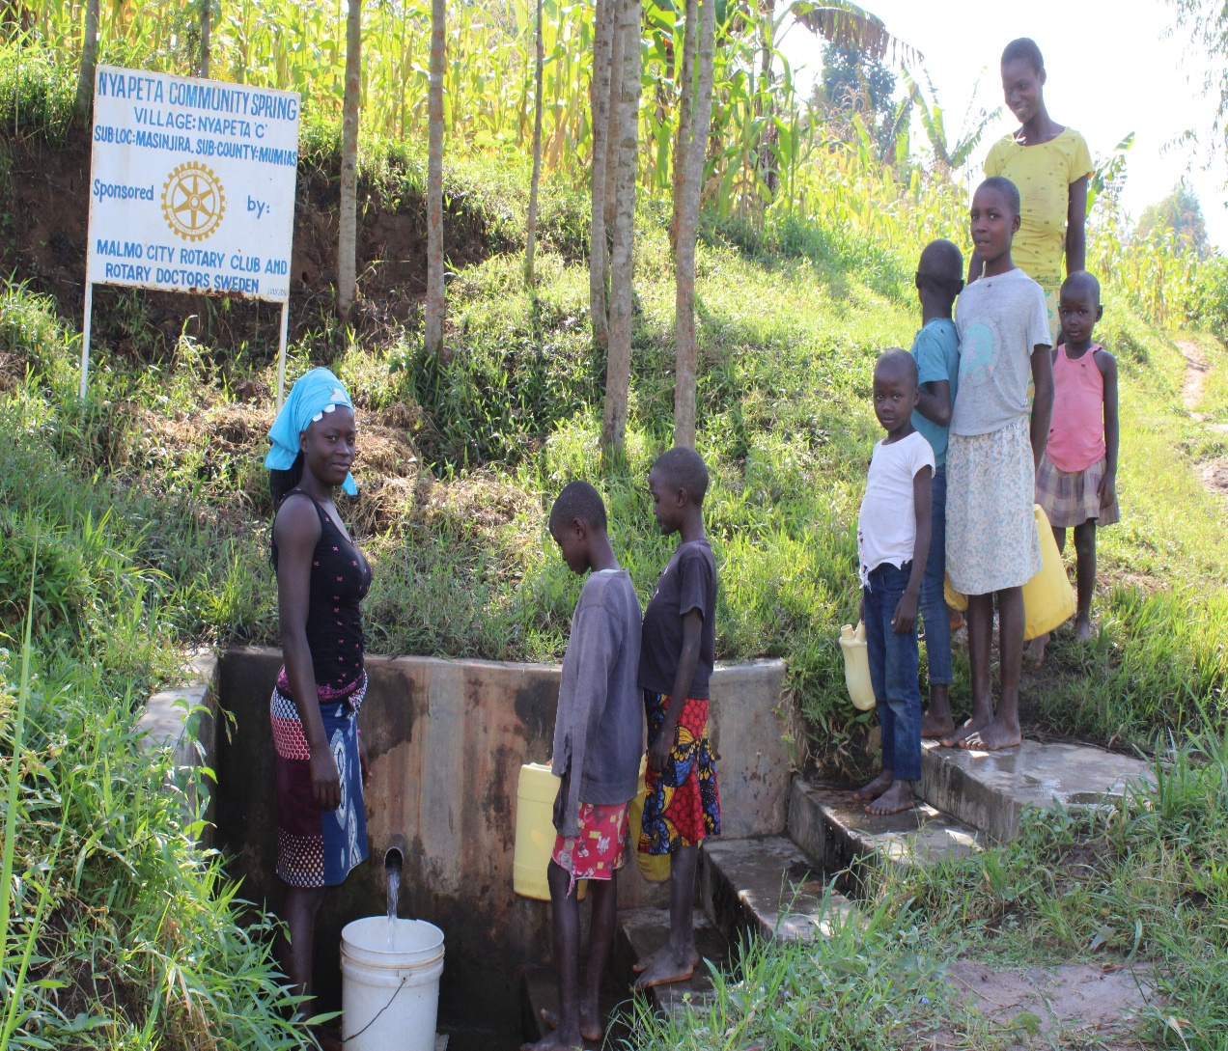
Status Nyapeta spring

Slide 7
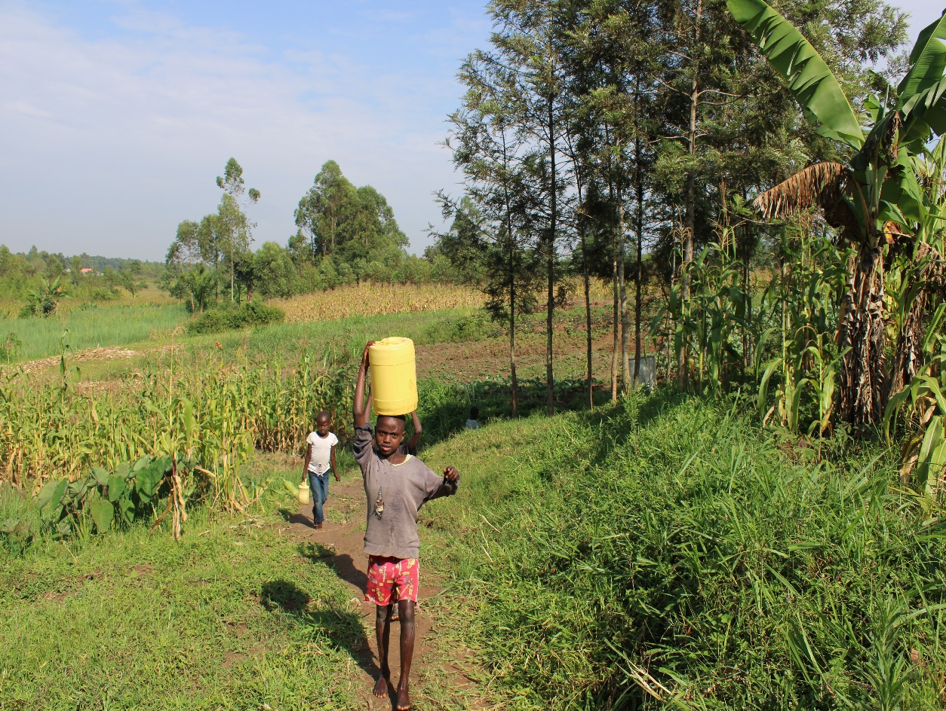

Slide 8
COMMENTS
A very well maintained and used spring by the community and they appreciates the support. We encourage them to keep up the use and maintenance.

Slide 9
VOTE OF THANKS
To Malmo city RC Sweden, on behalf of the Community, The Rotary Doctors Sweden and the Community Nursing Services. Thank you so much for this support and you can see how you have transformed the health of many in the community through safe drinking water!
THANK YOU and STAY SAFE FROM CORONA
JACINTA K. NICASIO

