Slide 1
REVIEW OF WATER PROJECTS SPONSORED
BY ORUST RC
REVIEW BY: JACINTA K. NICASIO

Slide 2
INTRODUCTION
Water: important resource for sustaining life. Clean and safe drinking water, hygiene and sanitation is important part in maintaining good health.
Rotary Doctors Sweden has been able to support communities’ access clean water through support of various RCs.
The Community makes request, form water project committee who oversee the protection of the spring, use and maintenance for sustainability for the project.

Slide 3
THE FOLLOWING WATER PROJECT HAS BEEN SUPPORTED BY YOUR CLUB
HALALA COMMUNITY SPRING
KOYULE COMMUNITY SPRING.
UHESIA COMMUNITY SPRING
NABULINDO COMMUNITY SPRING
OKELLO COMMUNITY SPRING

Slide 4
HALLALA COMMUNITY SHALLOW SPRING
PERIOD OF PROTECTED:
Dec2011.
AGE:
9years and 7months
CATCHMENT POPULATION:
230 Households, approximately 1150persons.

Slide 5
HALLALA REVIEW REPORT
 | PARAMETOR OF REVIEW | REPORT
1 | FUNCTIONALITY | Good water flow good can take less than 5sec min to fill a 20 water bucket The floor destroyed by a lot of water coming out , Drainage well maintained
2 | FENCE | Not there, post eaten by termites..
3 | SIGN POST | Was rusted and not readable and was taken away.
4 | USAGE | Used by lots of community members
5 | ANY OTHER REPORT | Functional committee, needs some repair of the floor and an additional pipe ,a lot of water that exceeds 2pipes.

Slide 6
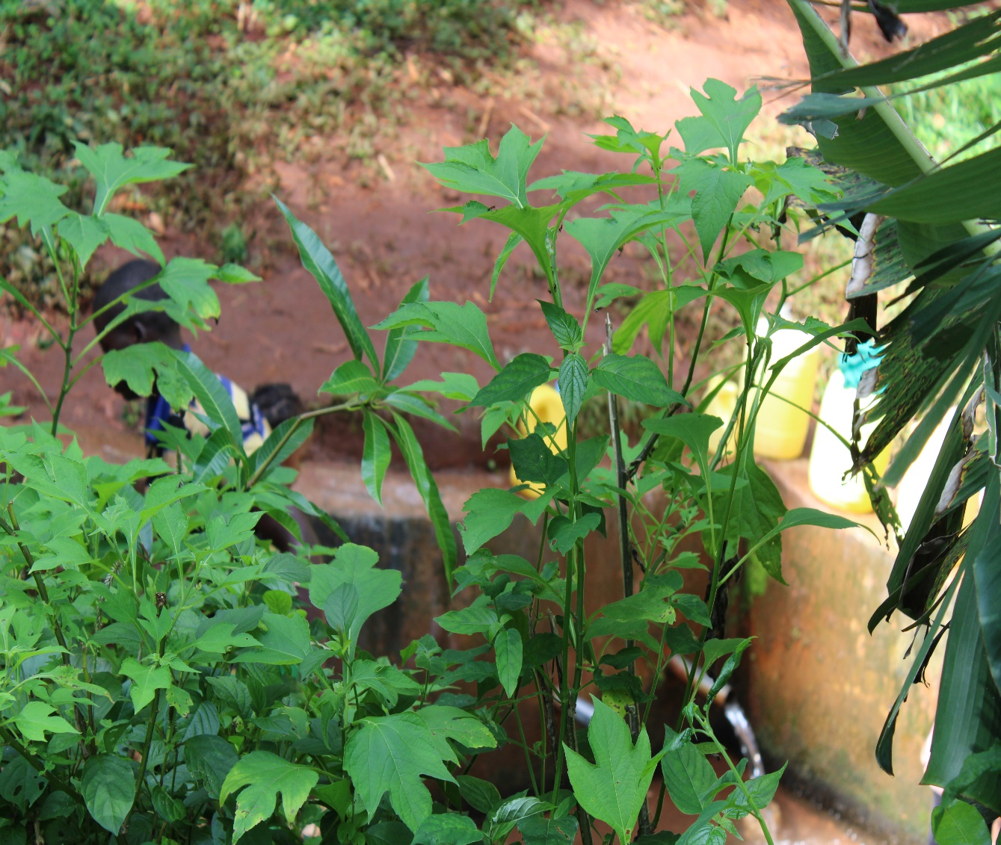
Pictures of Hallala community spring

Slide 7
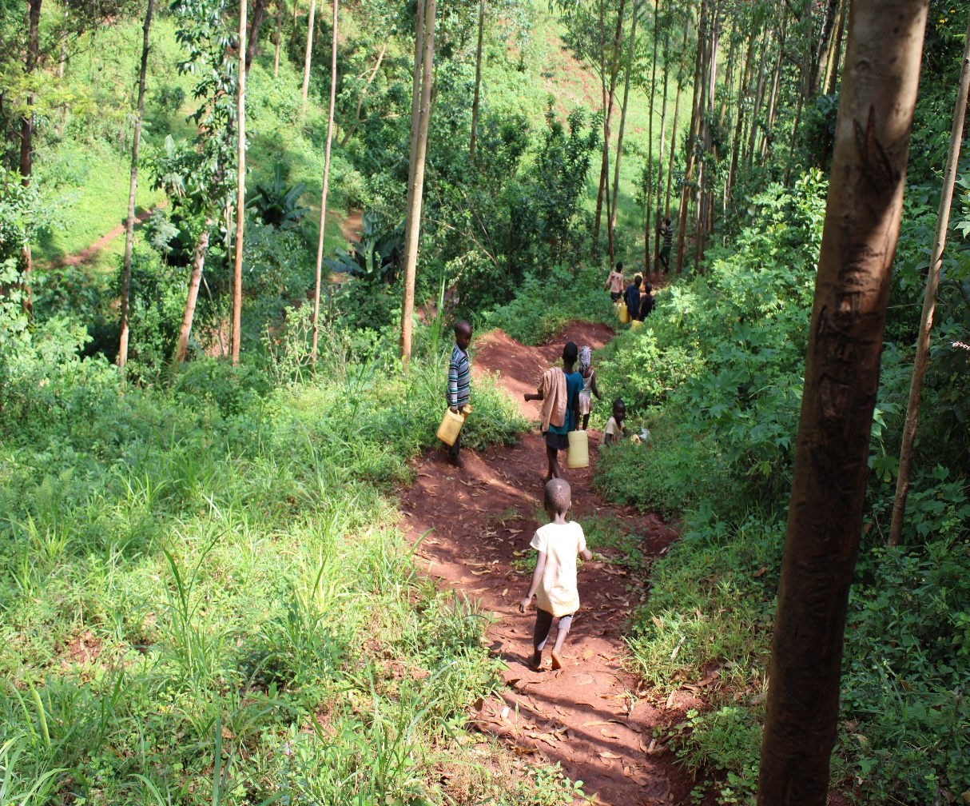
Hallala spring status

Slide 8
KOYULE COMMUNITY SPRING
PERIOD OF PROTECTED:
NOV/DEC 2013
AGE:
6years and 7months
CATCHMENT POPULATION:
184Households, approximately 1104persons.

Slide 9
KOYULE SPRING REVIEW REPORT
 | PARAMETOR OF REVIEW | REPORT
1 | FUNCTIONALITY | Good water flow, fills a 20 water bucket within 1minutes, Drainage well maintained
2 | FENCE | Not there. But the catchment tress growing well
3 | SIGN POST | Still standing and readable.
4 | USAGE | Used by all the house hold for drinking, cooking, washing and laundry and for animals.
5 | ANY OTHER REPORT | Functional committee, well protected source with the seedlings already grown.

Slide 10
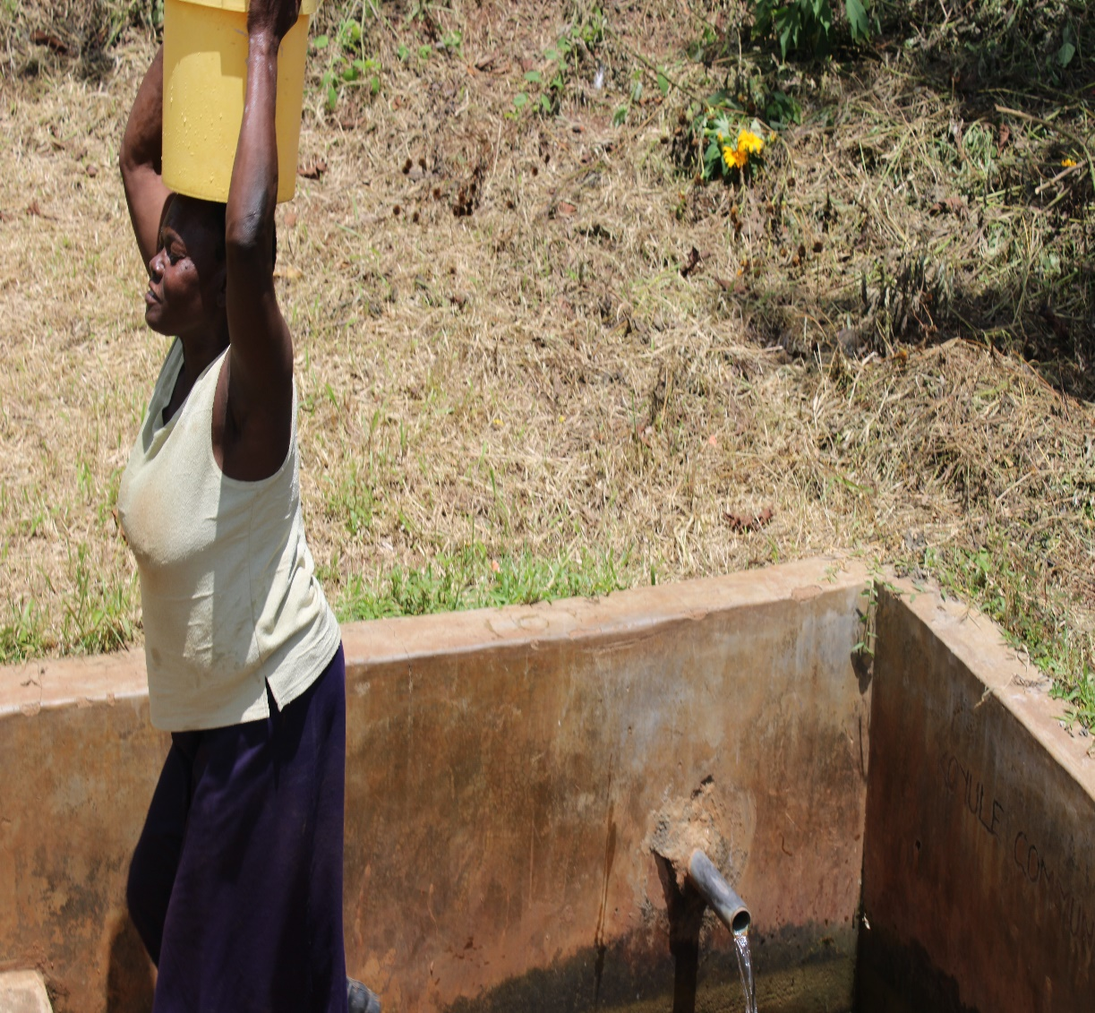
Koyule spring status

Slide 11
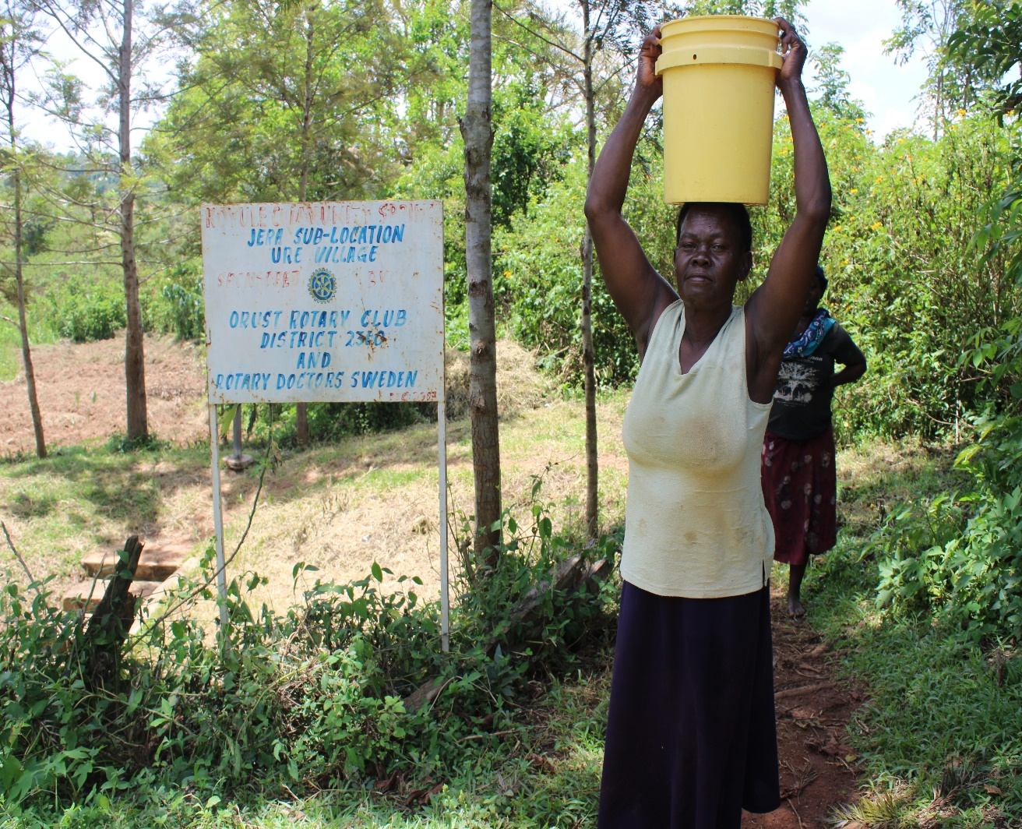

Slide 12
NABULINDO COMMUNITY SPRING
PERIOD OF PROTECTED:
JAN/FEB 2013
AGE:
7 years 7 months
CATCHMENT POPULATION:
204 Households, approximately 1020 persons.

Slide 13
NABULINDO REVIEW REPORT
 | PARAMETOR OF REVIEW | REPORT
1 | FUNCTIONALITY | Water flow throughout the year and fills a20 liter container in less than a min. The drainage well maintained The spring never dries up.
2 | FENCE AND DRAINAGE | No fence, the posts were eaten by ants
3 | SIGN POST | Still standing and readable.
4 | USAGE | Heavily used by all the house hold for drinking, cooking, washing and laundry and for animals.
5 | ANY OTHER REPORT | The community still happy and appreciates the project.

Slide 14
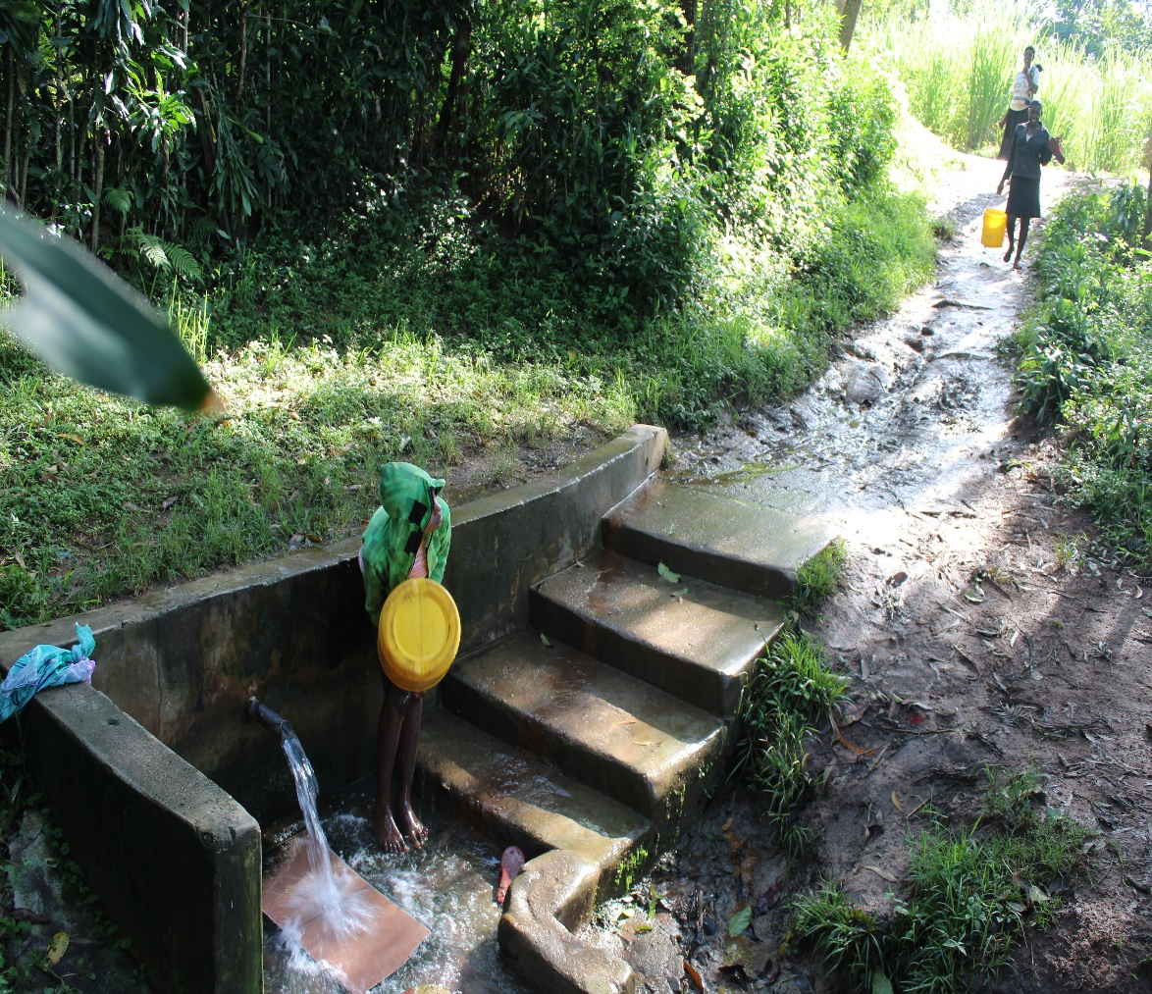
Nabulindo spring status

Slide 15
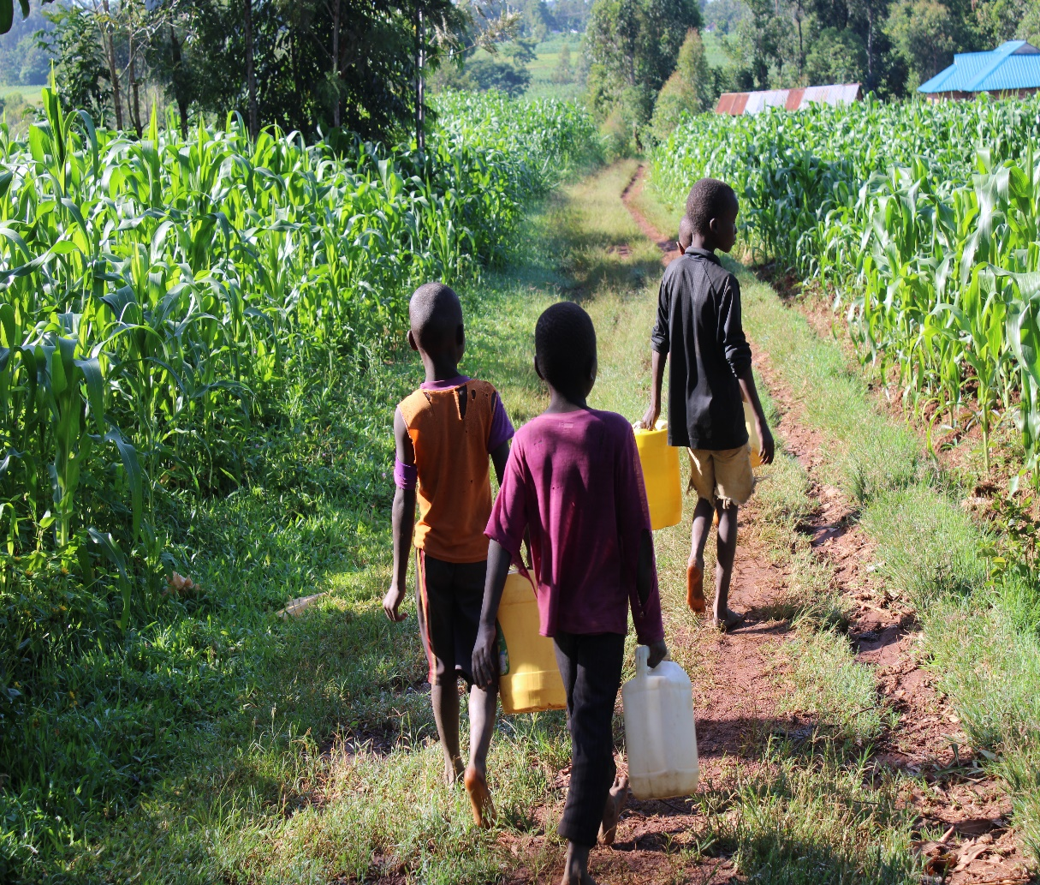

Slide 16
UHESIA COMMUNITY SPRING.
PERIOD OF PROTECTED:
June/July 2012
AGE:
8 years.
CATCHMENT POPULATION:
171 Households, approximately 1026 persons.

Slide 17
UHESIA SPRING REVIEW REPORT
 | PARAMETOR OF REVIEW | REPORT
1 | FUNCTIONALITY | Water flow throughout the year and fills a20 liter container in less than 2min. The drainage well maintained
2 | FENCE AND DRAINAGE | No fence, the posts were eaten by ants
3 | SIGN POST | rusty and not clear
4 | USAGE | Well used by all the house hold for drinking, cooking, washing and laundry and for animals.
5 | ANY OTHER REPORT | The committee still functional.

Slide 18
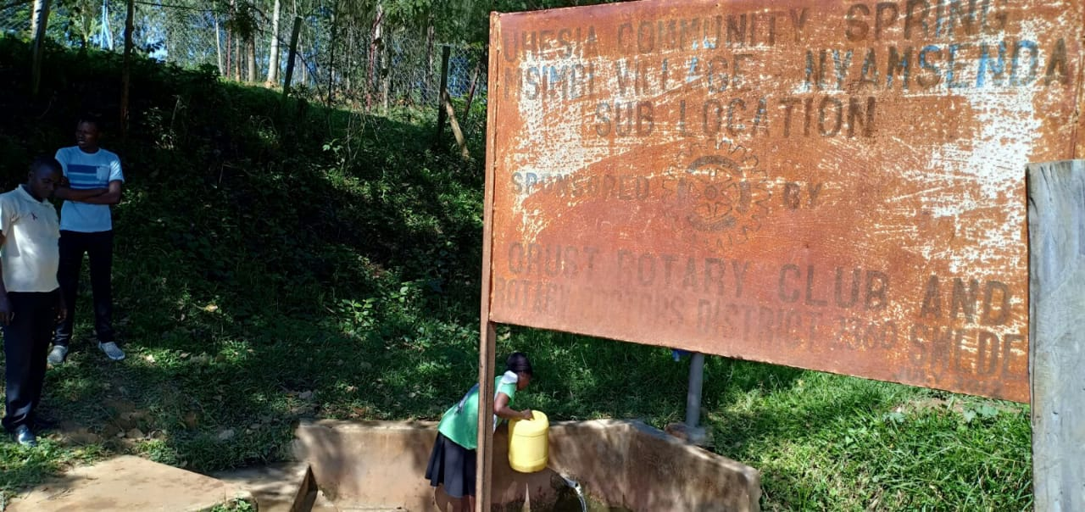
Uhesia spring status

Slide 19
Okelo spring
This failed in the beginning.

Slide 20
COMMENTS
The springs visited are doing well except for Okello which Failed in the beginning and it was reported.

Slide 21
VOTE OF THANKS
To Orust RC Sweden, on behalf of the Community, The Rotary Doctors Sweden and the Community Nursing Services. Thank you so much for this support and you can see how you have transformed the health of many in the community through safe drinking water!
THANK YOU and STAY SAFE FROM CORONA
JACINTA K. NICASIO

