Slide 1
REVIEW OF WATER PROJECTS SPONSORED
BY RODON RC
REVIEW BY: JACINTA K. NICASIO

Slide 2
INTRODUCTION
Water: important resource for sustaining life. Clean and safe drinking water, hygiene and sanitation is important part in maintaining good health.
Rotary Doctors Sweden has been able to support communities’ access clean water through support of various RCs.
The Community makes request, form water project committee who oversee the protection of the spring, use and maintenance for sustainability for the project.

Slide 3
THE FOLLOWING WATER PROJECT HAS BEEN SUPPORTED BY YOUR CLUB
WAMUKOYA COMMUNITY SPRING

Slide 4
WAMUKOYA COMMUNITY SPRING
PERIOD OF PROTECTED:
Nov 2017
AGE:
2year 10months
CATCHMENT POPULATION:
126Households, approximately 756 persons.

Slide 5
WAMUKOYA REVIEW REPORT
 | PARAMETOR OF REVIEW | REPORT
1 | FUNCTIONALITY | Good water flow, can take less than 30min to fill a 20 water bucket . Drainage well maintained. The committee encouraged to keep up
2 | FENCE | Well maintained,
3 | SIGN POST | Still standing and readable
4 | USAGE | Used by lots of community members
5 | ANY OTHER REPORT | Functional committee, the committee is very happy and thankful for the support.

Slide 6
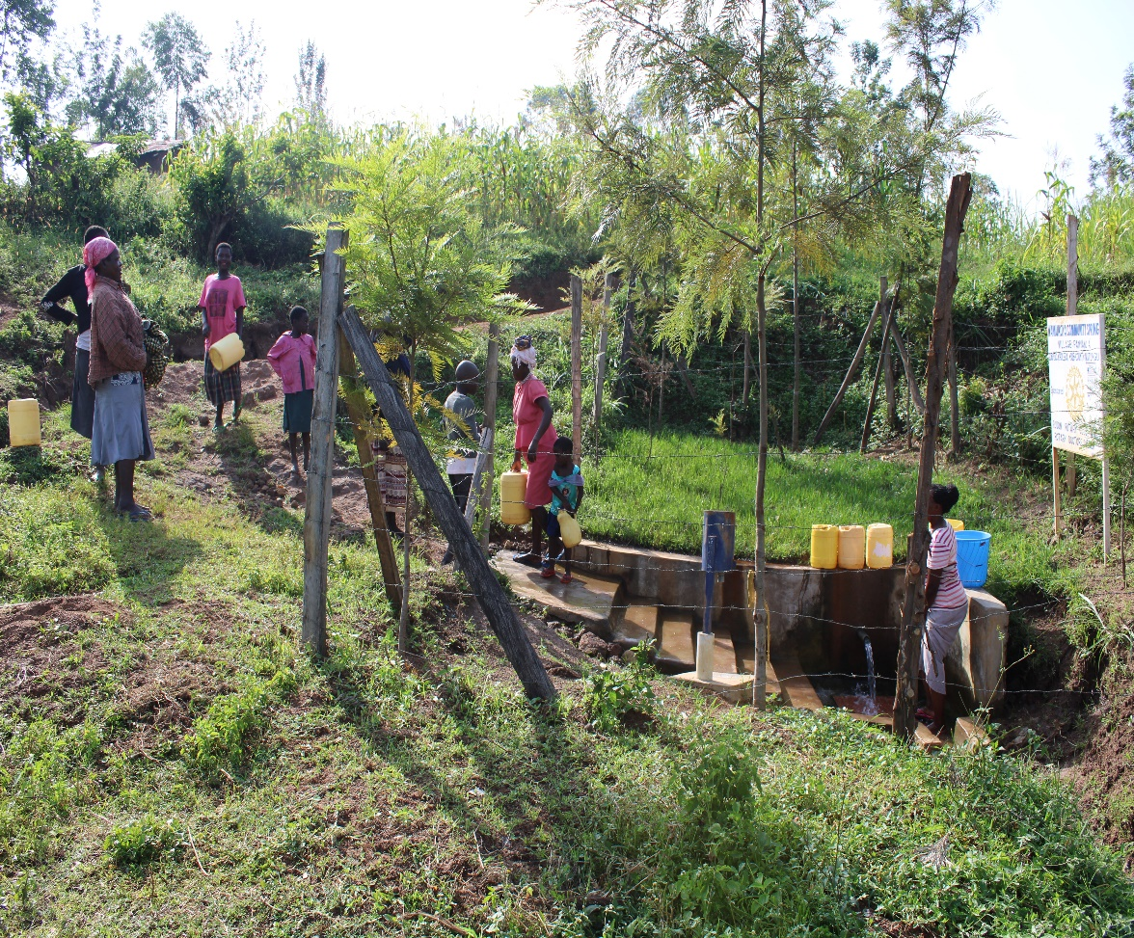
Status Wamukoya spring

Slide 7
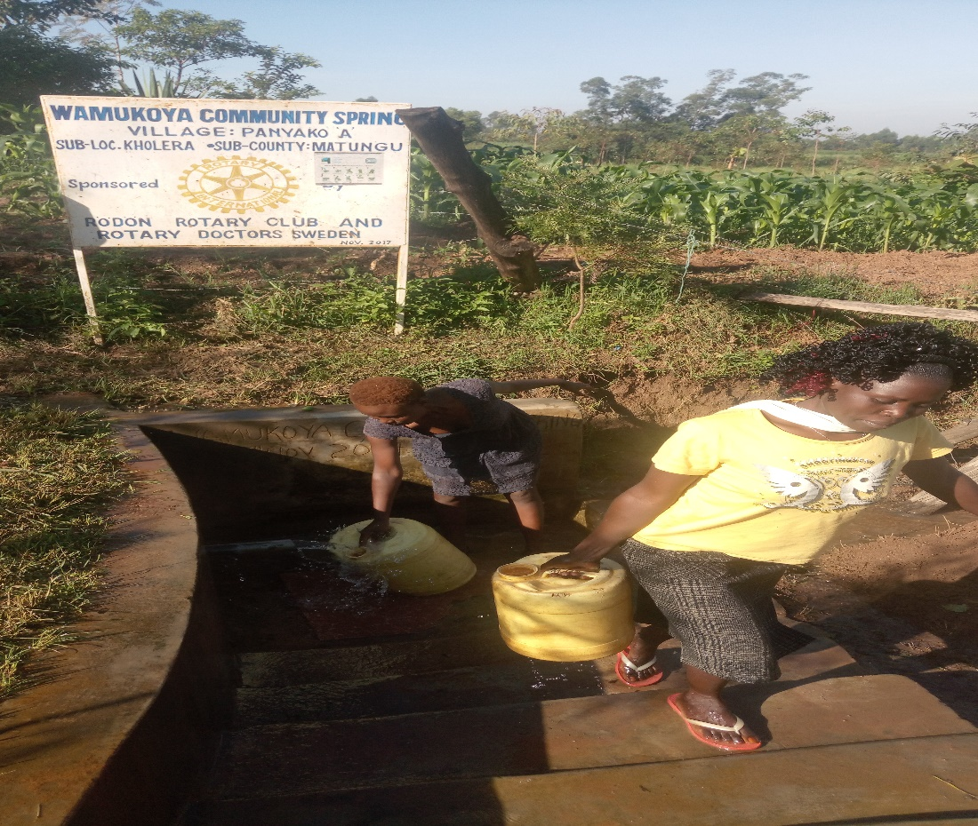

Slide 8
COMMENTS
The spring is doing very well and the community appreciates the support. We encourage them to keep up the use and maintenance.

Slide 9
VOTE OF THANKS
To Rodon RC Sweden, on behalf of the Community, The Rotary Doctors Sweden and the Community Nursing Services. Thank you so much for this support and you can see how you have transformed the health of many in the community through safe drinking water!
THANK YOU and STAY SAFE FROM CORONA
JACINTA K. NICASIO

