Slide 1
REVIEW OF WATER PROJECTS SPONSORED
BY TORP COMMERCIL MALL, UDDEVALLA &LJUNGSKILE RC.
REVIEW BY: JACINTA K. NICASIO

Slide 2
INTRODUCTION
Water: important resource for sustaining life. Clean and safe drinking water, hygiene and sanitation is important part in maintaining good health.
Rotary Doctors Sweden has been able to support communities’ access clean water through support of various RCs.
The Community makes request, form water project committee who oversee the protection of the spring, use and maintenance for sustainability for the project.

Slide 3
THE FOLLOWING WATER PROJECT HAS BEEN SUPPORTED BY YOUR CLUB
AFUTA COMMUNITY SPRING
CHUOLO COMMUNITY SPRING
KOLANGO COMMUNITY SPRING
KODINO COMMUNITY SPRING
MABUSI COMMUNITY SPRING.
NYAHERA COMMUNITY SPRING

Slide 4
KODINO COMMUNITY SHALLOW WELL
PERIOD OF PROTECTED:
Feb/March 2018.
AGE:
2years 4months
CATCHMENT POPULATION:
73 Households, approximately 438 persons.

Slide 5
KODINO REVIEW REPORT
 | PARAMETOR OF REVIEW | REPORT
1 | FUNCTIONALITY | Water flow good, can take about 2min to fill a 20 water bucket .Well maintained drainage.
2 | FENCE | Well maintained.
3 | SIGN POST | Still standing and readable.
4 | USAGE | Used by community members, at the time of taking photos no one was at the spring. Wrong timing!
5 | ANY OTHER REPORT | Functional committee.

Slide 6
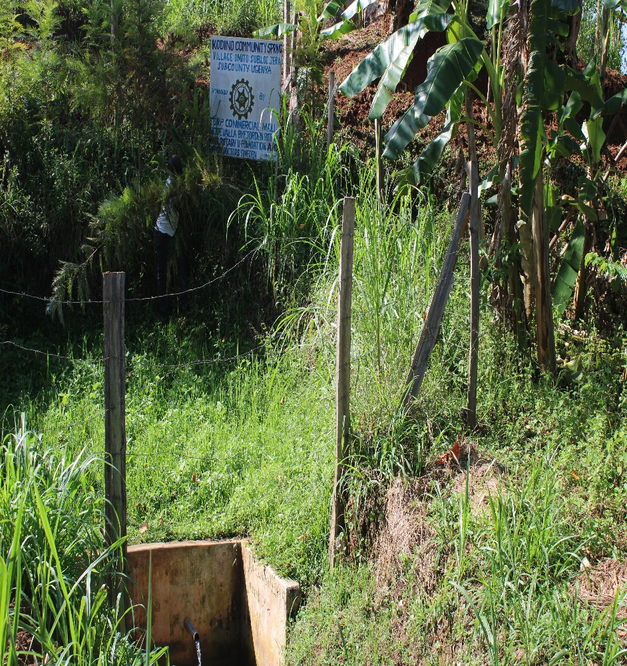
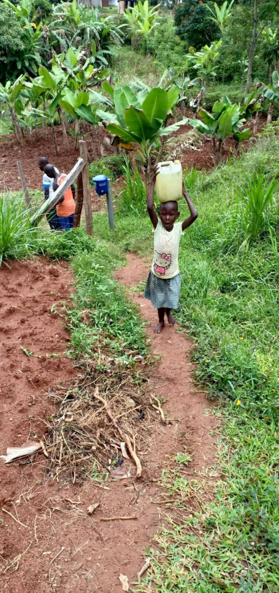
Kodino spring status

Slide 7
KOLANGO COMMUNITY SPRING
PERIOD OF PROTECTED:
FEB/MARCH 2018
AGE:
2 years and 4months
CATCHMENT POPULATION:
75 Households, approximately 450 persons.

Slide 8
REVIEW REPORT
 | PARAMETOR OF REVIEW | REPORT
1 | FUNCTIONALITY | Good water flow, fills a 20 water bucket within two minutes, no problems raised since hand over to community.
2 | FENCE | Still there
3 | SIGN POST | Still standing and readable.
4 | USAGE | Well used by all the house hold for drinking, cooking, washing and laundry and for animals.
5 | ANY OTHER REPORT | Functional committee, well protected source with the seedlings already grown.

Slide 9
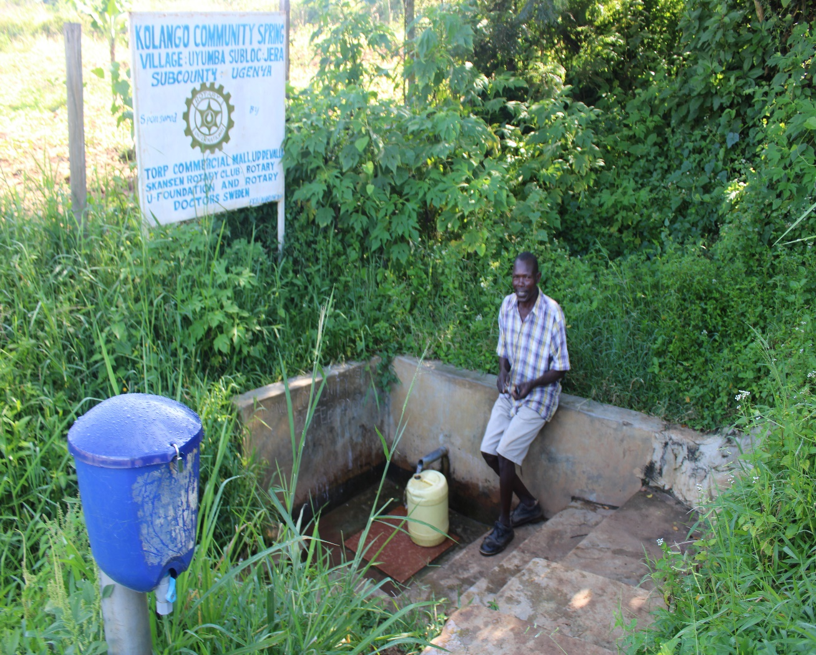
Kolango spring status

Slide 10
AFUTA COMMUNITY SPRING
PERIOD OF PROTECTED:
March/April 2019
AGE:
1years. 4m
CATCHMENT POPULATION:
108 Households, approximately 648persons.

Slide 11
AFUTA REVIEW REPORT
 | PARAMETOR OF REVIEW | REPORT
1 | FUNCTIONALITY | High yield throughout the year, well protected source with grown vegetation and well maintained.
2 | FENCE | Still there .
3 | SIGN POST | Still standing and readable.
4 | USAGE | Heavily used by all the house hold for drinking, cooking, washing and laundry and for animals.
5 | ANY OTHER REPORT | Functional committee, Still very new ,for future follow-up

Slide 12
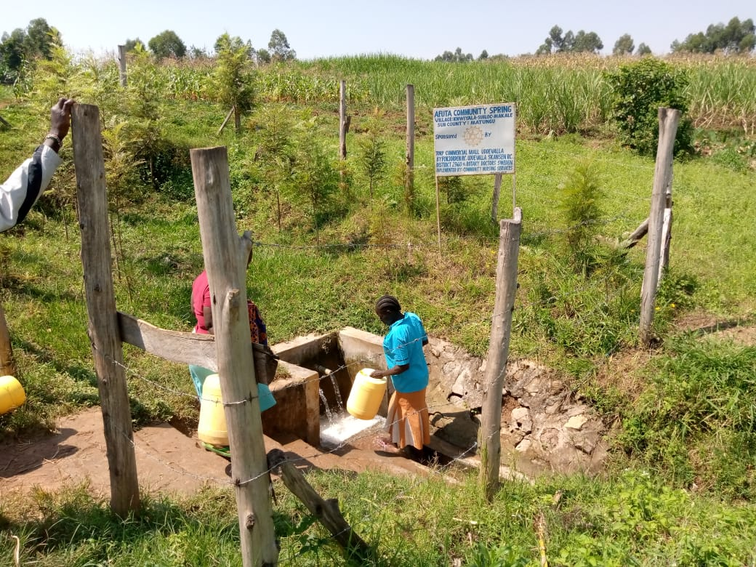
Status afuta spring

Slide 13
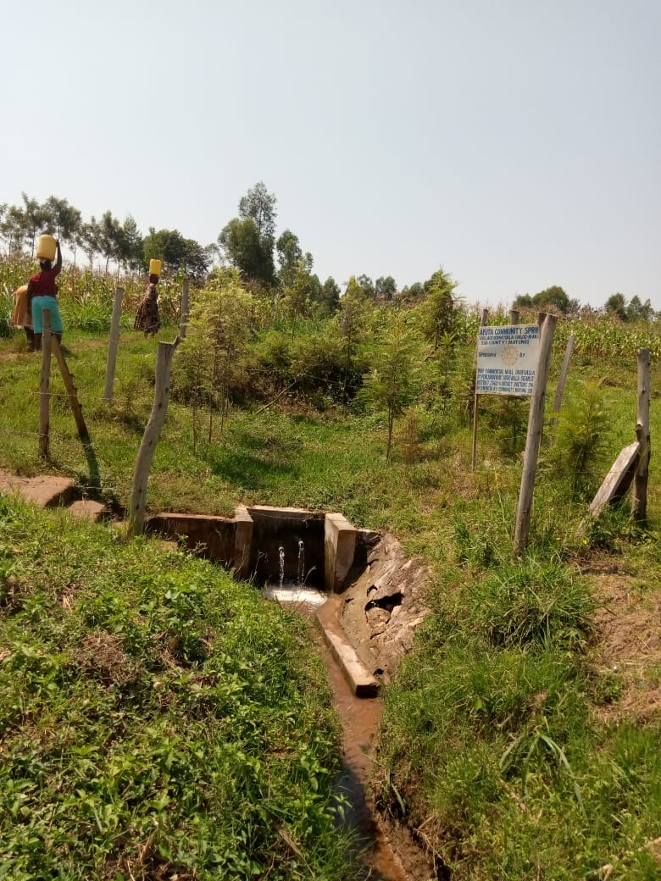
Status afuta spring

Slide 14
CHUOLO COMMUNITY SPRING
PERIOD OF PROTECTED:
March/April 2019
AGE:
1 years 4months.
CATCHMENT POPULATION:
50 Households, approximately 300 persons.

Slide 15
CHUOLO REVIEW REPORT
 | PARAMETOR OF REVIEW | REPORT
1 | FUNCTIONALITY | High yield spring throughout the year. The spring never dries up. The drainage well maintained.
2 | FENCE | Still there
3 | SIGN POST | Present and readable
4 | USAGE | Used by the community members and they have been very grateful for the support.
5 | ANY OTHER REPORT | Still very new ,for future followup

Slide 16
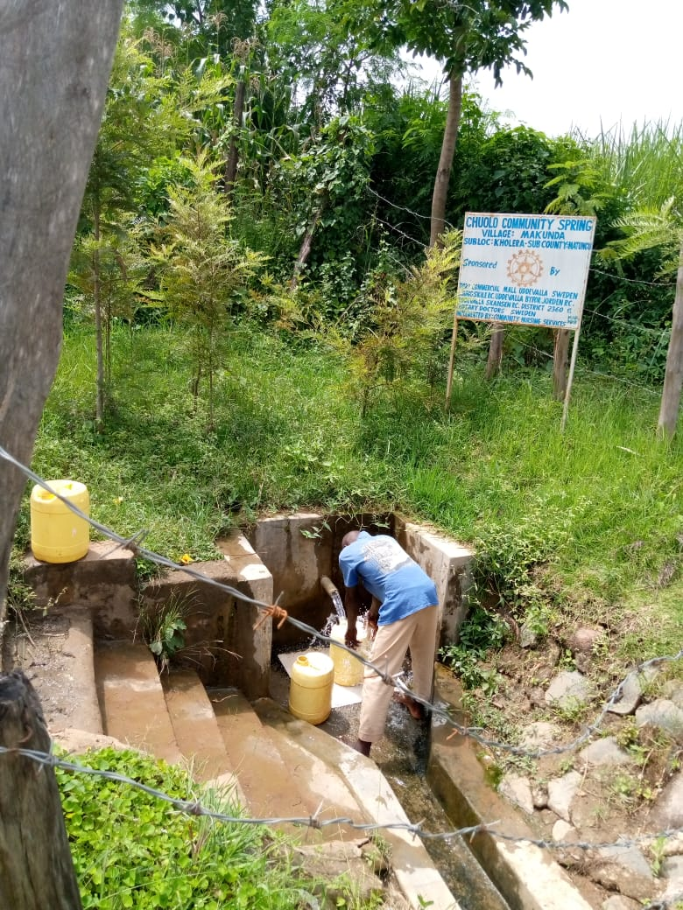
Status of Chuolo

Slide 17
NYAHERA COMMUNITY SPRING
PERIOD OF PROTECTED:
Feb/march 2020.
AGE:
5months.
CATCHMENT POPULATION:
100 Households, approximately 600 persons.

Slide 18
NYAHERA REVIEW REPORT
 | PARAMETOR OF REVIEW | REPORT
1 | FUNCTIONALITY | High yield so far takes less than 30 sec to fill a 20litre water bucket.
2 | FENCE | Fence still standing firm and source well protected growing shrubs and bushes.
3 | SIGN POST | Standing firm and readable.
4 | USAGE | Well used for all purpose, drinking, cooking, washing and for animals to drink.
5 | ANY OTHER REPORT | Great work by the spring committee, still very new for future follow ups.

Slide 19
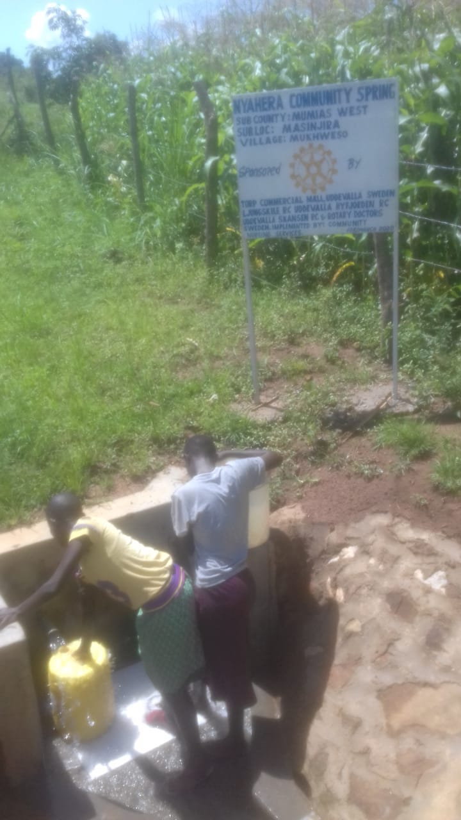
Nyahera spring status

Slide 20
MABUSI COMMUNITY SPRING
PERIOD OF PROTECTED:
FEB/MARC 2020
AGE:
5 Months
CATCHMENT POPULATION:
65 Households, approximately 330 persons.

Slide 21
MABUSI REVIEW REPORT
 | PARAMETOR OF REVIEW | REPORT
1 | FUNCTIONALITY | Great water yield so far , clean and no contamination of water.
2 | FENCE | Still standing strong
3 | SIGN POST | Still standing strong , clear and readable.
4 | USAGE | Used by all members of the community!
5 | ANY OTHER REPORT | Drainage good! Still very new, for follow-up

Slide 22
Mabusi spring Status

Slide 23
COMMENTS
Most of the springs visited are functioning very well, still very new and needs follow up in future

Slide 24
VOTE OF THANKS
To Torp commercial mall, Uddevalla, Ljungskile RC Sweden, on behalf of the Community, The Rotary Doctors Sweden and the Community Nursing Services. Thank you so much for this support and you can see how you have transformed the health of many in the community through safe drinking water!
THANK YOU and STAY SAFE FROM CORONA
JACINTA K. NICASIO

