Slide 1
REVIEW OF WATER PROJECTS SPONSORED
BY TROLLHATTAN STARKOCODER RC.
REVIEW BY: JACINTA K. NICASIO

Slide 2
INTRODUCTION
Water: important resource for sustaining life. Clean and safe drinking water, hygiene and sanitation is important part in maintaining good health.
Rotary Doctors Sweden has been able to support communities’ access clean water through support of various RCs.
The Community makes request, form water project committee who oversee the protection of the spring, use and maintenance for sustainability for the project.

Slide 3
THE FOLLOWING WATER PROJECT HAS BEEN SUPPORTED BY YOUR CLUB
KOLENDO COMMUNITY SPRING
KOSIMBO COMMUNITY SPRING
LUWOLA COMMUNITY SPRING
REROCOMMUNITY SPRING
ESHIANINI COMMUNITY SPRING.

Slide 4
KUMERU COMMUNITY SPRING
MAKHARI COMMUNITY SPRING
KORUCHO COMMUNITY SPRING
KORUCHO COMMUNITY SPRING
NAKHAKOSIA COMMUNITY SPRING
KATOM COMMUNITY SPRING

Slide 5
KOLENDO COMMUNITY SHALLOW WELL
PERIOD OF PROTECTED:
JUNE/JULY 2014
AGE:
6years
CATCHMENT POPULATION:
100 Households, approximately 600 persons.

Slide 6
KOLENDO REVIEW REPORT
 | PARAMETOR OF REVIEW | REPORT
1 | FUNCTIONALITY | Water flow good, can take about 2min to fill a 20 water bucket .Drainage slightly blocked
2 | FENCE | Not there
3 | SIGN POST | Still standing and but not readable
4 | USAGE | Used by community members, at the time of taking photos no one was at the spring. Wrong timing!
5 | ANY OTHER REPORT | Committee there but not very active. For follow up through volunteer.

Slide 7
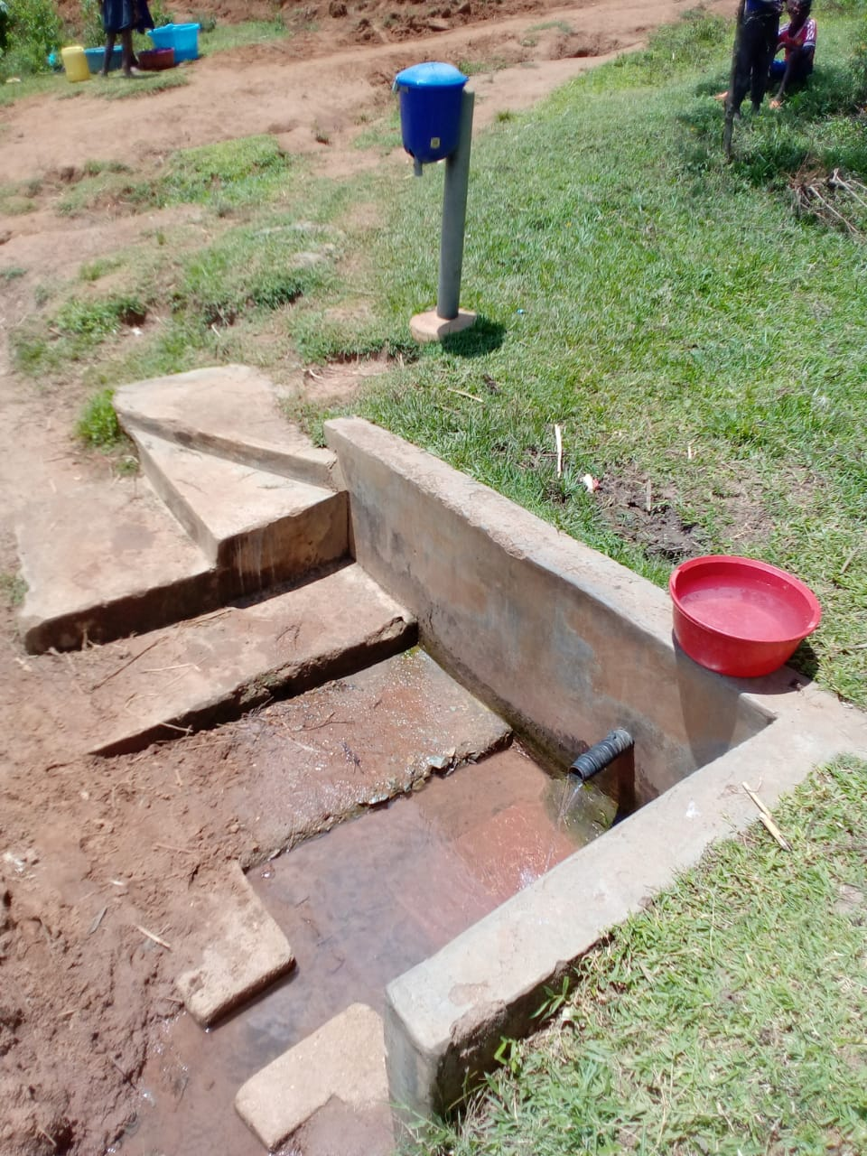
Status of Kolendo spring

Slide 8
RERO COMMUNITY SPRING
PERIOD OF PROTECTED:
JUNE/JULY 2018
AGE:
2 years
CATCHMENT POPULATION:
120 Households, approximately 720 persons.

Slide 9
RERO REVIEW REPORT
 | PARAMETOR OF REVIEW | REPORT
1 | FUNCTIONALITY | Good water flow, fills 20 water bucket within less than 30sec,Drainage well maintained .
2 | FENCE | One side fencing posts fallen
3 | SIGN POST | Still standing and readable.
4 | USAGE | Well used by all the community for drinking, cooking, washing and laundry and for animals.
5 | ANY OTHER REPORT | Functional committee, well protected source with the seedlings already grown.

Slide 10
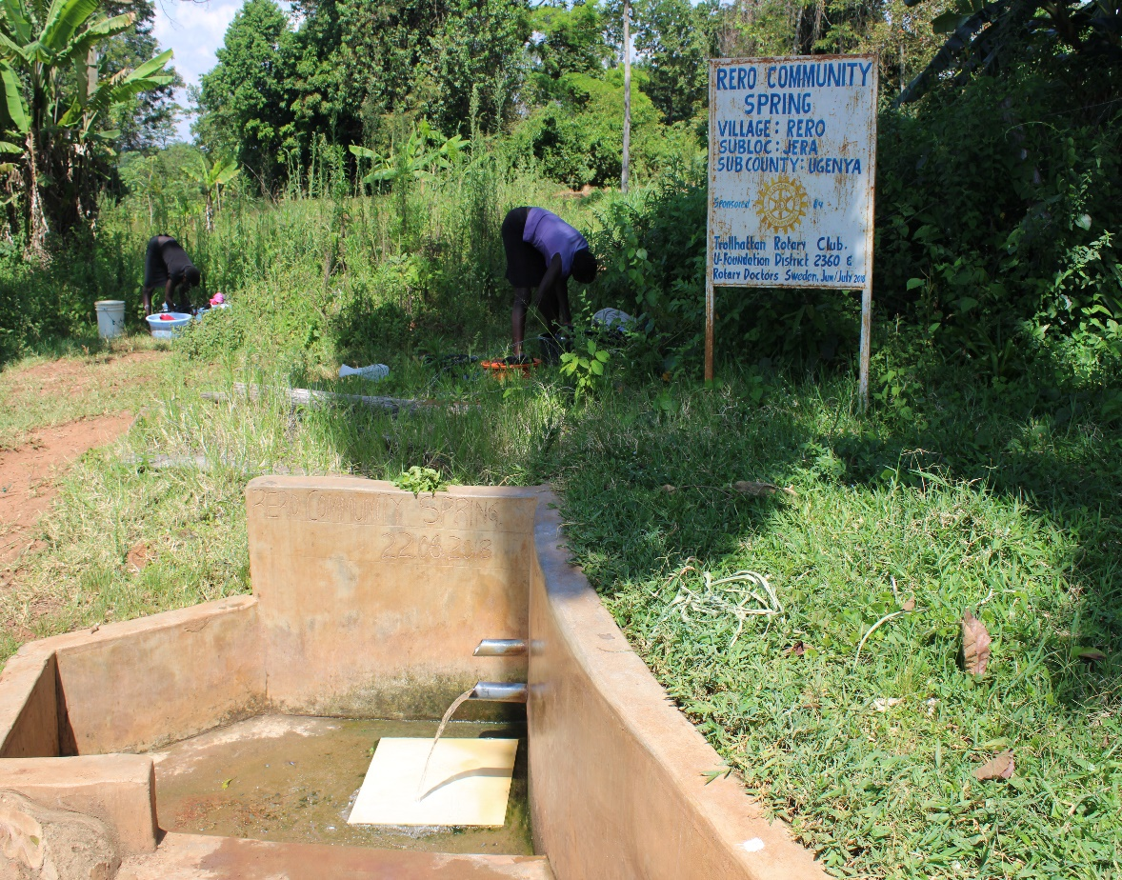
Status of Rero spring

Slide 11
KOSIMBO COMMUNITY SPRING
PERIOD OF PROTECTED:
NOV/DEC 2014
AGE:
5YEARS 7MONTHS
CATCHMENT POPULATION:
130 Households, approximately 780persons.

Slide 12
KOSIMBO REVIEW REPORT
 | PARAMETOR OF REVIEW | REPORT
1 | FUNCTIONALITY | Slightly low yield throughout the year but never dries up. Well protected source with grown vegetation and well maintained.
2 | FENCE | Not there
3 | SIGN POST | Still standing and but not very clear.
4 | USAGE | Well used by all the house hold for drinking, cooking, washing and laundry and for animals.
5 | ANY OTHER REPORT | Committee not very functional.

Slide 13
Status of Kosimbo spring

Slide 14
ESHIANINI COMMUNITY SPRING
PERIOD OF PROTECTED:
NOV/DEC 2018
AGE:
1 years 7months.
CATCHMENT POPULATION:
98 Households, approximately 588 persons.

Slide 15
ESHIANINI SPRING REVIEW REPORT
 | PARAMETOR OF REVIEW | REPORT
1 | FUNCTIONALITY | High yield spring throughout the year, filling time of a 20liters jerican is less than 30seconds
2 | FENCE | Still standing and well protected.
3 | SIGN POST | Present and readable
4 | USAGE | Used by the community members and they have been very grateful for the support.
5 | ANY OTHER REPORT | Still very new ,for future follow-up

Slide 16
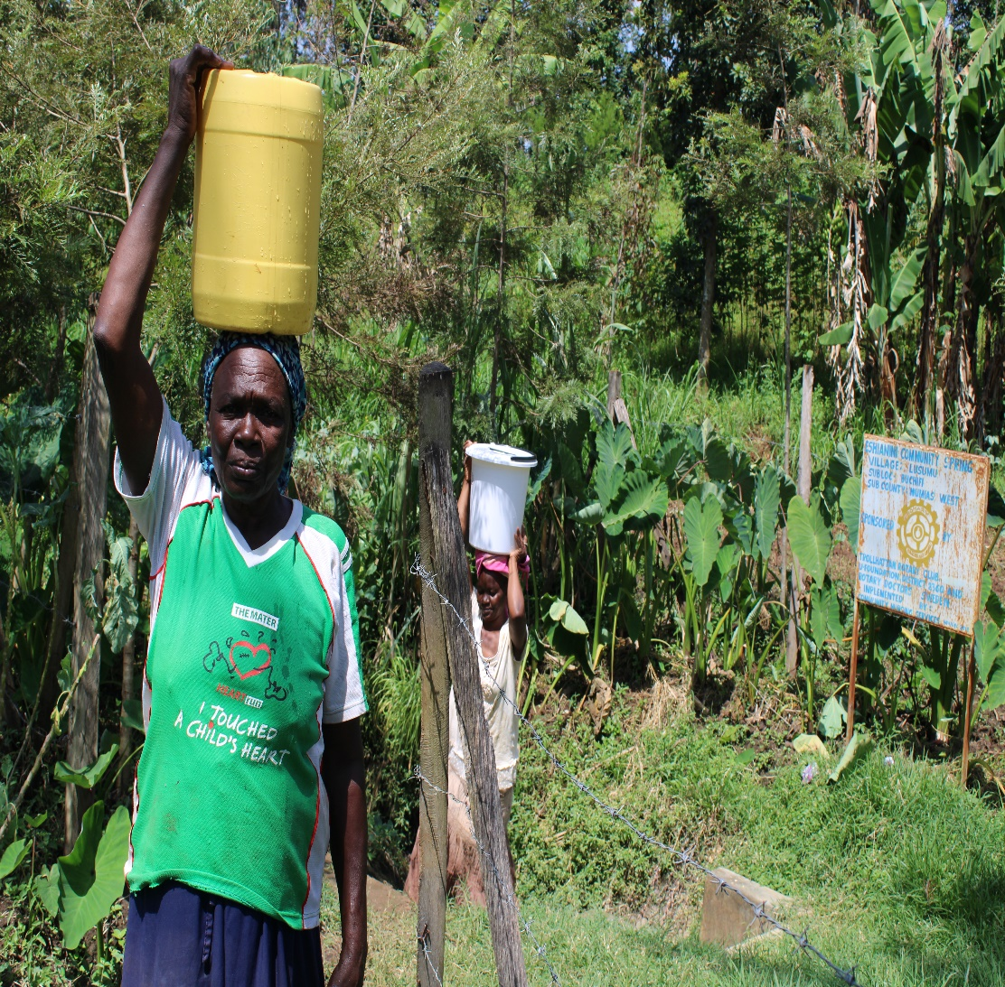
Status of Eshianini spring

Slide 17
NAKHAKOSIA COMMUNITY SPRING
PERIOD OF PROTECTED:
Feb 2017.
AGE:
3 YEARS 6MONHTS.
CATCHMENT POPULATION:
65 Households, approximately 390 persons.

Slide 18
NAKHAKOSIA REVIEW REPORT
 | PARAMETOR OF REVIEW | REPORT
1 | FUNCTIONALITY | High yield so far takes less than 30 sec to fill a 20litre water bucket. Drainage good and the spring never dries up.
2 | FENCE | Fence still standing firm
3 | SIGN POST | Standing firm and readable.
4 | USAGE | Well used for all purpose, drinking, cooking, washing and for animals to drink.
5 | ANY OTHER REPORT | Great work by the spring committee, Community very happy and still appreciated the support.

Slide 19
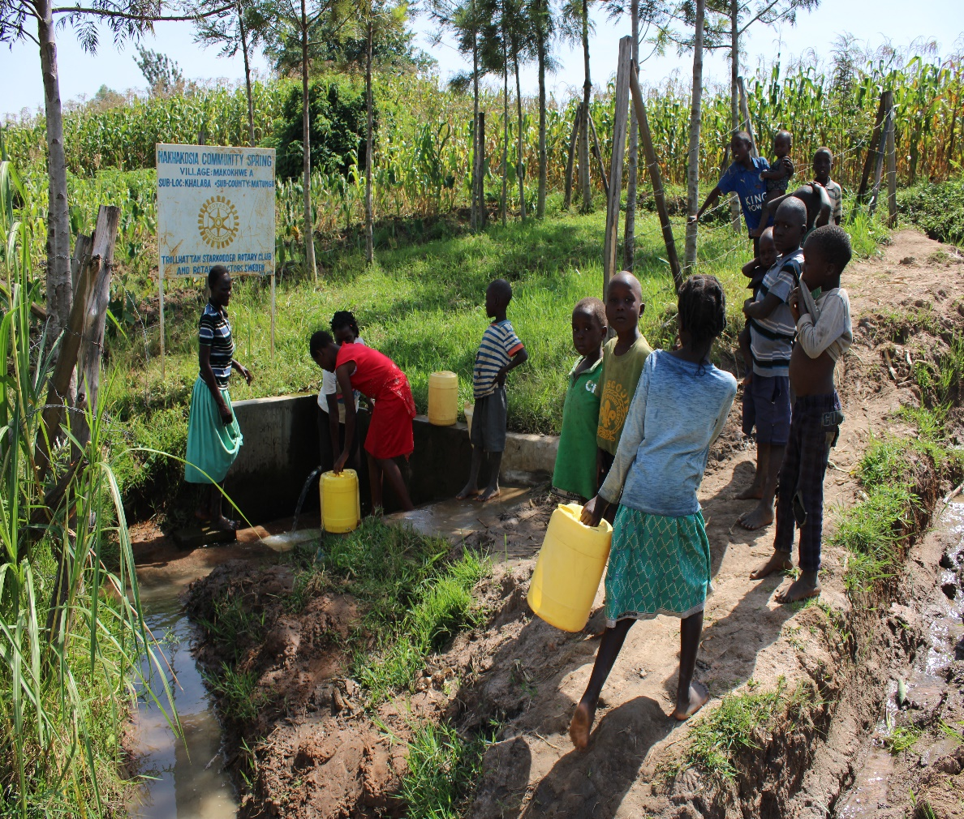
Status of Nakhakosia spring

Slide 20
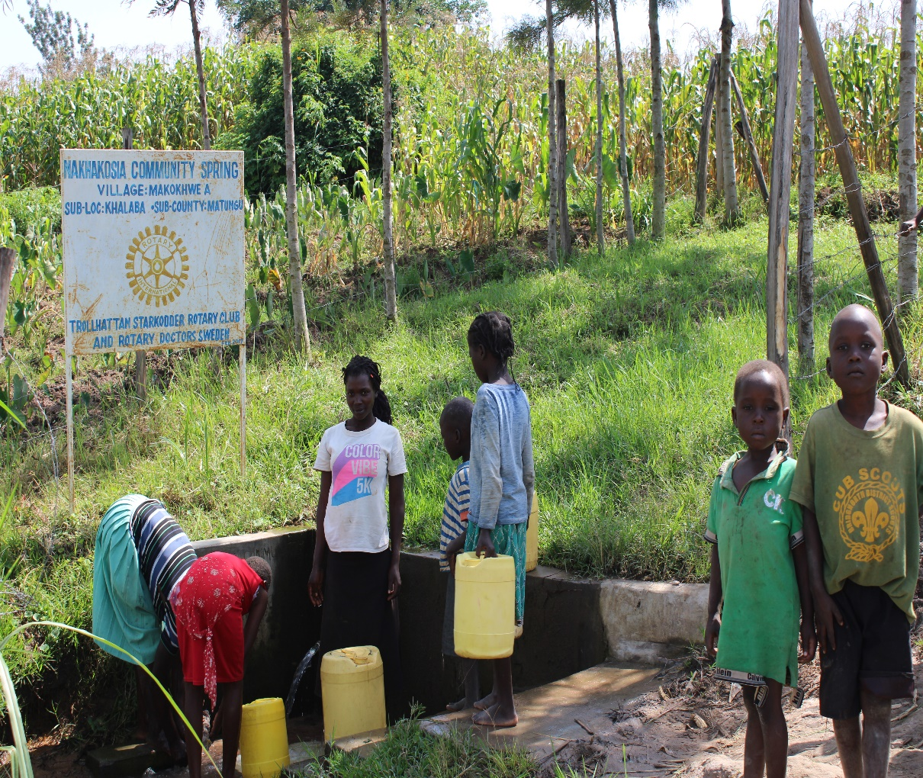

Slide 21
MAKWARI COMMUNITY SPRING
PERIOD OF PROTECTED:
JUNE/JULY 2019
AGE:
1 YEAR
CATCHMENT POPULATION:
47 Households, approximately282 persons.

Slide 22
MAKWARI REVIEW REPORT
 | PARAMETOR OF REVIEW | REPORT
1 | FUNCTIONALITY | Great water yield so far , clean and no contamination of water.
2 | FENCE | Still standing strong
3 | SIGN POST | Still standing strong , clear and readable.
4 | USAGE | Used by all members of the community!
5 | ANY OTHER REPORT | Drainage good! Still very new, for follow-up

Slide 23
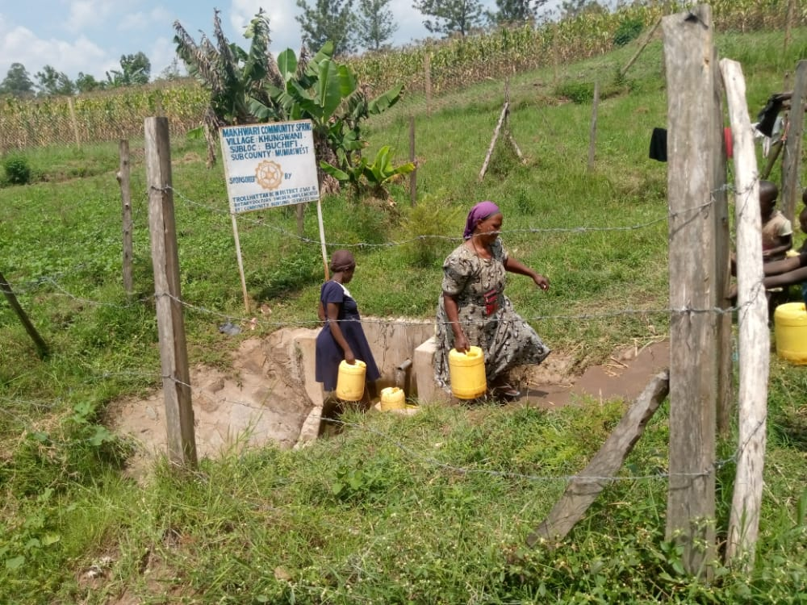
Status of Makhwari spring

Slide 24
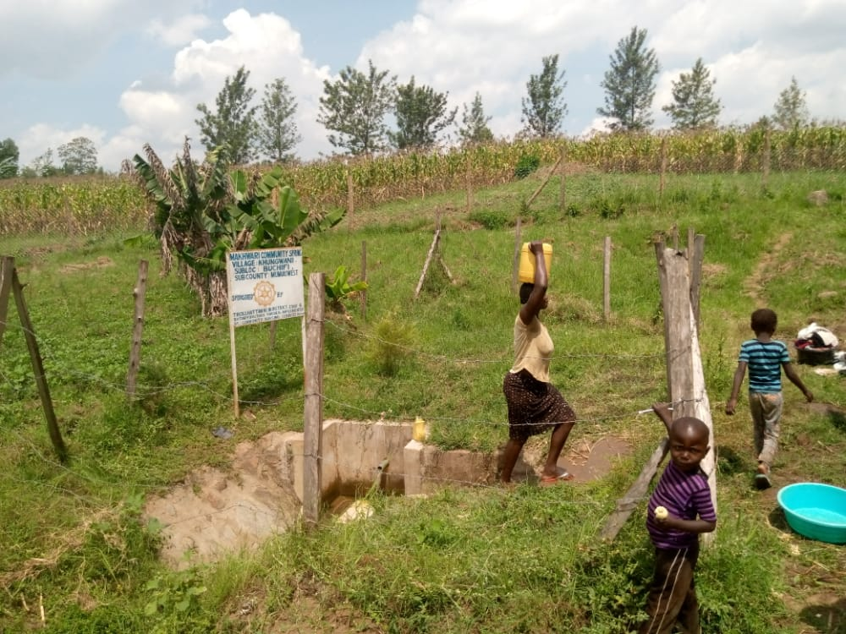

Slide 25
KUMERU COMMUNITY SPRING
PERIOD OF PROTECTED:
JAN 2020
AGE:
7 MONTHS
CATCHMENT POPULATION:
60 Households, approximately 360 persons.

Slide 26
KUMERU SPRING REVIEW REPORT
 | PARAMETOR OF REVIEW | REPORT
1 | FUNCTIONALITY | Great water yield so far , clean and no contamination of water BUT drainage was blocked
2 | FENCE | Still standing strong
3 | SIGN POST | Still standing strong , clear and readable.
4 | USAGE | Used by all members of the community!
5 | ANY OTHER REPORT | Drainage very blocked!Still very new, for follow up with committee to ensure they take their responsibility of maintaining the spring.

Slide 27
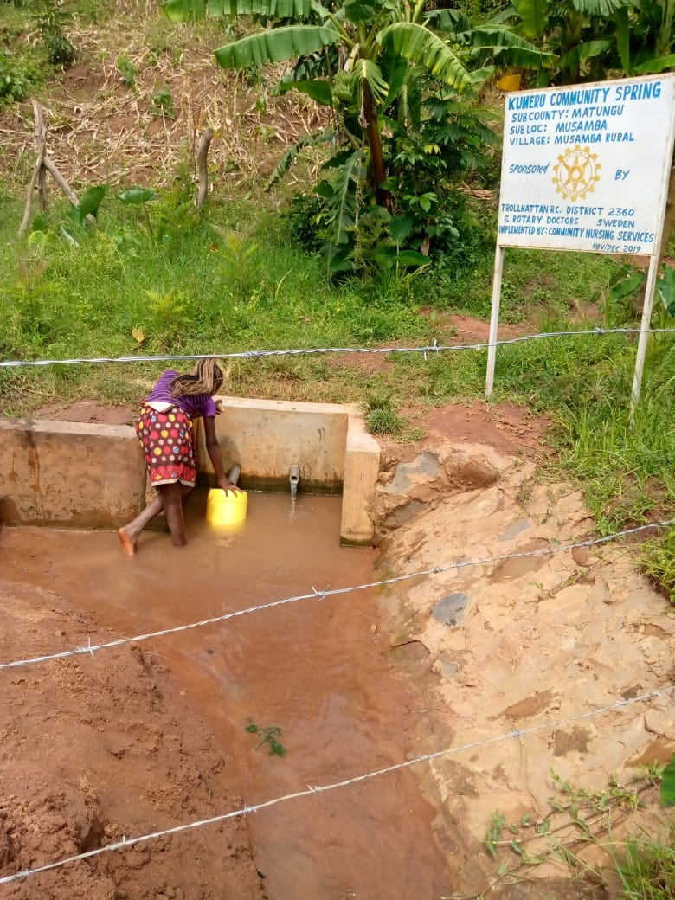
Status of Kumeru spring

Slide 28
LUWOLA COMMUNITY SPRING
PERIOD OF PROTECTED:
FEB 2016
AGE:
4YRS
CATCHMENT POPULATION:
45 Households, approximately 270 persons.

Slide 29
LUWOLA SPRING REVIEW REPORT
 | PARAMETOR OF REVIEW | REPORT
1 | FUNCTIONALITY | Great water flow, clean and no contamination of water .Drainage working well.
2 | FENCE | No fence!
3 | SIGN POST | Rusted, one support vandalized stands against a wall.
4 | USAGE | Used by all members of the community!
5 | ANY OTHER REPORT | Drainage good and working!

Slide 30
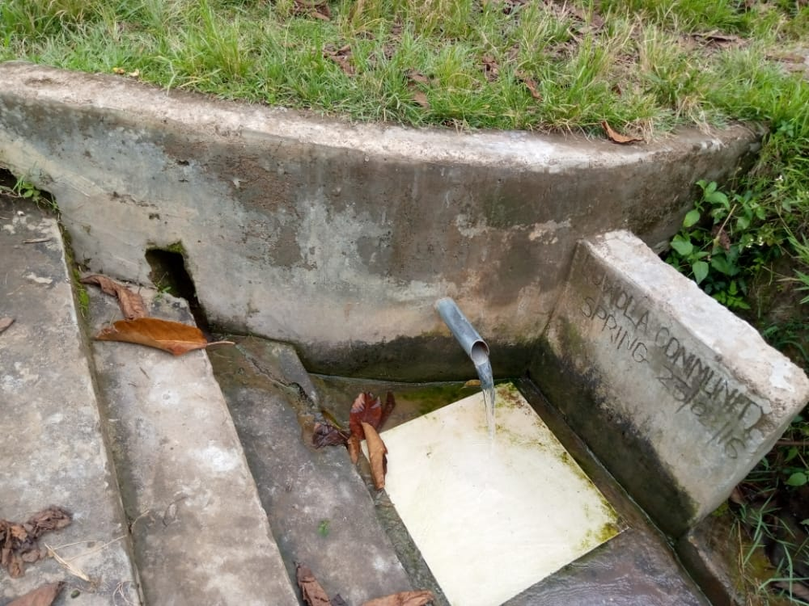
Status Luwola spring

Slide 31
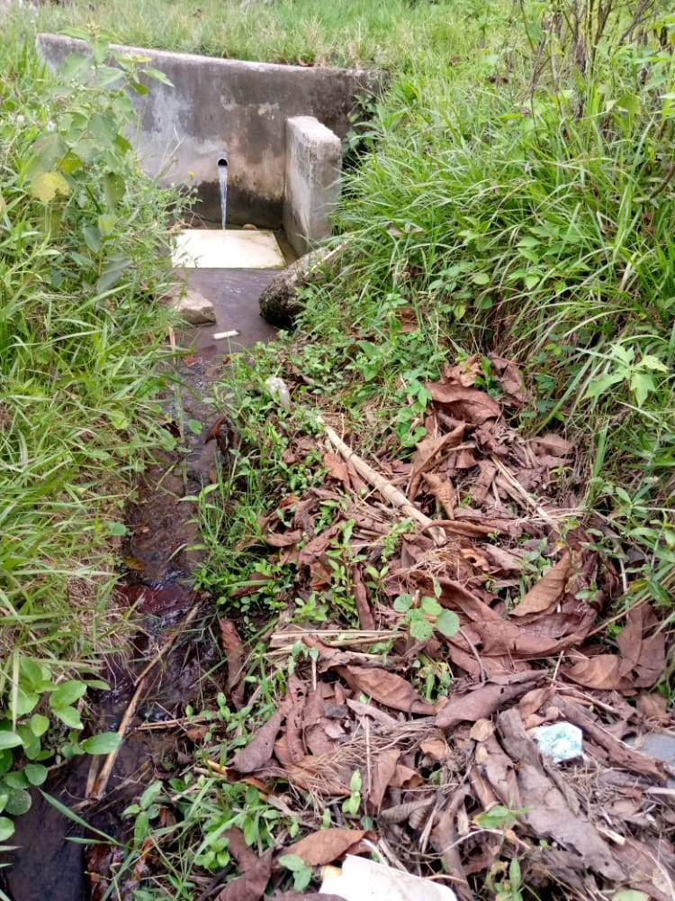

Slide 32
COMMENTS
Most of the springs visited are functioning very well, some still very new and needs follow up in future .
Two have not been visited ( Katom in sega and Korucho in Homabay)and plan to visit and update the club.

Slide 33
VOTE OF THANKS
To Trollhattan RC Sweden, on behalf of the Community, The Rotary Doctors Sweden and the Community Nursing Services. Thank you so much for this support and you can see how you have transformed the health of many in the community through safe drinking water!
THANK YOU and STAY SAFE FROM CORONA
JACINTA K. NICASIO

