Slide 1
REVIEW OF WATER PROJECTS SPONSORED
BY VANERSBORG AURORA.DISTRICT2360 RC
REVIEW BY: JACINTA K. NICASIO

Slide 2
INTRODUCTION
Water: important resource for sustaining life. Clean and safe drinking water, hygiene and sanitation is important part in maintaining good health.
Rotary Doctors Sweden has been able to support communities’ access clean water through support of various RCs.
The Community makes request, form water project committee who oversee the protection of the spring, use and maintenance for sustainability for the project.

Slide 3
THE FOLLOWING WATER PROJECT HAS BEEN SUPPORTED BY YOUR CLUB
MUKATI COMMUNITY SPRING.
PINGO COMMUNITY SPRING

Slide 4
PINGO COMMUNITY SHALLOW SPRING
PERIOD OF PROTECTED:
JUNE2019.
AGE:
1Year
CATCHMENT POPULATION:
81 Households, approximately 480persons.

Slide 5
PINGO REVIEW REPORT
 | PARAMETOR OF REVIEW | REPORT
1 | FUNCTIONALITY | Good water flow, can take less than 2 min to fill a 20 water bucket .Well maintained., though some members use the fence as wire line .This was addressed with the committee.
2 | FENCE | Well maintained.
3 | SIGN POST | Still standing and readable but not very clear
4 | USAGE | Used by lots of community members
5 | ANY OTHER REPORT | Functional committee.

Slide 6
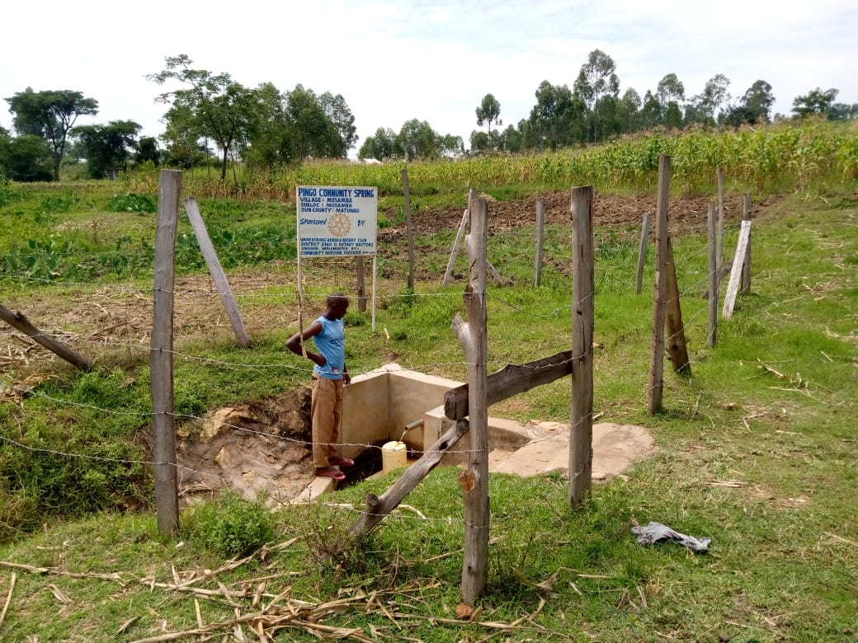
Status of Pingo spring

Slide 7
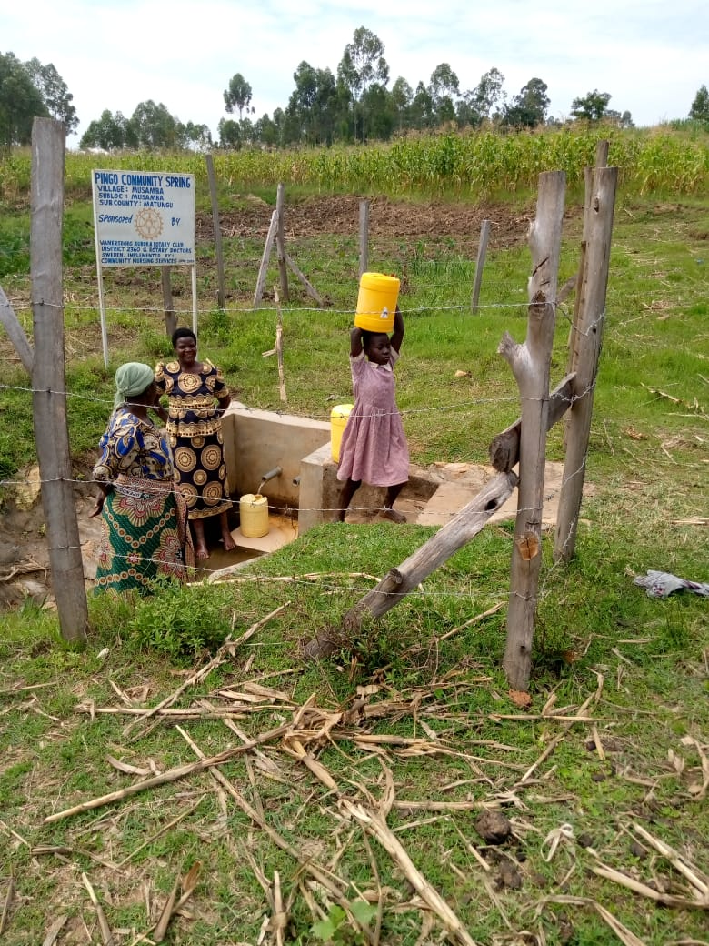

Slide 8
MUKATI COMMUNITY SPRING
PERIOD OF PROTECTED:
DEC/JAN2020
AGE:
7months
CATCHMENT POPULATION:
95Households, approximately 570persons.

Slide 9
MUKATI SPRING REVIEW REPORT
 | PARAMETOR OF REVIEW | REPORT
1 | FUNCTIONALITY | Good water flow, fills a 20 water bucket within 30seconds. Drainage still good
2 | FENCE | Still there
3 | SIGN POST | Still standing and readable.
4 | USAGE | Well used by all the community for drinking, cooking, washing and laundry and for animals.
5 | ANY OTHER REPORT | Functional committee, well protected source. Still very new less than a year. For future follow up.

Slide 10
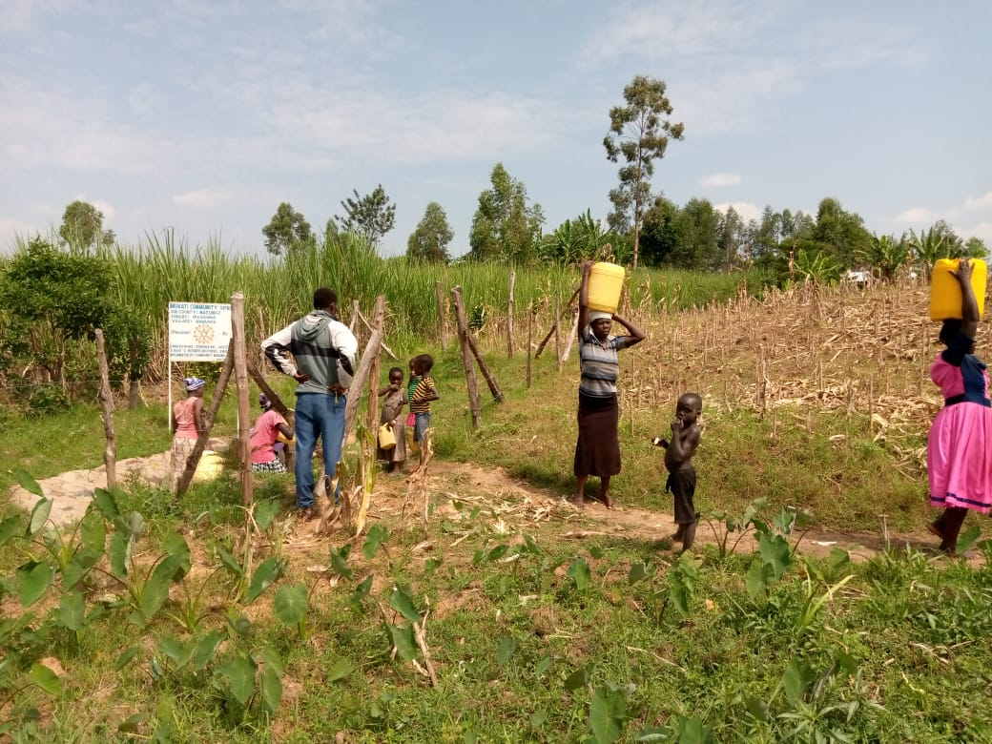
Mukati status

Slide 11
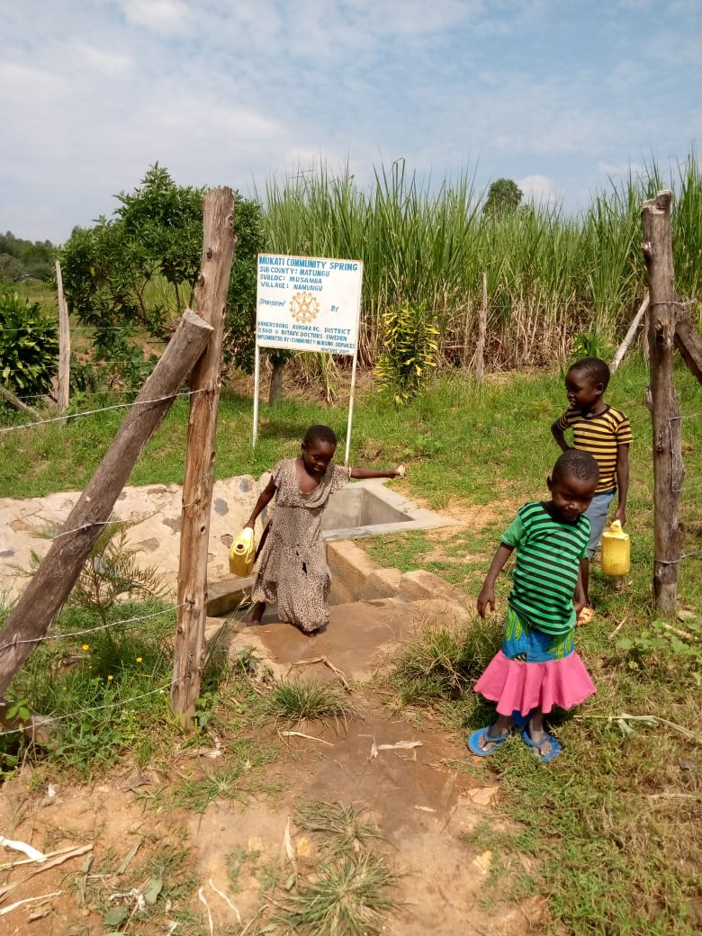

Slide 12
COMMENTS
The springs visited are doing very well.
They are still very new less than a year and are for possible follow up in the future.
The community is very happy and grateful for the support given.

Slide 13
VOTE OF THANKS
To Vanersborg Aurora, District 2360 RC Sweden, on behalf of the Community, The Rotary Doctors Sweden and the Community Nursing Services. Thank you so much for this support and you can see how you have transformed the health of many in the community through safe drinking water!
THANK YOU and STAY SAFE FROM CORONA
JACINTA K. NICASIO

