Slide 1
REVIEW OF WATER PROJECTS SPONSORED
BY VASTERVIK RC
REVIEW BY: JACINTA K. NICASIO

Slide 2
INTRODUCTION
Water: important resource for sustaining life. Clean and safe drinking water, hygiene and sanitation is important part in maintaining good health.
Rotary Doctors Sweden has been able to support communities’ access clean water through support of various RCs.
The Community makes request, form water project committee who oversee the protection of the spring, use and maintenance for sustainability for the project.

Slide 3
THE FOLLOWING WATER PROJECT HAS BEEN SUPPORTED BY YOUR CLUB
JEREMANI COMMUNITY SPRING
ATEYA COMMUNITY SPRING.
NAMWAYA COMMUNITY SPRING
ODOURI COMMUNITY SPRING
WAMAKOMBO COMMUNITY SPRING

Slide 4
JEREMANI COMMUNITY SHALLOW SPRING
PERIOD OF PROTECTED:
March 2018.
AGE:
2yrs 4 months
CATCHMENT POPULATION:
100 Households, approximately 600persons.

Slide 5
JEREMANI REVIEW REPORT
 | PARAMETOR OF REVIEW | REPORT
1 | FUNCTIONALITY | Good water flow good can take less than 5 min to fill a 20 water bucket . Drainage well maintained. The spring never dries up.
t | FENCE | Still intact
3 | SIGN POST | Standing and readable.
4 | USAGE | Used by lots of community members
5 | ANY OTHER REPORT | Functional committee, and well taken care off. For Future follow up again.

Slide 6
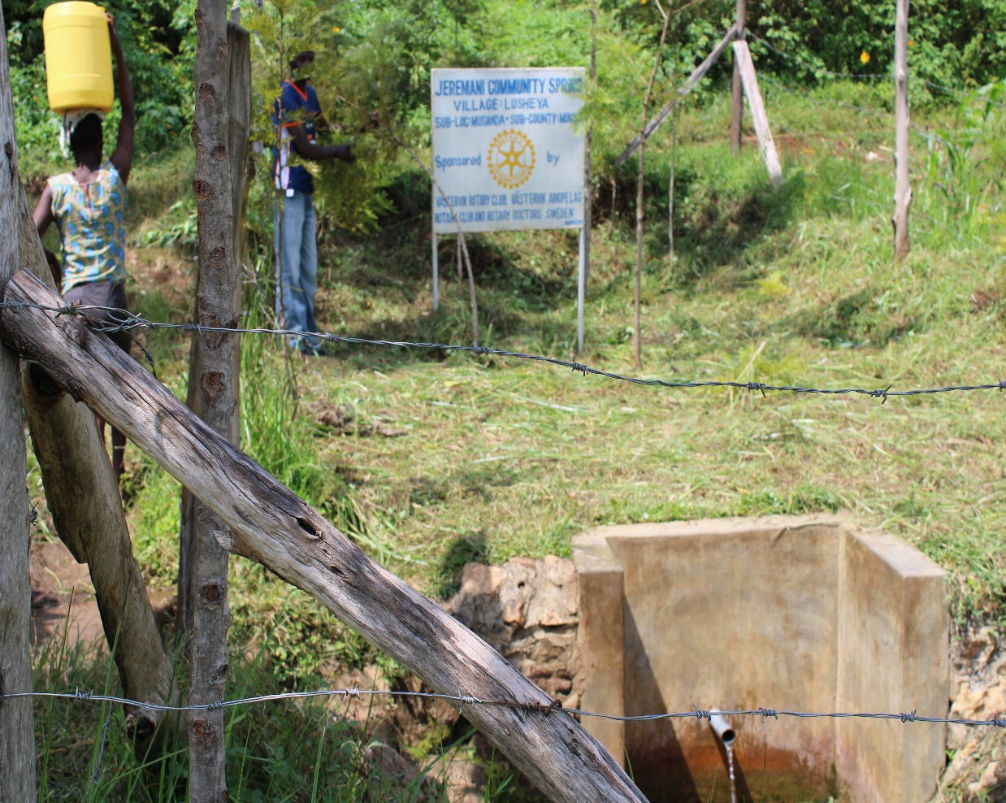
Status Jeremani spring

Slide 7
ATEYA COMMUNITY SPRING
PERIOD OF PROTECTED:
JULY/AUG 2019
AGE:
1yr
CATCHMENT POPULATION:
360Households, approximately 360persons.

Slide 8
ATEYA SPRING REVIEW REPORT
 | PARAMETOR OF REVIEW | REPORT
1 | FUNCTIONALITY | Good water flow through out the year and fills a 20 water bucket within 1minutes, Drainage well maintained Spring never dries up
2 | FENCE | Still very good.
3 | SIGN POST | Still standing and readable.
4 | USAGE | Well used by all the community for drinking, cooking, washing and laundry and for animals.
5 | ANY OTHER REPORT | Functional committee, well protected source with the seedling growing well

Slide 9
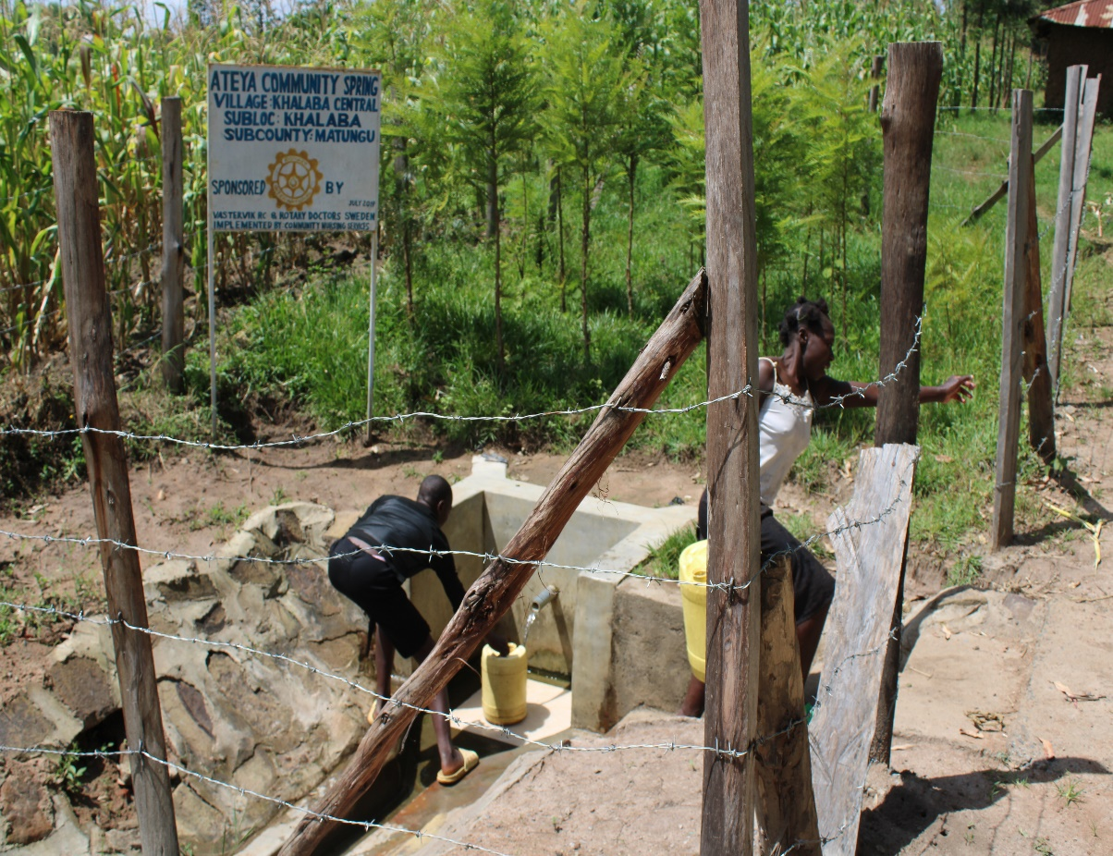
Ateya spring status

Slide 10
NAMWAYA COMMUNITY SPRING
PERIOD OF PROTECTED:
JUNE/JULY 2019
AGE:
1YR
CATCHMENT POPULATION:
47 Households, approximately 282 persons.

Slide 11
NAMWAYA REVIEW REPORT
 | PARAMETOR OF REVIEW | REPORT
1 | FUNCTIONALITY | Water flow throughout the year and fills a20 liter container in less than 30sec. The drainage well maintained The spring never dried up.
2 | FENCE AND DRAINAGE | Still inctact
3 | SIGN POST | Still standing and readable.
4 | USAGE | Heavily used by all the house hold for drinking, cooking, washing and laundry and for animals.
5 | ANY OTHER REPORT | The community still happy and appreciates the project. The project still very new and for follow up in the future.

Slide 12
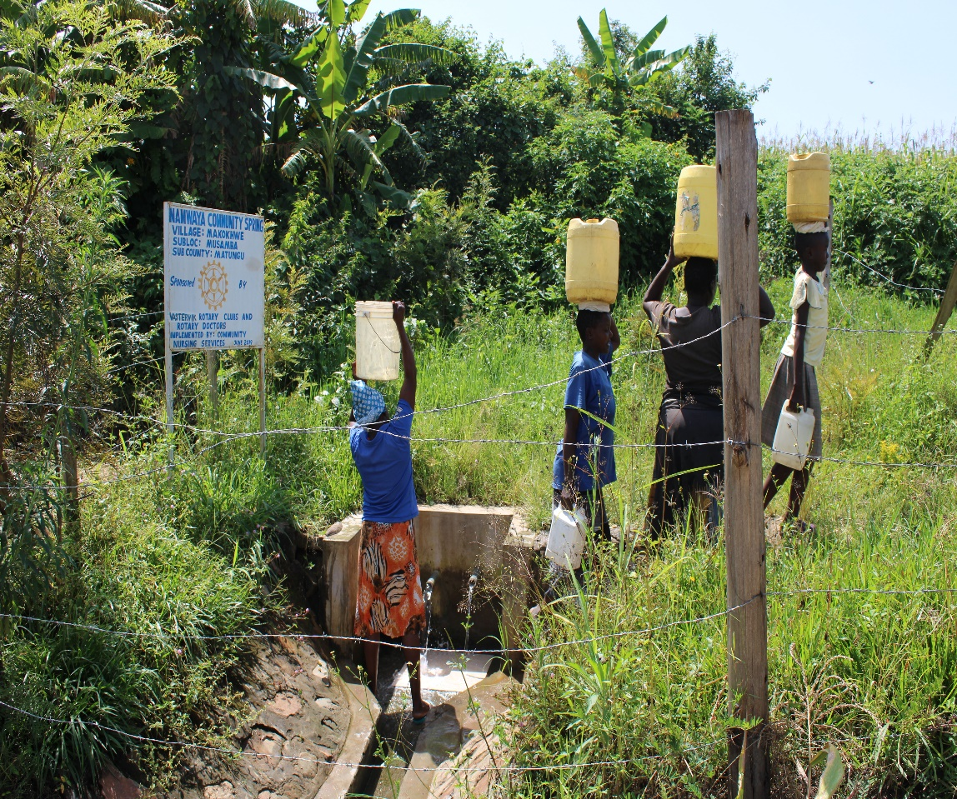
Namwaya spring status

Slide 13
Namwaya Spring status

Slide 14
ODOURI COMMUNITY SPRING
PERIOD OF PROTECTED:
FEB/MARCH 2019
AGE:
1YRand 4Months
CATCHMENT POPULATION:
70 Households, approximately 420 persons.

Slide 15
ODOURI SPRING REVIEW REPORT
 | PARAMETOR OF REVIEW | REPORT
1 | FUNCTIONALITY | Water flow throughout the year and fills a20 liter container in less than 2min. The drainage well maintained The spring Never dries up.
t | FENCE AND DRAINAGE | Still there
3 | SIGN POST | Still there and readable
4 | USAGE | Well used by all the house hold for drinking, cooking, washing and laundry and for animals.
5 | ANY OTHER REPORT | The committee still functional. The spring still very new, for future followup

Slide 16
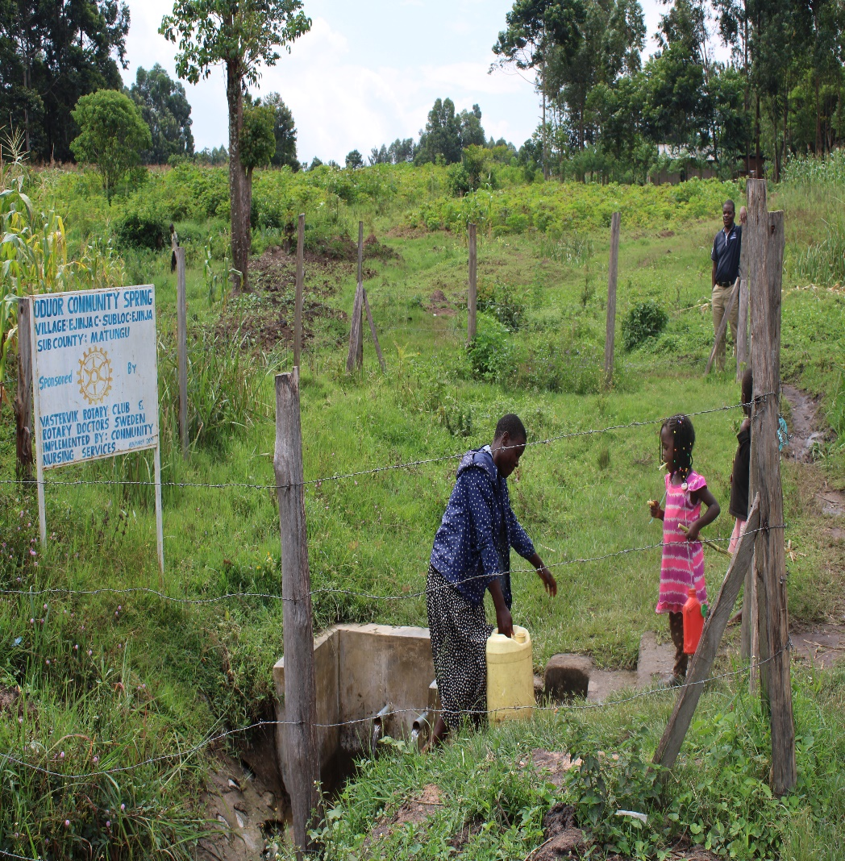
Status of odouri spring

Slide 17
WAMAKOMBO COMMUNITY SPRING
PERIOD OF PROTECTED:
FEB/MARCH 2019
AGE:
1YRand 4Months
CATCHMENT POPULATION:
120 Households, approximately 700persons.

Slide 18
WAMAKOMBO SPRING REVIEW REPORT
 | PARAMETOR OF REVIEW | REPORT
1 | FUNCTIONALITY | Water flow throughout the year and fills a20 liter container in less than 5min. The drainage slightly blocked The spring Never dries up.
t | FENCE AND DRAINAGE | Still there
3 | SIGN POST | Still there and readable
4 | USAGE | Well used by all the house hold for drinking, cooking, washing and laundry and for animals .
5 | ANY OTHER REPORT | Need for follow-up with the committee in spring maintenance. The spring still very new, for future follow up

Slide 19
Status Wamakombo spring

Slide 20
COMMENTS
The springs visited are doing well except for Wamakombo which drainage was slightly blocked.
For future follow-up with both the committee and community for sustainability assurance.

Slide 21
VOTE OF THANKS
To Vastervik Rc Sweden, on behalf of the Community, The Rotary Doctors Sweden and the Community Nursing Services. Thank you so much for this support and you can see how you have transformed the health of many in the community through safe drinking water!
THANK YOU and STAY SAFE FROM CORONA
JACINTA K. NICASIO

