Slide 1
REVIEW OF WATER PROJECTS SPONSORED
BY BÖRJESSONS STIFTELSE
REVIEW BY: JACINTA K. NICASIO

Slide 2
INTRODUCTION
Water: important resource for sustaining life. Clean and safe drinking water, hygiene and sanitation is important part in maintaining good health.
Rotary Doctors Sweden has been able to support communities’ access clean water through support of various RCs.
The Community makes request, form water project committee who oversee the protection of the spring, use and maintenance for sustainability for the project.

Slide 3
THE FOLLOWING WATER PROJECT HAS BEEN SUPPORTED BY YOUR CLUB
KHAKABA COMMUNITY SHALLOW WELL
MARAMBACH COMMUNITY SHALLOW WELL

Slide 4
KHAKABA COMMUNITY SHALLOW WELL
PERIOD OF PROTECTED:
MAR/APRIL 2019.
AGE:
1years and 3months
CATCHMENT POPULATION:
60 Households, approximately 420persons.

Slide 5
KHAKABA COMMUNITY SHALLOW WELL REVIEW REPORT
 | PARAMETOR OF REVIEW | REPORT
1 | FUNCTIONALITY | Good . Pump working well. Never dries up .
2 | FENCE | Well maintained.
3 | SIGN POST | Still standing and readable
4 | USAGE | Well used by of community members
5 | ANY OTHER REPORT | Functional committee.

Slide 6
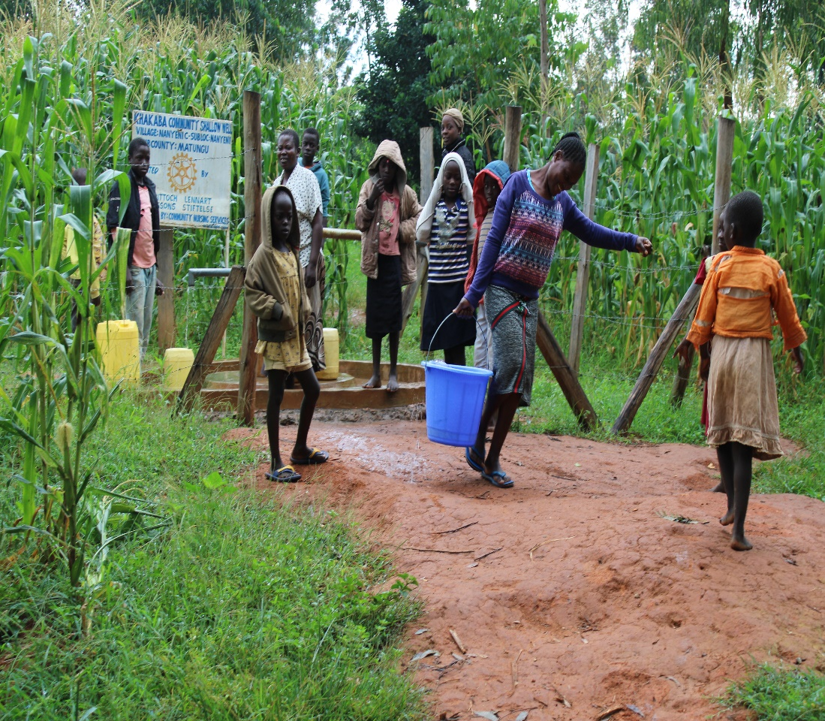
Status Khakaba shallow well

Slide 7
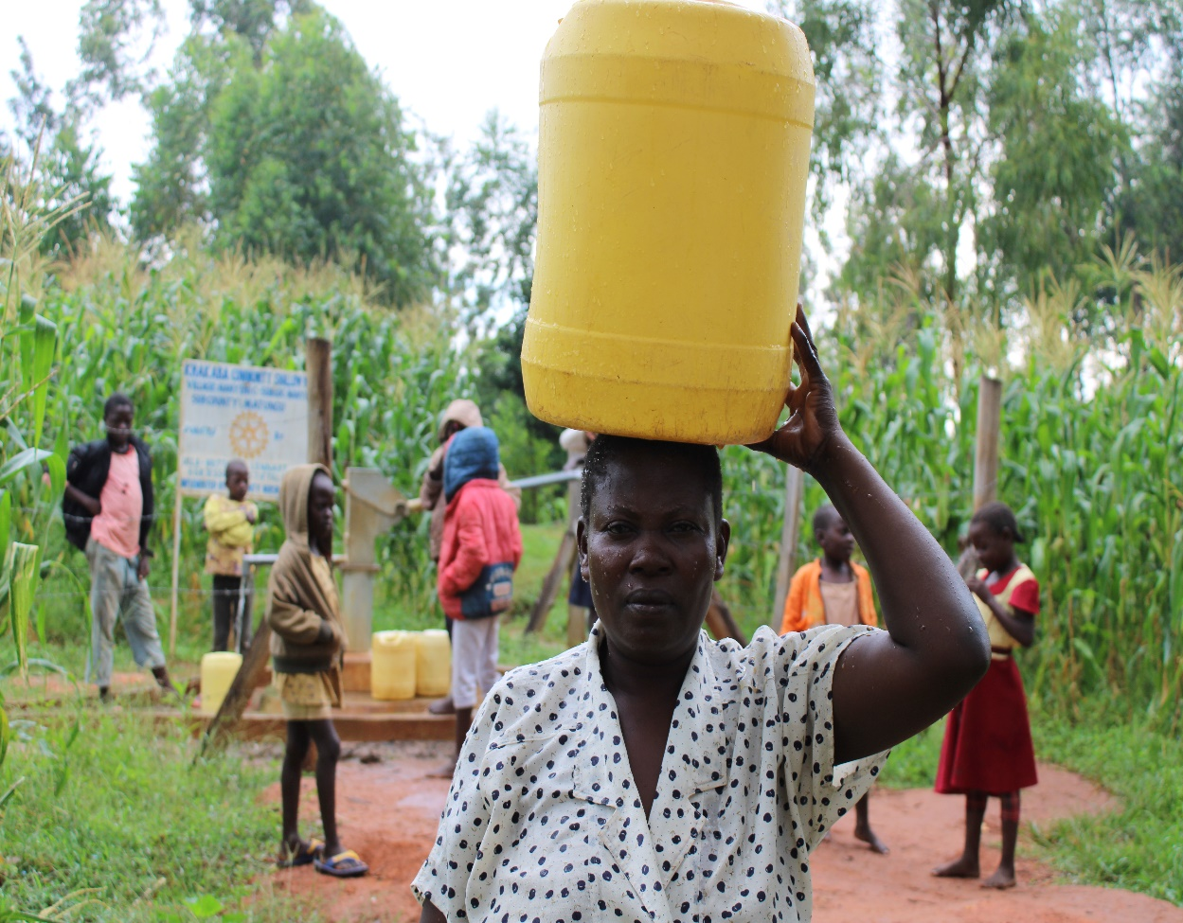

Slide 8
COMMENTS
The Community shallow is functioning well and the community is very happy for the support.
Marambachi community shallow well is very new and just reported about it in June. For future followup.

Slide 9
VOTE OF THANKS
To Ulla Britt och lennart RC Sweden, on behalf of the Community, The Rotary Doctors Sweden and the Community Nursing Services. Thank you so much for this support and you can see how you have transformed the health of many in the community through safe drinking water!
THANK YOU and STAY SAFE FROM CORONA
JACINTA K. NICASIO

