Slide 1
REVIEW OF WATER PROJECTS SPONSORED
BY FRASTA RC
REVIEW BY: JACINTA K. NICASIO

Slide 2
INTRODUCTION
Water: important resource for sustaining life. Clean and safe drinking water, hygiene and sanitation is important part in maintaining good health.
Rotary Doctors Sweden has been able to support communities’ access clean water through support of various RCs.
The Community makes request, form water project committee who oversee the protection of the spring, use and maintenance for sustainability for the project.

Slide 3
THE FOLLOWING WATER PROJECT HAS BEEN SUPPORTED BY YOUR CLUB
EBUBAMBULA COMMUNITY SHALLOW WELL

Slide 4
EBUBAMBULA COMMUNITY SHALLOW WELL
PERIOD OF PROTECTED:
OCT 2018.
AGE:
1years and 10months
CATCHMENT POPULATION:
108 Households, approximately 648persons.

Slide 5
EBUBAMBULACOMMUNITY SHALLOW WELL REVIEW REPORT
 | PARAMETOR OF REVIEW | REPORT
1 | FUNCTIONALITY | Good . Pump working well. Never dries up .
2 | FENCE | Well maintained.
3 | SIGN POST | Still standing and readable
4 | USAGE | Well used by of community members
5 | ANY OTHER REPORT | Functional committee.

Slide 6
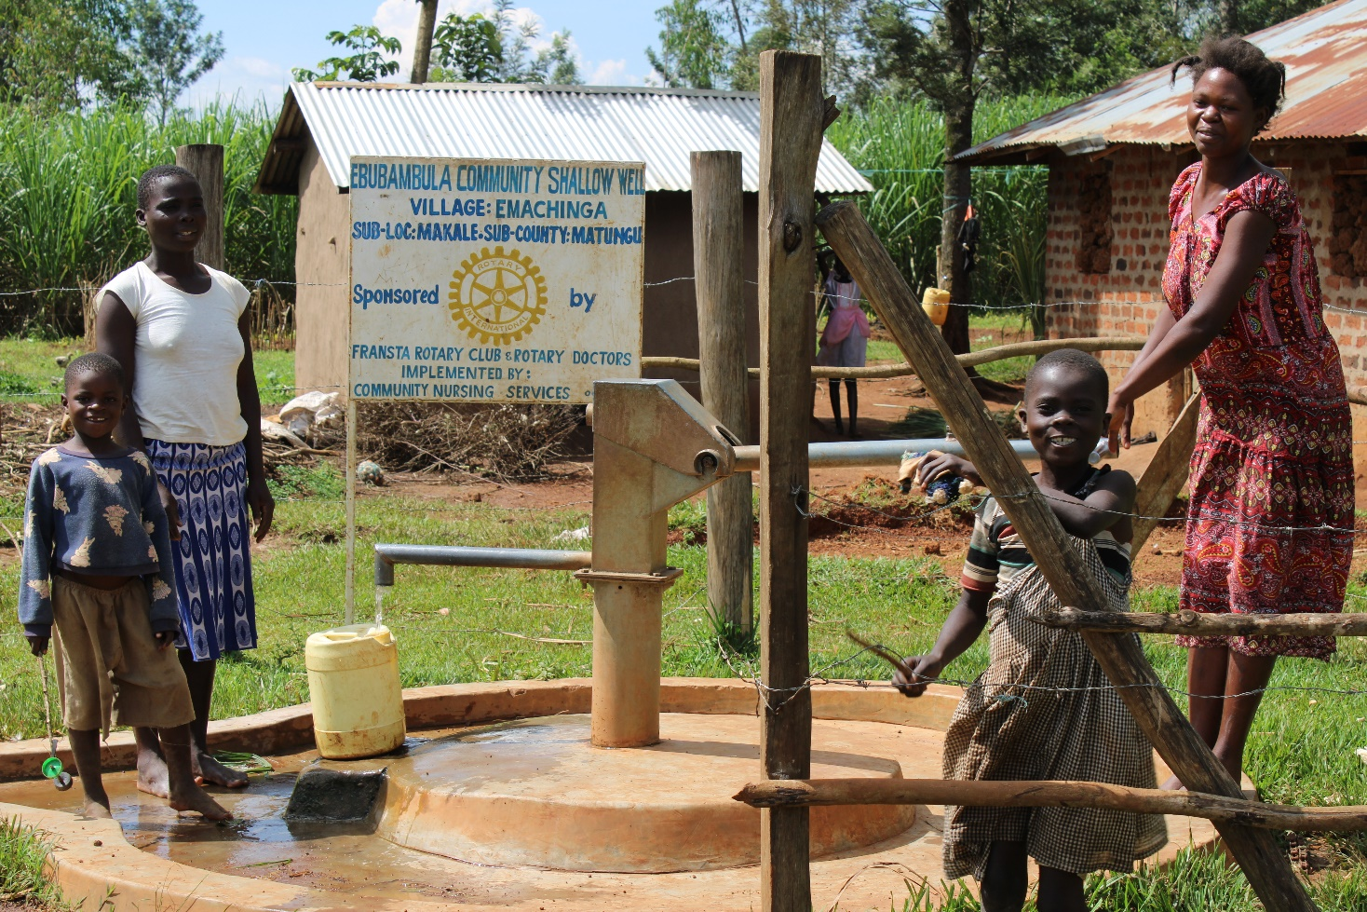
Status Ebubambula shallow well

Slide 7
COMMENTS
The Community shallow is functioning well and the community is very happy for the support.

Slide 8
VOTE OF THANKS
To Fransta RC Sweden, on behalf of the Community, The Rotary Doctors Sweden and the Community Nursing Services. Thank you so much for this support and you can see how you have transformed the health of many in the community through safe drinking water!
THANK YOU and STAY SAFE FROM CORONA
JACINTA K. NICASIO

