Slide 1
REVIEW OF WATER PROJECTS SPONSORED
BY UDDEVALLA SKANSEN RC
REVIEW BY: JACINTA K. NICASIO

Slide 2
INTRODUCTION
Water: important resource for sustaining life. Clean and safe drinking water, hygiene and sanitation is important part in maintaining good health.
Rotary Doctors Sweden has been able to support communities’ access clean water through support of various RCs.
The Community makes request, form water project committee who oversee the protection of the spring, use and maintenance for sustainability for the project.

Slide 3
THE FOLLOWING WATER PROJECT HAS BEEN SUPPORTED BY YOUR CLUB
NYANGULO COMMUNITY SPRING
KONYANGO COMMUNITY SPRING
EBULANDA COMMUNITY SPRING
CHAMYET COMMUNITY SPRING
ONGALOS COMMUNITY SPRING.
KHABUKHOSE COMMUNITY SPRING

Slide 4
CHIBWIRE COMMUNITY SPRING
KOMOND COMMUNITY SPRING
OGUTU EBUBAMBULA COMMUNITY SPRING
KOCHIENG COMMUNITY SPRING
NYANGAU COMMUNITY SPRING
ODOURI COMMUNITY SPRING
MULUTUNGU COMMUNITY SPRING

Slide 5
NYANGULO COMMUNITY SHALLOW WELL
PERIOD OF PROTECTED:
July/August 2011.
AGE:
10 years.
CATCHMENT POPULATION:
650 Households, approximately 3300 persons.

Slide 6
NYANGULO SPRING REVIEW REPORT
 | PARAMETOR OF REVIEW | REPORT
1 | FUNCTIONALITY | Slightly, not a heavy flow, can take about 5min to fill a 20 water bucket. Pipe worn out and needs replacement. Drainage slightly dirty. Needs repair the committee will take the repair up.
2 | FENCE | Not there, the posts were eaten by ants. This has left the filtration chamber exposed as people walk through it.
3 | SIGN POST | Still standing and readable.
4 | USAGE | Used by lots of community members,
5 | ANY OTHER REPORT | Committee still there but not very active, discussed the issue of minor repairs needed .To follow up.

Slide 7
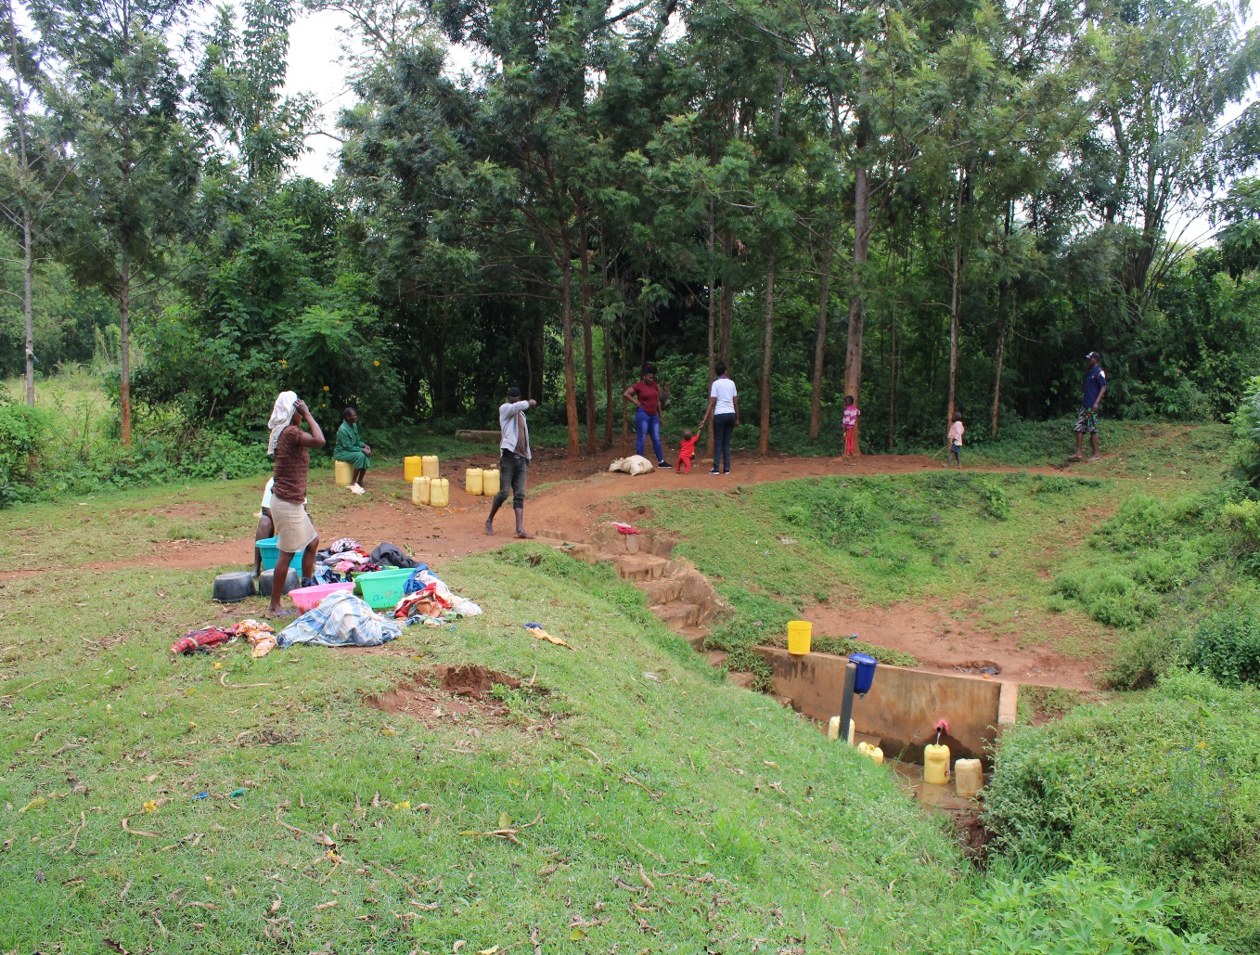
Pictures of the status of Nyangulo spring

Slide 8
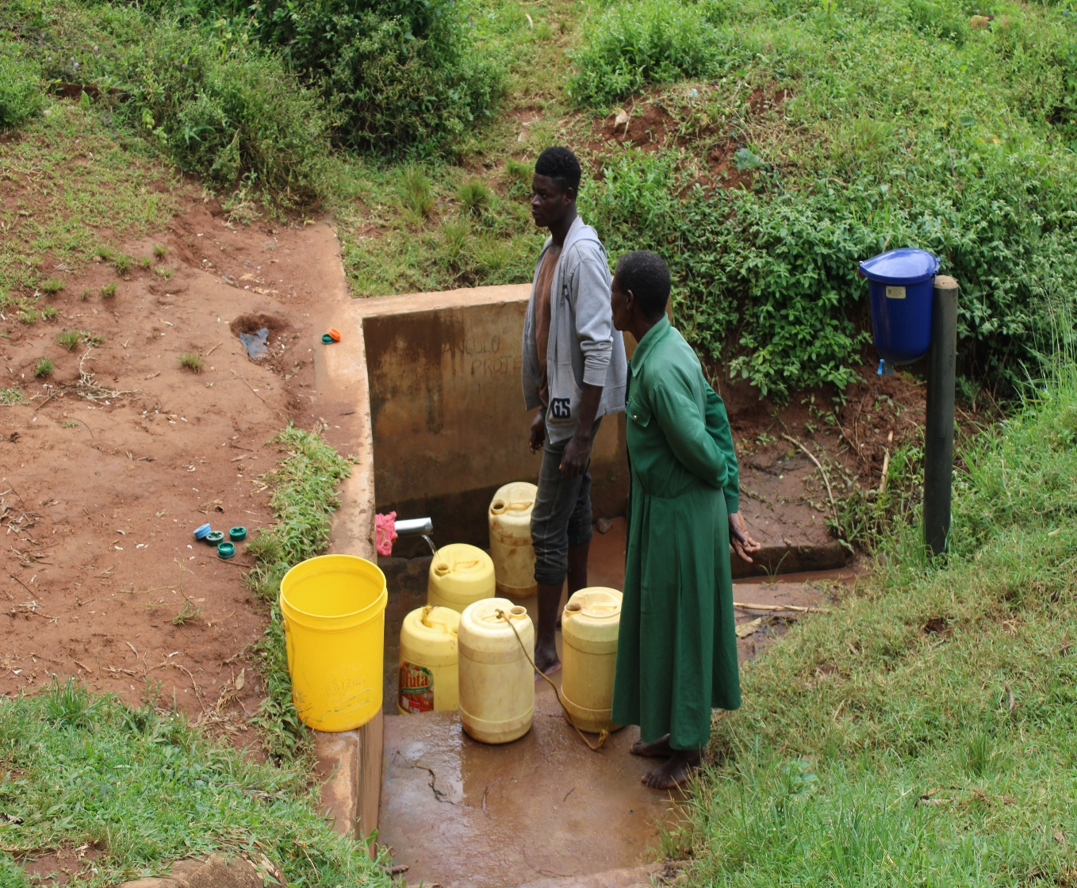

Slide 9
EBULANDA COMMUNITY SPRING
PERIOD OF PROTECTED:
July /Aug 2013.
AGE:
8years
CATCHMENT POPULATION:
220 Households, approximately 1200 persons.

Slide 10
EBULANDA REVIEW REPORT
 | PARAMETOR OF REVIEW | REPORT
1 | FUNCTIONALITY | Good water flow, fills a 20 water bucket within two minutes, Drainage well maintained.
2 | FENCE | Still there, was broken but repaired by the community.
3 | SIGN POST | Still standing but rusted not very readable.
4 | USAGE | Well used by all the house hold for drinking, cooking, washing and laundry and for animals.
5 | ANY OTHER REPORT | Functional committee, well protected source with the seedlings already grown.

Slide 11
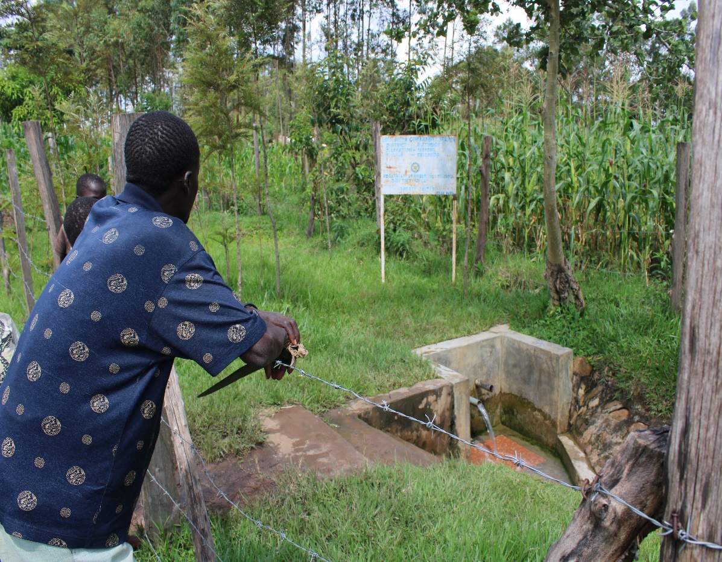
Ebulanda spring status

Slide 12
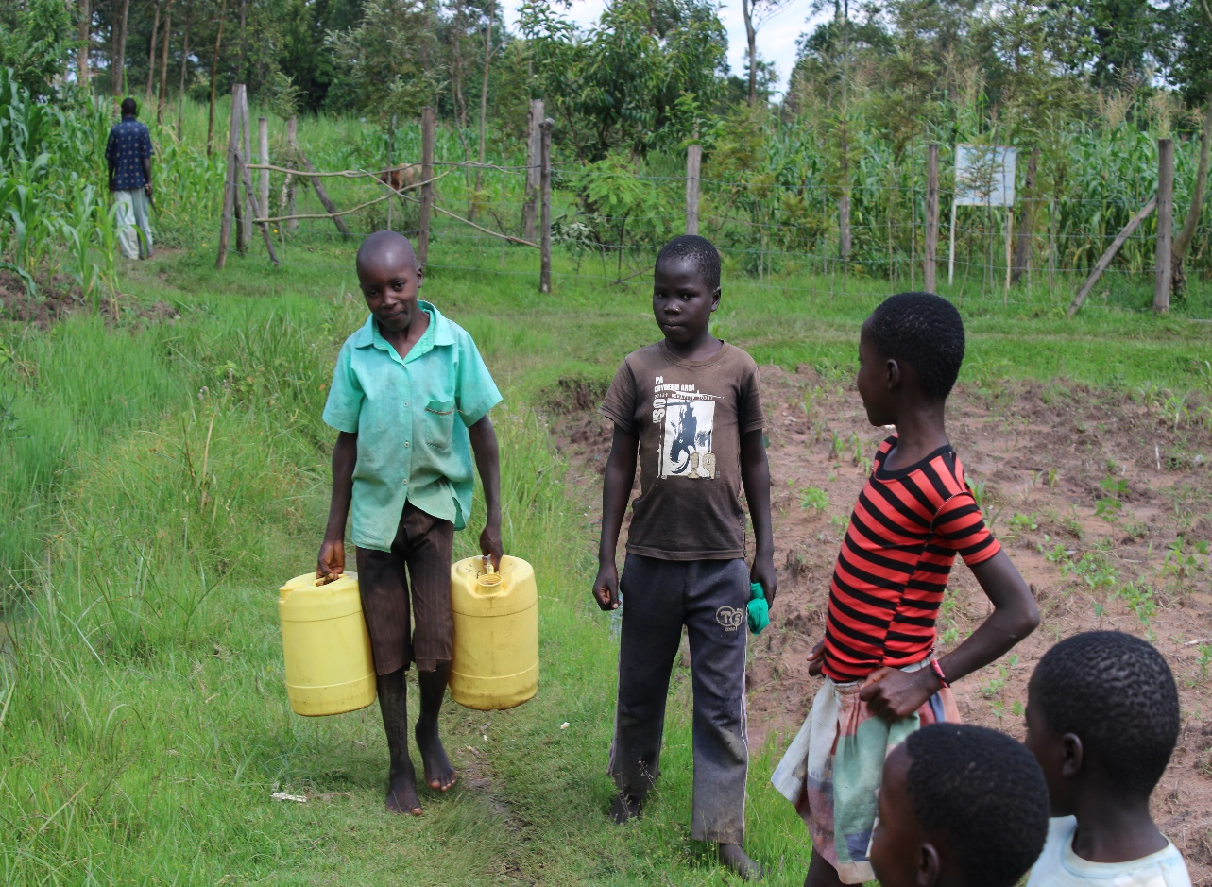

Slide 13
CHAMYET COMMUNITY SPRING
PERIOD OF PROTECTED:
OCT 2012
AGE:
8 years.
CATCHMENT POPULATION:
300Households, approximately 1800 persons.

Slide 14
CHAMYET REVIEW REPORT
 | PARAMETOR OF REVIEW | REPORT
1 | FUNCTIONALITY | Slightly not very high yield but it never dries up. Pipe worn out needs replacement Drainage is clear
2 | FENCE | No, fence but well protected by the community.
3 | SIGN POST | Not there.
4 | USAGE | Used by all the house hold for drinking, cooking, washing and laundry and for animals BUT by the taken of visit no one was fetching unfortunately.
5 | ANY OTHER REPORT | Committee not functional , discussed with our contact person there over formation of a new committee that would oversee repairs. Will follow up.

Slide 15
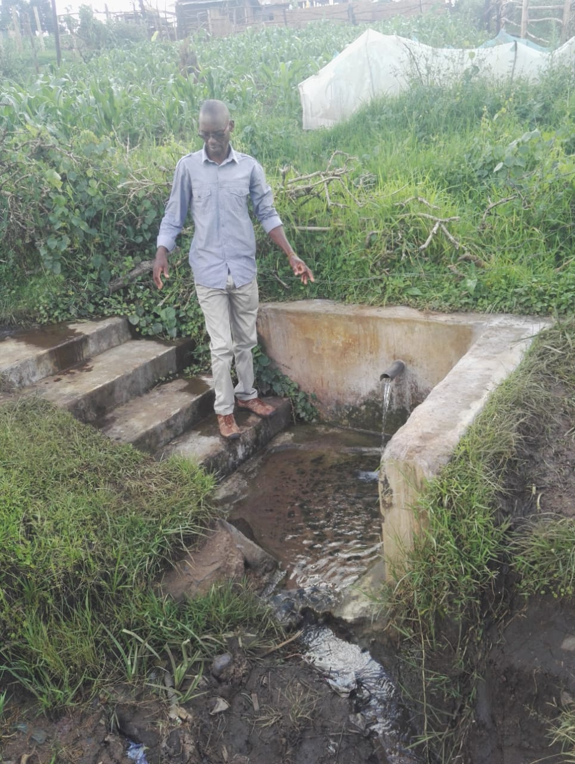
Status of Chamyet

Slide 16
ONGALOS COMMUNITY SPRING
PERIOD OF PROTECTED:
Nov/Dec 2015.
AGE:
4 years 6months.
CATCHMENT POPULATION:
190 Households, approximately 1000persons.

Slide 17
ONGALOS REVIEW REPORT
 | PARAMETOR OF REVIEW | REPORT
1 | FUNCTIONALITY | High yield spring throughout the year, Pipe worn out and needs replacement.
2 | FENCE | Destroyed by the termites, Drainage from the spring well maintained BUT there was water runoff from the road passing by, which could easy destroy or contaminate the water.
3 | SIGN POST | Sign post still standing, though very rusty and not easy to read.
4 | USAGE | Used by the community members
5 | ANY OTHER REPORT | Run off from the road needs to be controlled, and the fence replaced and the worn out pipe.

Slide 18
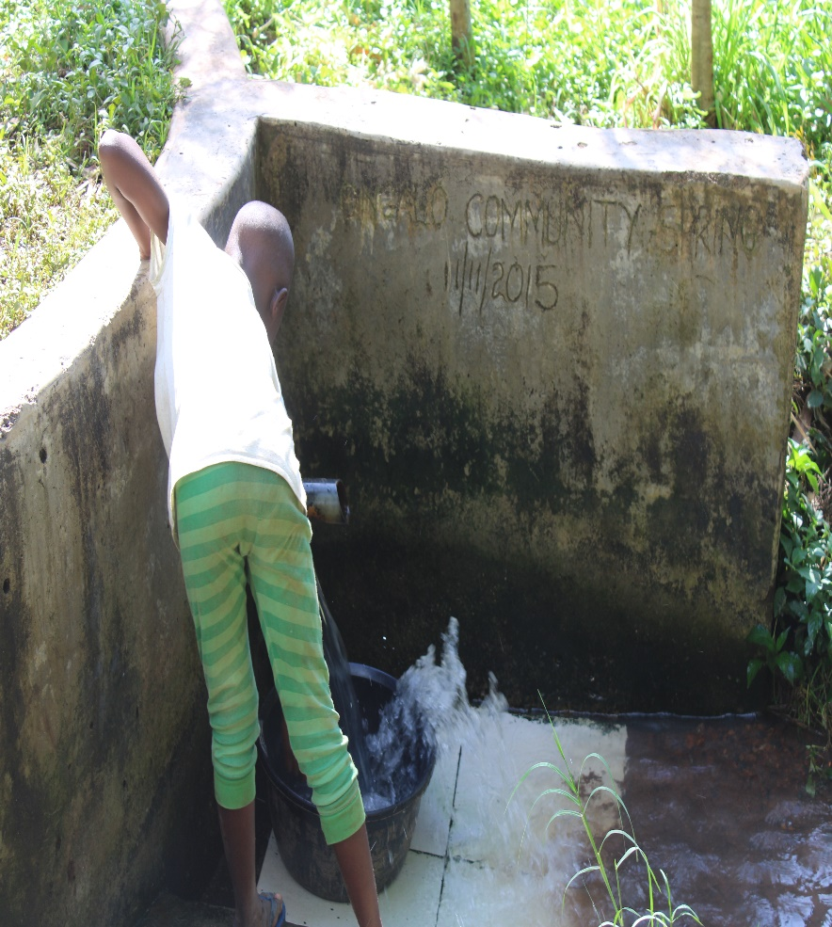
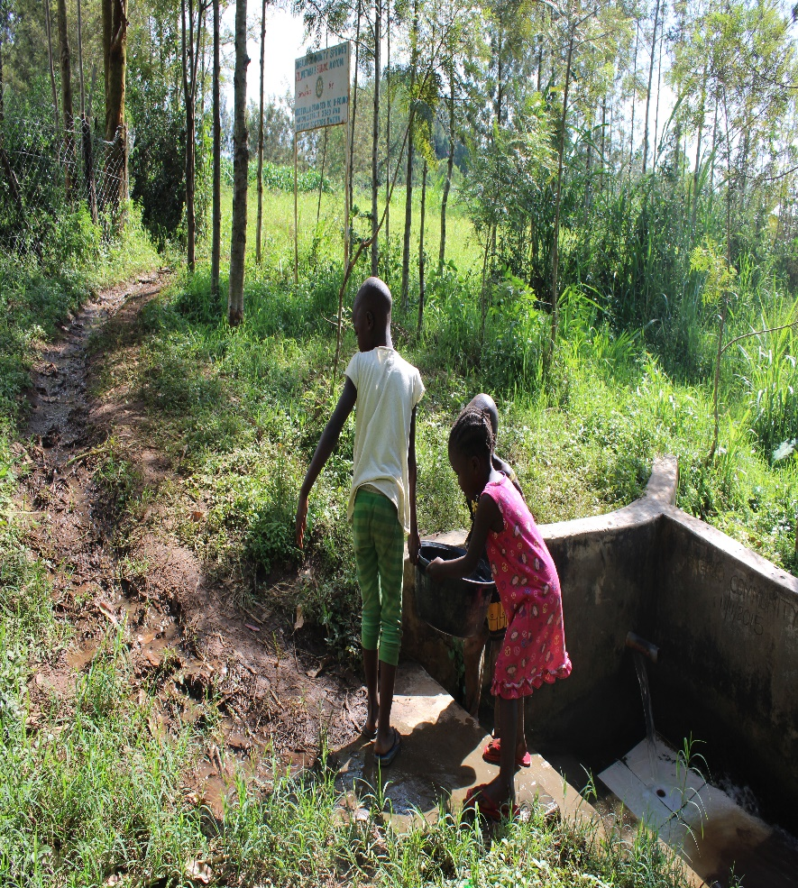
Status of Angalos

Slide 19
KHABUKHOSE COMMUNITY SPRING
PERIOD OF PROTECTED:
Nov/Dec 2016.
AGE:
3 year 8 months.
CATCHMENT POPULATION:
45 Households, approximately 240 persons.

Slide 20
KHABUKOSHE REVIEW REPORT
 | PARAMETOR OF REVIEW | REPORT
1 | FUNCTIONALITY | High yield throughout the year, takes less than 1 minute to fill a 20 water bucket. Drainage well maintained
2 | FENCE | Fence broken and community passing through the filtration chamber to get to the spring.This exposes the chamber.
3 | SIGN POST | Standing firm and readable.
4 | USAGE | Well used by the community for all purpose drinking, cooking, washing and for animals to drink.
5 | ANY OTHER REPORT | Committee still there but not functional, for follow-up in future

Slide 21
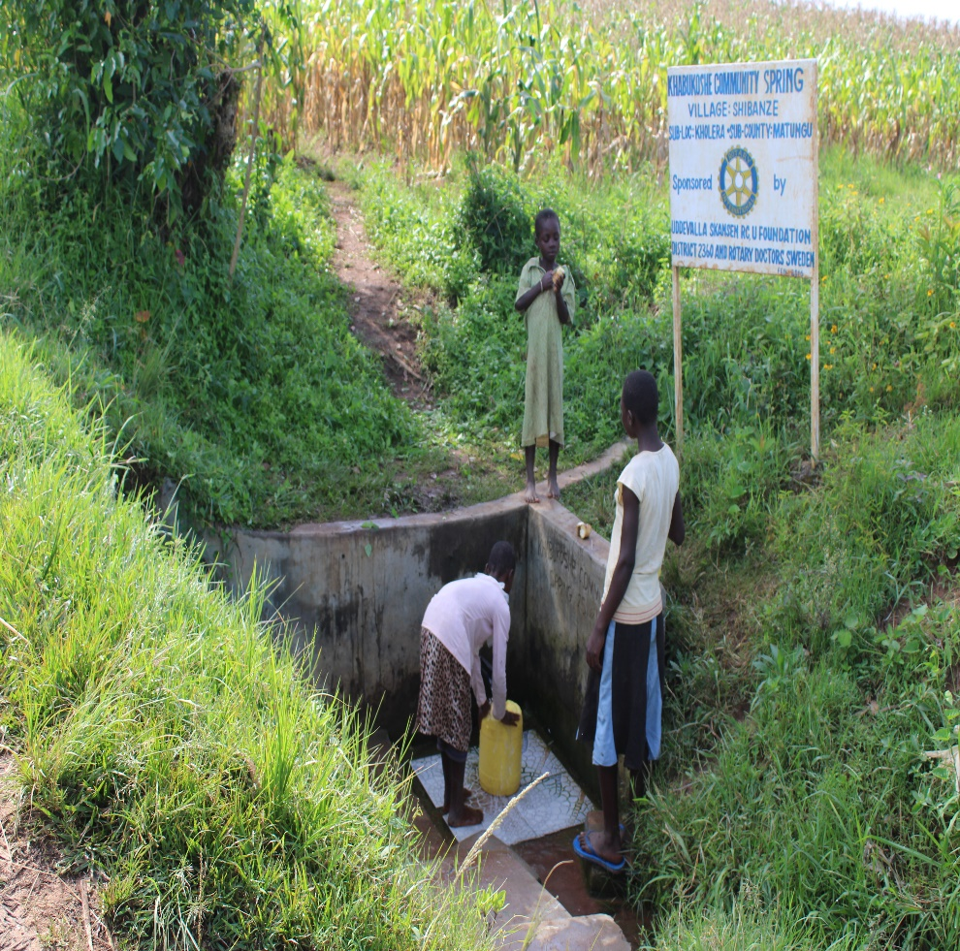
Status of Khabukoshe spring

Slide 22
KOMOND COMMUNITY SPRING
PERIOD OF PROTECTED:
July/June 2014.
AGE:
7years
CATCHMENT POPULATION:
110Households, approximately 660persons.

Slide 23
KOMOND REVIEW REPORT
 | PARAMETOR OF REVIEW | REPORT
1 | FUNCTIONALITY | Great water yield throughout the year, clean and no contamination of water. Drainange well maintained. Pipe worn out needs replacement.
2 | FENCE | Fence not there
3 | SIGN POST | Not there
4 | USAGE | Used by all members of the community!
5 | ANY OTHER REPORT | Needs replacement of the worn-out pipe

Slide 24
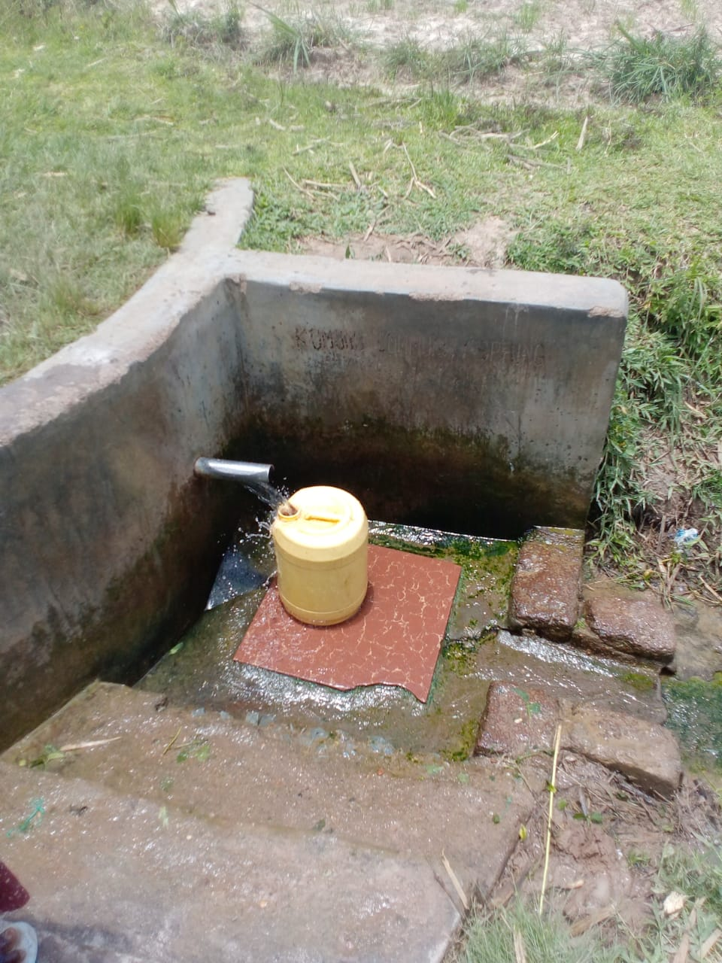
Komond spring status

Slide 25
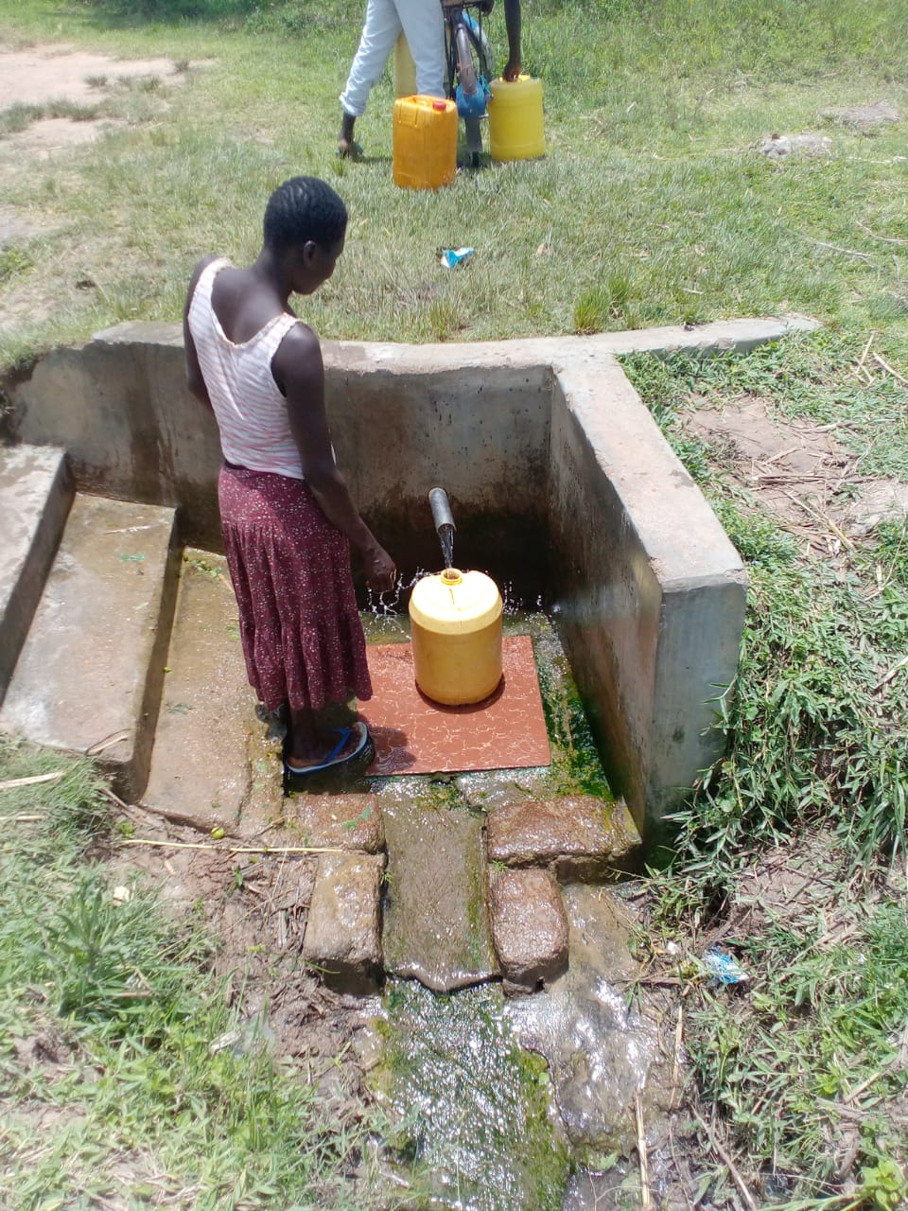

Slide 26
CHIBWIRE COMMUNITY SPRING
PERIOD OF PROTECTED:
FEB/MAR 2014
AGE:
6 years 6 months.
CATCHMENT POPULATION:
135Households, approximately 780 persons.

Slide 27
CHIBWIRE REVIEW REPORT
 | PARAMETOR OF REVIEW | REPORT
1 | FUNCTIONALITY | Good yield through out the year , Drainage good Floor worn out needs repair
2 | FENCE | Not present
3 | SIGN POST | Rusted, but still present.
4 | USAGE | Well used with a big population in the community and primary school when schools are ongoing.
5 | ANY OTHER REPORT | Needs minor repairs and it was discussed with the members found fetching.The community still happy and grateful.

Slide 28
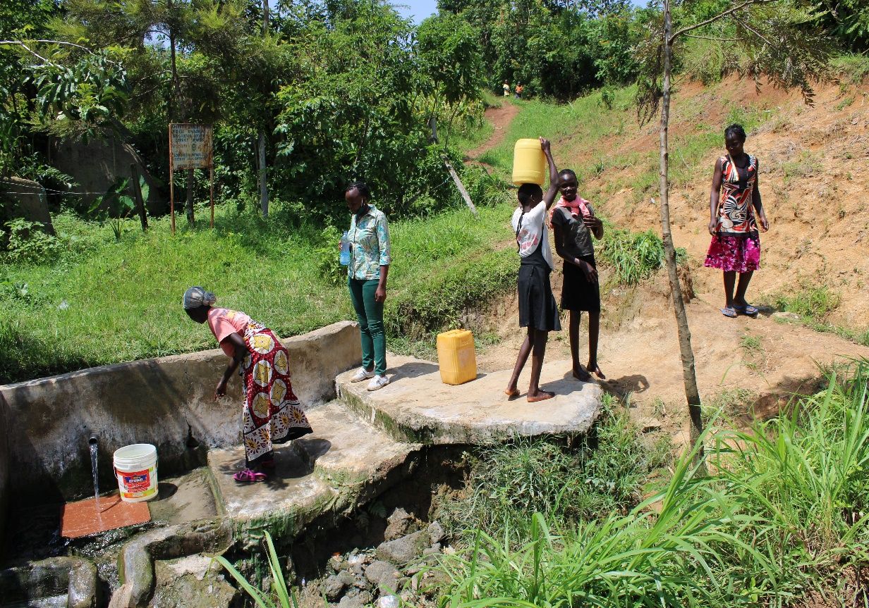
Chibwire status

Slide 29
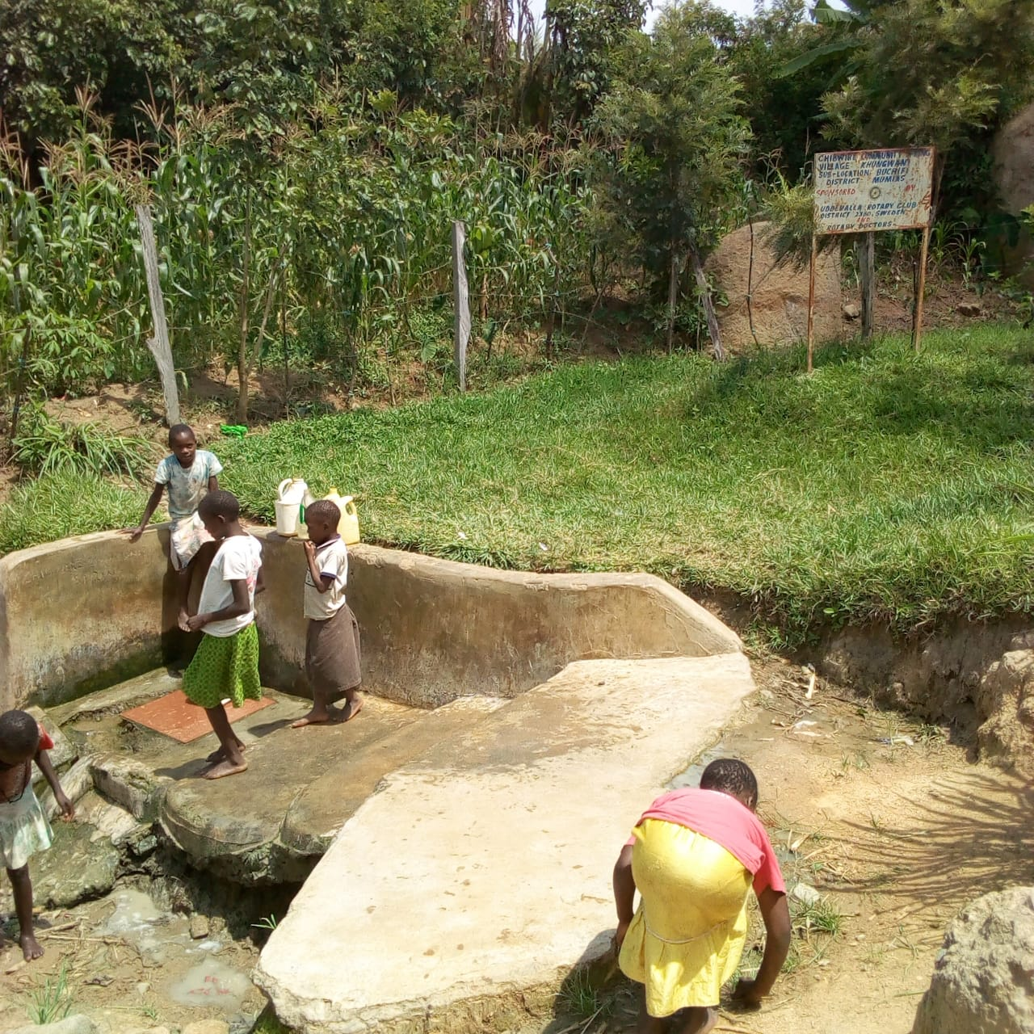

Slide 30
KOCHIENG COMMUNITY SPRING
PERIOD OF PROTECTED:
March 2015.
AGE:
6 years 3months
CATCHMENT POPULATION:
100 Households, approximately 600 persons.

Slide 31
KOCHIENG REVIEW REPORT
 | PARAMETOR OF REVIEW | REPORT
1 | FUNCTIONALITY | Good water flow throughout the year. Drainage blocked.
2 | FENCE | Fence still there.
3 | SIGN POST | Still there and readable!
4 | USAGE | Used by the community though at the time of visit we didn’t manage o get anyone.
5 | ANY OTHER REPORT | Couldn’t reach the chairman for do discuss but will follow-up through volunteer. Needs clearance of the drainage.

Slide 32
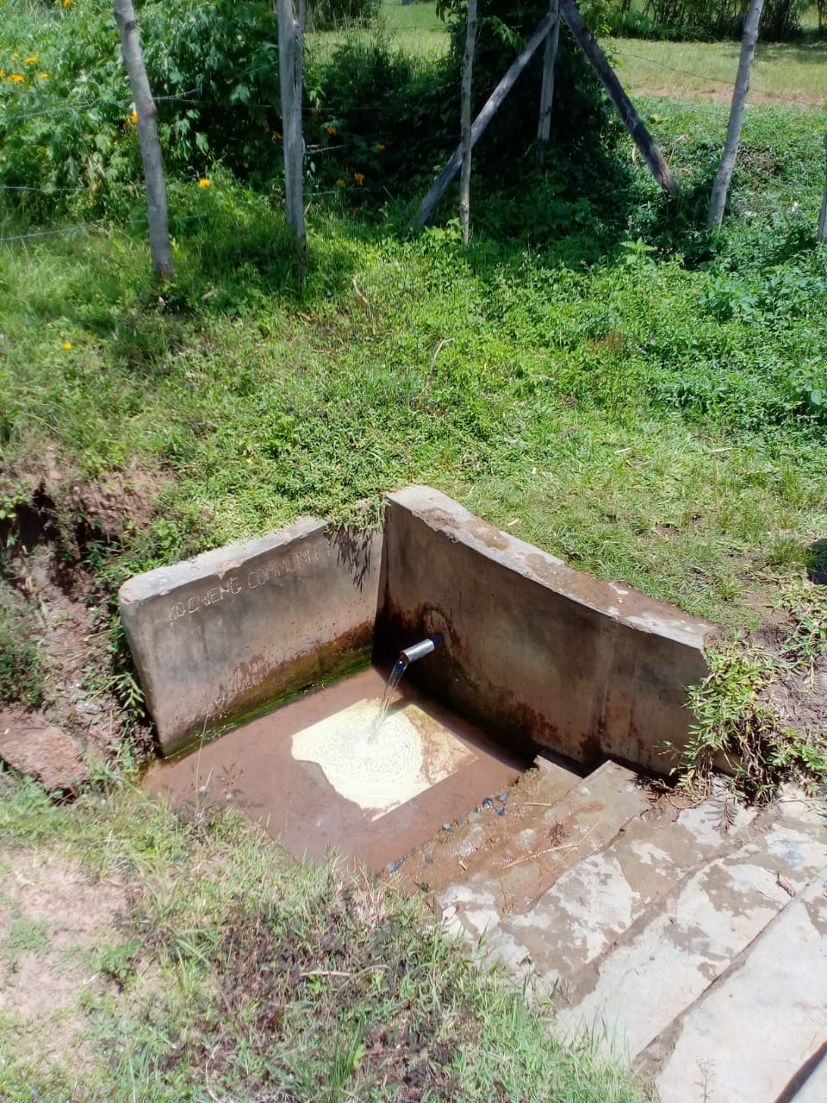
Status Kochieng

Slide 33
NYANGAU COMMUNITY SPRING
PERIOD OF PROTECTED:
June/July 2015
AGE:
5 years old.
CATCHMENT POPULATION:
120 Households, approximately 720 persons.

Slide 34
NYANGAU SPRING REVIEW REPORT
 | PARAMETOR OF REVIEW | REPORT
1 | FUNCTIONALITY | Slightly not high yield . It takes around 5min to 10 to fill 20litre water bucket fills Catchment protection area destroyed.
2 | FENCE | No fence
3 | SIGN POST | No sign Posts
4 | USAGE | Still being used by the community but unfortunately didn’t find anyone fetching.
5 | ANY OTHER REPORT | Non functional committee. For follow up by the community Volunteer

Slide 35
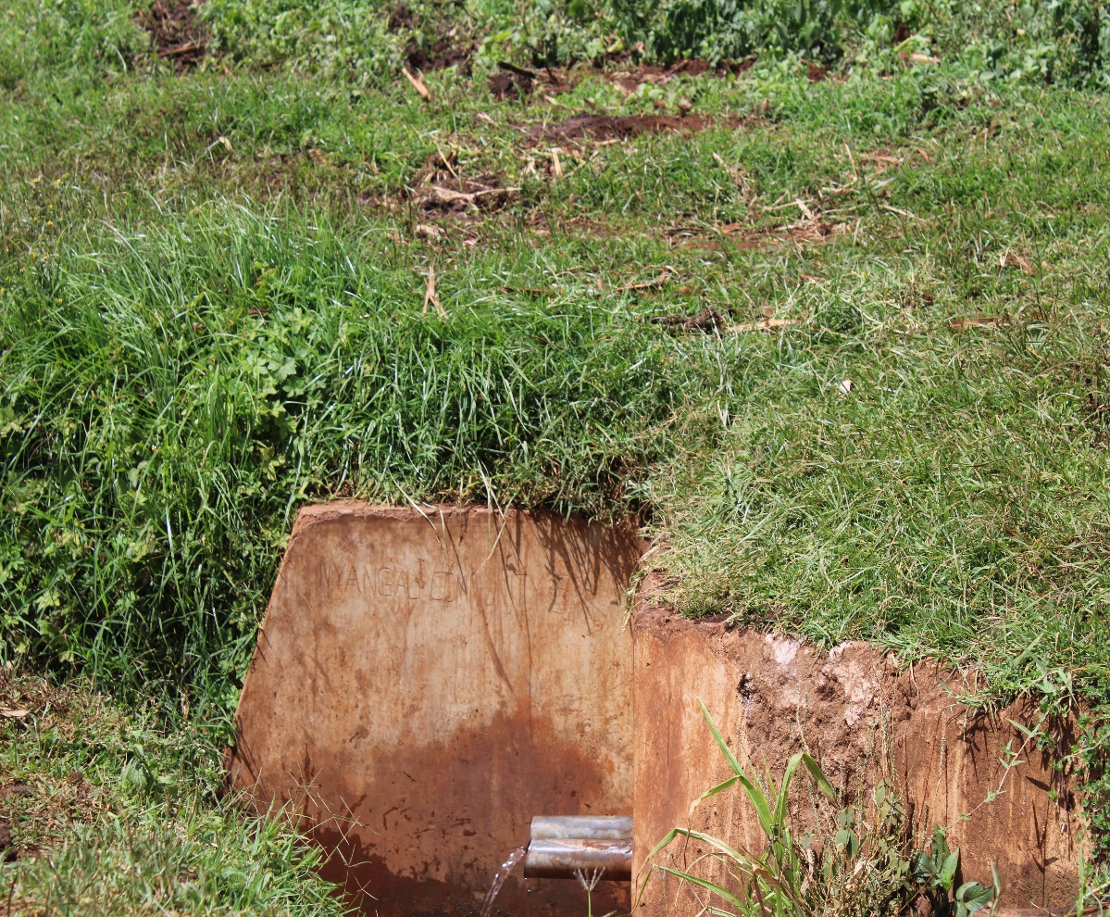
Status nyangua spring

Slide 36
ODOURI SPRING
PERIOD OF PROTECTED:
NOV/OCT 2016.
AGE:
3years old and 10months.
CATCHMENT POPULATION:
67 Households, approximately 402

Slide 37
ODOUR SPRING REVIEW REPORT
 | PARAMETOR OF REVIEW | REPORT
1 | FUNCTIONALITY | The spring has a good yield throughout the year round, the drainage is partially blocked,
2 | FENCE | Fence still good
3 | SIGN POST | Sigh post still there and readable
4 | USAGE | Highly used by the community .
5 | ANY OTHER REPORT | Committee very active and ready to do unblock the slightly blocked drainage..

Slide 38
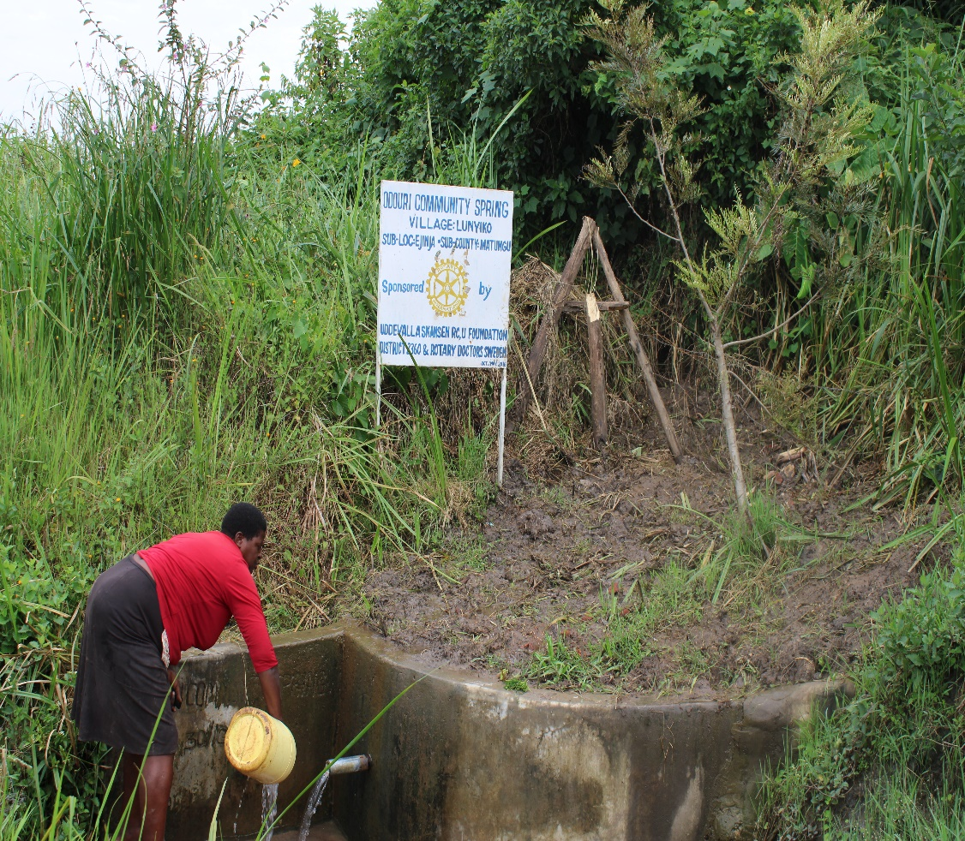
Odouri spring status

Slide 39
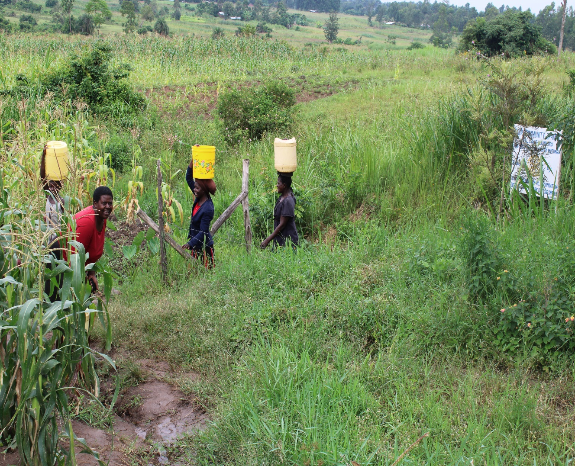

Slide 40
OGUTU EBUBAMBULA COMMUNITY SPRING
PERIOD OF PROTECTED:
Sept/Oct 2018
AGE:
1years 10 months
CATCHMENT POPULATION:
90 Households, approximately 540 persons.

Slide 41
OGUTU EBUBAMBULA SPRING REVIEW REPORT
 | PARAMETOR OF REVIEW | REPORT
1 | FUNCTIONALITY | The spring has a good yield throughout the year round, Drainage good. Well maintained spring
2 | FENCE | Fence still good
3 | SIGN POST | Sigh post still there and readable
4 | USAGE | Highly used by the community .
5 | ANY OTHER REPORT | Committee very active ,for future follow up cause its still new almost 2years.

Slide 42
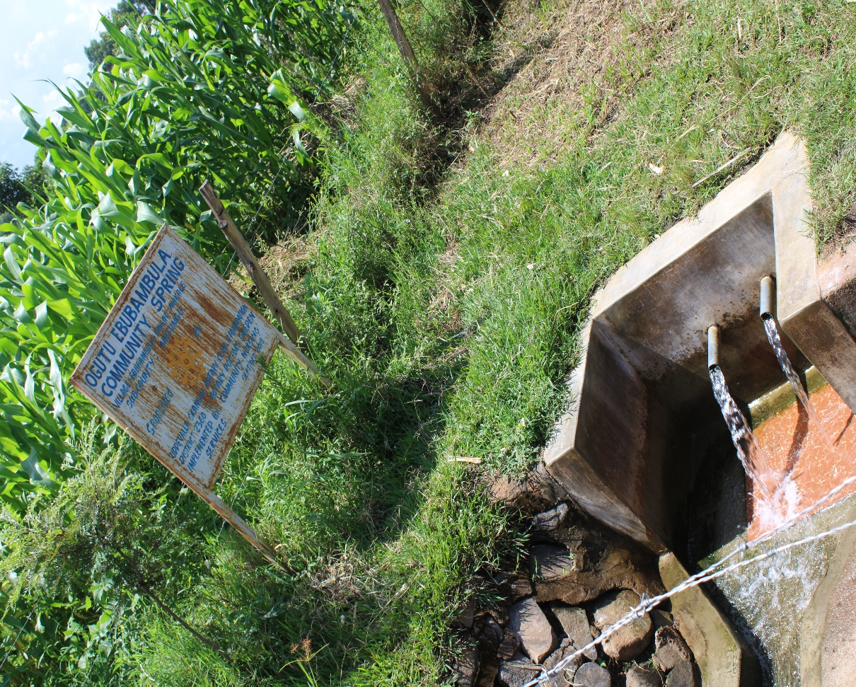
Status Ogutu Ebubambula spring

Slide 43
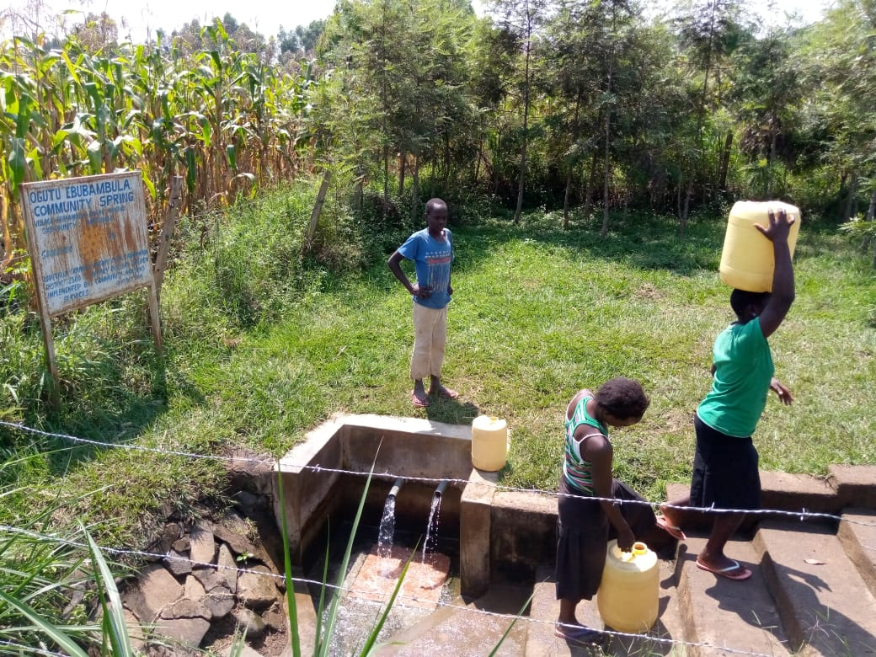
Status Ogutu Ebubambula

Slide 44
MULUTUNGU EBUBAMBULA COMMUNITY SPRING
PERIOD OF PROTECTED:
Sept/Oct 2019
AGE:
10 months
CATCHMENT POPULATION:
97 Households, approximately 582persons.

Slide 45
MULUTUNGU SPRING REVIEW REPORT
 | PARAMETOR OF REVIEW | REPORT
1 | FUNCTIONALITY | The spring has a good yield so far. Drainage good. Well maintained spring
2 | FENCE | Fence still good
3 | SIGN POST | Sigh post still there and readable
4 | USAGE | Highly used by the community though by the time of visit didn’t get anyone fetching.
5 | ANY OTHER REPORT | Committee very active ,for future follow up cause its still new almost 1year.

Slide 46
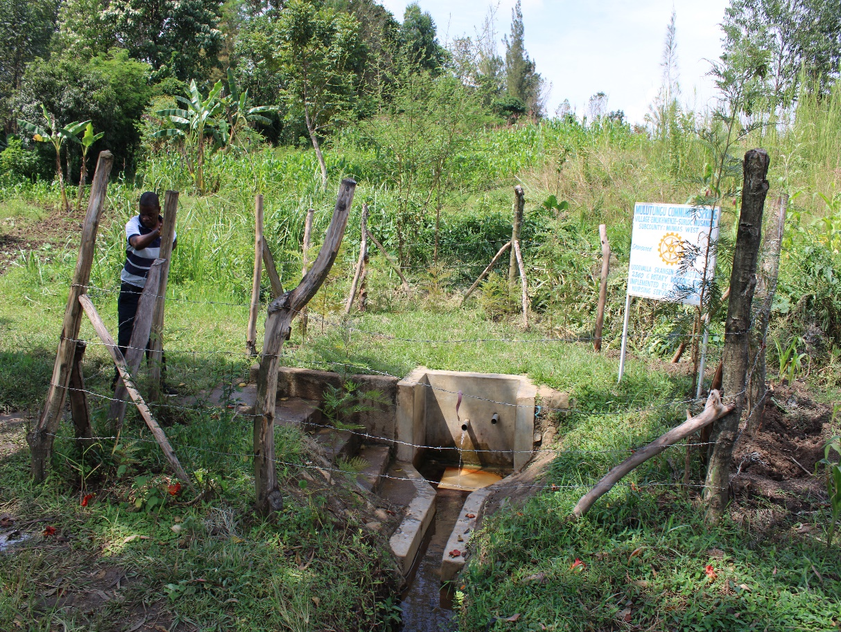
Status Mulutungu spring

Slide 47
COMMENTS
Most of the springs visited are function well, the greater challenge is on the fence. The termites eats up and destroy the fence even after several community effort to replace them. Also some drainages were slightly blocked.
There is one that has not been visited in Homabay( Konyango)will follow up and update the club.
It was great to see even over 8 years old springs still very functional.

Slide 48
VOTE OF THANKS
To Uddevalla Skansen Rc Sweden, on behalf of the Community, The Rotary Doctors Sweden and the Community Nursing Services. Thank you so much for this support and you can see how you have transformed the health of many in the community through safe drinking water!
THANK YOU and STAY SAFE FROM CORONA
JACINTA K. NICASIO

