Slide 1
Quality and patient safety
Tobias Wirén MD
Kacheliba hospital

Slide 2
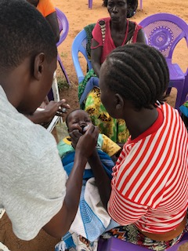
Cure
Relieve
Comfort

Slide 3
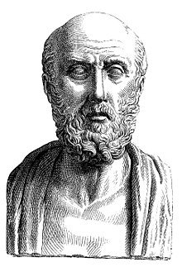
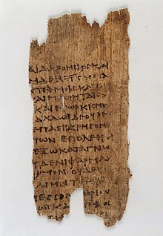
Hippocratic oath
Primum non nocere – First do no harm !
Always comfort
Sometimes cure and relieve
Never harm

Slide 4
Hippocratic oath 2019
I swear to fulfill, to the best of my ability and judgment, this covenant:
I will respect the hard-won scientific gains of those physicians in whose steps I walk, and gladly share such knowledge as is mine with those who are to follow.
I will apply, for the benefit of the sick, all measures [that] are required, avoiding those twin traps of overtreatment and therapeutic nihilism.
I will remember that there is art to medicine as well as science, and that warmth, sympathy, and understanding may outweigh the surgeon's knife or the chemist's drug.
I will not be ashamed to say "I know not," nor will I fail to call in my colleagues when the skills of another are needed for a patient's recovery.
I will respect the privacy of my patients, for their problems are not disclosed to me that the world may know. Most especially must I tread with care in matters of life and death. If it is given me to save a life, all thanks. But it may also be within my power to take a life; this awesome responsibility must be faced with great humbleness and awareness of my own frailty. Above all, I must not play at God.
I will remember that I do not treat a fever chart, a cancerous growth, but a sick human being, whose illness may affect the person's family and economic stability. My responsibility includes these related problems, if I am to care adequately for the sick.
I will prevent disease whenever I can, for prevention is preferable to cure.
I will protect the environment which sustains us, in the knowledge that the continuing health of ourselves and our societies is dependent on a healthy planet.
I will remember that I remain a member of society, with special obligations to all my fellow human beings, those sound of mind and body as well as the infirm.
If I do not violate this oath, may I enjoy life and art, respected while I live and remembered with affection thereafter. May I always act so as to preserve the finest traditions of my calling and may I long experience the joy of healing those who seek my help

Slide 5
Create barriers to avoid injured patients
Have a good patient safety culture
Have leaders that promote safety
Have an organisation where safety is important
Establish ways of working and the right tools to work in a safe way
Have skilled individuals that try to improve and teams that learn together
Ways of working, tools
Team and individual
Organisation
Leadership and culture
Injured patient

Slide 6
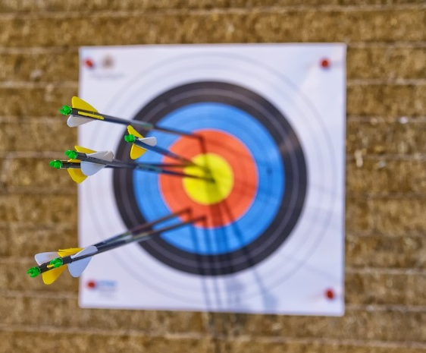
Patient safety culture
CME - Continuos Medical Education
Reporting of mishaps and adverse events
Analysis of adverse events
Reporting of positive outcomes
Working systematically with improvements
Good working conditions
Staff survey of attitude towards safety
Patient satisfaction survey
Focus on the safety system and not who is to blaim

Slide 7
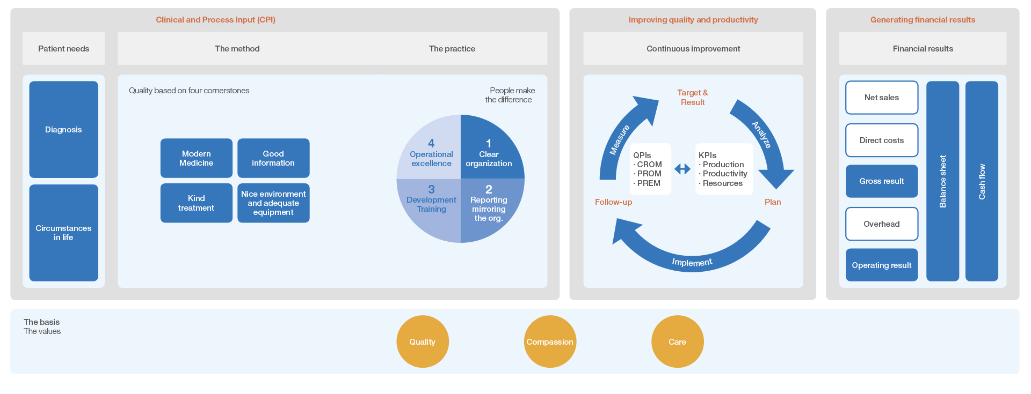
A model for continuous improvement

Slide 8
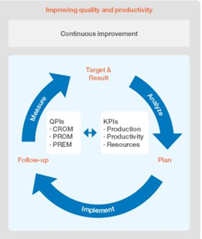
Are we good? How do we improve?

Slide 10
Stay curious!
https://youtu.be/d49kmiE_Bp4

Slide 11
Standards and care pathways
To follow standards important for safety and quality
Possible to evaluate and improve
More efficient and less stress

Slide 12
Remove ”waste” to have less stressful days
Defects and rework
Overproduction
Waiting
Misuse of staff/talent
Transportation
Inventory – storage
Motion
Over processing

Slide 13
Cheap and easy way to increase safety
5S
Sort
Set in order
Standardize
Shine (=clean)
Self Discipline

Slide 15
”It is not what you preach that matters, it is what you tolerate that matters”

Slide 16
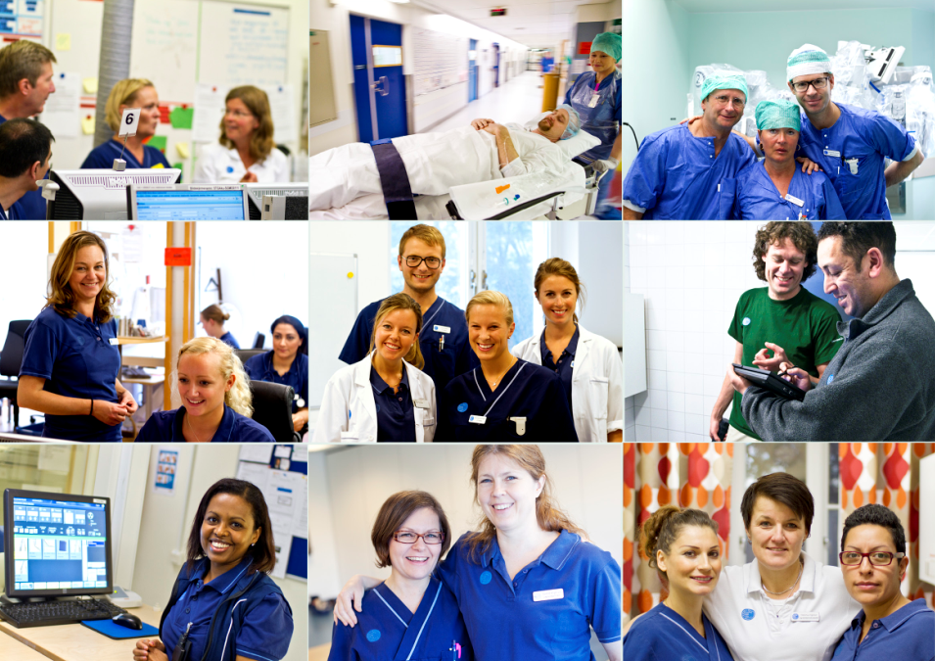
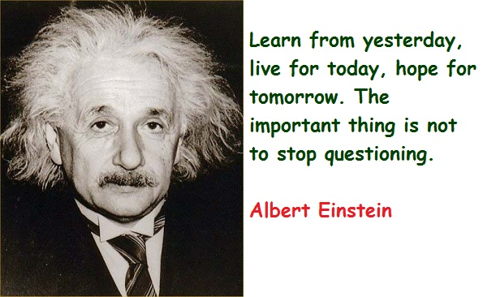
Thank You!

