Slide 1
Quality Improvement Training
Kacheliba Sub-County hospital
work-shop
19-20 th of April 2023
and at CME Tuesday 2nd of May
08.00-9.00 am

Slide 2
Presentation
Midwife Eva Borg
Dr Anders Dybjer

Slide 3
Rotary Doctors, Sweden (RDS)
Rotary Doctors has as a NGO been supporting Kenya health care since 1993. RDS work through the Kenyan NGO, Community Nursing Services (CNS). Support to North Pokot and Kacheliba hospital since 2018
Agreement with the county on three focus-areas at the sub-county hospital:
”On the job training”
Weekly Continous Medical Education (CMEs)
Support to Continous Quality Improvement (CQI) and the Quality Improvement Team (QIT) at the hospital

Slide 4
Quality Improvement training
Schedule
Day 1 19th of April: Background and theory - practical training QI
Day 2 20th of April: Practical training QI at OPD and Maternity
Day 3 2nd of May: CME – feedback on QI at OPD and Maternity

Slide 5
Quality Improvement Training
What is Quality in Health Care ?
Brainstorming – 4 groups (2 Cos and 2 nurses in each group)
Feedback from groups
Theory of quality outcome in Health Care

Slide 6
Quality in Health Care
WHO definition:
Effective
Safe
People-centred
Timely
Equitable
Integrated
Efficient

Slide 7
Quality Improvement Training
Kenya Quality Model for Health (KQMH)
is the framework since 2001 for quality improvement published by the Kenyan Ministry of Health since 2001.
Review 2008 and 2018.
Implementation Guidelines
for the Kenya Quality Model for Health (KQMH), 2011
Kenya Health Policy 2014-2030, Ministry of Health

Slide 8
Quality Improvement Training
KQMH 2018:
”It is expected that all stakeholders will play an active role in the implementation of these standards in all health facilities and that the health workers will make it an integral part of their performance assessment in the order to continously improve the quality of health care provided to the highest attainable level.”

Slide 9
Principles of KQMH
Leadership
Customer orientation
Involvement of people and stakeholders
Systems approach to management
Process orientation
Continuous Quality Improvement (CQI)
Evidence-based decision making

Slide 10
Dimensions of KQMH
12 dimensions:
Structure
1. Leadership
2. Human resourses
3. Policies, standards and guidlines
4. Facility and infrastructure (4.11 5 S)
5. Supplies management
6. Equipment
7. Referral system
8. Transport and fleet management
9. Health records and health management information systems
10. Financial management

Slide 11
Dimensions of KQMH
Dimension 11. Processes:
Outpatient services
Patient centred care
Infection prevention and control
Inpatient services
Accidents and emergencies
Surgical emergencies
Anaestesia
Safe delivery
Neonatal services
Dialysis services
Laboratory services
Pharmacy services
Radiology
Mortuary services

Slide 12
Quality Improvement Training
Short break

Slide 13
Quality Improvement Training
Brainstorming – 4 groups (2 COs and 2 nurses in each group)
Improvement suggestions at the OPD
All groups write down at least three suggestions of areas of improvement at the OPD/group.

Slide 14
Quality Improvement Training
Suggestions of Quality Improvement of OPD
1. ______________________________________
2._______________________________________
3._______________________________________

Slide 15
Quality Improvement Training
Feedback from the 4 groups:
Suggestions of improvement at the OPD ?

Slide 16
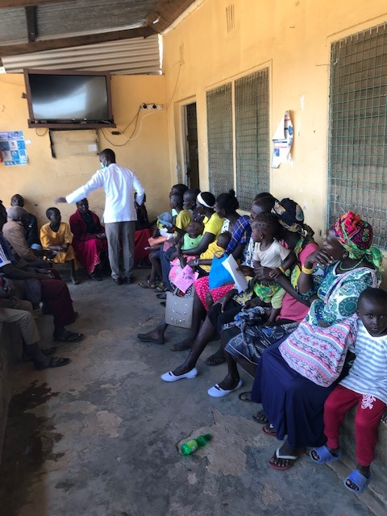
Status OPD/emergency room April 2023
Cleanliness and equipment
Utensils and orderliness OPD with no triage

Slide 17
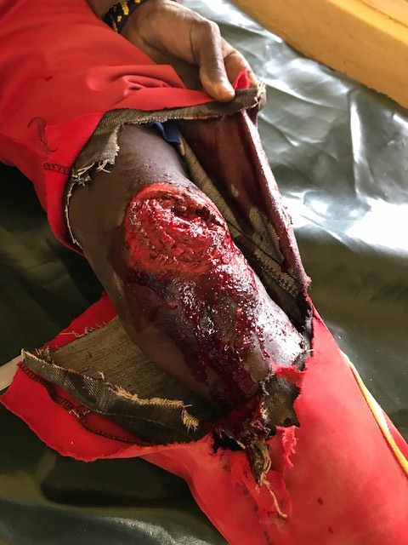
Status OPD/emergency room April 2023
Emergencies at OPD
Handling 1 child with convulsions, 2 injured by motorcycle accident and 1 vometing child in the same room

Slide 18
Status OPD/emergency room April 2023
Emergency medicines
Emergency box

Slide 19
Status OPD/emergency room April 2023
Instructions for the role of staff in emergencies
Transport within the hospital

Slide 20
Now you will continue with more professional training
Thanks from Eva and Anders

Slide 21
Quality Improvement Training day 2
Recap and reflection from day 1

Slide 22
- How to form QIT and WIT teams !
QIT = Hospital Quality Improvement Team
Delegated responsibility of CQI at the hospital – delegated from CEO/Med Sup
Multiprofessionals from the hospital (5-7 staffmembers)
Continous work (at least monthly)
Appointed chairman – appointed by Med Sup
WIT = Ward Improvement Team (OPD)
Delegated responsibility of CQI at the ward – delegated from QIT
Team from the ward (3-4 staffmembers)
Continous work (weekly)
Appointed chairman - Appointed by chairman of QIT

Slide 23
Quality Improvement Techniques - How to choose among suggestions of QI
High impact on Q but difficult to High impact on Q and
Change easy to change
Low impact on Q and difficult Low impact on Q but
to change easy to change

Slide 24
Quality Improvement Technique- Identification of root problem
Five Whys method:
Easy technique to find the root of a problem: Ask five times why !
Fishbone method:
Alternative technique to find the roots of a problem

Slide 25
Quality Improvement Techniques – Basic strategy for process improvement
KQMH: ”The facility shall implement 5 S (Kaizen framework) in all departments”:
5 S = Sort, Set in order, Shine, Standardise and Sustain

Slide 26
Quality Improvement Techniques
5 S (Kaizen framework) =
Sort: Separate needed items from unneeded and eliminate the latter.
Set in order: Keep needed items in the correct place to allow easy retrieval.
Shine: Keep the workplace swept and clean.
Standardise: Create a consistent approach with which tasks and procedures are done.
Sustain: Maintain established processes.

Slide 27
Quality Improvement Technique
PDSA
Plan - What shall we change ? How shall we change ?
Do - Try to make the suggested change in a small scale
Study - Study the effects of the change
Act - If the effect is good enough – perform the full scale change
(Adjust - If the effect is not good enough, adjust the change)

Slide 28
Quality Improvement Training
Brainstorming – 4 groups (2 COs and 2 nurses in each group)
Improvement suggestions at the Maternity
All groups write down at least three suggestions of areas of improvement at the Maternity.

Slide 29
Quality Improvement Training
Suggestions of Quality Improvement of Maternity
1. ______________________________________
2._______________________________________
3._______________________________________

Slide 30
Quality Improvement Training
Feedback from the 4 groups:
Suggestions of improvement in Maternity ?

Slide 31
Quality Improvement Training
Short break

Slide 32
Status Maternity April 2023
Delivery room – respectful maternity
Integrity and privacy
Handling of the newborn

Slide 33
Status Maternity April 2023
Standardiced procedure for normal deliveries ?
Standardiced examination of the newborn and before discharge ?

Slide 34
Status OPD/emergency room April 2023
Cleanliness
Orderliness

Slide 35
Status Maternity April 2023
Equipment- clean and functional ?

Slide 36
For training: Ward Improvement Teams 2 groups
WIT – OPD (6-8 staff members, both COs and nurses)
WIT – Maternity (6-8 staff members, both COs and nurses)
You get the suggestions of improvement areas in OPD/Maternity
You get the Quality Improvement Techniques to use.
You choose a chairman and a secretary in the group.
You give feedback on the 2nd of May at the CME of your work

Slide 37
The ball is yours !
Eva and Anders

