Slide 1
Quality Improvement Kacheliba District Hospital Suggestions and priorities – final edition
Åsa Lundgren, Rotary Doctors
November 2022

Slide 2
1. Hygien Goal: Reduce hospital aquired infections
Hand sanitation
Soap at the ward – done, but needs continous refilling
Hand-washing possibility near toilets – done, but need continous refilling
Clean floors twice a day
Clean latrines four times a day
Desinfect beds between patients
Source: National Infection Prevention and Control Guidelines for Health Care Services in Kenya, 2010)

Slide 3
2. Antimicrobial resistance Goal: Slow down the rising antimicrobial resistance so that common and cheap antibiotica still can be used.
CME (”common cold”): Awareness among staff
Prevent spread: Respiratory hygiene
Make patients aware of common cold, that antibiotics is not needed and what to do (Teaching among waiting patients? Video?)
(According to WHO about 5 milion people is estimated to die
every year due to infections with multiresistant bacteria.)

Slide 4
3. Efficacy Goal: To improve the quality and the efficacy in the meeting with the patient in OPD and wards
Staff to check vital signs (Adults: Temperature, BP, pulse, resp rate. Children: + weight, length, SD, MUAC, vaccination status, deworming?)on the OPD before the patients see CO.
Nurses to put iv-lines
Morning meetings (reporting and information)
Respect working hours (be on time and leave on time)
Pharmacist update CO what medicines are available

Slide 5
My suggested areas to priorities
Antimicrobial resistance
Reduse the antibiotic use in common colds.
Teach patients on respiratory hygien/cough hygien and put posters on OPD and ward.
Efficacy
Staff to check vital signs

Slide 6
Antimicrobial resistance: Reduce the use of antibiotics, especially in common cold.
Why?
Slow down the rising antibiotic resistance.
Antibiotics disturb the normal bacterial flora of the gut and it takes some months to restore it = risk of diarrhea/clostridium GE.
Side effects common (nausea, rash, vomiting, dizziness, yeast infections etc)
Allergic reactions (mostly cotrimoxazole and penicillins)
Have no effect on viral infections
Cost money

Slide 7
Antimicrobial resistance: Reduce the use of antibiotics, especially in common cold.
How?
CME
ReAct (reactgroup.org): For staff to learn more
Fact sheet about pneumonia versus common cold for staff

Slide 8
Common cold versus pneumonia

Slide 10
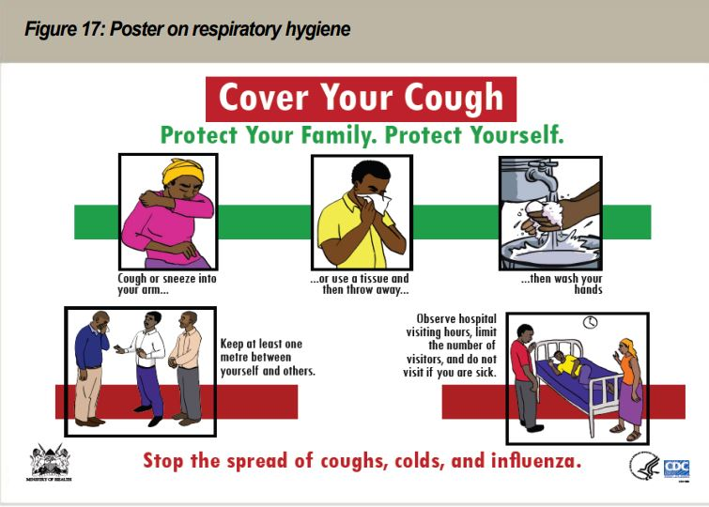

Slide 11
Staff to check vital signs
Why?
To find the most sick patients (high resp rate, low blood pressure)
Discover children with low weight/malnutrition
Discover people with hypertension
Increase the quality of OPD
Make the OPD more efficient
Reduce the work burden for CO which gives them more time to talk/explain to the patient

Slide 12
Staff to check vital signs
How?
Nurse/other staff member takes vital signs before CO sees patient.
Patients with bad vital signs – go stright to CO.
Children < 2 years + HoB/fever – BS for MPS before seeing CO

