Slide 1
Quality Improvement at Kacheliba District Hospital Åsa Lundgren, Rotary Doctors’ June 2024

Slide 2
Quality in Health Care
WHO definition:
Effective
Safe
People-centred
Timely
Equitable
Integrated
Efficient
Why are we here?

Slide 3
Kenya Quality Model for Health (KQMH)
KQMH is the framework since 2001 for quality improvement published by the Kenyan Ministry of Health since 2001.
Review 2008 and 2018.
Implementation Guidelines
for the Kenya Quality Model for Health (KQMH), 2011
Kenya Health Policy 2014-2030, Ministry of Health

Slide 4
Quality Improvement
KQMH 2018:
”It is expected that all stakeholders will play an active role in the implementation of these standards in all health facilities and that the health workers will make it an integral part of their performance assessment in the order to continously improve the quality of health care provided to the highest attainable level.”

Slide 5
Principles of KQMH
Leadership
Customer orientation
Involvement of people and stakeholders
Systems approach to management
Process orientation
Continuous Quality Improvement (CQI)
Evidence-based decision making

Slide 6
What is the gap?
The situation today.
How we want it to be.
What needs to be done and what do we need to get it done?

Slide 7
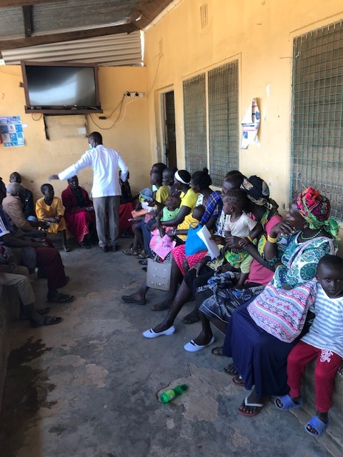
Example:
April 2023: OPD with no checking of vital signs.
Today: Temperature, BP and pulse are checked. Children are weighed and measured.
The gap?

Slide 8
How to form QIT and WIT teams
QIT = Hospital Quality Improvement Team
Delegated responsibility of CQI at the hospital – delegated from CEO/Med Sup
Multiprofessionals from the hospital (5-7 staffmembers)
Continous work (at least monthly)
Appointed chairman – appointed by Med Sup
WIT = Ward Improvement Team (OPD)
Delegated responsibility of CQI at the ward – delegated from QIT
Team from the ward (3-4 staffmembers)
Continous work (weekly)
Appointed chairman - Appointed by chairman of QIT

Slide 9
All staff has to understand why continous quality improvement is important!

Slide 10
Quality Improvement Techniques - How to choose among suggestions of QI
High impact on Q but difficult to High impact on Q and
Change easy to change
Low impact on Q and difficult Low impact on Q but
to change easy to change

Slide 11
OPD
Today
Triaging --- waiting--- CO----waiting----Lab----CO---- waiting----medicine
- Sometimes very sick patienst waiting
- Some days very busy och messy with patients wanting to come in
- Very short time/patient. Not examined.
- All children with a history of HoB go for malaria testing.
- Table is cleared every day but messy in cupboards, even the emergency tray.

Slide 12
Suggestion for triaging at Kacheliba district hospital (Malin Häggström and Amita Falk, Rotary Doctors’)
Why? Because the first hour(s) are vital for sick patients
Keep it simple!
2 groups: sick and urgent (= red) and not so sick (other)
Triage to find the red= sick
Go around the waiting area and look! Maybe a few times per day.
Take temperature on all patients. If over 38.5= Sick! = Red
If unconscious or very lethargic or unresponsive= sick! = Red

Slide 13
Give all “red”= sick! patients a red paper.
Put all red patients on one bench or on one side and mark this area “red” (this is done but does not work)
The medical staff gives priority to the red patients.
The “red” patients go to the lab first
Organise the waiting line, especially on Wednesdays.

Slide 14
OPD: Malaria testing on children with HoB
Suggestion:
Triage ----- waiting -----lab ------waiting-----CO-----
----waiting ---- medicine
Instead of seeing the CO twice (and sometimes 2 different Cos the child only meets one)

Slide 15
OPD – keeping order
Who is responsible?

Slide 16
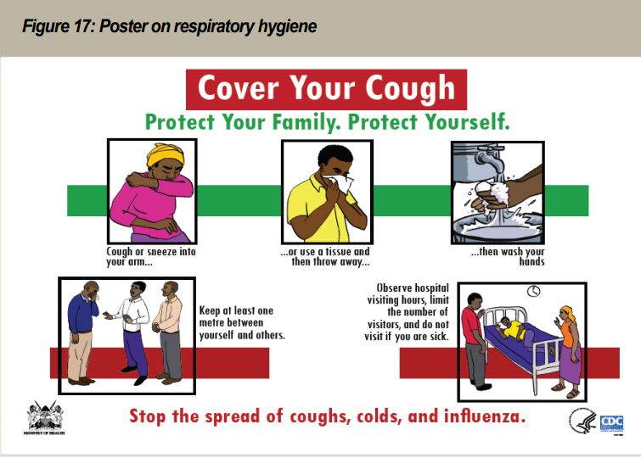
Infection control and hygiene
Handsanitation
Soap and water
Respiratory hygien
Patient awareness?

Slide 17
Antibiotics
Today: Overuse, especially in URTI (common cold) and GE.
Problem: - Antimicrobial resistance - Harm for the patient
Suggestion: - Lecture for COs - CME? - Information to staff on pneumonia (needs antibiotics) versus URTI (virus – no antibiotics) - Film

Slide 18
Quality improvement is a continous process! Where do you see things that are not effective, safe, people-centered, timely, equitable, integrated and efficient? What goals can you have? How can you reach them (the gap)?

