Slide 1
Quality Improvement Kacheliba District Hospital and Konyao Health Center
Suggestions by
Åsa Lundgren, Anna Danielsson, Jenny Koertge
Rotary Doctors
November-December 2022

Slide 2
1. Hygien Goal: Reduce hospital aquired infections
Hand sanitation
Soap at the ward – done, but needs continous refilling
Hand-washing possibility near toilets – done, but need continous refilling
Clean floors twice a day
Clean latrines four times a day
Desinfect beds between patients
Source: National Infection Prevention and Control Guidelines for Health Care Services in Kenya, 2010)

Slide 3
2. Antimicrobial resistance Goal: Slow down the rising antimicrobial resistance so that common and cheap antibiotics still can be used.
CME (”common cold”): Awareness among staff
Prevent spread: Respiratory hygiene
Make patients aware of common cold, that antibiotics is not needed and what to do
Restricted use of broad spectrum antibiotics eg ceftriaxone
(Teaching among waiting patients? Video?)
(According to WHO about 5 milion people is estimated to die
every year due to infections with multiresistant bacteria.)

Slide 4
3. Efficacy Goal: To improve the quality and the efficacy in the meeting with the patient in OPD and wards
Staff to check vital signs before the patients see CO.
- Adults: Temp, BP, pulse, RR
- Children: + weight, length, SD, MUAC, vaccination status, deworming
Triage according to vital signs
Morning meetings (reporting and information)
Respect working hours (be on time and leave on time)
Pharmacist update CO what medicines are available
Nurses to put iv-lines

Slide 5
4. Improve preparedness for emergencies Goal: To improve the quality of care in stabilizing a critically ill patient and thereby improve the prognosis of the patient.
Use of standardized method of investigation (A-E).
Guarantee the supply necessary supplies for resuscitation in the OPD
Supply an immobilizer for spinecontrol during transport
CPR training - adult and child - for all staff at least 1/year.
Learning from mistakes and casualties

Slide 6
5.Examination of the patient
Examination of the patient is essential to get the right diagnosis and treatment
All needed essential equipment for examination of the patient should be in place in the OPD and warden: stethoscope, BP machine, torch, tongue depressor, otoscope, reflex hammer.

Slide 7
Antimicrobial resistance: Reduce the use of antibiotics, especially in common cold.
Why?
Slow down the rising antibiotic resistance.
Antibiotics disturb the normal bacterial flora of the gut and it takes some months to restore it = risk of diarrhea/clostridium GE.
Side effects common (nausea, rash, vomiting, dizziness, yeast infections etc)
Allergic reactions (mostly cotrimoxazole and penicillins)
Have no effect on viral infections
Cost money

Slide 8
Antimicrobial resistance: Reduce the use of antibiotics, especially in common cold.
How?
CME
ReAct (reactgroup.org): For staff to learn more
Fact sheet about pneumonia versus common cold for staff

Slide 9
Common cold versus pneumonia

Slide 11
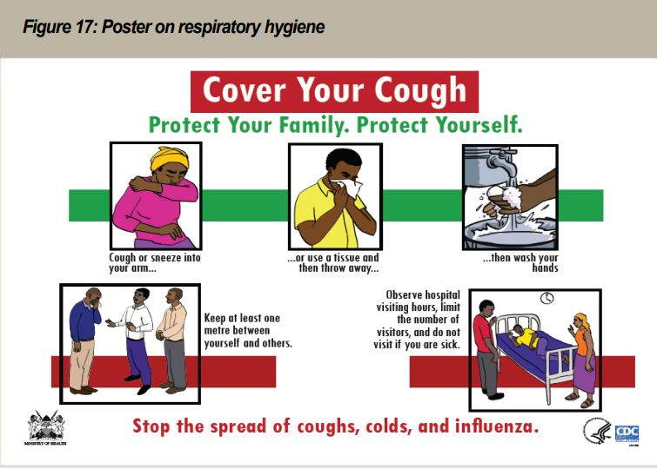

Slide 12
Staff to check vital signs
Why?
To find the most sick patients (high resp rate, low blood pressure)
Discover children with low weight/malnutrition
Discover people with hypertension
Increase the quality of OPD
Make the OPD more efficient
Reduce the work burden for CO which gives them more time to talk/explain to the patient

Slide 13
Staff to check vital signs
How?
Nurse/other staff member takes vital signs before CO sees patient.
Patients with bad vital signs – go stright to CO.
Children < 2 years + HoB/fever – BS for MPS before seeing CO
Triage according to vital signs
1) can wait
2) need to see CO soon
3) need to se CO immediately

Slide 16
Improve preparedness for emergencies
How?
Use of standardized method of investigation (A-E). CME
Guarantee the supply necessary supplies for resuscitation in the OPD (airway aids, oxygen, pulseoxymeters, BT machine, iv lines, tourniquet, defibrillator, emergency medications: adrenaline, atropin, diazepam/phenobarbital, morfine, glucose, fluids, antibiotics and paracetamol)
Immobilizer for spinecontrol during transport
CPR training - adult and child - for all staff at least 1/year. CME
Learning from mistakes and casualties by organizing monthly ”Morbidity and Mortality” staff meetings
Increase adherence to medical guidelines eg fluidtherapy for dehydration and burns. CME.

